Slide 1
All Things Alternate

Slide 2
Session Goals
General Session (Day 1)
Federal updates regarding students with significant cognitive disabilities
2. Appropriate Identification of Students for the AA-AAAS
3. Alternate Diploma Criteria
Day 2 Session
All Things Alternate Timeline
Standards Based Goals and Instruction
Transition Services and PEP Plan
Notes:
Read each

Slide 3
Special Education Documents/Updates
Every Student Succeeds Act (ESSA)- December 2015
Federal Law passed by Congress
Dear Colleague Letter- November 2015
Clarified FAPE for Students with Disabilities
Notes:
ESSA- Federal law passed by congress in 2015. Replaced No Child Left Behind
Dear Colleague Letter- Clarified (FAPE) free and appropriate public education.
Have participants take out the Dear Colleague Letter. Read portions of the letter to the audience pausing at particular words that you want them to say out loud. (first paragraph page 1 and page 5)
PAGE ONE highlights
Rigorous academic standards
High expectations
Alignment to grade level content standards
General Education curriculum
PAGE 5 highlights
Small number (1% of total number of all students at tested grade levels per subject) of children with the most significant cognitive disabilities
Alignment to grade level content standards
May be restricted in scope or complexity or take on the form of introductory or prerequisite skills

Slide 4
Who Should Take the Alternate Assessment
ESSA Requirement/Policy 2419
Prohibition of Local Cap
ESSA 1% Cap Waiver Requirements in Assessment Regulations
District Justifications

Slide 5
WV Alternate Standards, Assessment and Diploma Timeline
Year | 2017-2018 | 2018-2019 | 2019-2020 | 2020-2021
Alternate Standards | Current Next Gen Standards 9th grade cohort | (New Standards) Policy 2520.16 Alternate Academic Achievement Standards | Policy 2520.16 Alternate Academic Achievement Standards | Policy 2520.16 Alternate Academic Achievement Standards
Alternate Assessment | Current Alternate Summative Assessment (DLM) | Current Alternate Summative Assessment (DLM) | Current Alternate Summative Assessment (DLM) | Current Alternate Summative Assessment (DLM)
Diploma Type | Modified Diploma | Modified Diploma | Modified Diploma | Alternate Diploma
Notes:
This timeline shows what changes have been happening and are to happen in the areas of the Alternate Standards, Alternate Assessment, and Diploma Type
Read each section of the chart aloud to participants.
Last years 9th grade cohort is the first cohort to have the opportunity to graduate with an alternate diploma in 2020-2021.
July 2018 the new alternate academic achievement standards went into effect (policy 2520.16)
DLM will continue to be our alternate assessment (at least though) 2021
2020-2021 will be the first year for the Alternate Diploma

Slide 6

State-Defined Alternate Diplomas
Notes:
Refer participants to the NCEO brief Considerations for Developing State Defined Alternate Diplomas for Students with Significant Cognitive Disabilities
This brief gives the 3 alternate diploma criteria
No student can be denied the option of a standard diploma. If a student can meet the criteria of a standards diploma…. They can graduate with one.
ONLY students with a significant cognitive disability should be taking the alternate assessment.

Slide 7
Alternate Diploma Criteria
Be Standards-Based- Aligned to WV College and Career Standards
Be Aligned to State Requirements for a Regular Diploma
Be Obtained During FAPE Period
Notes:
Refer to each criteria section of the brief
Talk about graduation 2020 schools

Slide 8
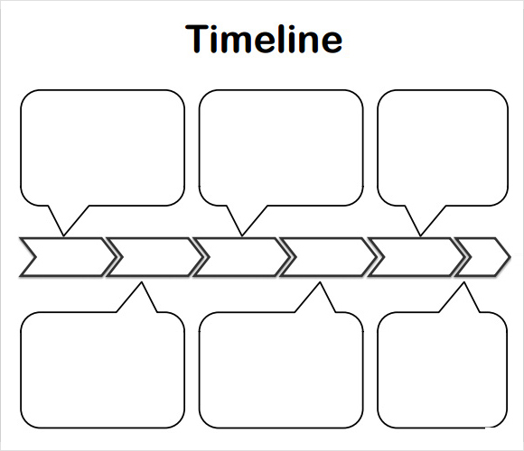
1980’s
1990’s
2015
Functional Life-Skills Curriculum to participate fully in community
INVOLVEMENT and PROGRESS in General Education Curriculum for ALL students
INCLUSION with same age peers in home school
Notes:
Take a look at this chart and decide where you think your district and specific school would be on the timeline.
What evidence do you have to support your thoughts?

Slide 9
IEP Includes Life Skills and the General Curriculum
Grade level academic standards
IEP Instruction State Alternate
assessment
Life skills curriculum
Notes:
Notice here that Life Skills Curriculum continues to be appropriate instruction for students with significant cognitive disabilities

Slide 10
Instruction Not Aligned to Standards
Curriculum:
Multiplication
Instruction on State alternate
IEP skill: assessment:
Telling time Combine sets
Notes:
Here is where we have to be careful.
When students are being removed from general education classes, and receiving instruction in a resource room or a separate class,
we have to be sure that the instruction that students are receiving is aligned to grade level content so that this does not happen.
Third grade curriculum is multiplication/combining sets, but during math instruction the student is working on telling time.
This does not mean that the student shouldn’t learn to tell time.
This skill would be taught in context of following a daily schedule for example.
Daily living skills such as telling time is taught “real time” ☺ not in isolated math times only/ or it might be part of a center activity.
Functional skills or daily living skills can be addressed
during naturally occurring routines,
concurrent with academic instruction,
or during some time devoted to a high priority IEP goal.
It is important not to hold students back from learning academics just because they are still catching up on some essential life skills.
Coming up Clarissa slide – grade level content standard (7th grade) 6 options with discussion.

Slide 11
Writing IEPs that Align to State Standards
Be familiar with the WVCCR State Standards.
Be familiar with the Alternate Achievement Standards.
Utilize the Alternate Standards Support Document
Ask the question “Is it Standards Based?”
Notes:
Is it standards based ?? Sometimes, in extending standards, the academic component becomes lost.

Slide 12
General Assessment Standards vs Alternate Assessment Standards
WVCCR
AA-AAA Standards
ELA.4.21- Write informative texts to examine a topic and convey ideas and information clearly.
ELA.4.22- Write narratives to develop real or imagined experiences or events using effective technique, descriptive details, and clear event sequence.
ELA.4.23- Produce clear and coherent writing in which the development and organization are appropriate to task, purpose, and audience.
A.ELA.4.21-Paraticipate in shared research and writing (e.g., explore a number of “how-to” books on a given topic and use them to write a sequence of instructions).
A.ELA.4.22- Add details to strengthen writing as needed incorporating guidance and support from adults and collaborative discussions.
A.ELA.4.23- Explore a variety of digital tools to produce and publish writing, including collaboration with peers.
Notes:
This slide gives you a snapshot of a “cross-walk” between the WVCCR standards and the AAA standards.
This example looks at three 4th grade standards.
I chose these standard because this snapshot is pretty similar standard to standard. This is not the case for all standards. There is not a one to one match up.
But I did want to see both standards (general and alternate) and how they do mirror the same “big idea” regarding grade level content standards.
We must be sure and make the distinction between which students with ID would take which assessment.

Slide 13
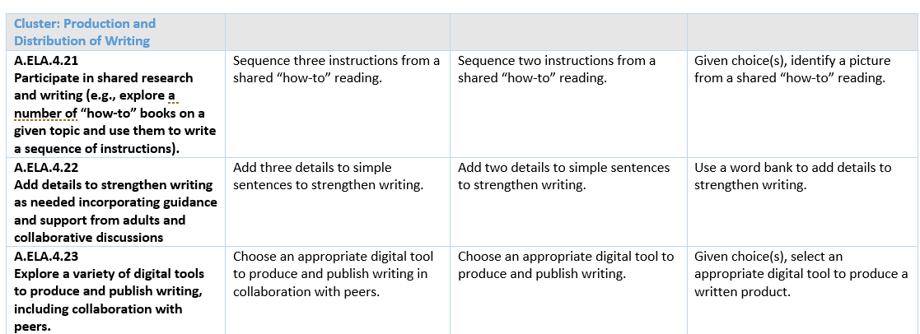
Alternate Academic Achievement Standards Support Document
Step three
Step two
Step one
Notes:
This is a sample section of the Alternate Standards Support Document.
Notice that the standards are the same as the previous slide.
This slide shows the progression from step one to step three.
Step one is the farthest away from the standard and step three is the closest to the standard.
This means that step one might be an appropriate place to begin instruction towards the alternate standard for a very low functioning student with a significant cognitive disability.

Slide 14
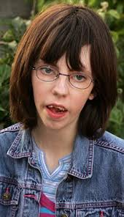
Meet Camilla
12 year old seventh grader with a significant cognitive disability.
Uses an augmented/alternative communication AAC device.
IEP goal needs: expand communication skills, improve her range of motion, participate more in her personal care.
She loves to swim, spend time with friends, and use her computer.
Her parents want Camilla to participate as much as possible in the general education environment, and also learn how to read.
Notes:
Meet Camilla :
Read the slide
Explain that we are going to look at a 7th grade ELA standard and decide which instructional goal options “are standards based”

Slide 15
Seventh Grade Standard:
Determine a theme or central idea of a text and analyze its development over the course of the text; provide an objective summary of the text.
1. Camilla will use her AAC device to greet peers in English class.
2. Camilla will acquire 20 sight words that relate to activities in her community and home.
3. After hearing text summaries read aloud, Camilla will select the major theme of each using response options that include text with picture symbol support.
4. Camilla will sequence 3 events from text read aloud to her using response options that include text with picture symbol support.
5. Camilla will organize story grammar elements related to fictional text on a graphic organizer and use the organizer as a support when summarizing the text.
6. Camilla will identify letter-sound correspondences for initial consonants and vowels and use this skill when writing using software that anticipates spelling from the first letters.
Notes:
Read the standard aloud.
Discuss that this is a grade level standard that is often thought of as too difficult for a student with a significant cognitive disability.
Read each option below and ask the participants to give a thumb up or thumb down as to whether the goal/objective is “standards based”- DIRECTLY RELATED TO THE STANDARD
Discuss the fact that all options are appropriate for Clarissa based upon her needs, but NOT ALL OPTIONS ARE RELATED TO THE GRADE LEVEL STANDARD.
The following options ARE grade level standards based:
3, 4, 5
Options 1, 2 and 6 are all appropriate areas of instruction for Camilla. However, these options ARE NOT aligned or based on the listed 7th grade standard.

Slide 16
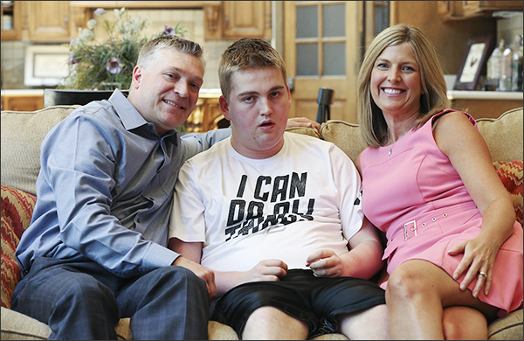
Meet Max
He is a 14 year old, 9th grade student with a significant cognitive disability.
He is used to working in small groups
for instruction.
He has emerging literacy and numeracy
skills. Neither was emphasized in his
school career so he entered high
school with minimal foundational math
skills.
He has good fine motor skills, and is able to move or tap one of two pictures to
show understanding of key ideas.
Max’s parents want him involved and making progress in general education as much as possible.
Notes:
Meet Max:
Read each bullet point
Like Camilla, Max has a significant cognitive disability.
His parents want him involved and making progress in general education.
We are going to look at the same kind of information as we did with Clarissa with Max in math.

Slide 17
Let’s align Max’s instruction to High School Algebra
Notes:
What do we know about courses for students with significant cognitive disabilities?
Reduced depth, breadth, and complexity
May be introductory or pre-requisite skills
Should be addressed through the lens of functional/life skills.

Slide 18
High School Algebra Standards
Expression formation is taught using a vocational activity of working at a hardware store
Notes:
So we are going to look at a HS math standard that would be appropriate for Max.
Remember we are choosing standards and viewing them through the lens of vocational activity.

Slide 19
Alternate
Standard A.M.A1HS.4
Max’s task:
His job is to set up bags of bolts and write (5b) for five bags of bolts.
The b means they do not know how many bolts go in each bag yet.
He will also make 4 bags filled with washers (4w)
The teacher has Max to create the expression by selecting numbers to put in the equation:
5b+4w
Notes:
Have participants look up this alternate standard in support document
Read each bullet point

Slide 20
Teacher Prep and Task Analysis
The teacher sets up five bags for the bolts.
The goal is to have 5 bolts per bag.
Max will count with one-to-one correspondence 1-5.
The teacher uses a large number line and covers the numbers beyond 5.
Max puts a bolt on each number 1-5 to create the first set.
Max then scoops the bolts into a bag.
He repeats this for 5 sets of bolts.
The teacher has Max make four bags with 8 washers following the same procedure as bolts.

Slide 21
Scaffold toward high school expectation
5 bags with (5) bolts + 4 bags with (8) washers
5(5) + 4(8)

Slide 22
Meaningful Partial Participation
By appropriately including students with the most significant cognitive disabilities through manipulations of breadth, depth, or complexity, at least some subset of grade-level content standards will be within the student’s educational experience
Notes:
So what does this mean??
What does this look like on IEPs and what does this look like in the classroom??
Hybrid Approach to Inclusion- time in separate setting as well as appropriate time in general education.
ESSA document page 1 – to raise academic expectations and increase inclusion for students with disabilities

Slide 23
Best Practice Document
Social Studies
(PE/Health and the Arts to come)
Notes:
These are “best practice” alternate standards for all grade levels for SS
PE/Health and the Arts (music and art only) have been updated. A best practice PE/Health and Art/Music Best Practice Document will be coming.
These are not state approved alternate standards since we are not required to write standards for these subjects (therefore… Best Practice Documents)

Slide 24
Transition Planning:
Why is it so important?
Secondary transition services are defined as a coordinated set of activities for a student with an exceptionality that are designed within a results-oriented process focused on improving the academic and functional achievement of the students to facilitate movement from school to post school activities.

Slide 25
Part VI:
TRANSITION PLANNING
Age of Majority- the student and parent have been informed...
Yes NO
Transition Planning Considerations:
  How were the student’s preferences and interests considered?
    Student Interview/Survey Functional Vocational Evaluation
    Parent Interview/Survey Transition Assessment (not listed)
    Interest Inventory

Slide 26
Part VI:
TRANSITION PLANNING
Transition Assessments Reviewed (specify)
The student’s educational program will lead to a:
standard diploma alternate diploma
Appropriate measureable post-secondary goals based upon age appropriate assessments:
Education/Training Goals:
Employment Goals:
Independent Living Goals (if appropriate):

Slide 27
Part VI:
TRANSITION PLANNING
Select one of the following Career Clusters:
Agriculture, Food and Natural Resources
Architecture and Construction
Arts, A/V Technology and Communication
Business Management and Administration
Education and Training
Finance
Government and Public Administration
Health Sciences
Hospitality and Tourism
Human Services
Information Technology
Law, Public Safety, Correction and Security
Manufacturing
Marketing
Science, Technology, Engineering, and Mathematics
Transportation, Distribution, and Logistics
Cluster Undetermined (Option for Grade 7 or below)

Slide 28
Part VI:
TRANSITION PLANNING
Specify the Career Pathway Option that aligns with the career cluster the student selected:
(Career Cluster)
Career Pathway Options:
Four Personalized Courses
State Approved CTE Program of Study (Limited to District Offerings and Enrollment)

Slide 29
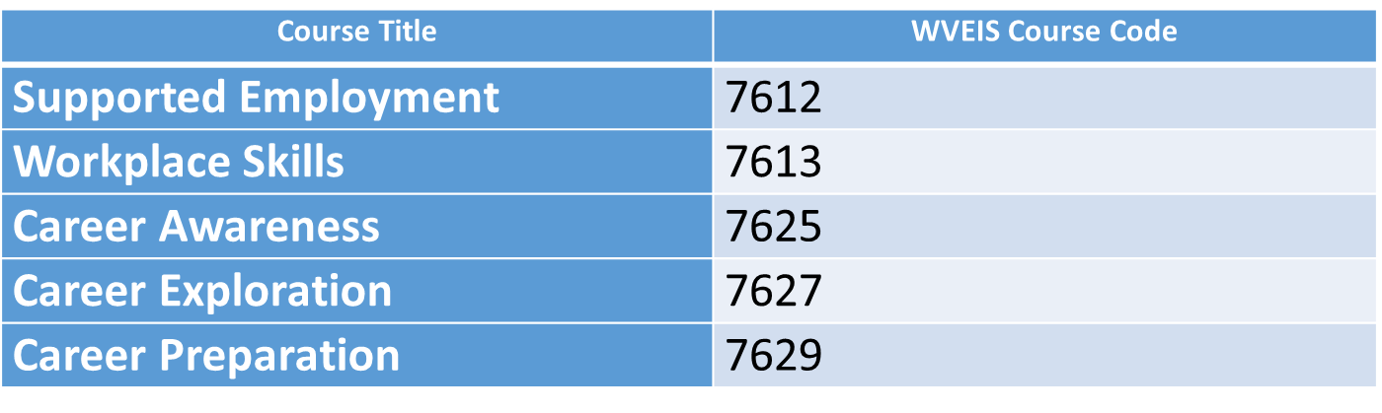
Alternate Diploma Students
Personalized Courses
Where can students (ages 14-21) be provided instruction and transition support?

Slide 30
Student Transcripts and Credits
Previous Schedule
Current Schedule
76110J- Social Skills
76100J- Daily Living Skills
31080J- Work Skills
48100J- Reading Support
68070- Health (related arts)
59117- Library Skills (related arts)
4008XJ ELA 8 Alternate Standards
3008XJ MATH 8 Alt Standards
6008XJ SCI 8 Alt Standards
7008XJ WV STU 8 Alt Standards
7946XJ ART Alternate Standards
6608XJ PHYS ED 8 Alt Standards
7610XJ DAILY LIVING SKILLS
Notes:
Notice the differences of these two schedules.
Previous schedule- focusing on Life Skills to the exception of grade level content areas
Current schedule- focusing on grade level content areas (ESSA requirement for alternate diploma) for 9-12. The example above is for 8th grade.

Slide 31

Dawn Embrey-King
Coordinator, WVDE
dembreyking@k12.wv.us

