Slide 1
19/20 RECOMMENDED BUDGET

Slide 2
RECOMMENDED BUDGET

Slide 3
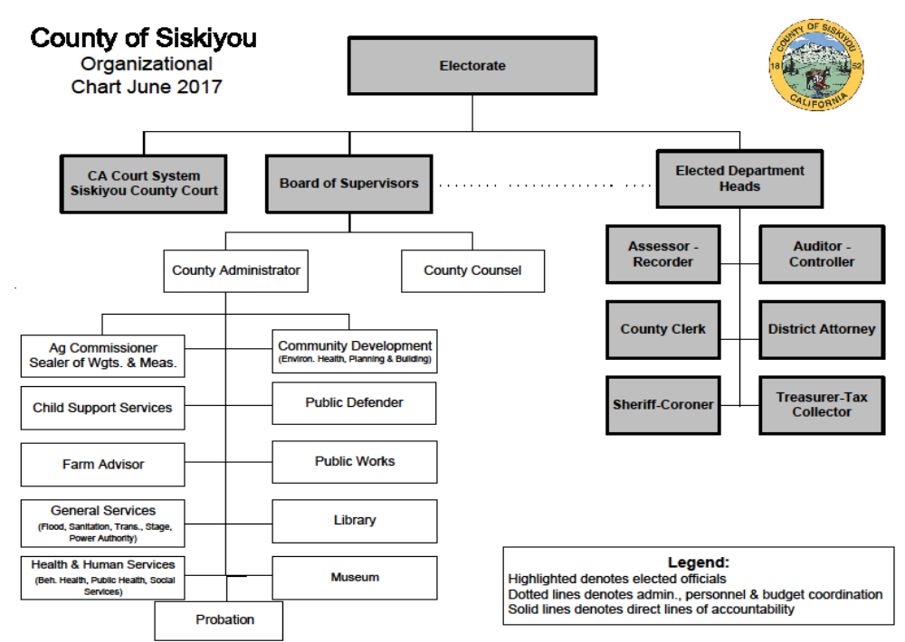

Slide 4
OVERVIEW

Slide 5
19/20 BUDGET
  Estimated 19/20 Fund Balance $1.61
  Provisions- $348,325 + $45,000 (Predatory Animal Vehicle) =$393,325
  Fiscally Conservative
    Balance Board priorities/Department needs with meeting responsibility to prepare for the future
Includes $1,900,000 additional 18/19 Federal PILT
  Unpredictable funds
Includes 1.5% of payroll to fund unfunded liabilities 115 Trust
  Pension- approximately $240,000- $270,000
  OPEB- approximately $240,000- $270,000
Provides approximately $1,100,000 funding for the jail construction project
Begins to address anticipated Power Authority Revenue decrease
  Reduces contribution to General Fund from $1,425,000 (GF/Risk/GASB) to $450,000
Does not
  Address employee negotiation impacts
  Adequately fund Provisions
  Adequately fund department needs

Slide 6
18/19 PILT DISTRIBUTION
19/20 Expenditure | $1,900,000
Jail Construction Project | $1,000,000
Courthouse Renovations Facilities- $100,000 ACO-$50,000 Courthouse Construction- $10,000 Risk- ADA Compliance- $25,000 | $250,000
Natural Resources/Klamath | $100,000
GF Backfill Provisions | $348,325
Sheriff Backfill | $201,675
Total | $1,900,000

Slide 7
NATURE CONSERVANCY
Action Item 7-A-1
The Nature Conservancy sold property to USFW
Sale included a $350,000 donation to County to mitigate future property tax losses
Accept donation and authorize chair to sign attached thank you letter
Determine use of funds
  Committed Account for special purpose
    Klamath issues
  Use for Jail Construction
  GF contribution to unfunded liabilities/POB
    Use consistent with purpose of donation
Recommended Action
  Accept Donation, use funds to offset unfunded liability Pension Obligation Bond expenses and authorize the chair to sign the thank you letter.

Slide 8
UNFUNDED LIABILITIES

Slide 9
UNFUNDED LIABILITIES
Pension- GASB 68-
2018 OPEB- GASB-75
  $46,998,000
    GF- $22,345,432
Total Liability - $139,573,347
 | 17/18 | 18/19 | 19/20
MISC | $61,961,598 | $68,772,391 | $69,463,462
Safety | $20,772,707 | $23,508,557 | $23,111,885
Total Liability | $82,734,305 | $92,280,948 | $92,575,347

Slide 10
PARS 115 TRUST
OPEB AND PENSION
Since the inception of the fund, Siskiyou County’s PARS 115 Trust (OPEB & Pension combined) has earned 3.41%, after fees, with $117,844.01 of earnings on $3,340,406.92 of contributions as of April 30, 2019.
The PARS 115 Trust was initially funded on 1-31-18 with one-time funds, then by ongoing monthly contributions based on a percentage of payroll recommended by the CAO and approved by the Board of Supervisors annually.
The financial markets were very volatile in 2018, with losses in the early part of the year, followed by strong gains for the majority of the year, and then a large correction in December that more than wiped out the gains earned during the year, causing overall negative returns for 2018.

Slide 11
However, even with all of the political uncertainty that currently affects the markets, there have been strong positive earnings in the beginning of calendar year 2019 that have more than made up for the losses in 2018.
Specifically, with the Moderate Index strategy that Siskiyou County selected, our PARS 115 Trust had annualized returns of 4.55% for the OPEB bucket, and 4.61% for the Pension bucket, for the 1 Year period ending 3-31-19, and annualized returns of 7.93% for the OPEB bucket, and 8.02% for the Pension bucket, for the 3 month period ending 3-31-19.
In comparison, the overall Moderate Index composite annualized earnings across all accounts reported by Highmark were 4.88% for the 1 Year period ending 3-31-19, and 8.17% for the 3 month period ending 3-31-19.

Slide 12
INVESTMENT RETURN
 | Highmark 1 Year Return | Siskiyou 1 Year Return | Highmark 2019 YTD Return | Siskiyou 2019 YTD Return
Conservative | 4.36% |  | 4.28%
Moderately Conservative | 4.77% |  | 5.98%
Moderate | 4.88% | 4.55%/4.61% OPEB/Pension | 8.17% | 7.93%/8.02% OPEB/Pension
Balanced | 5.32% |  | 9.21%
Capital Appreciation | 4.83% |  | 10.88%
Thank you Wayne Hammar, Treasurer-Tax Collector!

Slide 13
UNFUNDED LIABILITIES
PARS
Description |  | Comments
All-County Contributions Through April 30 2019 | $3,340,406.92
Earnings | $117,844.01 | After fees
Total | $3,458,250.93
19/20 Contribution (1.5% payroll) | $500,000.00 | Estimate
Total | $3,958,250.93

Slide 14
RESERVES

Slide 15
RESERVES
Fund | Estimated 18/19 | Estimated 19/20 | Notes
Accumulated Capital Outlay | $103,830 | $55,330
Power Authority Fund Balance | $2,271,671 | $1,780,425 | (+$2.5M Emergency Repair Committed) + $500,000 increase to committed
GASB 54 Committed Account | $1,050,000 | $1,150,000
115 Trust | $3,504,389 | $3,990,993
Total | $6,929,890 | $6,976,748 | $3,000,000 Committed to Power Authority

Slide 16
LABOR

Slide 17
CalPERS Rates as of 6/30/16

Slide 18
LABOR COSTS
 | Misc | Safety
PERS | 27.75% | 43.50%
Pension Obligation Bond | 2.95% | 8.7%
Unfunded Liabilities | .75% | .75%
Total | 31.45% | 52.95%

Slide 19
MINIMUM WAGE INCREASES
January 1, 2018, to $11 per hour
January 1, 2019, to $12 per hour
January 1, 2020, to $13 per hour
January 1, 2021, to $14 per hour
January 1, 2022, to $15 per hour.

Slide 20
RETIREE HEALTH INSURANCE
County pays 50% of the PERS Choice single premium rate for retirees

Slide 21
POWER AUTHORITY

Slide 22
POWER AUTHORITY
Contract End Dec 31,2020
  Consultants assisting County identify options/alternatives
    To date- County must anticipate 2/3 cut in revenue
  Backfill GF $450,000
  Good Precipitation
      Revenue this year- approx. $3,500,000
      Projects-
        Tram/Generator/Excitation System
      Emergency Repair
        Recommend moving additional $500,000
          Committed account fund balance 18/19 $2,500,000
          Committed account fund balance 19/20 $3,000,000

Slide 23
SISKIYOU POWER AUTHORITY
Fiscal Year | General Fund | Flood | Risk Mgmt Set-Aside | GASB 54 | OPEB & Pension | Klamath and Other Water Issues | Jail Project | Total
14/15 | $825,000 | $275,000 | $0 | $0 | $0 | $0 | $0 | $1,100,000
15/16 | $825,000 | $407,105 | $250,000 | $0 | $0 | $0 | $0 | $1,482,105
16/17 | $1,050,000 | $275,000 | $250,000 | $350,000 | $0 | $50,000 | $0 | $1,975,000
17/18 | $825,000 | $275,000 | $250,000 | $350,000 | $998,618 | $65,000 | $0 | $2,763,618
18/19 | $825,000 | $275,000 | $125,000 | $350,000 | $0 | $50,000 | $686,000 | $2,311,000
19/20 | $450,000 | $150,000 + $125,000 Waive Split | $0 | $0 | $0 | $0 | $0 | $725,000

Slide 24
FLOOD BUDGET
Action Item 7 A 2
Power Authority reduced its General Fund contribution from $1,425,000 (GF/ Risk/GASB) to $450,000
75/25 Split decreased Flood funding from $275,000 to $150,000
Flood Fund Balance has nearly been depleted
CAO Recommendation –
  Increase Flood Control additional $125,000- Waive the 75/25 split

Slide 25
BOARD PRIORITIES
Determined by the Electorate
Board
  Public Safety
    Build a jail
    Cannabis Enforcement
    Fire Service-CSA 4- Serious structural problems
  Staff-salaries/morale
  Preserve failing physical infrastructure and equipment
    Roof, HVAC, Paint, Flooring, vehicles, equipment
  Prepare for move to existing Courthouse
    Modification-est. $500,000-$750,000
  Maintain/Improve efficiencies –
    IT capabilities
    GIS, Current technologies
    Consolidate IT functions
    Energy efficiency
  Mandated Services

Slide 26
19/20 Recommended Budget Action Items

Slide 27
SUMMARY
Estimated 19/20 Fund Balance $1.61
Labor costs will continue to increase
  Unfunded liabilities
Provisions - $348,325
Revisions made today
    Reduce Provisions
    Reduce/cut somewhere else
    Increase Power Authority Contribution
    Direct CAO to revise at adopted budget

Slide 28
SHERIFF DEPARTMENT BUDGET

Slide 29
SHERIFF DEPARTMENT BUDGET
Fiscal Year | GF Contribution | Approx % increase
19/20 | $12,302,756 | 15%
18/19 | $10,613,874 | 7.4%
17/18 | $9,826,069 | 2.85%
16/17 | $9,553,582 | .19%
15/16 | $9,535,106 | 9.2
14/15 | $8,729,711 | -8.7
13/14 | $9,564,351

Slide 30
SHERIFF DEPARTMENT BUDGET
April 2019- Sheriff submitted budget Requesting $12,302,756 from General Fund
$1,688,882 increase from 18/19 General Fund Backfill
May 2019- Sheriff Voluntarily cut/increased revenue $586,317
    Delete/Freeze Lieutenant position-$133,917
    Reduce Cannabis reimbursement to Public Works from $40,000 to $30,000 and use COPS discretionary funding
    Use COPS funding pay $92,404 new vehicle lease (first payment only)
    Reduce overtime- $250,000
    Reduce Travel and Training- $49,996
    Increased POST revenue- $20,000
  19/20 Sheriff Request
    $ 12,302,756 - $586,286 = $11,716,470
  19/20 General Fund increase of $1,102,596
    Not including the $1,100,000 set-aside for the new jail

Slide 31
SHERIFF DEPARTMENT BUDGET
CAO requested additional $500,000 cuts
  $11,716,439 - $500,000= $11,216,439
CAO recommending increase of $602,565
Sheriff Request | 19/20 GF Contribution Request | 18/19 GF Contribution | Difference
Original | $12,302,756 | $10,613,874 | $1,688,882
Revised May | $11,716,439 | $10,613,874 | $1,102,565
CAO Rec | -500,000 |  | -$500,000
 | $11,216,439 | $10,613,874 | $602,565

Slide 32
SHERIFF DEPARTMENT BUDGET
Budget Analysis- 6 years (12/13-17/18)
  Labor Increased approx $764,211
  Workers Comp $303,400
  Retirement-$374,109
  Revenue decreased - $233,226
  Expenses decreased- $159,127
Sheriff Budget includes redirecting first payment of vehicle lease of 1 van and 8 patrol vehicles totaling - $92,404 to other discretionary funding source-
  County will be obligated for the remaining 3 Years of lease payment-$242,495
Budget also includes purchase of $37,657 Pick Up Truck
Additionally, budgets submitted with approximately $100,000 General Fund contribution to absorb over expending in the Bailiff Budget- Courthouse security
  This has been corrected in the budget-
  Discussion and follow up with Courts needed

Slide 33
SHERIFF DEPARTMENT BUDGET
Action Item 7-A-3
Budget is balanced with $500,000 cut
Board Action
  Approve CAO recommended reduction OR
  Increase Sheriff Budget AND
    Cut contribution to Jail Construction Project
    Cut another Department
    Increase Power Authority Contribution to General Fund

Slide 34
19/20 JAIL CONSTRUCTION
FUND BALANCE
SOURCE | AMOUNT | FY
18/19 Fund Balance | $2,328,850 | 18/19
Casino Impacts | $160,000 | 19/20
18/19 PILT | 1,000,000 | 19/20
General Fund- Inmate Health/Public Health Agreement | $50,000 | 19/20
19/20 Budget Interest/expenses | -105,650 | 19/20
19/20- TOTAL (projected) | $3,433,200
CCP Commitment | $250,000 $400,000 | 16/17 17/18
Future Casino Funds | $320,000
Future GF Inmate Health/Public Health Agreement | $100,000
TOTAL | $4,503,200

Slide 35
PERSONNEL
SEE TAB
SPREADSHEET

Slide 36
PERSONNEL SUMMARY
NON-GENERAL FUND
Create 1.1 FTE
Financial Impact $141,537

Slide 37
PERSONNEL REQUESTS
NON-GENERAL FUND
Board Action Item 7- A- 4 A(1-3)
Public Works
  Create Road Superintendent
  Create Civil Engineering Assistant
  Delete Environmental Compliance Specialist
  Financial Impact - $124,074
  CAO Recommendation
    Approve

Slide 38
PERSONNEL REQUESTS
NON-GENERAL FUND
Board Action Item 7- A- 4 B(1-10)
Social Services
  Create 1 FTE Information Systems Technician
  Re-class/Delete Information Systems Specialist III to Information Systems Specialist IV
    Approve Information Systems Specialist IV job description
  Create Social Worker IV
  Delete Nurse Case Assistant
  Create .6 FTE Public Health Nurse (shared with PH)
  Range Adjustment – IT
    10% - 2 Information Systems Specialist III
    10%- 1 Information Systems Specialist I
    10% - 1 Information System Supervisor
  Financial Impact -$201,629
  CAO Recommendation
    Approve

Slide 39
PERSONNEL REQUESTS
NON-GENERAL FUND
Board Action Item 7 –A- 4C
Public Health
  Create Senior Public Health Nurse
    .4 FTE- Senior Public Health Nurse
      Foster Care Program
      Shared with Social Services
  Financial Impact –$52,732
  CAO Recommendation
    Approve

Slide 40
PERSONNEL REQUESTS
NON-GENERAL FUND
Board Action Item 7-A-4D(1-3)
Behavioral Health
  Create 1 FTE BHS Services Specialists II
  Delete 1.9 FTE BHS Psychologist
  Financial Impact – Savings $145,026
  CAO Recommendation
    Approve

Slide 41
PERSONNEL REQUESTS
NON-GENERAL FUND
Board Action Item 7-A-4E
Department of Child Support Services
  Delete 1 Information System Specialist III
    IT needs met by Avenu
  Financial Impact – Savings $91,872
  CAO Recommendation
    Approve

Slide 42
PERSONNEL SUMMARY
GENERAL FUND
Delete 4.3 FTE
Total Savings- $530,736
Denied requests
  Create an Animal Control Officer

Slide 43
PERSONNEL REQUESTS GENERAL FUND
Board Action Item 7-A-4F(1-2)
County Counsel
  Create Executive Assistant/Legal
  Delete Senior Legal Secretary
  Financial Impact – $6,834
  CAO Recommendation
    Approve

Slide 44
PERSONNEL REQUESTS
GENERAL FUND
Board Action Item- 7-A-4G
Library
  Range Adjustment
    5%-County Librarian
      Library/Museum Department Merger
  Financial Impact – $5,685
  CAO Recommendation
    Approve

Slide 45
PERSONNEL REQUESTS
GENERAL FUND
Board Action Item- 7-A-4H(1-3)
Museum
  Delete Museum Manager
  Create .75 FTE Museum Coordinator
    Approve Museum Coordinator Job Description
  County Librarian
      Library/Museum Department Merger
  Financial Impact – Savings $34,053
  CAO Recommendation
    Approve

Slide 46
PERSONNEL REQUESTS GENERAL FUND
Board Action Item 7-A-4I(1-3)
Community Development- Planning
  Range Adjustments
    10% - 2 Senior Planners
      Long term vacancy
    10%-Information Systems Specialist III
  Financial Impact - $65,719
  CAO Recommendation
    Approve

Slide 47
PERSONNEL REQUESTS GENERAL FUND
Board Action Item 7-A-4J(1-3)
District Attorney
  Delete the Fiscal Administrator
  Create an Administrative Services Manager II
  Freeze a Attorney IV- 8 pay periods
Financial Impact – Savings $81,040
CAO Recommendation
  Approve

Slide 48
PERSONNEL REQUESTS GENERAL FUND
Board Action Item 7-A-4K(1-2)
Juvenile Hall
  Delete 3.05 FTE Juvenile Correctional Officers
  Financial Impact - $265,375 Savings
  CAO Recommendation
    Approve

Slide 49
PERSONNEL REQUESTS GENERAL FUND
Board Action Item 7-A-4L
Probation
  Freeze 1 FTE Deputy Probation Officer
  Financial Impact – Savings $102,261
  CAO Recommendation
    Approve

Slide 50
PERSONNEL REQUESTS GENERAL FUND
Board Action Item 7-A-4M
Sheriff
  Delete 1 FTE Sheriff Lieutenant
  Financial Impact – Savings $133,917
  CAO Recommendation
    Approve

Slide 51
PERSONNEL REQUESTS GENERAL FUND
Board Action Item 7-A-4N
Sheriff/Jail
  Range Adjustment
    10% Information System Specialist III
  Financial Impact - $7,672
  CAO Recommendation
    Approve

Slide 52
PERSONNEL REQUESTS GENERAL FUND
Board Action Item 7-A-4O
Agriculture- Animal Control
  Create 1 FTE Animal Control Officer
  Financial Impact –
  CAO Recommendation
    Deny

Slide 53
FIXED ASSETS

Slide 54
FIXED ASSETS REQUESTS
NON-GENERAL FUND
Board Action Item 7-A5(A-D5)
Department | Budget | # | Description | Total | CAO Recommendation
Communications | 6103-106020-762000 | 1 | New Phone Switch | $9,393 | Approve
Communications | 6103-106020-762030 | 1 | New Phone Switch | $7,450 | Approve
Automotive | 6111-110060-762000 | 1 | Tire Balancer | $7,000 | Approve
Solid Waste | 5350-404010-762030 | 1 | Software for Material Tracking at Oberlin Rd. TS | $15,000 | Approve
Road | 2103-301010-762010 | 2 | John Deere Tractor w/ Mower | $250,000 | Approve
Road | 2103-301010-762010 | 1 | Bucket Truck | $65,000 | Approve
Road | 2103-301010-762010 | 1 | Dump Truck | $175,000 | Approve
Road | 2103-301010-762010 | 1 | John Deere Backhoe | $150,000 | Approve
Road | 2103-301010-762010 | 1 | John Deere Grader | $285,000 | Approve

Slide 55
FIXED ASSETS REQUESTS
NON-GENERAL FUND
Board Action Item 7-A5(E-F3)
Department | Budget | # | Description | Total | CAO Recommendation
Information Technology | 6104-110040-762000 | 1 | iX Systems True NAS Storage Tarket for Backups | $13,000 | Approve
Information Technology | 6104-110040-762000 | 1 | ISR4431 Router | $5,200 | Approve
Human Services | 2120-501010-762000 | 4 | Ford Escapes | $88,000 | Approve
Human Services | 2120-501010-762000 | 2 | Ford Flex | $66,000 | Approve
Human Services | 2120-501010-762000 | 2 | IT Servers | $28,000 | Approve
Total CAO Approved |  |  |  | $1,164,043

Slide 56
FIXED ASSET REQUESTS
GENERAL FUND
Board Action Item 7-A5(G-K2) & N2
Department | Budget | # | Description | Total | CAO Recommendation
Jail | 1002-203010-762000 | 1 | Computer Storage-Image Legislation | $43,100 | Approve
Sheriff- Fingerprint | 1003-203229-762000-130 | 1 | Replace Network Switches | 7,543 | Approve
Auditor-Controller | 1001-102010-762000 | 1 | New Folder/Sealer | $8,000 | Approve
Recorder | 1001-207010-762000-106 | 1 | Server | $15,000 | Approve
Predatory Animal | 1001-207100-762000 | 1 | Ford F-350 | $50,000 | Approve
Museum Non-general fund $ | 1001-702010-762040-189 | 1 | Sculpture of the Modoc Indian Captain Jack | $2,500 | Approve
Museum Non-general fund $ | 1001-702010-762040-190 | 1 | Logging Sculpture | $1,037 | Approve
Total CAO Approved |  |  |  | $127,180

Slide 57
FIXED ASSET REQUESTS
GENERAL FUND
Board Action Item 7-A5(L-P2) Except N2
Department | Budget | # | Description | Total | CAO Recommendation
AG | 1001-206010-762000 | 1 | Ford F-350 | $65,000 | Deny
Animal Control | 1001-207090-762000 | 1 | Ford F-150 | $35,000 | Deny
Predatory Animal Control | 1001-207100-762000 | 2 | Honda ATV’s | $13,500 | Deny
Library | 1001-602010-762000 | 1 | Door-Assist Mechanism | $7,500 | Deny
Sheriff-COPS | 1002-202010-762000-2013 | 1 | Pickup | $37,657 | Neutral
Sheriff-COPS | 1002-202010-742000-2013 | 1 8 | 2019 Transit Cargo Van w/ Prisoner Insert- Lease 2020 Ford Police Interceptor Utility- Lease | $92,404 4 year lease $334,900 | Neutral Note: Obligates the County to 3 remaining payments totaling $242,495
Total CAO Deny Neutral |  |  |  | $121,000 $130,061

Slide 58
BUILDING IMPROVEMENTS

Slide 59
BUILDING IMPROVEMENTS GENERAL FUND
Board Action Item 7-A 6(A1-2)
Department | Budget | # | Description | Total | CAO Recommendation
Facilities | 1001-107010-761010 | 1 | Finish Jail Roof | $130,000 | Approved
Facilities | 1001-107010-761010 | 1 | Courthouse and Other Facility Improvement | $317,000 | Approved
Total CAO Approved |  |  |  | $447,000

Slide 60
BUILDING IMPROVEMENTS
NON-GENERAL FUND
Board Action Item 7-A 6(B-F)
Department | Budget | Description | Total | CAO Recommendation
Power Authority | 2511-205011-761010 | Design & install new backup generator for plant and tram | $300,000 | Approve
Power Authority | 2511-205011-761010 | Replace excitation system- hydro plant | $150,000 | Approve
Power Authority | 2511-205011-761010 | Design & install new tram at hydro facility | $500,000 | Approve
Scott Valley Airport | 5230-302040-761110 | Slurry Seal Design/Environmental of Runway | $15,000 | Approve
ACO | 4201-108010-761010 | Courthouse Projects | $50,000 | Approve
Courthouse Construction | 4203-201075-761010 | Courthouse Projects | $10,000 | Approve
New Jail | 4211-108030-761010 | New Jail Project | $125,000 | Approve
 |  | Total CAO Approved | $1,150,000

Slide 61
BUILDING IMPROVEMENTS
NON-GENERAL FUND
Board Action Item 7-A 6(G1-7)
Department | Budget | Description | Total | CAO Recommendation
Road | 2103-301010-761110-1265 | Guys Gulch Bridge | $25,000 | Approve
Road | 2103-301010-761110-1267 | Old Hwy 99 Road Alignment Improvement Project | $25,000 | Approve
Road | 2103-301010-761110-1264 | Shulmeyer Gulch Bridge | $25,000 | Approve
Road | 2103-301010-761110-1205 | Ager Road | $2,051,100 | Approve
Road | 2103-301010-761110-1268 | Salmon River Wooley Creek | $150,000 | Approve
Road | 2103-301010-761110 | Big Springs Road | $25,000 | Approve
Road | 2103-301010-761010 | Mt. Shasta Shop Fuel Master Control System | $15,000 | Approve
 |  | Total CAO Approved | $2,316,100

Slide 62
COMMITTED ACCOUNTS

Slide 63
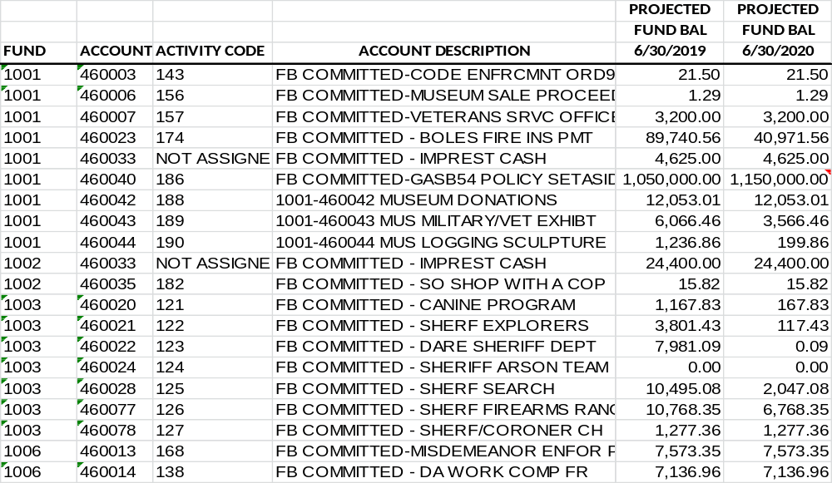
COMMITTED ACCOUNT BALANCES
Action Item – Recommend BOS approval

Slide 64
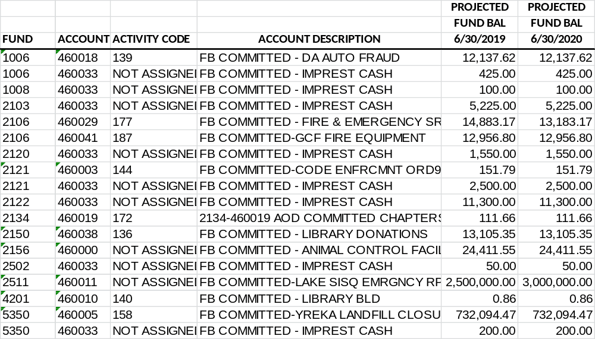
COMMITTED ACCOUNT BALANCES
Action Item – Recommend BOS approval

Slide 65
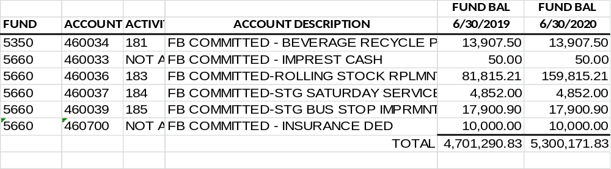
COMMITTED ACCOUNT BALANCES

Slide 66
COMMITTED ACCOUNTS
Board Agenda Item 7-A-7(A-8B)
CAO Recommended Motion
  Move to increase the Power Authority Emergency Repair Committed Account in the amount of $500,000 from the Power Authority Fund Balance & waive the
  75 /25 split
  Move to increase GASB 54 Committed Account in the amount of $100,000 from the General Fund
  Approve committed account balances as submitted.

Slide 67
CONTRIBUTION TO OTHERS

Slide 68
CONTRIBUTION TO OTHERS
Department | Organization | Amount
Board | Siskiyou Arts Council | $ 1,000
Board | Tobacco Education Council | $ 10,000
Board | Siskiyou Media Council | $ 1,000
Board | Dolly Parton | $ 500
Board | Siskiyou County Fire Chief's Assoc. | $ 1,000
Board | Ore-Cal RC&D | $ 375
Board | Family Resource Centers | $ 40,000
Board | Library Branches | $ 24,000

Slide 69
CONTRIBUTION TO OTHERS
Department | Organization | Amount
LAFCO | LAFCO | $ 15,000
Ambulance | Happy Camp | $ 1,200
Ambulance | Butte Valley | $ 1,200
Ambulance | City of Etna | $ 1,200
Emergency Medical Care Council | Sierra Sacramento Valley EMS Agency | $ 29,000
PSA II | PSA 2 Area Agency on Aging | $ 19,000
Natural Resources | Tulelake Irrigation District | $ 200
Farm Advisor | 4H Program | $ 10,000
Sheriff | SART | $ 1,000
Sheriff | SUMIT | $ 1,000
Sheriff | CHP-OT Reimbursement | $ 20,000
Sheriff | DOJ- OT Reimbursement | $ 24,000
DA | SART | $ 1,000
DA | SUMIT | $ 1,000

Slide 70
CONTRIBUTION TO OTHERS
Department | Organization | Amount
General County Fire | Hilt - Ins Reimb | $ 2,000
General County Fire | Klamath River - Ins Reimb | $ 1,000
General County Fire | Seiad - Ins Reimb | $ 1,000
General County Fire | Salmon River - Ins Reimb | $ 1,000
General County Fire | Siskiyou County Fire Chief's Association | $ 1,000
Human Services | SART | $ 1,813
Advertising | Superior CA Economic Development | $ 7,500
F&G | Cal-Ore Wetlands | $ 2,000
F&G | Cal Fish & Wildlife | $ 2,000
F&G | Siskiyou Horseman | $ 2,000

Slide 71
SALARY ORDINANCES
Board Action Item 7-A-9
SALARY ORDINANCE TAB
Action Item – 7 A 9
Recommend BOS approval of allocated positions and salaries for FY 19/20

Slide 72
NON-GENERAL FUND SUMMARY
SEE BINDER TAB

Slide 73
RECOMMENDED BUDGET
Board Action Item 7 A 10
  Move to approve Recommended Budget as presented (with modifications).

Slide 74
NEXT STEPS
Recommended Direction prior to Adopted Budget
Direct the CAO
  Fund Provisions at in a amount of $500,000
  Work with Department Heads to address unmet needs in accordance with Board priorities
    Sheriff
    Library
    Agriculture Department
  Work with Department heads in an effort to avoid personnel cuts
  Other-as directed by the Board

Slide 75
THANK YOU!
A sincere thank you to the Auditor and staff who filled the gap, Rachel York Wendy Winningham & Department Heads!

