Slide 1
What is Technology?
Introduction
© 2011 Project Lead The Way, Inc.

Slide 2

What is Technology?

Slide 3

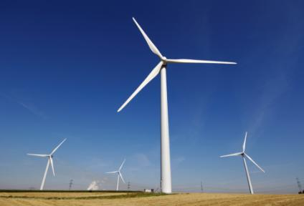
What is Technology?
Technology is comprised of the products and processes created by engineers to meet our needs and wants.
Notes:
Human innovation in action!
People have to need it – people have to want it – in order for technology to happen.

Slide 4

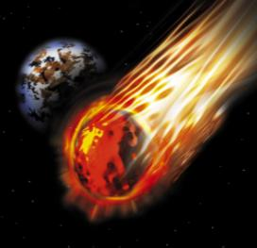
Technology vs. Science
Technology
  Study of our human-made world
  Deals with “what can be”
Science
  Study of our natural world
  Deals with “what is”
Notes:
When we study Science, we look at it in different subject areas.
Earth Science
Biology
Chemistry
Physics
Astronomy
Meteorology
Other specialty areas such as Quantum Physics and Computer Science

Slide 5
How Does Technology Address Human Needs and Wants?
Information
Environmental
Communication
Bio-Related and
Agriculture
Medical
Technology
Manufacturing
&
Construction
Transportation
Energy and Power
Nanotechnology
Notes:
Just like with science, when we study technology we look at it in the following categories
These forms of technology will be discussed throughout the presentation.

Slide 6

Information Technology
Information Technology allows us to send signals around the world.
  Examples:
  Television, Internet, satellite, GPS, cell phones
Notes:
Information Technology is the process of gathering and storing data to be used in various forms.
Provides streamlined access to vast sources of information
Allows us to produce more accurate forms of communication
Includes expanded resource choices
Enables us to retrieve data in seconds

Slide 7


Impacts of Information Technology
POSITIVE IMPACTS | NEGATIVE IMPACTS
INTERNET –Information is stored for easy access
INTERNET – Harder to distinguish between reliable and unreliable sources
Notes:
Impacts slides will provide one positive and one negative example. There should be a class discussion about how other technologies impact the student, school, community, world, etc.
COMPUTERS – Use of a computer to easily gather and store data
OBSCELENCE –Machines must be maintained and upgraded
Yellow Pages book compared to finding phone numbers on line – or stored in the memory of a phone.

Slide 8



Communication Technology
Communication Technology is giving or exchanging information.
  Examples:
  Magazines, DVDs, photography, video games
Notes:
Communication Technology is a process of giving or exchanging information.
Provides streamlined publishing techniques and allows us to produce more accurate drawings
Includes expanded entertainment choices
Enables us to contact people thousands of miles away

Slide 9

Impacts of Communication Technology
POSITIVE IMPACTS | NEGATIVE IMPACTS
DIGITAL CAMERAS Allow you to edit and print only the pictures you like
COMPUTERS, PRINTERS, & DIGITAL CAMERAS Make forgery and plagiarism easier
Notes:
CAD – Using a computer to generate more accurate drawings in a shorter period of time
PAPER USAGE – People tend to create and print more documents

Slide 10
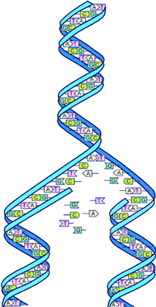
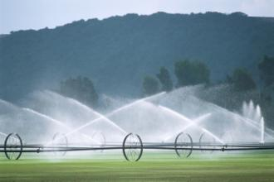
Bio-related and Agricultural
Technology
Biotechnology transforms living things into products or new forms of life.
  Examples:
  Genetic engineering, bionics
Agricultural Technology produces plants and animals for food, fiber, and fuel.
Examples:
  Irrigation, food preservation,
  weed and insect control
Both deal with living things:
  Plants, animals, and people
DNA Replication image from the Human Genome Project
Notes:
Bio-related Technology
Pharmaceuticals
Artificial limbs
Genetic engineering
Hydroponics
Imaging devices
Cardiovascular devices
Ethics
The Human Genome Project (HGP) was one of the great feats of exploration in history. The HGP gave us the ability to, for the first time, to read nature's complete genetic blueprint for building a human being.
Agricultural biotechnology is a range of tools, including traditional breeding techniques, that alter living organisms, or parts of organisms, to make or modify products; improve plants or animals; or develop microorganisms for specific agricultural uses. Modern biotechnology today includes the tools of genetic engineering. Biotechnology provides farmers with tools that can make production cheaper and more manageable. For example, some biotechnology crops can be engineered to tolerate specific herbicides, which makes weed control simpler and more efficient. Other crops have been engineered to be resistant to specific plant diseases and insect pests, which can make pest control more reliable and effective, and/or can decrease the use of synthetic pesticides. These crop production options can help countries keep pace with demands for food while reducing production costs. Advances in biotechnology may provide consumers with foods that are nutritionally-enriched or longer-lasting, or that contain lower levels of certain naturally occurring toxicants present in some food plants. Developers are using biotechnology to try to reduce saturated fats in cooking oils, reduce allergens in foods, and increase disease-fighting nutrients in foods. They are also researching ways to use genetically engineered crops in the production of new medicines, which may lead to a new plant-made pharmaceutical industry that could reduce the costs of production using a sustainable resource. http://www.usda.gov/wps/portal/!ut/p/_s.7_0_A/7_0_1OB?contentidonly=true&navid=AGRICULTURE&contentid=BiotechnologyFAQs.xml

Slide 11
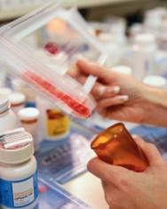
Impacts of Bio-Related Technology
POSITIVE IMPACTS | NEGATIVE IMPACTS
HEALTH – Improves quality of life, vitamins, vaccines, medications
HEALTH – Side effects of some medications – nausea, shortness of breath, etc.
Notes:
DISEASE – Research on controlling and eliminating diseases
DISEASE – Not all cultures embrace use of vaccines and thus disease spreads

Slide 12
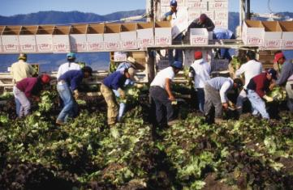
Impacts of Agricultural Technology
POSITIVE IMPACTS | NEGATIVE IMPACTS
FERTILIZERS– can make plants produce more food per acre
FERTILIZERS– have found their way into ground water, polluting good drinking water
Notes:
FOOD – More variety, healthier choices, processed so that it is safe and tastes good
GENTICALLY ALTERED CROPS – Potential for weeds and insects to mutate and become resistant

Slide 13
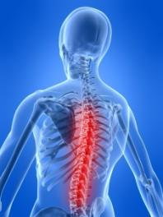
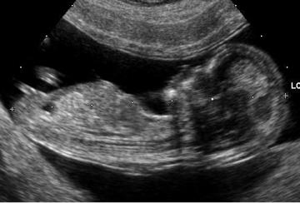
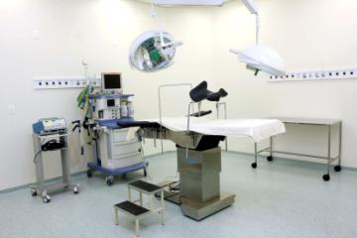
Medical Technology
Medical Technology creates tools
to treat disease and injury.
Examples:
Lasers, prostheses, ultrasound, medications

Slide 14
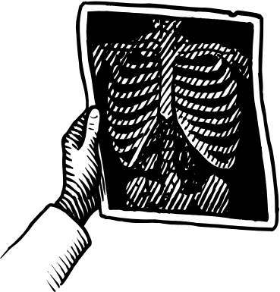
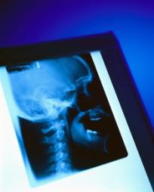
Impacts of Medical Technology
POSITIVE IMPACTS | NEGATIVE IMPACTS
X-RAYS – Make it easier to diagnose injuries
X-RAYS – Too many x-rays can cause cancer.

Slide 15

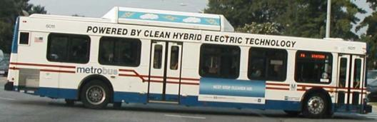
Environmental Technology
Environmental Technology creates tools to minimize the effect of technology on the development of living things.
Examples: Hybrid vehicles, conservation, waste management (recycling)
Notes:
Environmental Technology is study of processes to control waste, soil erosion, reducing sediment in waterways, conserving water, and improving water quality.

Slide 16

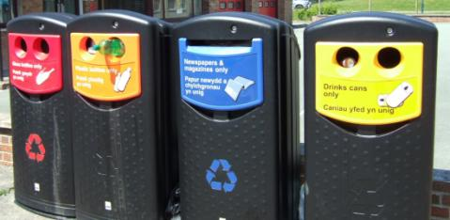
Impacts of Environmental Technology
POSITIVE IMPACTS | NEGATIVE IMPACTS
RECYCLING – Improves water and air quality
RECYCLING – Disposal of garbage is more complicated and time consuming
Notes:
DISEASE – Reduces chance of disease from pollution and chemicals

Slide 17
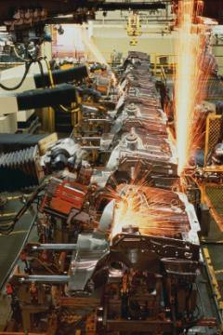
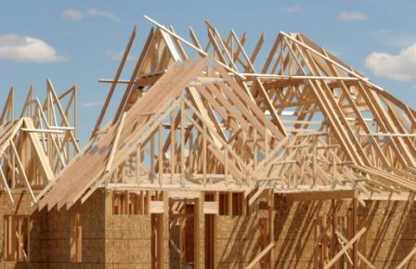
Production Technology
Production Technology is the manufacturing of physical goods on an assembly line and the construction of structures on a job site.

Slide 18
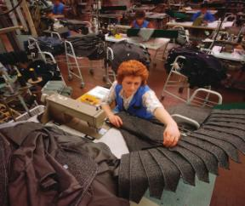
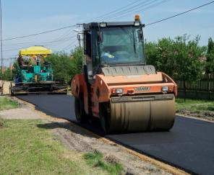
Production Technology
Manufacturing changes natural or synthetic materials into usable products.
Examples: Clothing, vehicles, food
Construction Technology builds structures that support loads and protect us from the environment.
Examples: House, bridge, roads
Notes:
Natural (found in nature) or Synthetic (human-made)
Examples of Manufacturing Technology: Clothing, entertainment devices, automobiles, chemical products, lumber, steel, food
Examples of Construction Technology: Houses, high-rise buildings, bridges, roads, dams, schools

Slide 19
Impacts of Production Technology
POSITIVE IMPACTS | NEGATIVE IMPACTS
MANUFACTURING – | MANUFACTURING –
CONSTRUCTION – | CONSTRUCTION –
New products help to make our life easier and increase leisure time
Many industries use materials that can harm the environment
Provides shelter, improves roads, creates employment opportunities
Noise and debris, traffic problems, accidents and injuries

Slide 20


Materials Technology
The development of materials with outstanding combinations of mechanical, chemical, and electrical properties that make other advances possible.
Examples: Mosquito repellent clothing, artificial skin grafts for burn victims, advanced building materials such as composite decking
Notes:
Decking - Recycled plastic and saw dust to make simulated wood deck materials
Car bodies can be made from plastic instead of metal. The B-2 bomber uses high tech composites to achieve its stealth capabilities.
The materials that form a composite are not changed. They work together to create a new material with desirable qualities.

Slide 21

Impacts of Materials Technology
POSITIVE IMPACTS | NEGATIVE IMPACTS
NEW MATERIALS – able to reuse recycled materials to help the environment
NEW MATERIALS – don’t know how the materials will behave over long periods of time.
Notes:
Materials technology enables us to design durable construction components. The ability to design and adopt better-performing, energy-saving, cost-efficient materials with known durability characteristics is key to our construction industries future.

Slide 22




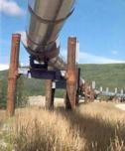
Transportation Technology
Transportation Technology Provides a way for people, animals, products, and materials to be moved from one place to the next.
Examples:
  Flight – Airplane, rocket, space shuttle
  Land – Train, subway, automobile, bicycle
  Water – Commercial, cruise ships
  Non-vehicle – Conveyor belts, pipelines

Slide 23

Impacts of Transportation Technology
POSITIVE IMPACTS | NEGATIVE IMPACTS
Traveling long distances faster
Accidents
Notes:
Traveling long distances faster
Use of energy, pollution

Slide 24
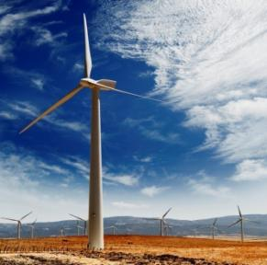
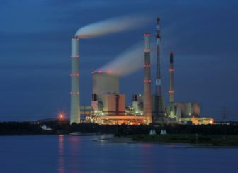
Energy and Power Technology
Energy is the ability or capacity to do work.
Examples:
  Chemical Energy → Gasoline
Mechanical Energy → Motion
Thermal Energy → Steam
    Electrical Energy → Electricity
    Radiant Energy → Light
Notes:
Technological products and systems need energy to function.
The availability of energy often determines the development of technology.

Slide 25

Energy and Power Technology
Power is the rate at which energy is transformed from one form to another.
Examples:
  Electrical power – provides light and operates motors
  Mechanical power – moves automobiles, trains, and airplanes
  Fluid power – uses fluids to produce motion
  Hydraulic – uses a liquid
  Pneumatic – uses a gas
Notes:
In the last slide, we stated that energy is the capacity to do work. In this definition, we are referring to potential energy.
Once we have potential energy, we put it to use by converting it into kinetic energy.
We have power when we can apply kinetic energy over a period of time to do work.
Power makes work easier.

Slide 26
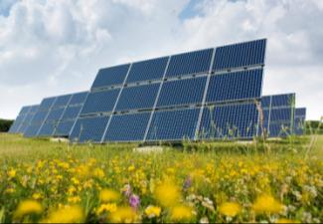
Impacts of Energy and Power Technology
POSITIVE IMPACTS | NEGATIVE IMPACTS
Without energy and power, most technologies would not exist or work
Overuse of nonrenewable resources
Notes:
Burning fossil fuels causes greenhouse gases associated with global warming.

Slide 27
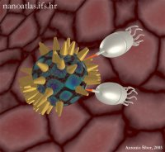
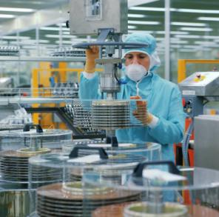
Nanotechnology
Nanotechnology is manipulating materials on an atomic or molecular level.
  Examples:
    Sensors, Nanobot, molecular manufacturing
Notes:
Nanotechnology is the creation of functional materials, devices and systems through control of matter on the nanometer length scale (1-100 nanometers), and exploitation of novel phenomena and properties (physical, chemical, biological, mechanical, electrical...) at that length scale. For comparison, 10 nanometers is 1000 times smaller than the diameter of a human hair. A scientific and technical revolution has just begun based upon the ability to systematically organize and manipulate matter at nanoscale. http://www.ipt.arc.nasa.gov/nanotechnology.html

Slide 28
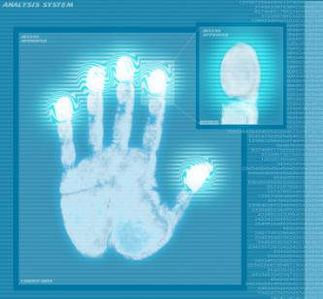
Impacts of Nanotechnology
POSITIVE IMPACTS | NEGATIVE IMPACTS
IMPLANTED SENSORS | IMPLANTED SENSORS
Continuously sense and adjust medical treatment
Impede privacy
Notes:
MOLECULAR MANUFACTURING – Faster diagnosis of diseases
MOLECULAR MANUFACTURING – Weapons and surveillance devices can be made small, cheap, and powerful.

Slide 29
Image Resources
Microsoft, Inc. (2008). Clip Art. Retrieved September 10, 2008, from http://office.microsoft.com/en-us/clipart/default.aspx
National Aeronautics and Space Administration (NASA). (n.d.). Genesis: Search for origins. Retrieved September 10, 2008, from http://genesismission.jpl.nasa.gov/educate/scimodule/cosmic/ptable.html

