Slide 1
MONTGOMERY PUBLIC SCHOOLS
MANAGEMENT OF INCOMING FUNDS
Local Schools
Teacher In-Service Training
SY 2021-2022

Slide 2
INTERNAL CONTROL - CASH RECEIPTS
According to the State Department of Education, audits show that the management of incoming funds in local schools as the primary weakness of internal controls for local school financial operations.

Slide 3
RECEIPTING OBJECTIVE
To be able to account for ALL funds turned in by a specific teacher or coach.

Slide 4
TEACHER RESPONSIBILITY
Document ALL receipts according to Local School Accounting procedures
The teacher or coach is responsible for turning in funds, receipt book, and Teacher Receipt Reconciliation Form DAILY

Slide 5
TEACHER RESPONSIBILITY (cont.)
The teacher or coach is responsible for verifying that a master receipt is issued to them totaling the revenue that they turned in to the office
The teacher or coach is responsible for ensuring they get their receipt book and their white copy of the Teacher Receipt Reconciliation Form back from the bookkeeper.

Slide 6
BOOKKEEPER’S RESPONSIBILITY
The bookkeeper is responsible for verifying that the revenue turned in by the teacher or coach is equal to the total amount of receipts written and issued by the teacher or coach in exchange for the revenue received and submitted.
The bookkeeper is responsible for issuing a master receipt to the applicable person using the receipt module and stapling the receipt in the teacher’s receipt book to the applicable receipt.

Slide 7
BOOKKEEPER’S RESPONSIBILITY (cont.)
The bookkeeper is responsible for returning the teacher’s receipt book and the white copy of the Teacher Receipt Reconciliation Form back to the teacher.

Slide 8


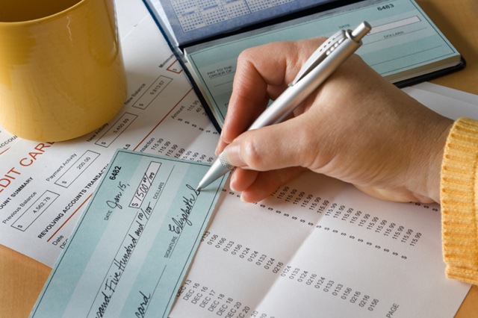
My School Bucks

Slide 9

https://www.myschoolbucks.com
We will continue to implement ways other than cash to receipt funds from parents.
Last year MPS implemented MySchoolBucks, an online service that allows parents to pay students' fees using a credit card, debit card or electronic check.
For more information about this procedure, please contact your local school bookkeeper.

Slide 10
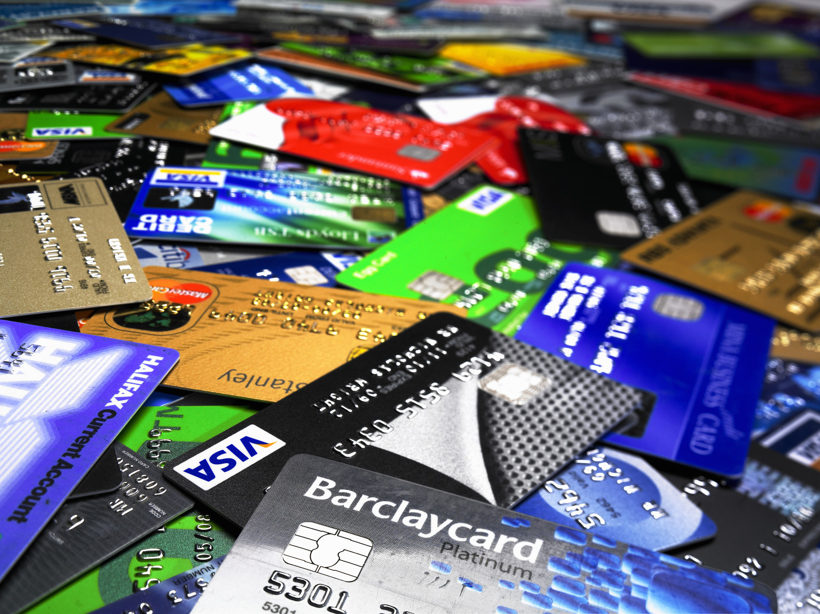
MYSCHOOLBUCKS FEATURES
Convenience - Available 24/7 on the web and mobile app.
Efficiency - Make purchases for all students and eliminates the need for students to take money to school.
Flexibility - Make payments using credit/debit cards and electronic checks.
Security – MySchoolBucks adheres to the highest security standards.
Notes:
The LSA Team is available to assist and train all bookkeeper on how to create products in MySchoolBucks. Product examples include: Field Trips, fees,
donations, etc.

Slide 11
BENEFITS OF MYSCHOOLBUCKS
Minimizes the number of cash/checks handled through the school
Minimizes receipt books so teachers/coaches can focus on instruction
Ensures health and safety of students/staff during COVID by minimizing cash handled
Notes:
The LSA Team is available to assist and train all bookkeeper on how to create products in MySchoolBucks. Product examples include: Field Trips, fees,
donations, etc.

Slide 12
RECEIPTS
A receipt should be issued at the time that money is collected
A Purpose Form can be used for any monies collected equivalent to $5.00 or less, except fee (1000 Activities) in Middle and High Schools
When a receipt needs to be voided, ALL portions of the receipt must remain in the receipt book and marked VOIDED

Slide 13
RECEIPTS (cont.)
Receipt books are available in the Bookkeeper’s office
Students are NOT permitted to sign out receipt books for teacher
The student gets the white original copy, the yellow carbon copy stays in the receipt book

Slide 14
RECEIPTS (cont.)
Before another receipt book can be issued, the previous book must be completed and signed back into the Bookkeeper
All receipt books must be turned in at the end of the school-term

Slide 15
RECEIPTING SUMMARY
All money turned in by a teacher or coach must be receipted in the teacher’s receipt book either by:
  Writing individual receipts for all 1000 Activity fees (under or over $5.00), (Middle and High Schools)
  Writing individual receipts for funds other than fees that are more than $5.00 per student
  Writing a receipt for the total amount of revenue recorded on a Purpose Form, Ticket Sales Form, Physical Inventory Form or any other forms of alternative methods of receipting

Slide 16
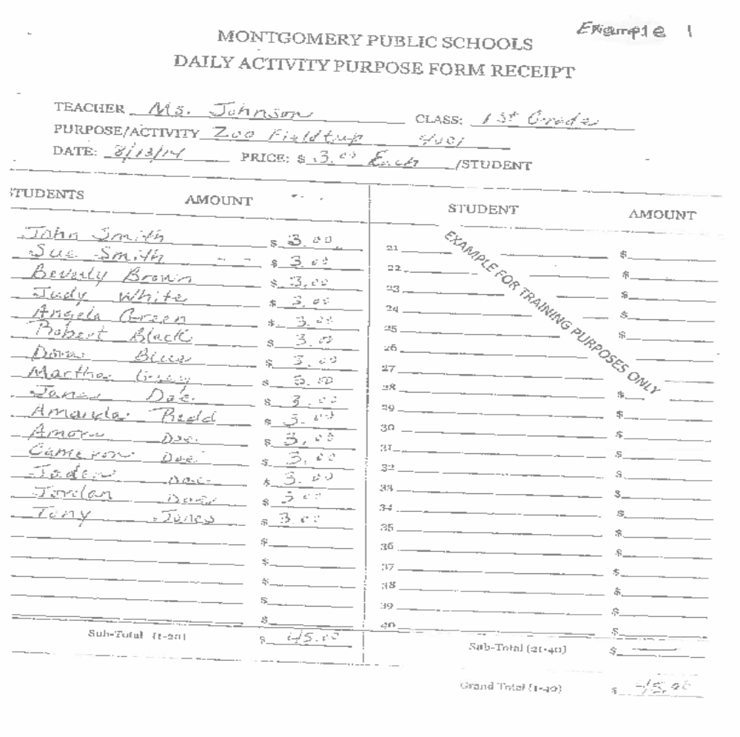

Slide 17
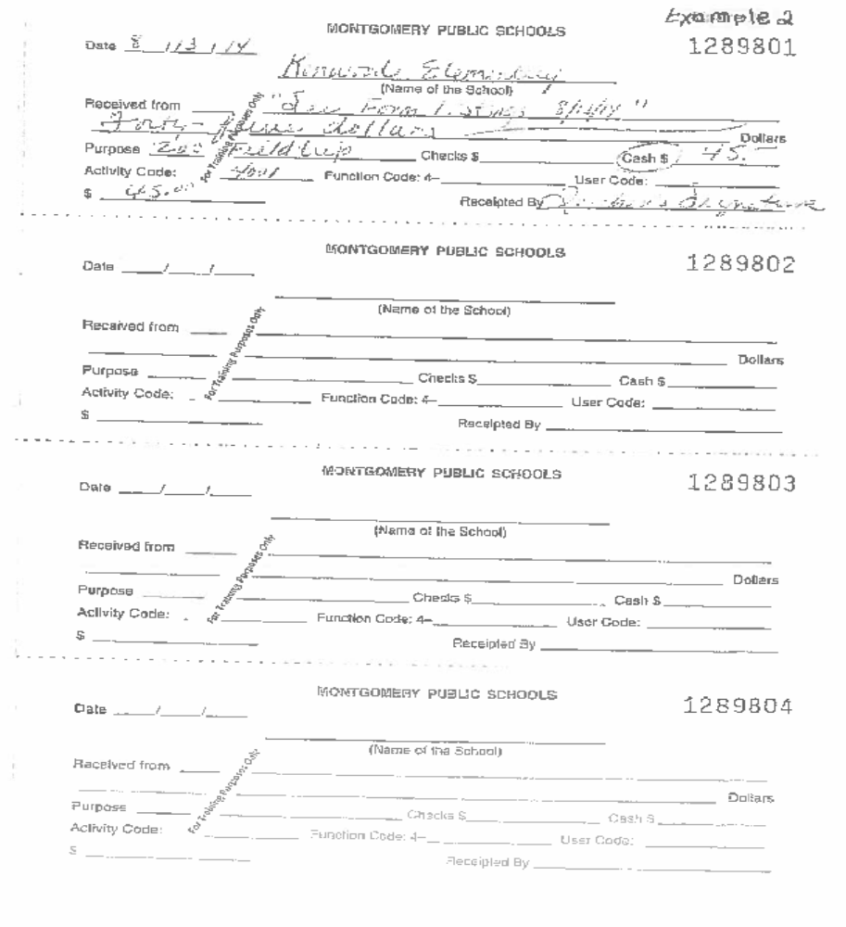

Slide 18
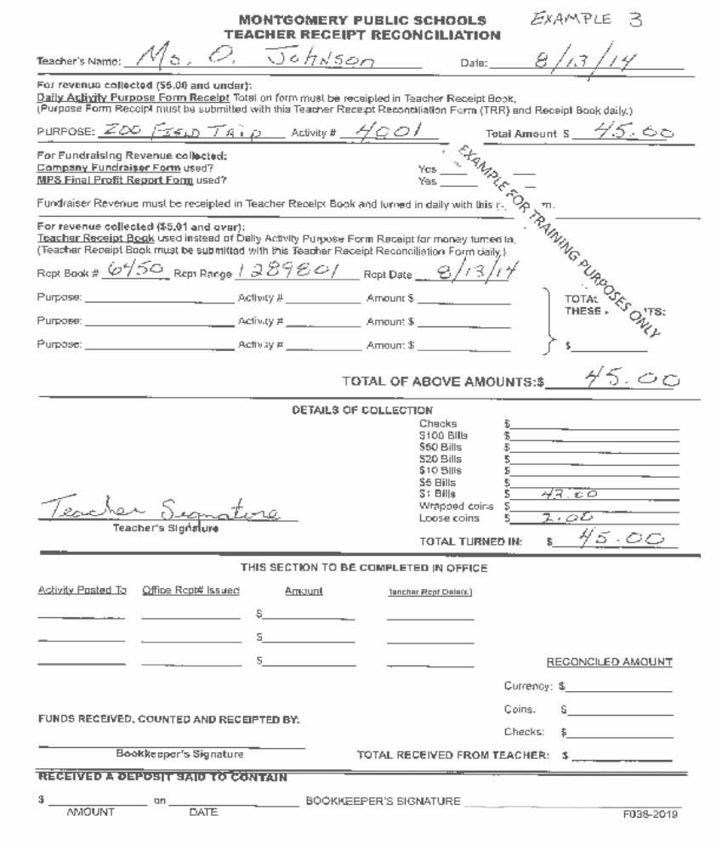

Slide 19
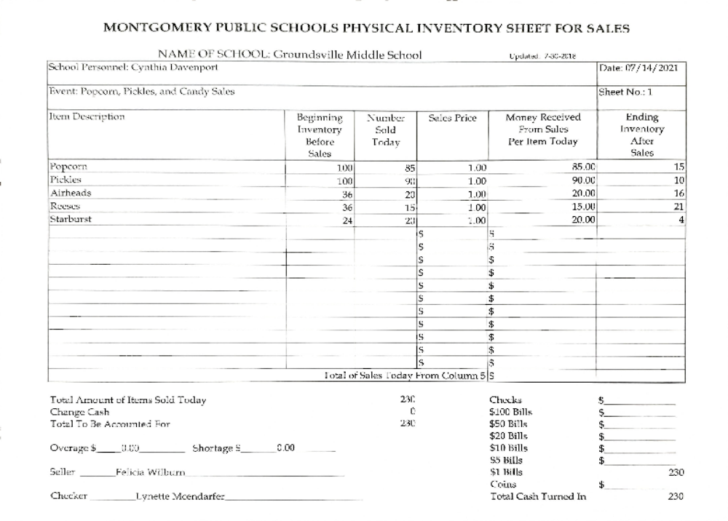
EXAMPLE
Notes:
The Physical Inventory Form can also be used to account for spoiled/damaged items held in your inventory.

Slide 20
FUNDRAISERS
All fundraisers and crowdfunding projects must be approved by the Principal and CSFO or his designee
Crowdfunding projects are considered fundraisers (examples: DonorsChoose and SnapRaise)”GoFundMe projects will not be approved”
All items (Monetary and non-monetary) obtained by fundraisers are the property of the Montgomery Public Schools and inventory procedures are applicable

Slide 21
Fundraiser
Within a reasonable time after completion of the fundraising activity, a Final Profit Report form should be submitted to the Principal to summarize the activities of the fundraiser and ensure a profit is realized.
The Final Profit Form should include all payments received, all expenses or fees incurred, and the resulting profit or loss. Appropriate documentation should be attached.
Fundraiser and Crowdfunding approval forms and Final Profit form are available in the Bookkeepers Office or on the MPS Website.
Foods of minimal nutritional value may not be sold during the school day
Notes:
Schools should realize a 40% profit when conducting fundraisers. We are recommending that when conducting fundraisers please look at pre-ordering items for sale.
We understand that some companies require a minimum number of boxes to order which will require keeping an inventory. In those cases, please order the minimum. For example: World’s Finest, and Old Fashioned.
Examples of pre-orders include Krispy Kreme, T-Shirts, candy grams, which can all be ordered thru MySchoolBucks.
Yankee Candle & Scholastic does not require a minimum or pre-orders because parents order directly and the schools get a percentage

Slide 22
CONCESSIONS
A Master Receipt should be issued by (school bookkeeper), after counting or verifying the amount of the receipt from (teacher receipt book) at the time the funds are received
The person presenting the funds for receipt should wait for a Master Receipt to be prepared and verify the information on the Master Receipt before leaving the office
Supporting documentation (Physical Inventory Form) for items sold must accompany the funds collected
Foods of minimal nutritional value may not be sold during the school day

Slide 23
TICKET SALES AND ADMISSIONS
GoFan is an online platform that offers ticketing for athletic events for Middle and High Schools
GoFan is the easiest and best way to buy tickets for all athletic events
MPS is expanding GoFan for use for non-athletic events such as Proms, Fall Festivals, Dances, Plays, etc.
For more information on GoFan procedures please contact your bookkeeper
y

Slide 24
DEPOSIT PROCEDURES
Deposits should be made DAILY!
Sort money according to denominations (coins, 1’s, 5’s, etc.)
Money SHOULD NOT be kept in the classroom overnight (RISKY BUSINESS)
Deposits SHOULD NOT be sent to the office by students (SHAKY BUSINESS)
y

Slide 25
PURCHASE ORDERS
Purchase orders are processed on XXXXXXXXX (day of the week)
The monthly cut-off date for processing purchase orders is the XXTH OF EACH MONTH.

Slide 26
PURCHASE ORDERS (cont.)
Each purchase order will be assigned a number by the computer system, then given to the Principal for approval. *PLEASE ALLOW AT THE LEAST THREE DAYS FOR PROCESSING*
Upon approval, a copy of the original purchase order will be provided to the teacher. The teacher may then place the order either by faxing or emailing.

Slide 27
CASH DISBURSEMENTS
All transactions for local school accounting shall be paid by check and no cash payments should be made
All funds collected in a school should be spent for the purpose in which they were collected, except as otherwise approved by the superintendent or her designated representative

Slide 28
CHECKS
Normally, checks will be written on XXXXXX and given to the Principal to be signed on XXXXXX.
Checks will not be written without an approved purchase order, invoice for payment and verification of goods and services received.

Slide 29
REFUNDS
Please encourage students to keep their receipts. A refund is not given without producing a copy of the MPS receipt
*PRINCIPAL MUST APPROVE ANY EXCEPTIONS*

Slide 30
Public Funds Expenditures UNALLOWABLE
Food items for social gatherings
Meal expenditures for employees' spouses
Faculty & staff Christmas luncheon
Flowers for sickness, death, secretary’s day, etc.
Gifts for faculty/staff birthdays
Faculty appreciation gifts
Championship rings
T-Shirts for office/teachers
Alcoholic beverages
Food items for teacher’s lounge

Slide 31
Public Funds Expenditures ALLOWABLE
School landscaping, furnishings, and decorations
Expenditures for pictures for school office
Expenditures for flower arrangement for school office
Membership in professional organizations
Academic incentives for students
Athletic and band uniforms for students
Pregame/Postgame meals for student athletes
and coaches (NOT Principals or spouses)
Transportation to events related to a school sponsored activity
Notes:
When purchasing furnishings, decorations, and pictures, please make sure that the purchases are of a modest sum.

Slide 32
BOOKKEEPING OFFICE HOURS
MONDAY - FRIDAY
X:XX A.M. – XX:XX P.M.
X:00 P.M. – X:00 P.M.

Slide 33
Receipt of Acknowledgement
Please click on the following link to access the Google Form for Acknowledge of Local School Accounting Procedures

Slide 34


