Slide 1
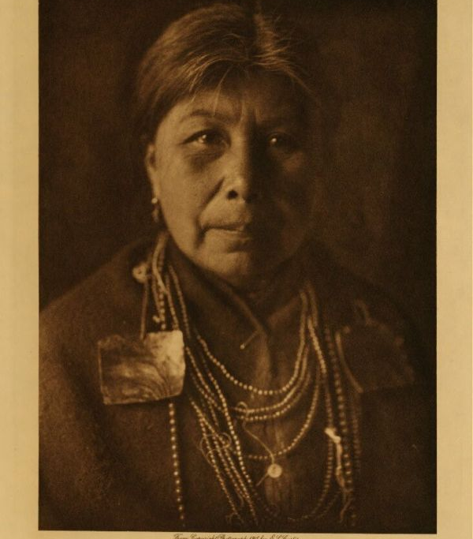
Pacific Coast Native Americans
This Photo by Unknown author is licensed under CC BY-SA.

Slide 2
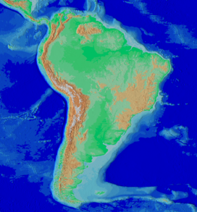
Region
The Pacific Northwest is located in the region of the western of the United States.
Located in the Pacific Ocean.
It runs North to South from British Columbia, Canada, to Oregon. Idaho, parts of Montana, northern California, and southeastern Alaska are also listed as parts of the Pacific Northwest in some accounts.
.The Northwest region is along the Pacific Ocean coast. The soil is very rocky, so it does not make for good farming. Like the Northeast region, the Northwest region has very cold winters and warm summers. http://nativeamericanadventures.weebly.com/northwest.html
This Photo by Unknown author is licensed under CC BY-SA.

Slide 3
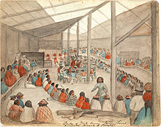
Survival/Food
The food they ate was Salmon was a major source of food
Along with other fish such as trout, halibut and herring, followed by acorns, hundreds of different plants, they also hunted marine mammals (whales, otters, seals), bears, beavers, lynx, deer, and small game like rabbits and hares.
These also include western red cedar, deer, elk, huckleberry, Wapato and camas.https://www.wildernesscollege.com/northwest-coast-native-americans.html
This Photo by Unknown author is licensed under CC BY-SA.

Slide 4
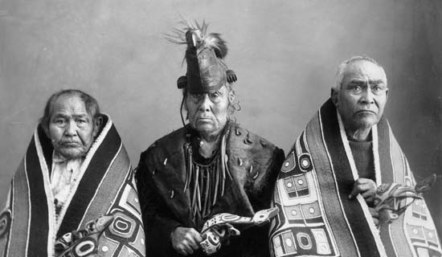
Clothing
They Dressed fairly simple among Northwest Coast peoples. Although ceremonial clothing and some hats could be highly decorated
Most clothing was worn for protection from the environment rather than for show.
Throughout the region women wore skirts or gowns of buckskin, soft leather, or woven wool or plant fibers. Men’s dress changed from tribe to tribe but was in general quite minimal—most men wore nothing but ornaments on warm days. https://kids.britannica.com/students/article/Northwest-Coast-Indians/480466/287443-toc

Slide 5
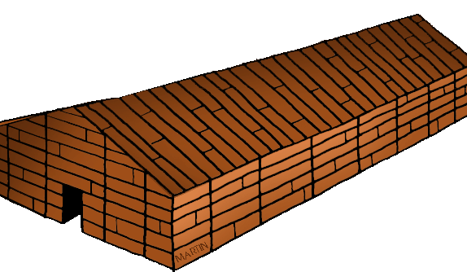
Homes
The Northwest Pacific Coastal Indians did not live in tepees as did the Yakima Indians of Eastern Washington.
Instead, they lived in longhouses built of thick cedar planks. These homes were also called plank houses. These early people chopped down and split massive cedar trees using beaver teeth and stone axes. Amazing!
The longhouses were huge. Some were about 100 feet long and 25 feet wide, with low roofs for easy heating. The only openings in the whole building was the entrance door and a hole in the roof to allow smoke to escape.
If the longhouse was built by the tribe, the Chief would assign space within the longhouse. Each family would be assigned a living area, a space of their own, within the house.
https://nativeamericans.mrdonn.org/northwest/longhouses.html

Slide 6
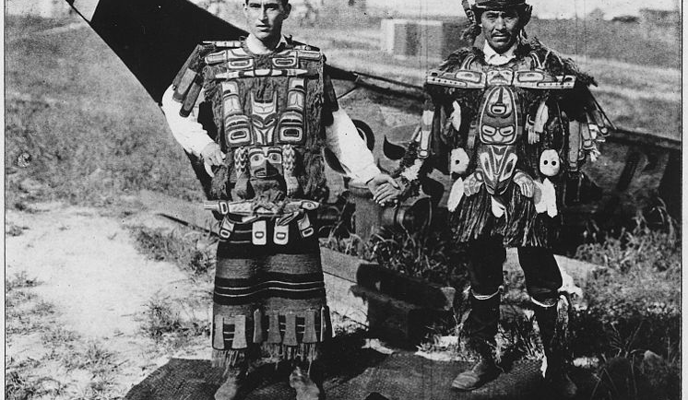
Tribes
The Tlingit Indians are original people of the Pacific Northwest Coast. They live in Southeastern Alaska and in British Columbia and the Yukon in Canada.
Nisga’a, Gitksan, and coastal and southern Tsimshian) are often called the “northern matrilineal tribes.” https://en.wikipedia.org/wiki/Indigenous_peoples_of_the_Pacific_Northwest_Coast#Nisga'a
https://www.encyclopedia.com/humanities/encyclopedias-almanacs-transcripts-and-maps/pacific-northwest-0
This Photo by Unknown author is licensed under CC BY-SA.

Slide 7
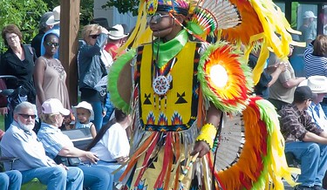
Fun Facts
The Northwest Coast American Indians lived in clans and had a native population of about 250,000. Below you'll find out who these men and women were, what they ate, where they lived, and why the northwest coast tribes were known to be the richest tribes. In this section there are many interesting facts on their handmade items such as jewelry and masks as well as their tribal customs and traditions. https://native-american-indian-facts.com/Northwest-Coast-American-Indian-Facts/Northwest-Coast-American-Indian-Facts.shtml
This Photo by Unknown author is licensed under CC BY-SA-NC.

