Slide 1
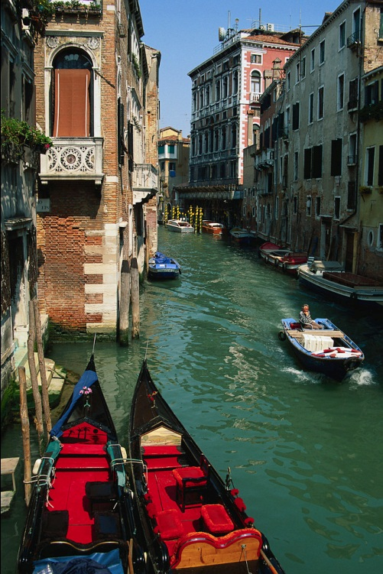
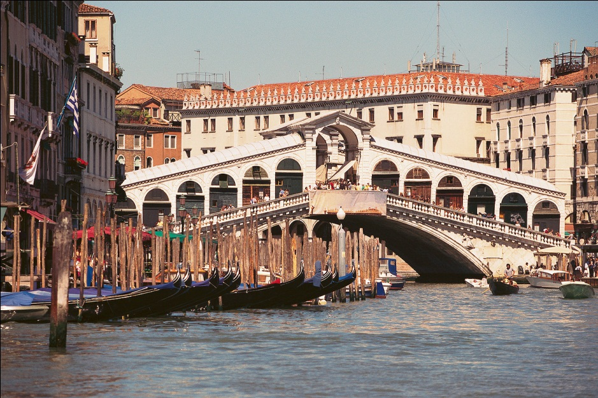
The Renaissance and Reformation
Chapter 14, section 1, pages 344-349
A period of creativity, of new ideas and inspirations, is called the Renaissance(1400’s)
Renaissance began in Italy (cities of Florence and Venice)

Slide 2
New Ideas of the Renaissance
New Ideas from trade with far off places in Asia
Goods traded made people curious about the larger world
Books written by Ancient Greeks and Romans
Humanities-history, poetry, grammar
Humanism-emphasized the abilities and accomplishments of human beings. Humanists believed that people were capable of great things.

Slide 3
Renaissance Art
Art
-Developed new techniques-perspective (3-D).
-Artists were humanists-wanted paintings and sculptures to show people’s personalities.
Michelangelo-Italian painter and sculptor
Leonardo da Vinci-painter, sculptor, architect, scientist, engineer and inventor
Is known as a “Renaissance Man”-great achiever in many areas.

Slide 4
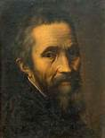
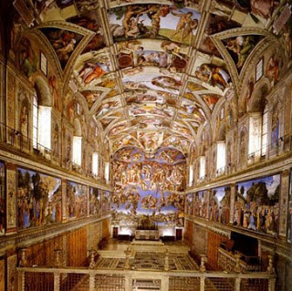
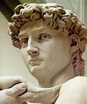
Michelangelo

Slide 5
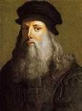
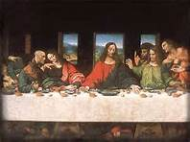
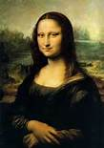
Leonardo da Vinci

Slide 6
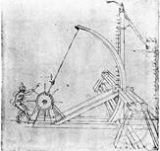
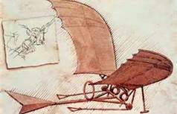
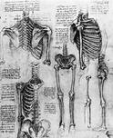
Da Vinci-Inventor/Scientist

Slide 7
Renaissance Literature
William Shakespeare (English)
-wrote poetry
-most famous for his plays
30 comedies, histories and tragedies
Julius Caesar, Romeo and Juliet
Renaissance writings were read and enjoyed by many by a new invention. . .

Slide 8
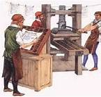
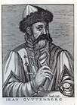
Renaissance Science
What Renaissance invention is this?

Slide 9
The Movable Printing Press
Inventor: Johann Gutenberg
-Could print books quickly and cheaply
-People could share ideas with people in distant lands
-Helped the Renaissance spread beyond Italy

Slide 10
The Reformation
Early 1500s
Distrust of the Catholic Church
The complaints led to the movement called the Reformation -religious reform
Protestant Reformation
Began in Germany
Led by German monk, Martin Luther

Slide 11
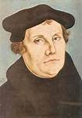
Martin Luther
German monk
Was one of the first to protest the Catholic Church- thought the leaders corrupt
1517- nailed a list of complaints to church door in Wittenberg
Luther and his followers formed a separate church
Protestants, Christians who broke from the Catholic Church

Slide 12
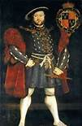
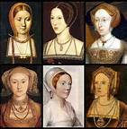
King Henry VIII and the Reformation
Pope refused to grant his divorce in 1534.
Broke from the Catholic Church to form
The Church of England.
John Calvin helped spread the
Protestant movement throughout
France and Switzerland.

Slide 13
The Catholic Reformation
Catholics who were dissatisfied with the church
Catholic Reformation- a series of reforms within the Catholic Church
Reforms
Focus on spiritual concerns
Make church teachings easier to understand
Spread Catholic teachings throughout the world by missionaries.

Slide 14
Religious Wars
Catholics VS the Protestants
Most lived in peace with one another.
Bloody wars broke out in France, Germany, the Netherlands and Switzerland
Results?
1.People relied less on the church.
2.Began to look to science for answers.

Slide 15
Be Like Martin Luther
Martin Luther did not like how the Catholic Church was being run. As a result he made a list of his complaints and nailed them to the church door in Wittenberg. Do you have any complaints about how HCMS is run? Make a list of at least 5 suggestions that you think would make our school better.

