Slide 1
How To Earn Scholarships
What Can I do NOW?

Slide 2

What are Merit Scholarships?
Good grades
ACT/SAT score
This is why ACT scores are so important. ☺

Slide 3
Look at 3 examples using the ASU scholarship estimator
Example 1- Example 2- Example 3-
Student has: Student has: Student has:
3.63 GPA 3.62 GPA 3.64 GPA
15 ACT 22 ACT 27 ACT
Rank 49/312 Rank 48/312 Rank 50/312
no merit Dean’s Provost’s
Scholarship $6,000/year $8,000/year
Awarded = $24,000 = $32,000

Slide 4
How can students prepare for the ACT/SAT?
Challenge yourself with Honors and AP Classes
Do well in your classes.
Take & study class notes
Get ACT Study Guide (from our library, you can also buy them); TIME yourself on practice tests
Read Test-tips
Practice, Practice, Practice

Slide 5


Also Important for Scholarships:
Leadership and Volunteerism
The Baird $40,000+
The Dorrance $90,000+
Student leaders are found in clubs, sports, student groups, study groups, community service, student government, doing school projects…..

Slide 6
Other Scholarships
Obama Scholarship – must qualify for a Pell Grant; report less than $42,000 on FAFSA; must meet academic requirements
Lumberjack Scholars – 3.5 unweighted GPA; no C’s; pays tuition for 4 years
Arizona Assurance – 3.0 GPA on required courses; family income is less than $42,000; pays room and board for first yr only

Slide 7
More Scholarships
MCCD President’s Scholarship – min 3.0 GPA and test into Eng 101, Mat 120(or higher), and min Rdg score of 74 in ACCUPLACER
FIRST – Get involved in Robotics (Mr. Carlson)
GCU Inspiring Students- 3.5 unweighted GPA and 100 study hours at GCU Learning Lounge (for DREAMERS and DACA too)
Many, many many MORE

Slide 8
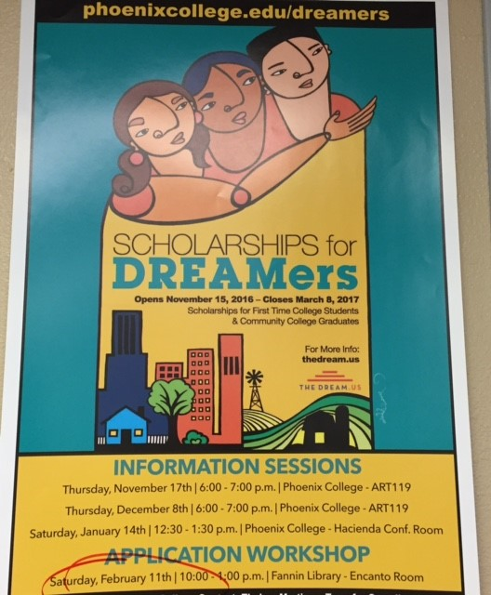
DACA
Full tuition for Phoenix College, GWCC, SMCC and/or ASU
Min 2.5 GPA

Slide 9
DACA/DREAMERS
Private and Out-of-State universities
GCU (ACT and GPA)
Western New Mexico
St Mary’s ( San Antonio)
Visit Metro Tech website for more information

Slide 10
Make Time For Enrichment Opportunities!
Be A Leader Institute High School (9th-12th)
  Meets one Saturday/month
Summer Camps at College Depot
More summer camps next year
Discover/Cultivate your passion!!
  Find ONE place/project
  Visit our website

Slide 11
QUESTIONS???

