Slide 1

SANFORD MIDDLE SCHOOL HORNETS

Slide 2

House of Gozen

Slide 3
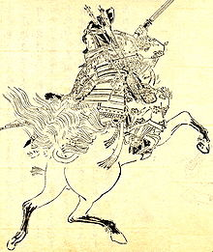
Tomoe Gozen
Tomoe Gozen was a late twelfth-century female samurai warrior, known for her bravery and strength.

Slide 4

House Color: Red
The color red symbolizes strength, leadership, and courage.

Slide 5
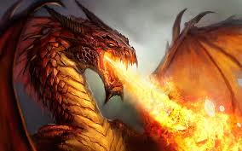
House Mascot: Dragon
Dragons are known for their dominance
Ambition
Power

Slide 6
House Motto: Valere
Valere is a Latin word meaning, “strength”.

Slide 7

House of Chaucer

Slide 8
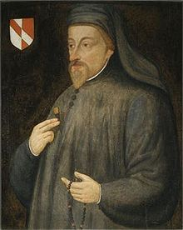
Geoffrey Chaucer
Chaucer is known as the Father of English literature, and is widely considered the greatest English poet of the Middle Ages.

Slide 9
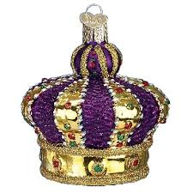
House Color: Regalia (purple)
The color regalia symbolizes royalty.

Slide 10
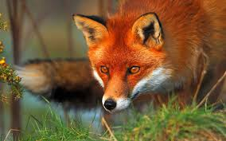
House Mascot: Fox
Live in close groups.
In folklore, the fox is often portrayed as a misunderstood hero.
Often depicted as a sacred creature that can bring wonder.

Slide 11
House Motto: Acutus
Acutus is a Latin Word meaning “sharp” or “wise”.

Slide 12

House of Ramses

Slide 13
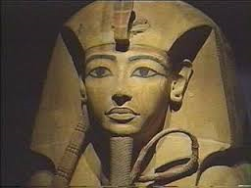
RRamses
Ramses was the founding Pharaoh of Ancient Egypt.

Slide 14

House Color: Black
The color black symbolizes power, elegance, formality, and mystery.

Slide 15
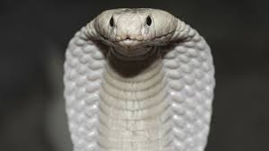
House Mascot: Cobra
Protection
Power
Authority

Slide 16
House Motto: Inveniam
Inveniam is a Latin word meaning, “determined”.

Slide 17

House of Fibonacci

Slide 18
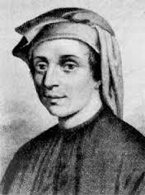
Leonardo Fibonacci
Fibonacci was an Italian mathematician, considered to be "the most talented Western mathematician of the Middle Ages".

Slide 19

House Color: Orange
The color orange represents enthusiasm, creativity, determination, success, and encouragement.

Slide 20
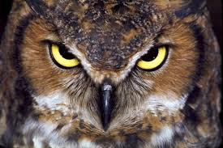
House Mascot: Owl
Wisdom
Bravery
Longevity

Slide 21
House Motto: Sophus
Sophus is a Latin Word meaning, “wisdom”.

