Slide 1
Short Answer Essay

Slide 2
Short Answer – 3 Questions – 40 minutes – 20% of Exam Score
Question 1 (required): periods 3-8 1754-1980
Question 2 (required): periods 3-8
Choose between Question 3, periods 1-5 1491-1877 and Question 4, periods 6-9 1865-present

Slide 3
3 Types:
Two secondary sources from historians giving different views on an event or time period.
Primary source (quote, map, cartoon).
Prompt or identification question.

Slide 4
Tips:
Put it in your own words. Don’t quote!
Provide specific examples.
Get to the point
Use complete sentences.
Stay in the time period.
If asked for an example, similarity etc., make it the most important
Stay within the page
Watch for categories of analysis (political, economic, cultural, social, intellectual). Give examples that match.

Slide 5
Samples – 2015 APUSH Exam
https://secure-media.collegeboard.org/digitalServices/pdf/ap/ap-united-states-history-exam-sample-responses.pdf

Slide 6
Example – Two Sources from Historians
“[W]e have in [United States history] a recurrence of the process of evolution in each western area reached in the process of expansion. Thus American development has exhibited not merely advance along a single line, but a return to primitive conditions on a continually advancing frontier line, and a new development for that area. American social development has been continually beginning over again on the frontier. This perennial rebirth, this fluidity of American life, this expansion westward with its new opportunities, its continuous touch with the simplicity of primitive society, furnish the forces dominating American character. The true point of view in the history of this nation is not the Atlantic course, it is the Great West…In this advance, the frontier is the outer edge of the wave—the meeting point between savagery and civilization.”
  Frederick Jackson Turner, historian, “The Significance of the Frontier in American History,” 1893
“[T]he history of the West in a study of a place undergoing conquest and never fully escaping its consequences…Deemphasize the frontier and its supposed end, conceive of the West as a place and not a process, and Western American history has a new look. First, the American West was an important meeting ground, the point where Indian America, Latin America, Anglo-America, Afro-America, and Asia intersected. …Second, the workings of conquest tied these diverse groups into the same story. Happily or not, minorities and majorities occupied a common ground. Conquest basically involved the drawing of lines on a map, the definition and allocation of ownership (personal, tribal, corporate, state, federal, and international), and the evolution of land from matter to property.”
  Patricia Nelson Limerick, historian, The Legacy of Conquest: The Unbroken Past of the American West, 1987
Using the excerpts above, answer parts A, B, and C.
A) Briefly explain ONE major difference between Turner’s and Limerick’s interpretations.
B) Briefly explain how someone supporting Turner’s interpretation could use ONE piece of evidence from the period between 1865 and 1898 not directly mentioned in the excerpt.
C) Briefly explain how someone supporting Limerick’s interpretation could use ONE piece of evidence from the period between 1865 and 1898 not directly mentioned in the excerpt.

Slide 7
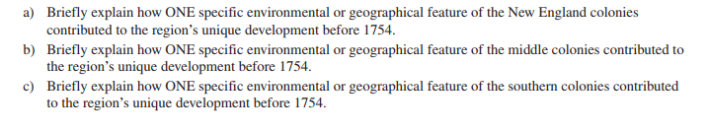
Example – Prompt or Identification Question

Slide 8
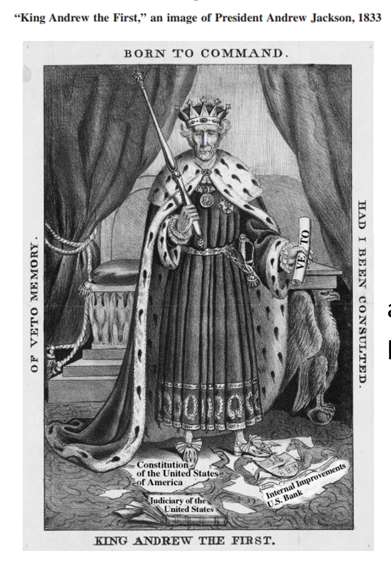
Example – Primary Source
Briefly describe ONE perspective about politics in the 1830s expressed in the image.
Briefly describe ONE specific event or development that led to the perspective expressed in the image.
Briefly explain ONE specific effect of the political developments referenced by the image.

