Slide 1
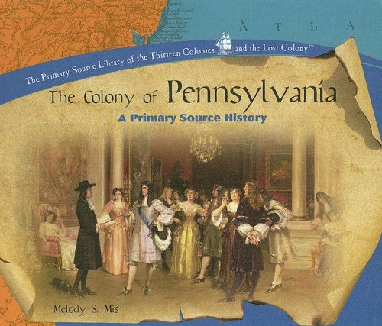
Lesson #2- Formation of Government

Slide 2
Lesson #2- Formation of Government
Activating Strategy
Think-Pair- Share
What does the term “Frame of Government” mean?

Slide 3
Lesson #2- Formation of Government
Essential Question:
How was Pennsylvania’s government created, structured, maintained, and changed?

Slide 4
Lesson #2- Formation of Government
Vocabulary
Constitution- a statement of the basic principles and laws of a nation, state, or group.
Charter- the grant of authority or rights
Articles- separate parts of anything written
Government-the governing body of a state, nation, or community

Slide 5
Lesson #2- Formation of Government
ADD THESE STATEMENTS TO YOUR VOCABULARY PAGE
William Penn was the founder and proprietor of Pennsylvania.
William Penn made four attempts to make PA a self governing nation

Slide 6
Lesson #2- Formation of Government
The Frame of 1682 (the First Frame)
Constituted a parliament consisting of two houses with 72 members
Upper House (The Council) could propose legislation but Lower House (Assembly)could not.
Granted the proprietor (William Penn) a greater power.
The Frame of 1682 was rejected because they did not want a proprietary government.

Slide 7
Lesson #2- Formation of Government
The Frame of 1683 (the Second Frame)
The proprietor’s voting power in legislative(law making) process remained one of the major concerns in framing the government.
Penn managed to convince the assembly that the proprietor’s veto power was necessary.

Slide 8
Lesson #2- Formation of Government
The Frame of 1696 (Markham’s Frame)
The new frame significantly changed the allocation of political power within the legislature
It also reduced the size of the legislature to a more manageable level – each county elected only two representatives to the council and four to the assembly.
A person needed to reside in the colony for two years before he could vote
Lasted until 1699

Slide 9
Lesson #2- Formation of Government
The Frame of 1701(The Charter of Privileges)
Penn Created a charter that allowed his citizens to enjoy the most freedoms.
Very progressive for the time –
  Religious freedom
  Trial by jury
  Freedom of the press
  Limited use of death penalty
  No Tax increases without vote
Remained the governing constitutional document until 1776

Slide 10
Lesson #2- Formation of Government
Pennsylvania Charter of Privileges
Penn’s attempts to reinforce proprietary government turned out to be unpopular.
The Frame of 1701 strengthened the controlling role of the assembly.
The assembly was to be elected annually by freemen and composed of four representatives from each county.
“Home Rule” was granted to the Lower Counties.

Slide 11
Lesson #2- Formation of Government
Think: What was the importance of having a state constitution?
Pair: Discuss your answer with your shoulder partner.
Share your response with the class.

Slide 12
Lesson #2- Formation of Government
The Constitution of Pennsylvania 1776
A Declaration of the Rights of the Inhabitants of the Commonwealth, or State of Pennsylvania.
This part of the Constitution outlines the freedoms and rights of individuals given to all citizens of PA.

Slide 13
Lesson #2- Formation of Government
The Constitution of Pennsylvania 1776
Plan or Frame of Government for the Commonwealth or State of PA.
This part of the constitution details how the government will be set up and how it will operate.

Slide 14
Lesson #2- Formation of Government
Each group will examine the Section in the State Constitution that you have been assigned.
1) Each group will read their assigned section.
2) On the chart paper, you will summarize what is being outlined in your section.
3) Write your group’s response on the chart paper. Make sure you identify the Section that you have been assigned.

Slide 15
Lesson #2- Formation of Government
Group Assignments
Group # Assigned Section
1 1 and 8
2 2 and 9
3 3 and 13
4 4 and 14
5 5 and 22
6 6 and 23
7 7 and 25

Slide 16
Ticket out the Door
3- Things that Penn provided the citizens in his Charter of Privileges
2- What was the name of the two law making bodies in Pennsylvania
1- What was the one major problem that the citizens did not agree on with Penn in the first two Frames.

