Slide 1
JAZZ HISTORY
DANCE

Slide 2
JAZZ DANCE
Jazz dance is a highly energetic, contemporary, and exciting form of dance.
It is an integral part of the entertainment field as it is seen on television, movies, music videos, and commercials. It has expanded to different venues and cabaret shows found at vacation resorts, cruise ships, and theme parks. Jazz dance also captivates adult, teen, and children audiences and allows a form of recreation and fitness to improve health.
The movements of Jazz dance are brought to America by African slaves as early as 1510. The shimmy is a movement influenced by the Shika dance in Nigeria and the Lindy-Hop and Jitterbug are influences from the Shango and Ejor Tribal dances, while the Snake is from the Congo.

Slide 3

1930’s
Tap dance was created and performed by the infamous Fred Astaire and Ginger Rogers dancing duo during the years of the Depression.

Slide 4
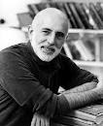

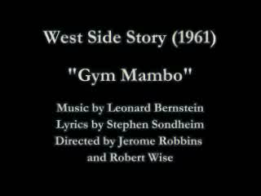
1940’s
Agnes De Mille choreographed Oklahoma after WWII was put to a stop.
West Side Story was choreographed by Jerome Robbins who created the pimp walk.
Hoofers became popular. (Famous style of tap).
West Side Story:
http://www.youtube.com/watch?v=II2uaRmlQNg

Slide 5

1950’s
Elvis Presley was introduced along with popular dance moves such as: The Madison, the Birdland, the Bop, the Locomotion, the Chicken, and the Mashed Potato.

Slide 6


1960’s
The Twist was created by Presley’s hip gyrations and music groups such as The Beatles and Beach Boys emerged.
Eugene Louis Facciuto AKA Luigi and Gus Giordano have both received continuing fame as developers of jazz dance technique and choreography.
Luigi developed his technique as a result of an auto accident that left him paralyzed on the ride side. Doctors claimed he would never walk, let alone dance again. Luigi became persistent with operations, physical therapy, and his own study of body development based on dance exercises. He attained ability to dance again and developed exercises necessary for building strength.

Slide 7

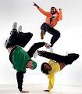
1970’s
Discoteques were the rise to line dances like the Bus Stop, The Roller Coaster, The Hustle, and The Bump.
Grease the musical became popular along with A Chorus Line, Saturday Night Fever, and Stayin Alive.
The Campbellock, also known as locking, was interesting as it included robotic movements with wild, out-of-control moves with stops and starts.
B-boying also became a past time for young asian dancers on the streets of New York.

Slide 8

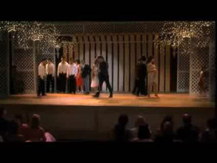
1980’s
Musical Theatre was most prominently known by Andrew Llyod Webber.
His musicals included: Jesus Christ Superstar, Joseph and the Amazing Technicolor Dreamcoat, Starlight Express, Phantom of the Opera, and Cats.
Many other movies that included dancing during that time were: Fame, Flashdance, Footloose, Breakdancing, and Dirty Dancing.
Michael Jackson’s music videos took flight as well.
Footloose:
http://www.youtube.com/watch?v=BUsNpfXwEy0
Dirty Dancing:
http://www.youtube.com/watch?v=WpmILPAcRQo

Slide 9
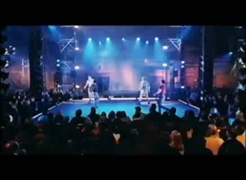

1990’s
Famous Broadway Musicals:
Bring in da Noise, Bring in da Funk
Tap Dogs
Rent
Jazz has recently evolved into Hiphop and hiphop is now evolving into Krump and other newer styles of dance. It will continue to do so as trends and new art forms take place.
Bring in da Noise, Bring in da Funk
http://www.youtube.com/watch?v=oZ88TFp8iWg
Tap Dogs:
http://www.youtube.com/watch?v=Pa8qOHIRI3A

Slide 10

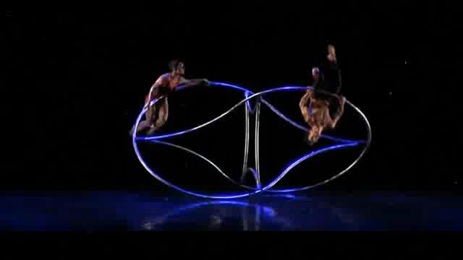
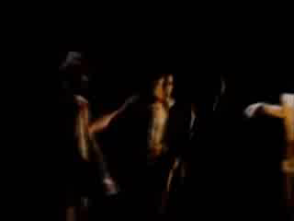
PILOBOLUS AND MOMIX
Pilobolus:
http://www.youtube.com/watch?v=elWf8nI6ivw&feature=results_main&playnext=1&list=PL08ACAB82C504081C
Momix:
http://www.youtube.com/watch?v=_SJ4NLLbO8g
Lines Ballet:
http://www.youtube.com/watch?v=cl34KY2albE

Slide 11
BIBLIOGRAPHY
Kraines, Minda Goodman. Jump Into Jazz; Fourth Edition. 1999.
West Side Story:
http://www.youtube.com/watch?v=II2uaRmlQNg
Footloose:
http://www.youtube.com/watch?v=BUsNpfXwEy0
Dirty Dancing:
http://www.youtube.com/watch?v=WpmILPAcRQo
Bring in da Noise, Bring in da Funk
http://www.youtube.com/watch?v=oZ88TFp8iWg
Tap Dogs:
http://www.youtube.com/watch?v=Pa8qOHIRI3A
Pilobolus:
http://www.youtube.com/watch?v=elWf8nI6ivw&feature=results_main&playnext=1&list=PL08ACAB82C504081C
Momix:
http://www.youtube.com/watch?v=_SJ4NLLbO8g
Lines Ballet:
http://www.youtube.com/watch?v=cl34KY2albE

