Slide 1
History and Scope of Microbiology

Slide 2
What is Microbiology?
Micro - too small to be seen with the naked eye
Bio - life
ology - study of

Slide 3
Organisms included in the study of Microbiology
1. Bacteria Bacteriology
2. Protozoans Protozoology
3. Algae Phycology
4. Parasites Parasitology
5. Yeasts and Molds Mycology
  Fungi
6. Viruses Virology

Slide 4
5 Kingdoms of Living Organisms
1. Animalia
2. Plantae
3. Fungi
4. Protista
5. Monera - Bacteria and Cyanobacteria
Eukaryotic vs. Prokaryotic

Slide 5
Classification System
3 Domains 1978 Carl Woese
  1. Bacteria
    Unicellular prokaryotes with cell wall containing peptidoglycan
  2. Archaea
    Unicellular prokaryotes with no peptodoglycan in cell wall
  3. Eukarya
    Protista
    Fungi
    Plantae
    Animalia
Notes:
Archaea Methanogens, Halophiles, Extreme Thermophiles

Slide 6
Bacteria - what comes to mind?
Diseases
Infections
Epidemics
Food Spoilage
Only 1% of all known bacteria cause human diseases
About 4% of all known bacteria cause plant diseases
95% of known bacteria are non-pathogens

Slide 7
Uses of Microbes
Benefit Humans
1.Bacteria are primary decomposers - recycle nutrients back into the environment (sewage treatment plants)
2. Microbes produce various food products
  cheese, pickles, sauerkraut, green olives
  yogurt, soy sauce, vinegar, bread
  Beer, Wine, Alcohol

Slide 8
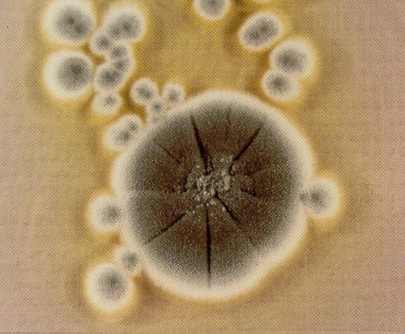
3. Microbes are used to produce Antibiotics
Mold
  Penicillium notatum (Penicillin)
1928 Alexander Fleming
4. Bacteria synthesize chemicals that our body needs, but cannot synthesize
Example: E. coli
  B vitamins - for metabolism
  Vitamin K - blood clotting
Escherichia coli
  Dr. Escherich
  Colon (intestine)

Slide 9
5. Biochemistry and Metabolism
Very simple structure
rapid rate of reproduction
provides “instant” data
6. Microbial antagonism
Our normal microbial flora prevents potential pathogens from gaining access to our body

Slide 10
7. Insect Pest Control
Using bacteria to control the growth of insects
Bacillus thuringiensis
  caterpillars
  bollworms
  corn borers
8. Bioremediation
Using microbes to clean up pollutants and toxic wastes
Exxon Valdez - 1989
2 Genera
  Pseudomonas sp.
  Bacillus sp.

Slide 11
9. Recombinant DNA Technology, Gene Therapy, Genetic Engineering
Bacteria can be manipulated to produce enzymes and proteins they normally would not produce
  Insulin
  Human Growth Hormone
  Interferon
10. Food Chains
Marine and fresh water microorganisms

Slide 12
Microbes do benefit us, but they are also capable of causing many diseases
Pneumonia Whooping Cough
Botulism Typhoid Fever Measles
Cholera Scarlet Fever Mumps
Syphilis Gonorrhea Herpes 1
Chlamydia Tuberculosis Herpes 2
Meningitis Tetanus RMSV
Strep Throat Lyme Disease AIDS
Black Plague Diarrhea Gangrene

Slide 13
History of the Study of Microorganisms
1665 Robert Hooke
  “little boxes” - “cells”
  Cell Theory - all living things are made up of cells

Slide 14
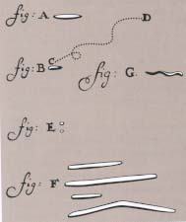
Anton van Leeuwenhoek 1674
- 1st person to actually see living microorganisms
“wee animalcules”

Slide 15
Spontaneous Generation
Theory that life just “spontaneously” developed from non-living matter
Example:
  toads, snakes and mice - moist soil
  flies and maggots - manure and decaying flesh

Slide 16
Experiments to disprove Spontaneous Generation
Francesco Redi 1668
Rudolph Virchow 1858
  Theory of Biogenesis
    Cells can only arise from preexisting cells
Louis Pasteur 1861

Slide 17
Francesco Redi’s experiments with meat
uncovered
covered
Maggots
No maggots
Disproved that maggots arise from decaying meat!!

Slide 18
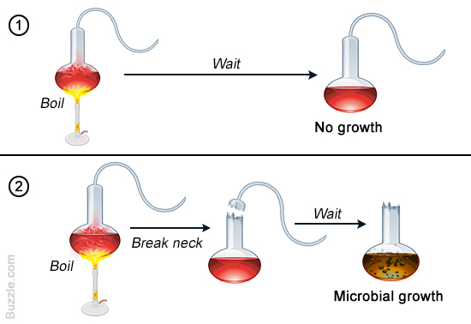
Louis Pasteur (1861)
Notes:
12

Slide 19
History (cont.)
1861 Pasteur
  Proved Microorganisms are present in nonliving matter
  Microbes can be destroyed by heat
    Aseptic Technique
Fermentation mediated by yeast, not air
  Pasteurization to prevent wine and beer spoilage (by bacteria)
Notes:
13

Slide 20
1857-Louis Pasteur saves France’s wine
Good wine contained yeast
Sour wine contained bacteria
  (Bacteria that use alcohol and produce acetic acid spoil wine by turning it to vinegar (acetic acid).
He reasoned that if wine is heated to destroy the harmful bacteria it wouldn’t spoil (process known as Pasteurization)

Slide 21
Ignaz Semmelweis
(1818-1865)
Taught medicine in Vienna
No one connected germs w/ disease yet
Puerperal fever “childbirth fever” caused 25-30% mortality
Nearby obstetric hospital had only a 2% death rate
Notes:
19

Slide 22
Ignaz Semmelweis (cont.)
He made some observations
Medical Students working on cadavers moved from the dissecting room to the maternity ward
Midwives
  Stayed only in maternity ward
Notes:
21

Slide 23
Ignaz Semmelweis (cont.)
Ordered students to wash hands and medical instruments in chlorinated lime
Mortality dropped to 1.3%
By 1848, 0% mortality
Notes:
22

Slide 24
Germ Theory of Disease
Pasteur proposed that wine spoiling in an analogy for disease (bacterial growth made the wine “sick”)
germ theory
  some diseases are caused by microorganisms

Slide 25
Germ Theory of Disease
Hard for people to believe that diseases were caused by tiny invisible “wee animalcules”
Diseases, they thought, were caused by:
  demons
  witchcraft
  bad luck
  the wrath of God
  curses
  evil spirits

Slide 26
Edward Jenner (country doctor)
  Milkmaid didn’t get smallpox b/c they contracted the milder form of cowpox
  Immune system cannot distinguish btw cowpox/smallpox
  Scratched a farmboy w/ a needle bearing fluid from cowpox
  Small pox Vaccine
    Vacca-cow
  Vaccination w/ cowpox provided immunity for smallpox
Notes:
16

Slide 27
Robert Koch
-1st to prove that bacteria actually caused diseases
1876
Microbial Etiology of Infectious Disease
  etiology - the cause of a disease
Established “scientific rules” to show a cause and effect relationship between a microbe and a disease
  Koch’s Postulates

Slide 28
Pure Culture
Key to Studying Microbes
Definition: Pure culture is a population of organism, all of which are the progeny of a single organism
-In nature, microbes almost never occur as pure cultures

Slide 29
Koch’s Postulates
1. The same organisms must be found in all cases of a given disease.
2. Organism can be isolated and grown in pure culture.
3. The isolated organism must reproduce the same disease when inoculated into another animal
4. The original organism must again be isolated from the experimentally infected animal.

Slide 30

Exceptions to Koch’s Postulates
1. Some organisms have never been grown in pure culture on artificial media
Treponema pallidum - Syphilis

Slide 31
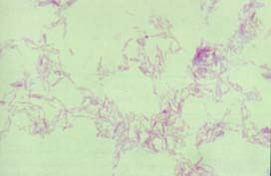
Exceptions to Koch’s Postulates
Mycobacterium leprae
Leprosy
Never been grown in pure culture on artificial media
Abdominal cavity of the Seven Banded Armadillo

Slide 32
Exceptions to Koch’s Postulates
In exclusively human diseases, it is not morally acceptable to inoculate a deadly pathogen into a “human guinea pig”
HIV

Slide 33
Koch established the Microbial Etiology of 3 important diseases of his day
1. Cholera (fecal-oral disease)
  Vibrio cholerae
2. Tuberculosis (pulmonary infection)
  Mycobacterium tuberculosis
3. Anthrax (sheep and cattle)
  Bacillus anthracis

Slide 34
Koch - 1st to use Agar to solidify culture media

Slide 35
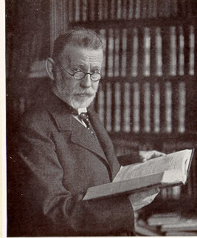
Paul Ehrlich-hospital dermatologist
Chemotherapy-Treatment using chemical substances
1910 Paul Ehrlich -”Magic bullet”
  Salvarsan (arsenic derivative)
    Preparation 606
      Syphilis
Notes:
17

Slide 36
Golden Age of Microbiology 1857 - 1914
Pasteur
  Pasteurization
  Fermentation
Joseph Lister
  Phenol to treat surgical wounds – 1st attempt to control infections caused by microoganisms
Robert Koch
  Koch’s Postulates
Edward Jenner
  vaccination
Paul Erlich
  1st synthetic drug used to treat infections
  Salvarsan - arsenic based chemical to treat Syphilis
    “salvation” from Syphilis

Slide 37
  Alexander Fleming 1928
  scottish researcher
Discovered Penicillin (fungus) by accident
Was convinced that nasal mucus had antibacterial effects
Left his Staphylococcus culture on an agar plate for 2 weeks-went on vacation-came back &found mold on his plate which prevented bacterial growth
  (a mycology lab underneath him had this rare spore drift)
Notes:
18

Slide 38
