Slide 1
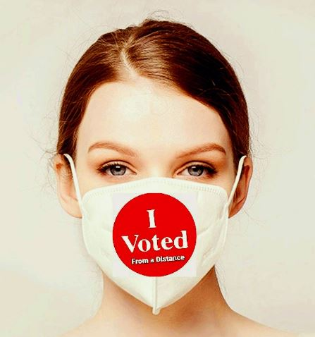
2020 County Election Administration Training Conference
2020 Elections
and SVRS
Let's make voting from a distance an easy choice

Slide 2
Much ado about elections…
Activating Elections in SVRS
  Regularly Scheduled
  Special Elections
Pre-Election Voter Maintenance
  County Checklist
Generating Rosters/Greeters Lists
  Generating
  Printing
  Pollbook Reports
Post Voting History
  Paper roster posting
  Electronic Rosters
  AB/MB History
  Rejected Late AB history
Processing EDRs
  Pending EDR's (ePollbook)
  Paper/Manual EDRs
  AB EDRs
Post-Election Work and Voter Maintenance

Slide 3
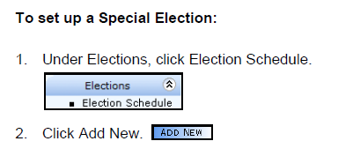
Activating Elections
State Primary and State General Elections are set up by OSS
Special Elections are “Initialized” by the home county of the district holding the special election
Regularly Scheduled Election dates:
  2nd Tuesday in February, April and May
  Initializing your election in SVRS serve as your Notice of Election to OSS
Notes:
Adam

Slide 4
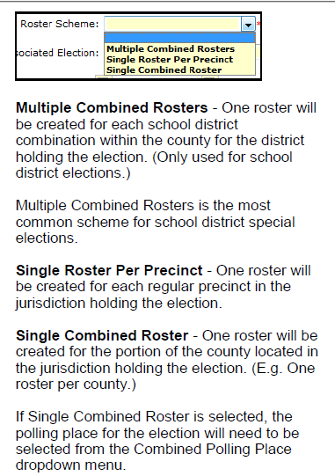
Election Set-up
Roster Schemes:

Slide 5
County Pre-Roster Checklist
Voter Registration maintenance – Process before generating rosters:
  Voter registration applications (Regular and Online) with an application date prior to the 21 day cut-off period
  DVS Pending Applications
  COA Express and Pending COA Un-precinctable NCOA and ERIC records
  DOH - SSA
  Court records (Court Express, Court Events)
  MDL/SSN verification
  Review show ID report
  Process returned PVCs
  Review potential duplicate report

Slide 6
Generating Rosters and Greeter's Lists
Election Schedule Checklist Tab
  Selecting your roster print preferences can be done as soon as the election is Active
  Marking your rosters “Ready To Build” – cannot be done until after the Voter Registration 21 day cut-off
Print Preferences
  County to print Rosters
  County to print Greeter’s Lists - greeter’s list must be printed if using ePollbook
  OSS to print Rosters/Greeter’s List
    Greeter’s list must be requested at the time rosters are built
    Allow 5 day business days for OSS to print and ship

Slide 7
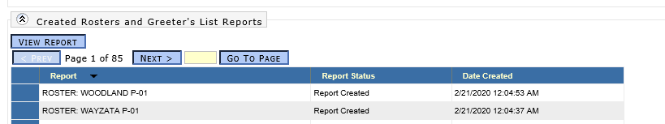
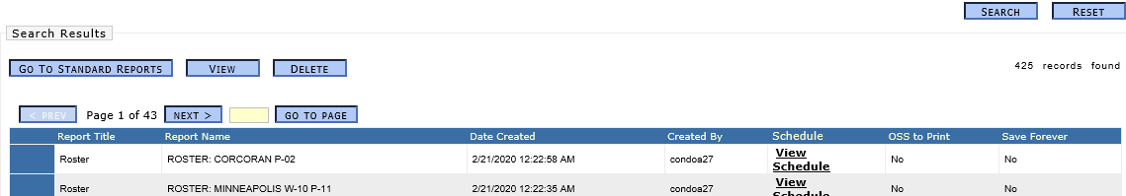
Roster/Greeter's List Printing
After the 21 day registration cutoff, click the Mark Ready to Build Rosters
A job runs every 4 hours starting at 8am that builds your rosters
Print rosters from Roster Print Preference Tab
Or, Print rosters from Saved Reports the day after they were marked ready to build

Slide 8
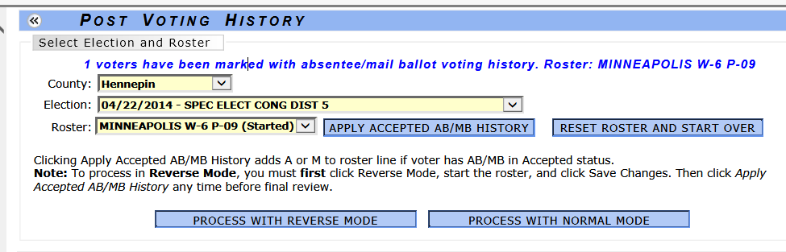
Post Voting History - Roster
Post Voter History module
  Reverse Mode adds history for all
  Normal Mode – only adds history for those you wand
  Paper roster posting - use the Express screen !
Select a roster and click Apply Accepted AB/MB
Only ABs that are in “Accepted” status will have history posted via the roster

Slide 9
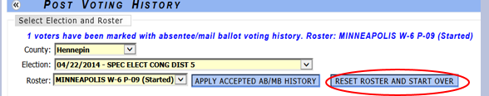
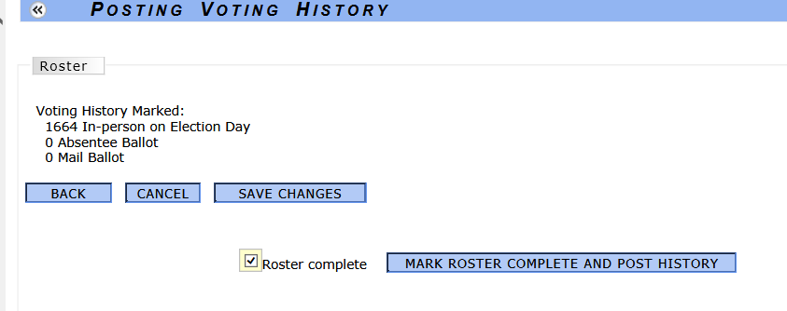
Post Voting History - Roster
  Clicking Reset Roster and start over removes all history for selected roster
  Reset your roster and start over can be used only if you have NOT marked your roster complete
  Verify voter history summary counts on last page of roster
  Once you have completed posting all votes and your total vote counts for that roster is verified you will need to close the roster by checking the Roster Complete box and clicking the Mark Roster Complete and Post History button

Slide 10
Post Voting History - Roster
History will not be posted to the voter's record until the following:
  You have checked the "Roster Complete" box
  The Process voter history job runs, which happens nightly at 12:30AM
Once a Roster is marked complete:
  Roster will not show up in the drop down list
  Corrections will need to be done manually through the voter’s record – Correct Voter History module
Posting Late AB History for Rejected Abs
  Rejected Abs do not get posted via Roster

Slide 11
Processing EDRs
Manual entry of EDRs
  Roster Precinct selection – selecting an incorrect precinct will result in Challenging a voter and queuing a Wrong Polling Place letter
  Search for an existing Voter
    If matching voter record is found, update their record
    If no matching voter record is found, add New Voter
    Voter History is posted immediately once record is submitted
EDR Absentee
    How to search
    Add/Update from AB Record

Slide 12
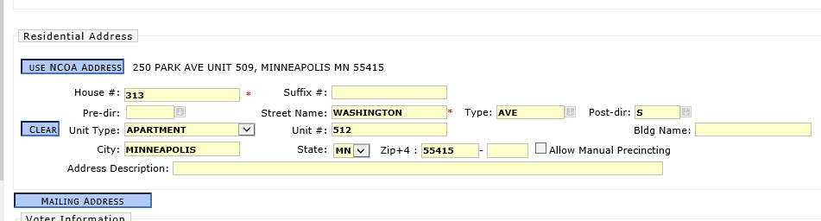
Processing EDRs
Processing EDR using COA Address button
  COA data is loaded the day after the election
  Check if COA address matches residential address
  Populate the residential address fields from the COA record
  Using the COA Address button will remove the COA record from the COA Express queue
  When all EDRs are processed for a precinct, click EDR complete checkbox

Slide 13
Processing Pending EDRs
Pending EDR's (ePollbook EDR files)
2018 post Election – A high number of Voter merges were processed due to updating the wrong voter from the Pending EDR queue
  New Pending EDR default search criteria has been added
Pending Late Registrations
  Automatically Registered the day after the election

Slide 14
Post-Election Work
Send PVCs to 3% random sample of EDRs
Complete all Roster History Posting
Process EDRs
All EDRs must be processed no later than 10 weeks after the election
Mark “EDR Complete” for all precincts
Mail Wrong Polling Place letters
Process returned PVCs – Track “Undeliverable” EDR PVCs

Slide 15
Post-Election Work
Run “EDR/PVH Statistics” Report - verify record counts
Run “Voters Updated Due to Voting” Report
Run “Voter Records with Duplicate History” Report
Run “Potential Duplicate Voter Records” Report
Post Late AB/MB History
Mail Rejected AB Post-Election Notices
Process DOH records
Process Court/DOC records
Process Online/DVS applications
Process COA queued records

Slide 16
We are your biggest fans and we
THANK YOU !!!
Questions…comments…concerns ??
Email: elections.dept@state.mn.us
From our 6 feet to yours,
The OSS Elections Team

