Slide 1




Honors World History
Miss Colleen Bonner | Fall -2017
….…………………………………………………………………………………………………………………………………………………………………………………………….
Course and Contact Information:
Email and Phone Ext.:
colleenbonner@Johnston.k12.nc.us
(919) 934-7333 Ext. 5934
Room # 240
Schedule:
1st Block:
Planning
2nd Period:
Honors World History
3rd Block:
Honors World History
4th Period:
Honors World History
Tutoring:
Tuesday and Thursdays- 2:30-3:00 p.m.
All other times by appointment only.
Google Classroom Codes:
Honors: ahlhk6
Standard: 823zvb
Course Description:
World History is a survey course and a continuation of the K-8 core curriculum beginning with the Neolithic Revolution and concluding with the Modern Era. Students will assess the impact of political, social, economic, and cultural changes on individual societies as well as the scope of history as a whole.
What We Will Study:
Basic World Geography, Dating (CE/BCE), Terminology, Prehistory
Ancient Near East – Mesopotamia/Fertile Crescent, Persia/Egypt
India & China
Greece
Rome
The Middle Ages – Europe (Dark), Asia, Africa
The Renaissance
Age of Exploration Mesoamerica & South America
European Monarchy/ Enlightenment/French Revolution
Industrial Revolution and Imperialism
Nationalism, WWI, Interwar Years, Great Depression, WWII and Post-WWII Europe and Asia
Cold War
Today’s World - Globalization
……………………………………………………...............................................
….…………………………………………………………………………………………………………………………………………………………………………………………………….
Assignments and Grading:
Honors- 45%
Summative Assessments: Unit Tests, Project Based Learning Unit Presentations, Simulations
Honors- 25%
Formative Assessments: Quizzes of Both Vocabulary and Content, Project Based Learning Step Assessments,
Guided Notes, Vocabulary, Other Assorted Assignments
Honors- 30%
Interactive Notebook and Classwork: Organized and Completed Notebook and all Classwork Activities.
The difference in grade weights between Honors World and Standard World
Honors- 45%+25%+30%= 100%
Standard- 40%+30%+30%= 100%

Slide 2


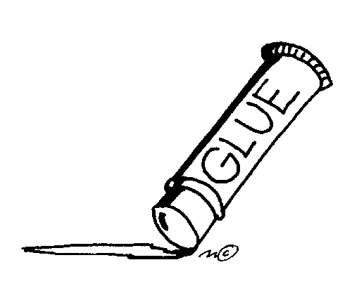


Classroom Policies and Procedures:
….…………………………………………………………………………………………………………………………………………………………………………………………….
FOLLOW INSTRUCTIONS. This includes those given by me, administrators, and staff. Please ask me for help on something you don't understand. I won't do your work for you but we're in this together-- Teacher, Student, and Parent. I'll do my best to be clear and concise, but you must PAY ATTENTION.
COME TO CLASS ON TIME, PREPARED WITH ALL REQUIRED MATERIAL. Always assume that you need your notebook, pen, and pencil despite any special schedule. ** Be in your seat before the bell rings. This means book bags off desks, notebook out ready to work. Being late can hurt you grade.
TURN IN YOUR ASSIGNMENTS ON TIME. It is your responsibility to keep up with your work. Grades can drop 5-10 points for everyday late. Assignments not turned in will receive a 1 in the gradebook.
ALLOW STUDENTS TO LEARN AND TEACHERS TO TEACH. I'll treat you with respect and consideration and it's expected that you will treat peers and adults in a courteous and respectful manner. Adopt an attitude of a scholar. This classroom is ours, not mine or yours.
KEEP THE CLASSROOM (and desks) CLEAN. Before leaving class check your area. Pick up paper and return furniture to its original place unless otherwise instructed. Put trash in the trash can.
ETHICAL BEHAVIOR. Do your own work. Work that has been copied from others or plagiarized will not be accepted. **** Cheating on tests will result in a zero on that test and parental contact.
**For specific classroom procedures, please view the classroom procedures PowerPoint posted on my Google Classroom website.**
Absences and Tardiness:
More than four absences in a term and more than eight absences in a semester will put you at risk of failing the class.
Please refer to the Johnston County Public Schools policy on what counts as an excused absence. A note from a parent after an absence does not make the absence excused.
The absence will still count towards the student's total absences and could impact the student's final grade.
Make Up Work
● Check out what you may have missed on Ms. Bonner’s Google Classroom site.
● You have the same amount of time you were absent to turn in your work after you return (i.e. one day absent = one day to turn in assignment).
● Write “ABSENT” and the date you were gone at the top of all make-up work.
● If you know you are going to be absent in advance, ask me for work ahead of time.
Supplies:
A college ruled five subject notebook
A two pocket folder
Black and blue pens and #2 pencils
Glue sticks/ clear tape optional (but helpful)
….……………………………………
Technology Policy:
Please refer to the policy posted on my West Johnston School website and around the classroom regarding use of technology and Bring Your Own Device programs.
All other classroom policies and procedures are posted on the Policy and Procedures 2017-2018 PowerPoint.
Students and parent should view that together before signing the behavior contract. The students will view it in class on the first day of school.
…………………………………………………………………………………………………………………………………………..….
……………………………………………………..................................................................................................
….…………………………………………………………….
Welcome
to
World History!
Let me know if I can help you in anyway!

