Slide 1
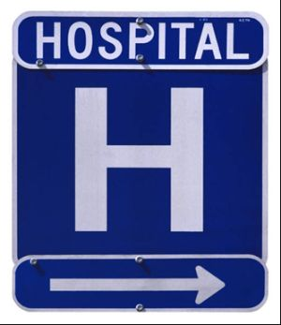
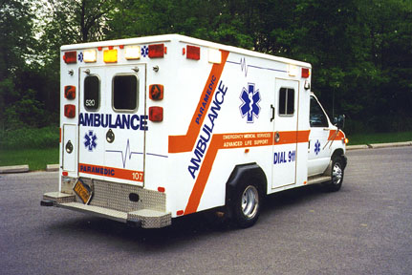

Slide 2
Health Care System
Medicine has been around for thousands of years. Hippocrates is known as the father of Western medicine as far back as the 4th century B.C. The healthcare system as we know it is much younger with advancements in technology and better understanding of diseases and medications todays medicine is roughly just 50 years old
Medicine has been practiced in some form or another since humans have been living.
Different cultures believed in different ways of treating illness, some believed that sickness was a result of the moods of the gods, others tried to use reasoning to explain sickness

Slide 3
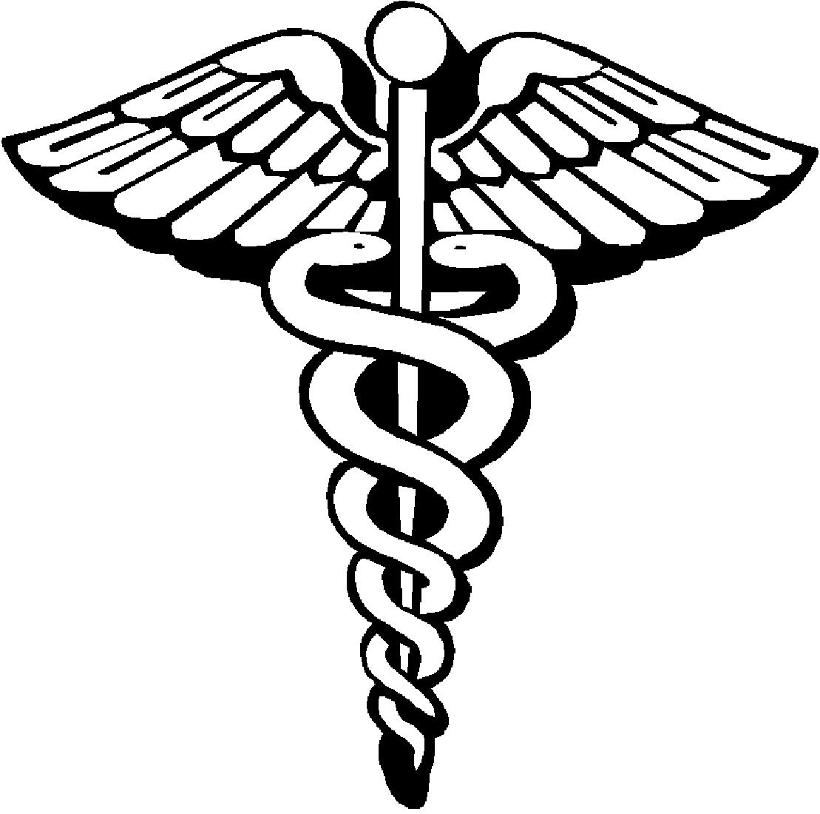
Healers in ancient times used natural remedies like diets, rest, and medicines made from herbs and plants.
Religion has always been a big part of healthcare. The symbol we use today is linked with ancient times the Greek god of healing was symbolized by the snake. This evolved into what today we know as the caduceus

Slide 4
Medicine in the Middle Ages
Period from A.D. 500-1500
Reason began to replace spiritual or superstitious causes for illness
Barbers cut more than hair in the middle ages. Known as Barber-surgeons, they performed surgery to treat cataracts, and practiced phlebotomy. Many served in military and treated injuries
Amputated limbs with burned stumps to seal blood vessels
The barber pole we see today looks similar as it did in this time period when Barbers would do an operation the bandages would be hung on a pole and sometimes placed outside as an advertisement

Slide 5
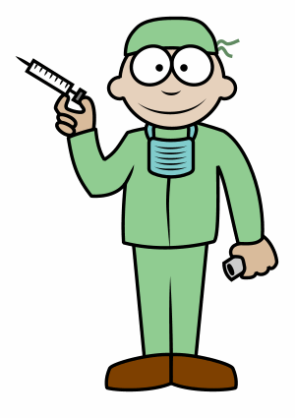
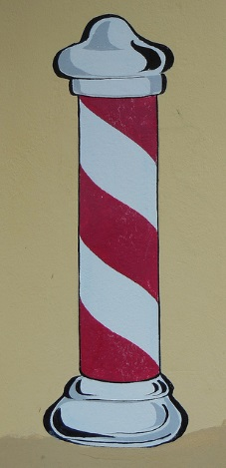
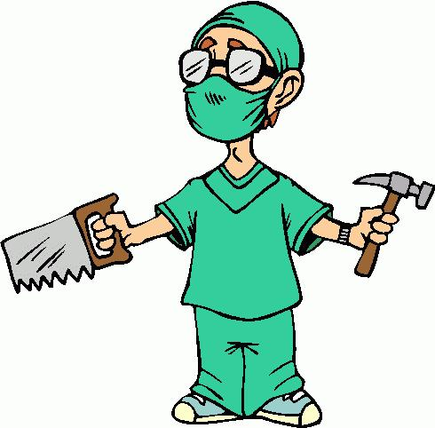

Slide 6
Medical regulation began in the middle ages
Physicians were licensed after training with experienced doctors
Difference between physician and surgeons
Women weren’t allowed to practice medicine
Religion continued to play a big role in medicine with many religious leaders calling for the care of the sick and dyeing

Slide 7
Medical practice went through many changes
The invention of the printing press made it possible to publish books faster thus spreading knowledge faster and made it more readily available
During the 16th century the scientific method came into use, this changed the way people thought about medicine
This allowed the acquisition of new knowledge
Instead of using guess work or supernatural events to explain diseases, people began to look for the cause based on what they could see around them

Slide 8
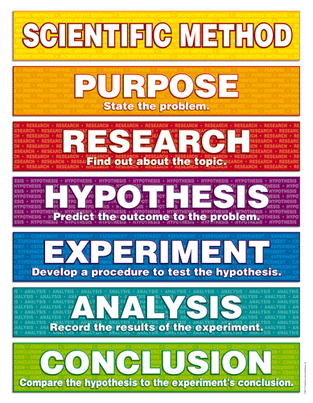
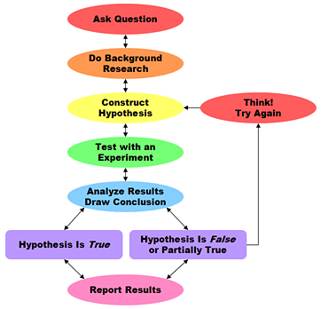

Slide 9
Scientific method based on observation and taking careful notes, this was not common in the Middle Ages
The microscope was invented which allowed observation of clients and symptoms
Robert Hooke built one of the first microscopes

Slide 10
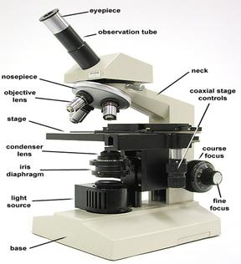

Slide 11
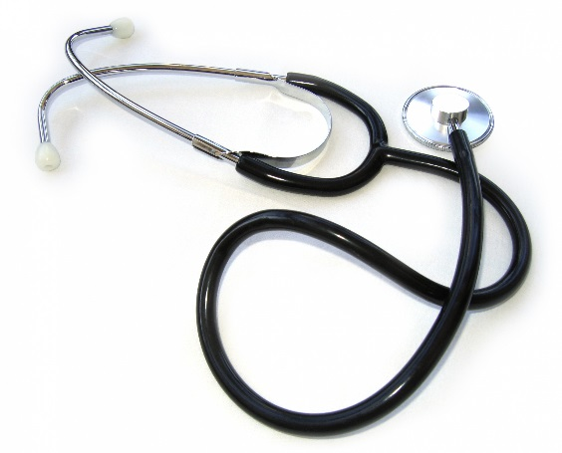
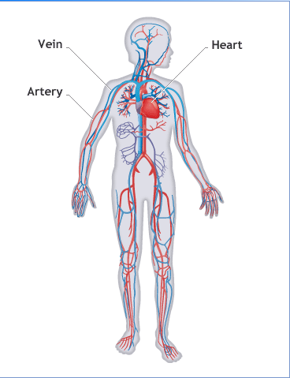
During the Industrial Revolution medicine experienced huge advancements
The stethoscope was introduced, as well as the microscope
This allowed for visualization of blood cells, bacteria, and protozoa
Doctors realized that blood was carried through the body by large vessels but they didn’t understand how it circulated through the body this of course was explained with the discovery of capillaries

Slide 12
Edward Jenner (1749-1823) helped make the connection between health and the environment. Jenner discovered that milkmaids exposed to cowpox did not get smallpox . In 1796 he began inoculating people and thus vaccinations were born
Louis Pasteur (1822-1895) Father of microbiology
Joseph Lister (1827-1912) was ridiculed for insisting people use soap to disinfect instruments and clean hands before the Doctor moved from one Pt to another
Today this is known as medical asepsis and is the stand of care today

Slide 13
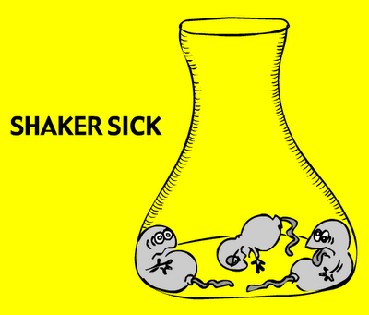
Robert Koch (1843-1910) discovered that pathogens(disease causing microbes) are the source of some diseases and proved that Lister was correct in his recommendations
This ushered in the era or modern microbiology and the use of anesthetic thus making surgery possible

Slide 14
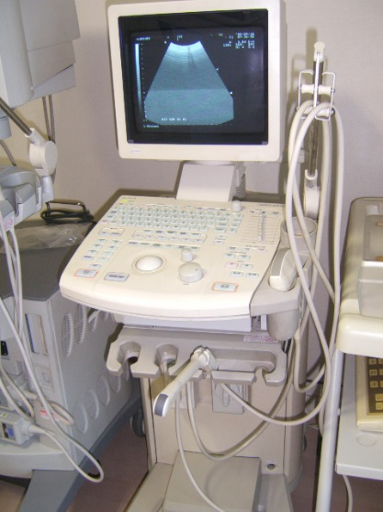
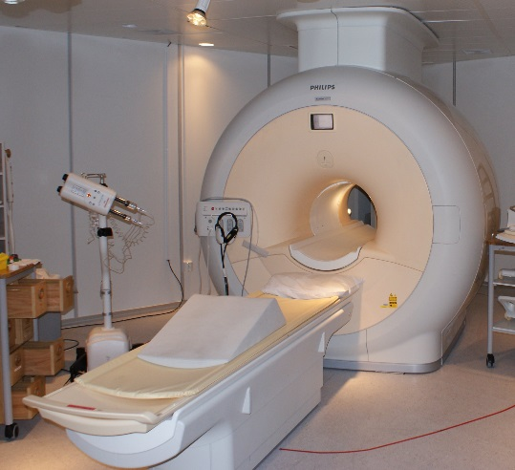
Modern Healthcare
20th century had rapid growth with discoveries in electronics and computer science changed clinical medicine
Antibiotics were invented, Radium for cancer treatments, X-rays gained importance in diagnoses
Axial tomography(CT scan), magnetic resonance imaging(MRI), and ultra sound or sonographic imaging had improved diagnosis and treatment for many diseases

Slide 15
Today organ transplants are common. Research has found a way to grow certain body systems artificially
In vitro fertilization allows couples to have children when they are infertile
Todays healthcare workers need to be able to think critically and be flexible with approaches in Pt care and treatment. The field has and will continue to be forever changing and adapting to todays fast paced world

Slide 16
Health Care Facilities
Ambulatory Care and Outpatient Surgery- these are facilities where the Pt can simply walk in the morning for a procedure and walk out that afternoon(out Pt)
Home Health Care- a member of a healthcare team comes out to a Pt residence and does in home care for that Pt
Hospitals-Pt typically require closer monitoring and care for an extended period of time
Religious, Private, and Nonprofit Hospitals
Long term care(nursing homes/assisted living)- typically an environment were Pt live full time. In certain instances this could be weeks during a rehab assignment or a permanent arrangement

Slide 17
Other medical components to the healthcare system are
Practitioner's offices
Clinics
Laboratories
Emergency Medical Services(EMS)
Rehabilitation
Hospice

Slide 18
Number of deaths and births in a nation affect the overall age of its population
The median is 37.1 y/o
Males 35.8 y/o
Females 38.5 y/o
In 1980 the median ages were as followed
Median Age 30.0
Males 28.8
Females 31.3

Slide 19
Paying for healthcare
Medicare- provides health insurance to people 65 y/o and older, and those who are disabled
Medicaid- health insurance for low income people also included are the elderly, blind, disabled on government income, low income pregnant women, and certain people with low income and high medical expense
Managed Care-specifies specifically what and how much a person can spend on a certain procedure
Worker’s Compensation- if a person is hurt doing their job the company they are working for has to pay for medical expenses

Slide 20
Levels of care
Preventive care- bp and ca screenings
Primary care(health promotion)- prenatal care, family planning, daily exercise
Secondary Acute Care- emergency care, radiological procedures
Tertiary Care- intensive care
Restorative care- cardio/pulmonary rehab
Continuing care- assisted living

Slide 21
Issues in health care delivery
Competency-Ongoing CEU, and furthering ones education is necessary in today’s healthcare field
Evidence-Based Practice-the integration of best knowledge, which includes clinical expertise, best research evidence, and Pt values
Quality Health Care- The level of care we provide our Pt’s and the level of care the Pt feels is different and needs to be equal on both sides
Pt satisfaction- it is important that the level of care we provide meets or exceeds the Pt’s expectations while receiving services

Slide 22
