Slide 1
Greek Medicine

Slide 2
History of Greek Medicine
Before Hippocrates, medicine was based on myths
  Treatment was based on religion and rituals
When Hippocrates lived, science became a more prominent role of medicine
  Sickness was now viewed as part of the natural world
  Doctors looked at diet and lifestyle instead of saying an illness was due to astrology or the gods
Greek physicians became innovators of health and medicine

Slide 3
Hippocrates Biography
Born in a Greek island named Cos at around 460 B.C.
  Cos was known for its medical school
Born into a family of medical background
  Father and grandfather were physicians
After his parents died, he traveled throughout Greece and Macedonia
  Learned under many great thinkers of Greece
  Advised many cities on how to fight diseases and plagues
Later returned back to Cos to teach medicine
Died in 377 BC

Slide 4
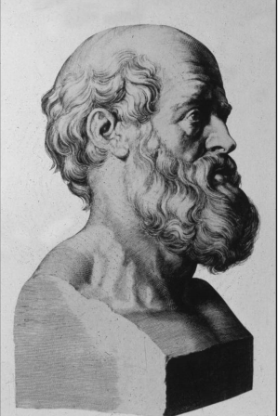
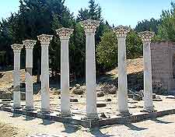
Hippocrates
Fig 2. Remains of Medical School in Cos
Fig 1. Hippocrates

Slide 5
Hippocrates’ Legacy and Contributions to Greek Medicine
Considered “father of Western medicine”
Hippocrates used a scientific approach to medicine which paved the new standard of medical practice
  Also based medicine off philosophy and was inspired by the popular philosopher group, the Pythagoreans
  Used the three fundamental principals of observation, experience and rationale.
Hippocratic Corpus- collection of writings under his name
  Cover a wide variety of topics including, general medicine, environmental medicine, treatments, theories of diseases, and remarks about human physiology
Opened the idea that water and air can cause sickness, and stressed the idea of a proper diet
Worked in many areas of health, and created many new ideas
He introduced numerous medical terms universally used by physicians, including symptom, diagnosis, therapy, trauma and sepsis

Slide 6
Four Humors
Hippocrates based the four humors from the four elements of nature (water, earth, wind and fire)
  The four humors are black bile, yellow bile, phlegm and blood
The state of good health is reliant on a balance of all four humors
  Physicians must rebalance the humors for a sick patient in order to help with healing
  This is where Hippocrates idea of examining the patient, observing symptoms, and finding a diagnosis before treatment becomes important

Slide 7
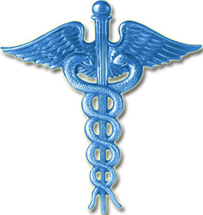
Hippocrates Oath
Today, physicians take the Hippocratic Oath before they began their medical career
Set of ethical standards they swear to follow
  Treat fellow employees with respect
  Patient’s needs are a priority
  Never harm a patient
  No unprofessional relations with a patient
Fig 2. Oath Symbol

Slide 8
Impact of Hippocrates
Hippocrates helped develop medicine to what it is today
During his life, diseases and sickness became more common, so his practice of using science helped improve health care
Developed professional standards

Slide 9
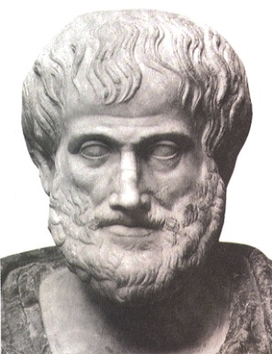
Other Famous People in Greek Medicine and Their Contributions
Homer:
  Homer was the earliest source of medical knowledge in Greece.
  Within the Iliad, Homer mentions nearly 150 different wounds.
  Homer also barely described the treatment of wounds.
  Aristotle:
    Was very influential because of his critical observations of natural phenomenon, and provided methods of scientific experimentation and investigation.
Fig 3. Aristotle

Slide 10
Collective Greece Contributions
The Greeks created medical schools.
  As early as 500 BC, a man named Alcameon (who also discovered the optic nerve) created a medical school around the Mediterranean colonies in Greece.
The Greeks discovered that the heart functioned like a pump that sent blood throughout the body.
The Greeks also discovered that the brain was the center of the nervous system.

Slide 11
Works Cited
D'Angour, Armand. "Ancient And Modern." History Today 62.2 (2012): 6. MasterFILE Premier Web. 18 Aug. 2013.
Downey, Ed. "Hippocrates Of Cos." Hippocrates Of Cos (2006): 1. MAS Ultra - School Edition Web. 18 Aug. 2013.
Emmanouil Magiorkinis, et al. "Health And Disease In Ancient Greek Medicine." International Journal Of Health Science 1.2 (2008): 32-36. Academic Search Premier. Web. 18 Aug. 2013.
Falagas, M. E. "Science in Greece: From the Age of Hippocrates to the Age of the Genome." The FASEB Journal 20.12 (2006): 1946-950. Print.
Magiorkinis, Emmanouil, Aristidis Diamantis, and George Androutsos. "Gods And Heroes Of Medicine In Greek Mythology." Archives: The
International Journal Of Medicine 1.3 (2008): 144-147. Academic Search Premier. Web. 18 Aug. 2013.
Markel, Howard. "“I Swear by Apollo” — On Taking the Hippocratic Oath." New England Journal of Medicine 350.20 (2004): 2026-029. Print.
Orfanos, C. E. "From Hippocrates To Modern Medicine." Journal Of The European Academy Of Dermatology & Venereology 21.6 (2007): 852- 858. Academic Search Premier. Web. 18 Aug. 2013.
Scarborough, John. "Hippocrates And The Hippocratic Ideal In Modern Medicine: A Review Essay." International Journal Of The Classical Tradition 9.2 (2002): 287-297. Academic Search Premier. Web. 18 Aug. 2013.
Yapijakis, Christos. "Hippocrates of Kos, the Father of Clinical Medicine, and Asclepiades of Bithynia, the Father of Molecular Medicine." In Vivo 23.4 (2009): 507-14. Web. 18 Aug. 2013. <http://iv.iiarjournals.org/content/23/4/507.full>.

Slide 12
Photograph Citations
Fig 1.
Hippocrates. 1. Photograph. Health and Disease in Ancient Greek Medicine. 6th ed. Vol. 21. N.p.: n.p., n.d. 852-58. EBSCO. Web. 22 Aug. 2013. <http://web.ebscohost.com.lib.chandleraz.gov/ehost/pdfviewer/pdf viewer?vid=3&sid=e233a63c-01ef-4995-8461- 3e70be23265a%40sessionmgr4&hid=112>.
Fig 2.
Kos Medical School. N.d. Photograph. Kos, Greece. Kos. Web. 22 Aug. 2013.
Fig 3.
The Hippocratic Symbol. 2008. Photograph. Morality in the Healthcare System. Web. 22 Aug. 2013.
Fig 4.
Aristotle. N.d. Photograph. Huffington Post. 27 Oct. 2012. Web. 22 Aug. 2013.

