Slide 1
Quarter 3
Grammar Focus
PERRY HIGH SCHOOL 2014
Authors: Lindsey Tillman & Lindsay Hartgraves

Slide 2
Lesson 1: Phrases and Clauses
PERRY HIGH SCHOOL 2014
Authors: Lindsey Tillman & Lindsay Hartgraves

Slide 3
Clauses
A CLAUSE is a group of related words that has a subject AND a verb.
While a PHRASE has ONLY a subject OR a verb… OR neither.

Slide 4
Guided Practice
Label the following as a phrase or a clause.
At the store
She ran away
Although I like cake
Quickly running
The bright smile
On the roof of the house
Over the top
Because I said so
Phrase
Clause
Clause
Phrase
Phrase
Phrase
Phrase
Clause
Nice Job!! ☺

Slide 5
Extra Practice
In your notes, copy down the following groups of words. Write a “P” if it is a phrase and a “C” if it is a clause.
He works very hard every day
After a good day
If I need to call you
In a dark dangerous hallway
Before the next light
This car’s not working

Slide 6
Independent Clauses
Main Clause
Can stand alone as a sentence
Can be joined to another clause
Example: Fred filled a cardboard tube with gunpowder.

Slide 7
Dependent Clauses
(Subordinate clause)
Cannot stand alone as a sentence
Often uses subordinate conjunctions
Because he wanted to make his own firecrackers.

Slide 8
Subordinate Conjunctions
After, although, as, because, before, directly, if, like, once, since, till, unless, until, when, whenever, where, while, which

Slide 9
Guided Practice
Label the following clauses as independent or dependent.
I really love grammar
Since I ran 5 miles
Although I go to Perry
I am going to the Homecoming dance
Henry loves to give hugs
Bobby was absent this week
Kayla is switching schools
Until I know how to swim
Independent
Dependent
Dependent
Independent
Independent
Independent
Independent
Dependent
You’re the Best!! ☺

Slide 10
Extra practice
Independent or dependent clause?
Copy down the following clauses. Write “I” for independent or “D” for dependent.
Because it’s the best solution
It doesn’t really interest me.
After the movie is over.
If he ever calls.
There could be a problem.
Since the last time they visited.

Slide 11
Grammar Writing Activity
Write a paragraph informing your reader about your god/goddess:
Underline two independent clauses and circle two dependent clauses.

Slide 12
Lesson 2: Compound and Complex Sentences
PERRY HIGH SCHOOL 2014
Authors: Lindsey Tillman & Lindsay Hartgraves

Slide 13
#1: Simple Sentence
A simple sentence has one subject and one verb
    I like to study grammar.
A simple sentence is also called an independent clause.
An independent clause ends with a period or semicolon.

Slide 14

Simple sentence
One subject
I love you.
One verb
Independent clause: only one subject and one verb

Slide 15
#2: Compound Sentence
A compound sentence is made up of two or more simple sentences joined by one of the following:
    A comma and one of the FANBOYS
      I like to study grammar, and I love this class.
    A semicolon
      I like to study grammar; I love this class.
    A semicolon and a transitional
      I like to study grammar; therefore, I love this class.

Slide 16
Coordinating Conjunctions
What are Coordinating Conjunctions?
F- For
A- And
N- Nor
B- But
O- Or
Y- Yet
S- So

Slide 17
Conjunctive Adverbs (Transitions)
therefore
however
nevertheless
consequently
Furthermore
For example
thus

Slide 18

Compound sentence
Independent clause
I love you; therefore, you love me.
Independent clause
Two independent clauses joined together

Slide 19
Comma Splice
is the INCORRECT use of a comma to join two independent clauses.
INCORRECT: I love you, you love me.
CORRECT: I love you, so you love me.
CORRECT: I love you; you love me.

Slide 20
Complex Sentence
A complex sentence is a simple sentence (independent clause) to which a part of a sentence (dependent clause) has been added.
  Because I like to study grammar, I love this class.
  I love this class because I like to study grammar.

Slide 21
Complex sentence
Dependent clause
Because you love me, I love you.
Independent clause
A dependent clause joined to an independent clause. (The dependent clause needs the rest of the sentence for support.)

Slide 22
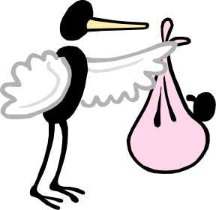
Dependent clause
Fragment!
Because you love me.
A dependent clause contains a subject and verb. It begins with a subordinating conjunction, and thus it does not express a completed thought.
A dependent clause is also called a subordinate clause.
Dependent clauses, like babies, cannot stand alone.

Slide 23
Common Subordinating (Dependent) Conjunctions
after | even if | now that | that | where
although | even though | once | though | whereas
as | if | rather than | unless | wherever
as if | whenever | since | until | whether
because | in order that | so that | when | which
before |  | than | in case | while

Slide 24
Guided Practice
Label the following clauses as compound or complex.
I really love grammar, and I am not lying.
Since I ran 5 miles, I lost 1 pound.
Although I go to Perry, my brother goes to Basha.
I am going to the dance, and I have a date.
Henry loves to give hugs, but not to me.
Bobby was absent, and he missed the test.
Kayla is switching schools since she is moving.
Until I know how to swim, I won’t go surfing.
Compound
Complex
Complex
Compound
Complex
Compound
Complex
Complex
You’re the Best!! ☺

Slide 25
Grammar Writing Activity
Write a paragraph explaining who your hero is and what characteristics he/she possesses.
Underline two complex sentences and circle two compound sentences. Be sure they are punctuated correctly.

Slide 26
Lesson 3: Compound/Complex Sentences
PERRY HIGH SCHOOL 2014
Authors: Lindsey Tillman & Lindsay Hartgraves

Slide 27
#4: Compound/Complex Sentence
A compound/complex sentence is the last and most complicated type of sentence.
It contains at least one dependent clause and at least two independent clauses.

Slide 28
Compound complex sentence
Dependent clause
Because we are a family, I love you, and you love me.
2 independent clauses
A dependent clause added to two or more independent clauses

Slide 29
Guided Practice – Make each of these a compound complex sentence
Using different types of sentences is easy!
I love watching volleyball because my sister plays on the team.
The author suggested.
Taking a stand against an injustice is not always easy.
This quarter we are examining heroes.
Odysseus is the hero of the Odyssey.

Slide 30
More Guided Practice – Label each with the TYPE of sentence.
1. The teacher walked into the classroom, greeted the students, and took attendance.
2. Juan played football while Jane went shopping.
3. Juan played football, yet Jim went shopping.
4. Although Mexico has a better team, they lost the tournament, and their more aggressive style did not pay off.
5. The island was filled with many trails winding through the thick underbrush, a small lake, and dangerous wild animals.
6. Naoki passed the test because he studied hard, but Stacy did not understand the material.
Simple
Complex
Compound
Compound/Complex
Simple
Compound-Complex

Slide 31
Grammar Writing Activity
Write a paragraph explaining the characteristics of a fictional superhero?
You MUST include two compound-complex sentences and properly punctuate them. Highlight both sentences in your paragraph.

Slide 32
Lesson 4: Commas
PERRY HIGH SCHOOL 2014
Authors: Lindsey Tillman & Lindsay Hartgraves

Slide 33
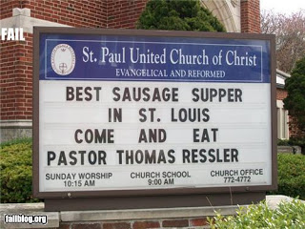

Slide 34
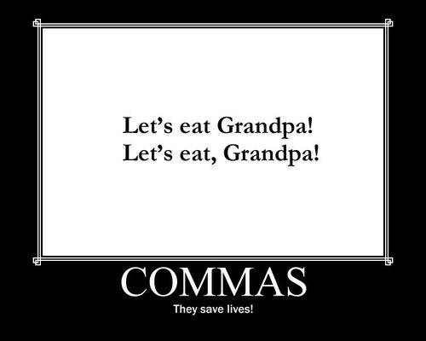

Slide 35
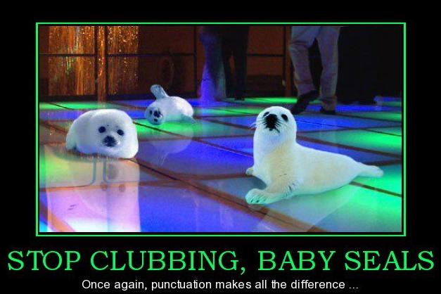

Slide 36
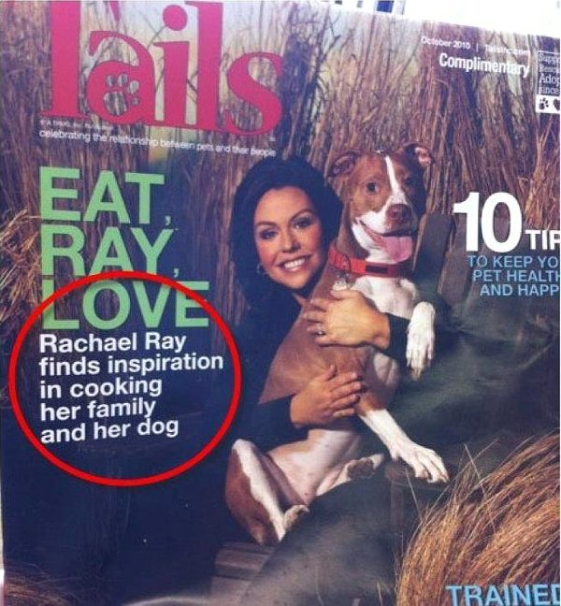

Slide 37

Commas can change an entire sentence.

Slide 38
Rule 1:
Use a comma to separate 3 or more items in a list. Use a comma before the conjunction that separates the list.
*Remember an “item” may refer to a noun, verb, phrase, or clause.

Slide 39
Rule 1:
Use a comma to separate 3 or more items in a list. Use a comma before the conjunction that separates the list.
Example: I need to buy eggs, milk , and bread at the store.
Example: This weekend I plan to run , skate , and jump at the park.

Slide 40
Rule 2:
Use a comma to set off an interjection that begins a sentence.
Example: Ahhhhhh, I love commas!

Slide 41
Rule 3:
Use a comma to set off direct quotations.
Example: “We need to buy more sugar,” she said, “before it runs out!”Example: “I am tired,” he muttered.

Slide 42
Rule 4:
Use a comma to separate items in dates and addresses.
Example: Today is Thursday, April 18, 1943

Slide 43
Rule 5:
Use a comma before a coordinating conjunction to link 2 independent clause.
Example: I want to buy the new jacket, but it is too expensive.

Slide 44
Rule 6:
Use a comma to separate a dependent clause (incomplete thought) from an independent clause.
Example: Without water, the plant will die.

Slide 45
Rule 7:
Use commas to separate a word or phrase from the rest of the sentence. *Appositive – noun or noun phrase that renames another noun.
Example: I am ready for my dad, who is sitting on the sofa, to make me some food.
Example: My brother, a 26 year old male, is watching TV.

Slide 46
Rule 8:
Use a comma to separate two or more adjectives that modify a noun individually.
Example: Finding an honest, intelligent leader has been impossible.

Slide 47
Rule 9:
Use a comma to set off transitional device.
Example: Terry Hale, for example, was not successful because he insisted on taking short cuts.

Slide 48
Rule 10:
Use a comma to set off conjunctive adverbs (combines 2 independent clauses).
Example: Leslie Feder is playing a strong game; therefore, he is likely to be named player of the game.

Slide 49
Compare and contrast a transitional device and conjunctive adverb.
Transitional
Device
Conjunctive
Adverb

Slide 50
Guided Practice – Add the necessary commas to the following sentences.
  I need to visit my mother wash my car and buy six stamps.
  Well I hope the problem will be fixed soon.
  “Okay” spoke the teacher excitedly “Time’s up!”
  September 11 2001 is a date that will be remembered.
  Terry is working on a project and he should be finished with it next week.
  If I get a new job I will be very happy.
  Emily Thorne who has a secret moved into the Hamptons.
  Perry High got a new fierce mascot.
  For instance the physics teacher has class of only 12.
  I have to make weight for wrestling therefore I cannot have that muffin.

Slide 51
Grammar Writing Activity
Write a paragraph(s) explaining what characteristics do “real life” heroes and fictional superheroes share?
You MUST use all at least 4 different comma rules in your response (excluding rule #4). Label each rule in your paragraph.
Get your agenda for signature check
Grab a lit. book

Slide 52
Lesson 5: Semi-Colon
PERRY HIGH SCHOOL 2014
Authors: Lindsey Tillman & Lindsay Hartgraves

Slide 53
Our friend the semicolon
Semicolons help connect closely related ideas when a style mark stronger than a comma is needed. Using semicolons effectively helps to make writing sound more sophisticated.
There are 3 instances when using a semicolon will improve conventions in writing.

Slide 54
#1: Link 2 Independent clauses to connect closely related ideas
Lynn and Pat are friends. Every week they get coffee.
Becomes……
Lynn and Pat are friends; every week they get coffee.

Slide 55
#2: Link clauses connected by conjunctive adverbs/transitional phrases
Kim never exercises. She is very out of shape.
Becomes…..
Kim never exercises; consequently, she is very out of shape.

Slide 56
#3: Link lists where the items contain commas to avoid confusion between list items
There are basically two ways to write: with a pen or pencil, which is inexpensive and easily accessible; or by computer and printer, which is more expensive but quick and neat.

Slide 57
Now you try. Re-write the following sentences using semi-colons.
  I like cows. I hate the way they smell.
  I like cows: they give us milk, which tastes good, they give us beef, which also tastes good, and they give us leather, which is used for shoes and coats.
  I only eat grass fed beef. Feeding cows corn is unnatural.
  Write your own sentence about football using a semicolon and a conjunctive adverb/transitional phrase. ☺

Slide 58
Grammar Writing Activity
Write a paragraph summarizing the obstacle/s you’ve had to face in your mythological journey narrative.
You MUST properly use TWO semicolons and highlight them in your paragraph.

Slide 59
Writing Titles Correctly
PERRY HIGH SCHOOL

Slide 60
How to Write Titles Correctly
Why would we underline, italicize, or put quotes around titles in any work?

Slide 61

How to Write Titles Correctly
Before the advent of computers and word-processing programs, there were only two options available when punctuating a title: underlining or quotation marks.
When computers started to become more commonplace, a third option - italicization - was added as an alternative to underlining.

Slide 62
When do I underline/italicize?
Italics and underlining generally serve similar purposes.
However, the context for their use is different. When handwriting a document--or in other situations where italics aren't an option--use underlining.
When you are word processing a document on a computer, use italics.

Slide 63
The Rules – MLA - Use Quotation Marks
Use quotation marks around the titles of:
  short poems
  song titles
  short stories
  magazine or newspaper articles
  Essays
  Speeches
  chapter titles
  short films
  and episodes of television or radio shows.

Slide 64
The Rules – MLA - Use Italics/Underline
Italicize the titles of:
  Magazines
  Books
  Newspapers
  academic journals
  Films
  television shows
  long poems
  plays of three or more acts
  Operas
  musical albums
  works of art
  Websites
  individual trains, planes, or ships. (cause why not ☺)

Slide 65
General Rule: Big Things/Little Things
One way of looking at titles is to determine if it belongs to something that is big or something that is little.
A big thing is something that contains little things. For example, a CD album contains many songs. A book contains many chapters. A web site contains many web pages. A TV series contains many episodes. Etc.
  Big thing (container) = italicize/underline
  Small things (items in container) = quotation marks

Slide 66
Big Things/Little Things Examples
Words Fail Me is a book with a chapter “Are Your Eggs Ready to Hatch?”
The first episode of first season of the British television series Black Books is called “Cooking the Books.”
“Head Over Feet” is a song on Alanis Morissette’s third studio album Jagged Little Pill.

Slide 67
In the following sentences put in quotation marks wherever they are needed, and underline words where italics are needed
  Do you like the poem Trees that we read in class yesterday?
  The Star Tribune has a great article about high school football entitled Gridiron Greats.
  My favorite movie is Bohemian Rhapsody.
  My favorite episode of Saturday Night Live is Dog Show.

Slide 68
Grammar Writing Activity
Write a paragraph describing two of Odysseus’s greatest weaknesses.
Tell me in which section of the text he demonstrated this weakness and write the title properly in MLA format.

