Slide 1

THIRD QUARTER ACADEMIC AWARDS ASSEMBLIES
2ND-3RD Grade 8:30-9:30am
4th-5th Grade 9:45-10:45am
Kinder-1st 1:30-2:30pm

Slide 2
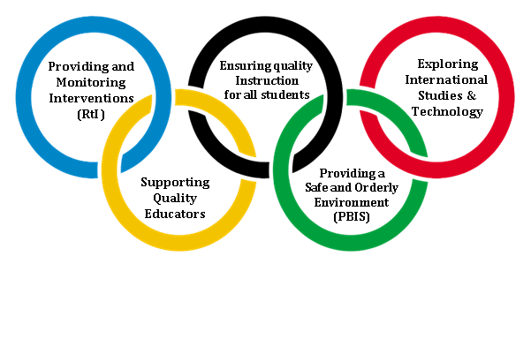
Going for the Gold
Awarding Excellence
April 16, 2013
Third Quarter
2nd, 3rd, and MG Assembly Plan: (Start at 8:45am)
Seating Times:.
8:20am Third Grade (Someone at Pod to send tardy students to gym)
8:25am Second Grade (Someone on hall to send tardy students to gym)
8:28am Multi-Grade Classes
Presentation Order:
Welcome: Mrs. Burnette (Intro. Of Mrs. Dobson)
Specialists: Tabor, Thompson-Totten, Weston, Worrell; Coe, Leach, Smart ESL (if applicable),
Grade Level Presentations:
Multi-Grade: Ader
2nd—Allen, Dennis, Duffy, Ervin, Kluttz, Underhill
3rd—Larrimore, Airo, Drake, K. Martin, Whitman, York
Closing/Dismissal: Ms Bryant
2nd, 3rd, and Multi-Grade Teacher Presentation:
1) Teacher will go to right side of stage (backstage) to wait as the teacher before them is Presenting at the podium. (Take all certificates ) Students who are receiving awards should be lined up in order and standing with you off-stage.
2) You should introduce yourself (and your TA) before starting.
3) The teacher should call out the student’s name and then the certificates that he/she will be receiving while the student is coming to the stage. Save Absent Students until the end and call them so we aren’t looking for them.
4) They should hand the certificates (clipped together for that student) to Mrs. Burnette to present.
5) The students should walk in front of the podium, shake Mrs. Burnette’s right hand, receive the certificates and go stand on the stage with Ms. Bryant and Mrs. Dobson while other classmates are called.
6) When the whole class is called, you will ask for a round of applause and then walk over to dismiss your students with you.
**Your TA or colleagues should maintain behavior with remaining students while you manage those on the stage.
Please settle your students quickly and quietly.
Welcome and Introduction Mrs. Burnette
Awards Criteria Mrs. Dobson
Specialists’ Presentations Specialists
Grade Level Celebrations Teachers
Closing Ms. Bryant
*Thanks for coming to support your child
and Konnoak. We appreciate you!!!!

Slide 3
Going for the Gold
Awarding Excellence
April 16, 2013
Third Quarter
4th, 5th, and MG Assembly Plan: (9:45am)
Seating Times:.
9:33am Fourth Grade Classes
9:38am Fifth Grade Classes
9:42am Multi-Grade Class
Presentation Order:
Welcome: Mrs. Burnette
Awards Criteria: Mrs. Dobson
Specialists: Worrell, Weston, Thompson-Totten, Tabor, Smart, Leach, Coe; ESL (if applicable)
Grade Level Presentations:
Multi-Grade: Nicholls
4th—Branon, Evans, Golden, Guerin, McClure, Prout, Shen
5th—Anderson, Barron, Cao, Hoover, Marvin, Thomas
Closing/Dismissal: Ms Bryant
Teacher Presentation:
1) Teacher will go to right side of stage (backstage) to wait as the teacher before them is Presenting at the podium. (Take all certificates ) Students who are receiving awards should be lined up in order and standing with you off-stage.
2) You should introduce yourself (and your TA) before starting.
3) The teacher should call out the student’s name and then the certificates that he/she will be receiving while the student is coming to the stage. Save Absent Students until the end and call them so we aren’t looking for them.
4) They should hand the certificates (clipped together for that student) to Mrs. Burnette to present.
5) The students should walk in front of the podium, shake Mrs. Burnette’s right hand, receive the certificates and go stand on the stage with Ms. Bryant and Mrs. Dobson while other classmates are called.
6) When the whole class is called, you will ask for a round of applause and then walk over to dismiss your students with you.
**Your TA or colleagues should maintain behavior with remaining students while you manage those on the stage.
Please settle your students quickly and quietly.
Welcome and Introduction Mrs. Burnette
Awards Criteria Mrs. Dobson
Specialists’ Presentations Specialists
Grade Level Celebrations Teachers
Closing Ms. Bryant
*Thanks for coming to support your child
and Konnoak. We appreciate you!!!!

Slide 4
Going for the Gold
Awarding Excellence
April 16, 2013
Third Quarter
Kinder, First, and MG Assembly Plan: (10:45am)
Seating Times:.
1:20pm Kindergarten Grade
1:25pm First Grade
1:28pm Multi-Grade Classes
Presentation Order:
Welcome: Mrs. Burnette
Awards Criteria: Mrs. Dobson
Specialists: Specialists’ Representative
Grade Level Presentations:
Multi-Grade: Mota, Pipkins
Kinder—Arkwright, Aguiguin, Bush, Williams, Wooten, Hall
1st—Hall, Frick, Kerns, S. Martin, Valencia
Closing/Dismissal: Ms Bryant
4th, 5th, and Multi-Grade Teacher Presentation:
1) Teacher will go to right side of stage (backstage) to wait as the teacher before them is Presenting at the podium. (Take all certificates ) Students who are receiving awards should be lined up in order and standing with you off-stage.
2) You should introduce yourself (and your TA) before starting.
3) The teacher should call out the student’s name and then the certificates that he/she will be receiving while the student is coming to the stage. Save Absent Students until the end and call them so we aren’t looking for them.
4) They should hand the certificates (clipped together for that student) to Mrs. Burnette to present.
5) The students should walk in front of the podium, shake Mrs. Burnette’s right hand, receive the certificates and go stand on the stage with Ms. Bryant and Mrs. Dobson while other classmates are called.
6) When the whole class is called, you will ask for a round of applause and then walk over to dismiss your students with you.
**Your TA or colleagues should maintain behavior with remaining students while you manage those on the stage.
Please settle your students quickly and quietly.
Welcome and Introduction Mrs. Burnette
Awards Criteria Mrs. Dobson
Specialists’ Presentations Specialists
Grade Level Celebrations Teachers
Closing Ms. Bryant
*Thanks for coming to support your child
and Konnoak. We appreciate you!!!!

