Slide 1
WELCOME
GRADE 9
MRS. FROATS
guidance counselor

Slide 2
WELCOME
GRADE 9
the most important grade in high school!

Slide 3
WELCOME
GRADE 9
Studies have shown that students who do not make it through grade 9 are the most likely to drop out of high school before they graduate!

Slide 4
Today:
Meet MRS FROATS – GUIDANCE COUNSELOR for grades 9 & 10 & Mrs. Froats gets to meet YOU!
TELL ME SOMETHING INTERESTING ABOUT YOU

Slide 5
Today:
Meet MRS FROATS – GUIDANCE COUNSELOR for grades 9 & 10 & Mrs. Froats gets to meet YOU!
Discuss the value of EDUCATION
Review the GRADUATION REQUIREMENTS
Compare different TESTS/EXAMS
Investigate FUTURE PLANS

Slide 6
REMIND:
Sign up for the app to get important info from the Guidance Dept:
1. To get txt messages – text the message @4ba6cb to the number 81010 or 412-729-3322
OR
2. On your phone, open your web browser and go to the link: rmd.at/4ba6cb
follow the instructions to sign up and get the app

Slide 7
WHAT WE DO:
ACADEMICS
PERSONAL/SOCIAL ISSUES
CAREER COUNSELING

Slide 8

$
=

Slide 9
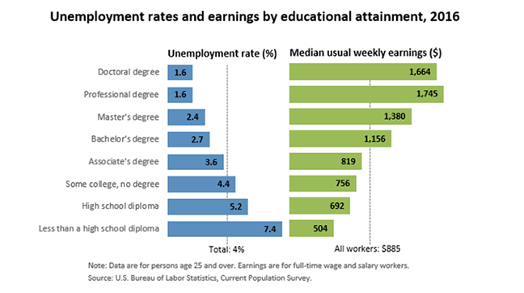
$
=

Slide 10
$
=
More simply:
After working for 30 years, Joe the HS dropout will make about $690,000 compared to $1,600,000 for Sam the college grad/tech specialist and Sally with an MD can make over $2.5 million!

Slide 11
$
=
Something to think about….from Mike Rowe, star of “Dirty Jobs”
https://www.youtube.com/watch?v=p8Lk1KwWEMo

Slide 12

GRADUATION
REQUIREMENTS:
53 units = 1 unit per semester class
ENGLISH = 8 UNITS
SOCIAL STUDIES = 8 UNITS
MATH = 6 UNITS
SCIENCE = 6 UNITS
HEALTH AND P.E. = 3 UNITS
BUSINESS ED. & COMPUTER= 2 UNITS
FAMILY & CONSUMER SCIENCE = 1 UNIT
FINE ARTS = 1 UNIT
ELECTIVES = 18 UNITS

Slide 13
GRADUATION
REQUIREMENTS:
OTHER IMPORTANT INFO:
To be advanced to the next level you must earn credits-
From freshman to sophomore = 12 units
From sophomore to junior = 26 units
From junior to senior = 37 units
To walk across the stage = 53 units

Slide 14

Important Tests
Keystones
PSAT
SAT
ACT

Slide 15
Important Tests
KEYSTONE
EXAMS
Are given in several subject areas – English*, Math*, Biology* *Proficiency required for GRADUATION.
(American History may be in the future)

Slide 16
Important Tests
PSAT
Preliminary Scholastic Aptitude Test
Practice test for SAT
Usually taken Fall of sophomore year
Can qualify for National Merit Scholar Award
PSAT will be given here on October 11 – to all 10th grade students
$16…SIGN UP IN GUIDANCE OFFICE
Notes:
16

Slide 17
Important Tests
SAT
ACT
&
College Entrance Exams
Usually taken Junior Year

Slide 18

Future plans – something to think about:
The next 4 years:
Take a variety of electives – you may find a hidden passion for something you never knew
Join clubs, sports &/or activities --- things in & out of school. Don’t say I don’t know how to__________
  Part time job? Summer Camp?
  Meet new people and talk to teachers, coaches, etc
Be serious about the AAA’s: your Academics, your Attendance and your Attitude
Enjoy your High School Life – it will go fast
Visit some post secondary schools, talk to workers

Slide 19
Future plans – something to think about:
Post-Secondary Options :
On the Job Training/ Apprenticeships - electrician
Community College - CCAC
Technical/Specialty School - PTC
4 year College or University – Slippery Rock, Duquesne
Post-Graduate/ Professional Program – Pitt Medical School
OCTOBER 11 --- CAREER DAY
Entrepreneur/Tradesman Panel
CCBC Aviation
Range Resources

Slide 20
Future plans – something to think about:
Explore:
A good GOAL – visit 5 schools, volunteer/work, job shadow before the start of your senior year:
-one this summer (between grades 9-10)
-two next summer (between grades 10-11)
-three the summer before senior year

Slide 21

WACTC
Western Area Career and Technology Center
All 9th grade students are invited to visit WACTC:
January 2017
See “shops” in action – welding, auto mechanics, health assistant, cosmetology, culinary arts, etc.
Meet and talk with instructors
Must have completed permission slip turned in by the deadline- you will get more info in homeroom
WACTC is your elective – no room in your schedule for more

Slide 22
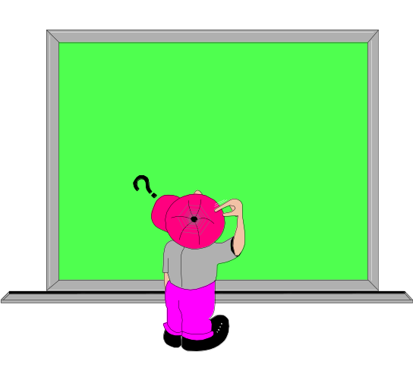
“The consequences of our actions are so complicated…that predicting the future is a very difficult business indeed.”
J.K. Rowling, Harry Potter and the Prisoner of Azkaban

