Slide 1

NM-Rising:
Developing New Mexico’s Vision for Supporting Student Success

Slide 2





STRATEGIC LEVERS
Smarter Return on Investment | Real Accountability for Real Results | Ready for Success | Effective Teachers and School Leaders | Options for Parents
Prioritize and maximize resources for better student outcomes | Become a transparent education system that is defined by academic excellence | Every New Mexico student graduates high school ready for college or career | An effective principal leading every school and an effective teacher in every classroom | Ensure every parent has access to high-quality options for their child

Slide 3
INVESTING IN OUR SCHOOLS
Over the past 6 years New Mexico made unprecedented investments in:
  Early childhood education
  Historically low-performing schools
  Interventions that produce results
New Mexico’s students are making huge gains

Slide 4
NEW MEXICO STUDENTS ARE MAKING GAINS
Last year:
77 of our 89 districts made gains in Mathematics
5,000 more students were proficient in reading
NM Students made unprecedented gains in 19 of 21 measures in Math, ELA, and Science

Slide 5
NM GRADUATION RATE HITS ALL-TIME HIGH
Since 2011, graduation rates have increased by 8 percentage points, and up 2.4 percentage points since last year.

Slide 6
RECORD HIGH YEAR FOR AP IN NEW MEXICO
+50% increase in AP exams taken since 2010
+48% increase in students taking an AP exam since 2010
+27% increase in exams earning a passing grade since 2010
+90% increase in students taking an AP class since 2010
$3.55 million potential tuition savings for New Mexico ‘s students and families
National Accolades
#2 Nationally for percent growth in students taking exams
#2 Nationally for percent growth in exams taken
#4 Nationally for providing access to students of low-income backgrounds

Slide 7
New Mexico ranks 3rd among PARCC states for average growth, and ranks in the top half of PARCC states for growth in 10 out of 12 areas in elementary and middle school.
Assessment | PARCC Rank |  | Assessment | PARCC Rank
ELA Grade 3 | 7 |  | Math Grade 3 | 3
ELA Grade 4 | 3 |  | Math Grade 4 | 2
ELA Grade 5 | 3 |  | Math Grade 5 | 2
ELA Grade 6 | 2 |  | Math Grade 6 | 4
ELA Grade 7 | 2 |  | Math Grade 7 | 3
ELA Grade 8 | 3 |  | Math Grade 8 | 2
#1 among PARCC states in 11th Grade ELA Proficiency

Slide 8
SCHOOL GRADES INCREASE COMPARISON
PPE schools, historically earning D or F grades are now taking advantage of opportunities to improve, more than double statewide growth.

Slide 9
NMTEACH SUMMATIVE STATEWIDE RATINGS
Since the first year of teacher evaluation, the number of teachers earning Highly Effective and Exemplary ratings has increased by 30%.

Slide 10
New Mexico Rising Together
Return Tour
Revisiting our communities to share our response to feedback
Farmington – April 17
Albuquerque – April 18
Roswell – May 8
Las Cruces & Alamogordo – May 9
Santa Fe – May 10
Santa Rosa – May 15
Gallup – May 25

Slide 11
WE KNOW WHAT WORKS
New Mexico is building on the strong foundation we’ve set and focusing on supporting our students on their journey to success.

Slide 12


Slide 13
FUNDAMENTAL BELIEFS
Every child regardless of background or zip code is capable of achieving at the highest levels when exposed to great instruction and school leadership.
There is a moral imperative to hold all students to the highest expectations and we know that all students will rise to the academic challenges put before them.

Slide 14
OUR PLEDGE
By 2020, New Mexico will be the fastest growing state in the nation when it comes to student outcomes

Slide 15
BOLD GOALS
More than 50 percent of New Mexico students will be proficient on PARCC by 2020
More than 80 percent of students in the class of 2020 will graduate high school
75 percent of New Mexico graduates that enroll in a higher education institution will be prepared and not require remediation
New Mexico will be on track to meet the ambitious “Route to 66” goal of 66 percent of working-age New Mexicans having a degree or post-high-school credential by 2030

Slide 16
NEW MEXICO RISING
Engaging our Communities for Excellence in Education
The PED partnered with New Mexico First to reach new levels of stakeholder engagement . Here’s what was accomplished:
1827 people engaged
25 community events hosted
21 schools visited
50 Tribal Leaders engaged
4 working groups completed
414 completed surveys
10 cities visited
1,681 miles covered
8 reports written
1 State Plan

Slide 17

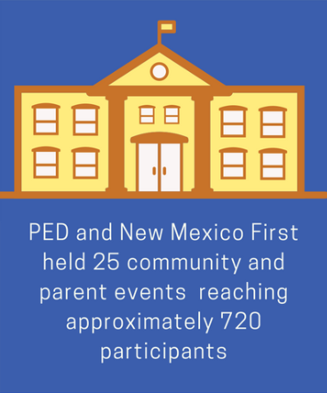
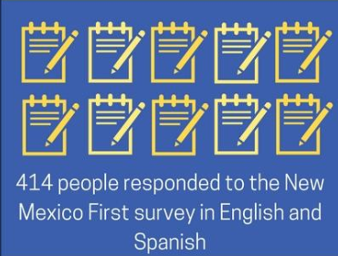
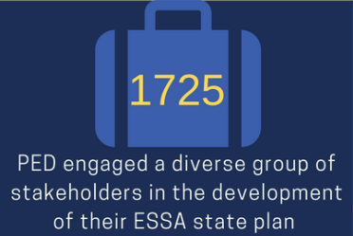
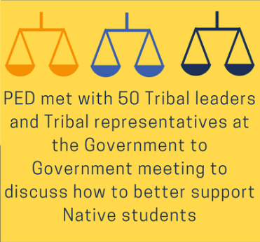
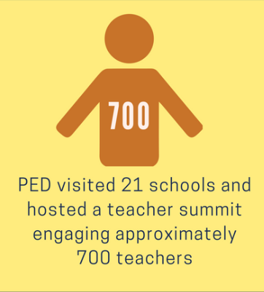
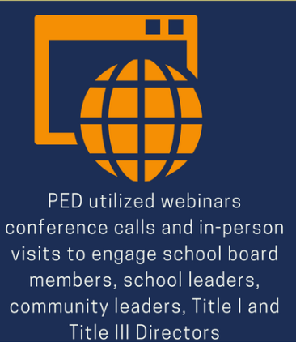
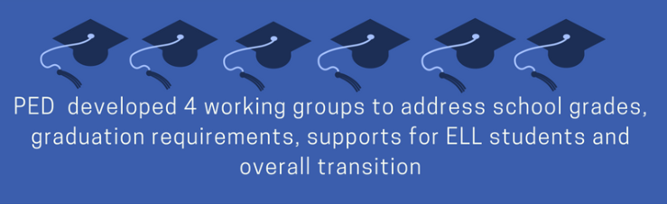
ESSA Update

Slide 18
NM PLAN: EMPOWERING OUR EDUCATORS
WE HEARD: Let’s celebrate our educators and elevate and champion the teaching profession.
NM plan:
With NMTEACH as the foundation, the PED is committed to ensuring that all students have equal access to highly-effective & exemplary educators throughout the course of their academic careers by:
  Creating more transparency around preparation programs
  Developing cultural competency programs
  Enhancing recruitment practices
  Strengthening induction methods for new teachers
  Expanding mentorship and professional development options for teachers

Slide 19
NM PLAN: ACADEMIC ASSESSMENTS
We heard: Reduce the time students spend taking tests so that teachers have more instructional time. Boost supports for students English learners and tribal communities.
NM plan:
  Testing time was reduced by 90 minutes
  New Mexico will continue to administer rigorous assessments that provide transparent information to teachers and parents allowing them to make informed decisions for students.
  NM is seeking opportunities for tribal communities to develop assessment in heritage languages—through both state and federal competitive funding

Slide 20
NM PLAN: SCHOOL GRADES
WE HEARD: The vast majority of stakeholders advocated for stability and continuity for as many years as possible under the current school grades system as well as sufficient time to respond to new federal requirements as it pertains to school and district accountability.
NM PLAN:
Gives districts until the 2018-19 school year to transition to the new system.
Beginning in 2018-19 the grading system will include new OTL instruments, and greater weight on student academic proficiency including science
A redesigned school grade report card developed with input from parents and communities.
Emphasizes growth across the spectrum so that all students are held to a high expectation of learning.

Slide 21
NM PLAN: SUPPORTING OUR SCHOOLS
WE HEARD: Our communities have different needs and unique challenges. We must have the flexibility to intervene with the right strategies.
NM Plan: The PED is committed to support the lowest-performing schools, and increasing opportunities for students across the state to have a well-rounded high quality education.
Identify the bottom 5% and those below 67% graduation rate (CSI)
Target schools where specific populations are not making significant gains when compared to their peers.
Create set of more rigorous interventions for schools that don’t exit
Invest in parental and family engagement opportunities and networks
Deep investments in 21st century community learning centers
Opportunities to expand broadband and technology access for schools

Slide 22
Our Commitment
New Mexico’s students are rising and succeeding. We’re committed to solidifying our place as a national leader in education expectations and student outcomes.
We will continue to rise, together.

Slide 23
NM-Rising: State Plan
Every Student Succeeds Act
2017 & Beyond

