Slide 1
Digital Citizenship
Welcome!

Slide 2
Michelle Diaz
I am starting my 18th year of teaching.
As a child, I was a competitive figure skater.
While in college, I studied in Spain.

Slide 3
Citizenship?
What does it mean?
What are you a citizen of?
How are you a school citizen?
  Be SAFE
  Be RESPECTFUL
  Be RESPONSIBLE

Slide 4
How Are You a GOOD CITIZEN?
Equal rights for all
Treat others kindly
Do not take what is not yours
Communicate clearly with respect
Is a responsible student
Manage money
Respect privacy and personal freedoms
Stay safe
Take care of self; physically, socially & emotionally

Slide 5
Digital?
Definition: http://www.dictionary.com/browse/digital
Examples:
  Computers
  Netbooks
  Tablets
  Phones
  Gaming systems
  ????

Slide 6
Digital Citizenship
The concept of LITERACY is undergoing a profound transformation. New competencies are needed to access, analyze, create, reflect and take action using digital tools, texts and technologies in all aspects of our lives: in the school and workplace, for home and leisure, and for social interaction, relationships and citizenship in a democratic society.
The road to DIGITAL CITIZENSHIP starts with respect, care and dignity.
DIGITAL CITIZENSHIP is about how to handle one’s self safely and responsibly online.

Slide 7
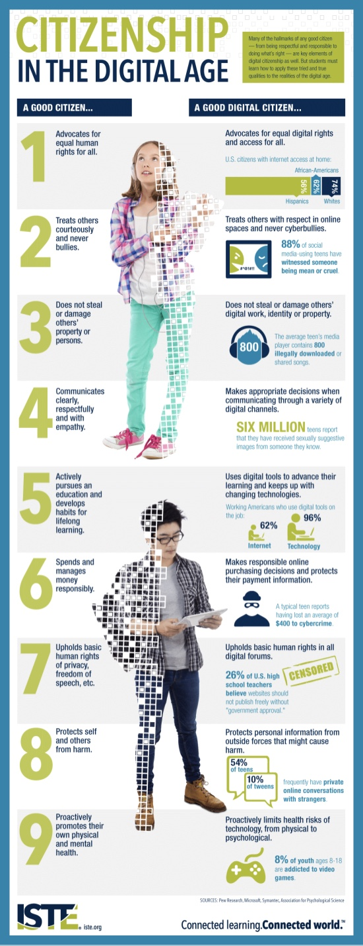
https://www.youtube.com/watch?v=FdEXijFXfD8&list=PLvzOwE5lWqhRhUa0Zet5__9yfLX8NRvb3&index=2

Slide 8
Digital CITIZENSHIP – PURPOSE
To prepare students to…
  find and evaluate information
  connect and collaborate with others
  produce and share original content
  use the Internet and technology tools to achieve many academic, professional and personal goals…
In a safe and responsible manner as they become 21 Century Learners with the Common Core State Standards as a frame work.

Slide 9
Digital citizenship – 8 topics
Privacy & Security
Self-Image & Identity
Relationships & Communication
Cyberbullying & Digital Drama
Digital Footprint & Reputation
Creative Credit & Copyright
Information Literacy
Internet Safety

Slide 10
Curriculum – Grade 5
Title | Description
Rings of Responsibility | Students explore what it means to be responsible to and respectful of their offline and online communities as a way to learn how to be good digital citizens.
Private and Personal Information | How can you protect yourself from online identity theft? Students think critically about the information they share online.
The Power of Words | Students consider that they may get online messages from other kids that can make them feel angry, hurt, sad, or fearful. Students identify actions that will make the Upstanders in the face of cyberbullying.
Whose is it, Anyway? | Students learn that copying the work of others and presenting it as one’s own is called plagiarism. They also learn about when and how it’s ok to use the4 work of others.
Talking Safely Online | Students learn that the Internet is a great place to develop rewarding relationships. But they also learn not to reveal private information to a person they know only online.

Slide 11
Curriculum – grade 6
Title | Description
Digital Life 101 | Students are introduced to the 24/7 , social nature of digital media and technologies, and gain basic vocabulary and knowledge for discussing the media landscape.
Strategic Searching | Students learn that to conduct effective and efficient online searches, they must use a variety of searching strategies.
Scams & Schemes | Students learn strategies for guarding against identity theft and scams that try to access their private information online.
Cyberbullying: Be Upstanding | Students learn about the difference between being a passive bystander versus a brave upstander in cyberbullying situations.
A Creator’s Rights | Students are introduced to copyright, fair use, and the rights they have as creators.

Slide 12
Curriculum – grade 7
Title | Description
My Media | Students review their media habits and the array of media they use on a weekly basis, and reflect on the role of digital media in their lives.
A Creator’s Responsibility | Students reflect on their responsibilities as creators and users of creative work.
Safe Online Talk | While acknowledging the benefits of online talk and messaging, students learn how to handle situations or online behavior which may make them feel uncomfortable.
Which Me Should I Be? | Students learn that presenting themselves in different ways online carries both benefits and risks.
Gender Stereotypes Online | Students analyze a “Dress Up Your Avatar” feature of a virtual world for kids for evidence of stereotypes about boys and girls.

Slide 13
Curriculum – grade 8
Title | Description
Trillion Dollar Footprint | Students learn that they have a digital footprint and that this information can be searched, copied and passed on, but that they can take some control based on what they post online.
Identifying High-Quality Sites | Students learn that anyone can publish on the Web, so not all sites are equally trustworthy.
Reality of Digital Drama | Students draw connections between young teens’ perceptions of digital drama and stereotypes of men and women on reality TV.
Cyberbullying: Crossing the Line | Students learn to distinguish good-natured teasing from cyberbullying.
Rework, Reuse, Remix | Students expand their understanding of fair use, apply it to case studies, and create an original work of fair use.

Slide 14
1. 82% of teens say that they own which of the following?
a) cell phone
b) smartphone
c) iPod Touch or similar device
d) iPad or similar device
The correct answer is a, a cell phone. The vast majority of teenagers have their own cell phone (82%), including 41% who say they have a smartphone. Cell phone ownership varies by age – 74% of 13- to 14-year olds, compared with 87% of 15- to 17-year-olds.

Slide 15
2. What percent of teens describe themselves as “addicted” to their cell phones?
a) 11%
b) 27%
c) 41%
d) 63%
The correct answer is c, 41%. And 21% of wish that their parents would spend less time with their cell phones and other devices.

Slide 16
3. 68% of teens say they do which of the following at least once a day?
a) text
b) visit a social network
c) instant message (IM)
d) use email
The correct answer is a, text. Two-thirds (68%) of teens text every day, half (51%) visit social networking sites daily, and 11% send or receive tweets at least once every day. Teens prefer texting due to the convenience – 30% saying it’s the quickest and 23% because it’s the easiest way to get in touch with one another.

Slide 17
4. How many characters (letters, punctuation marks, symbols, and spaces) can you send in a regular text message?
a) 110
b) 140
c) 200
d) 250
The correct answer is b, 140. Text messages and tweets are limited to 140 characters (including letters, punctuation marks, symbols, and spaces).

Slide 18
5. How often do 34% of teens visit social networking sites?
a) at least once a day
b) several times a day
c) once a week or less
d) never
The correct answer is b: About a third of teens visit their main social networking site several times a day. In fact, 90% of teens say they have used social media and 75% currently have a profile on a social networking site.

Slide 19
6. What percent of teens say that they don’t understand their social networking site’s privacy policies?
a) 24%
b) 35%
c) 46%
d) 61%
The correct answer is a, 24%. About a quarter of teen users admit they understand their social networking site’s policies either “not too well” or “not at all.”

Slide 20
7. What percent of teens still prefer face-to-face communication with their friends over communication online or via texting?
a) 22%
b) 36%
c) 49%
d) 61%
The correct answer is c, 49%. About half of all teens say their favorite way to communicate with their friends is in person. 38% believe face-to-face conversations to be more fun, and 29% say that they can better understand what people really mean in person. Only 4% prefer talking on the phone as their favored way to communicate with friends.

Slide 21
8. What percent of teens say they have said something bad about someone online that they wouldn’t have said in person?
a) 33%
b) 67%
c) 49%
d) 25%
The correct answer is d, 25%. A quarter of all teens admit to saying something bad about someone online that they wouldn’t have in person. Similarly, 1 in 4 (24%) social media users say they “often” encounter one or more types of derogatory speech (sexist, homophobic, racist, or anti-religious).

Slide 22
9. What percent of teens say that social networking helps them connect with people who share a common interest?
a) 35%
b) 42%
c) 57%
d) 66%
The correct answer is c, 57%. A majority of teens say social media help them keep in touch with friends they can’t see regularly (88%), get to know other students at their school better (69%), and connect with new people who share a common interest (57%).

Slide 23
10. What percent of teens agreed they wish they could “unplug” for a while?
a) 13%
b) 27%
c) 29%
d) 43%
The correct answer is d, 43%. Of this percentage, 13% agree strongly and 30% agree somewhat that they sometimes wish they could “unplug.” More than a third agree “somewhat” that they sometimes wish they could go back to a time when there was no Facebook.

