Slide 1


Seventh grade language arts
Here is a list of language arts skills students learn in seventh grade! These skills are organized into categories, and you can move your mouse over any skill name to view a sample question. To start practicing, just click on any link. IXL will track your score, and the questions will automatically increase in difficulty as you improve!
Focus on: Context Clues
Claims and Evidence
Sensory Details
Point of View
Shades of Meaning
https://www.ixl.com/ela/grade-7

Slide 2


7th Grade Language Arts Skill Builders
Interactive Practice Links
Grammar/Reading/General Resources
  https://www.internet4classrooms.com/skills-7th-langbuilders.htm
  Scroll around the website to practice any of the skills you need to review. Not all links connect, but most do!

Slide 3



http://www.prepdog.org/7th-grade.htm
http://www.lumoslearning.com/llwp/resources/common-core-practice-tests-and-sample-questions/practice-test.html?btn=start&cur=1116&cookieSelect=true

Slide 4

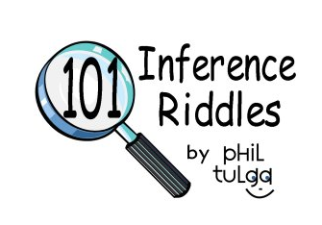
http://www.english-online.org.uk/games/gamezone2.htm
http://www.learner.org/interactives/spelling/spelling.html?s=g6-8
http://www.philtulga.com/Riddles.html

Slide 5



7-12 Student Interactives
http://www.uen.org/7-12interactives/lang_arts.shtml
http://www.softschools.com/quizzes/language_arts/

Slide 6
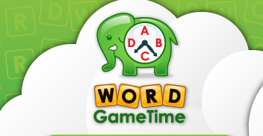
http://www.wordgametime.com/grade/7th-grade
7th Grade Games, Videos and Worksheets
Seventh grade language arts has children analyzing higher-level texts and expressing themselves through different types of writing. Children will continue to learn new subject-specific words and encounter those words in the texts they read. They will then utilize those words when creating presentations and writing essays.
Through Word Game Time’s free videos, children will find step-by-step instructions for creating effective presentations and writing different types of texts. To find inspiration for their writing and to help keep their minds sharp for analysis, children can play a large selection of free vocabulary games, including those that involve breaking codes and solving crossword puzzles.

