Slide 1

Sixth Grade Registration
Hidden Valley Middle School

Slide 2

HVMS VISITATION
Receive registration information
Question and answer period
Visit classrooms and elective areas

Slide 3

What your day may be like!
English/Math Everyday all year
Math/English Everyday all year
Science/SS Every other day all year
Electives/
PE
A-Day
Electives/
PE
B-Day

Slide 4


Advisory
Three times a month
Character lessons; life lessons
“Go to” adult
Advisor “rolls” with the you all three years at HVMS

Slide 5
Club Day
Last week of the month
Book, Minecraft, Knitting, Cause for Paws,
Guitar, Music, Team Sports, Fitness, American Sign Language, Drama, Coloring, Golf, Stem, Drawing, etc.

Slide 6


BELL SCHEDULE
1ST Block 8:20-9:55
2nd Block 10:00-11:35
LUNCH 11:35-12:05
3rd Block 12:10-1:45
4th Block 1:50-3:25

Slide 7

Advanced classes
Focus on reading material from a variety of historical periods
Learn to write in a variety of modes
Problem-solving activities using critical thinking, writing, and technological skills related to real-life situations
Independent experiments
Develop skills for writing comparison essays, change-over-time essays, & document-based responses

Slide 8

What are the characteristics of students who will be successful in Advanced classes?
Attend school regularly
Prioritize tasks & responsibilities
Work within time constraints
Appreciate a challenging curriculum
Good organization skills
Be willing to complete summer reading
Science Fair Project

Slide 9

English
English 6
Advanced English 6- teacher recommendation, requires summer reading
All year, every day
95 minute block
SOL test

Slide 10

Math
Math 6
PreAlgebra 6— teacher recommendation
All year, every day
95 minute block
SOL test

Slide 11


AMP
Accelerated Math Program
Placement based on meeting selection criteria
All year, every day
95 minute block
SOL test

Slide 12

U.S. History Pt. 1
U.S. History Pt. 1
Advanced U.S. History Pt. 1- teacher recommendation,
All year, every other day
95 minute block

Slide 13

Science 6
Science 6
Advanced Science 6— teacher recommendation, science project
All year, every other day
95 minute block

Slide 14
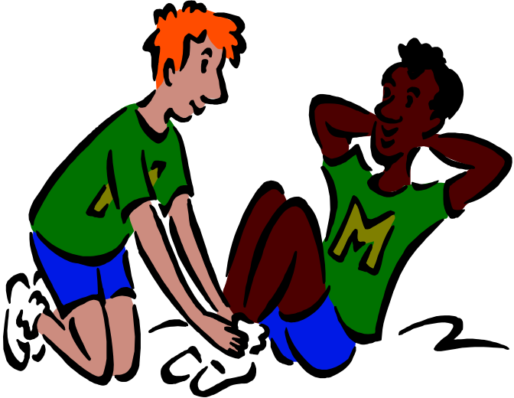
Health & PE
95 minute block
All year, every other day
Beginning and end of year all PE
Cold weather 45 mins. PE and 45 mins. Health
Everyone dresses out for PE

Slide 15

Electives
95 minute block
Choir-meets all year, every other day
Band-meets all year, every other day
Interest 6-new class every 6, or 9 weeks, every other day, may include: Art, Coding, World Languages, Computer Skills, Technology Education
Directed Study Hall

Slide 16

Class Choices
English (95 min block, all year, every day)
Math (95 min block, all year, every day)
Science (95 min block, all year, every other day)
U.S. History Pt. 1 (95 min block, all year, every other day)
Health & PE (95 min block, all year, every other day)
Elective (95 min block, all year, every other day)

Slide 17

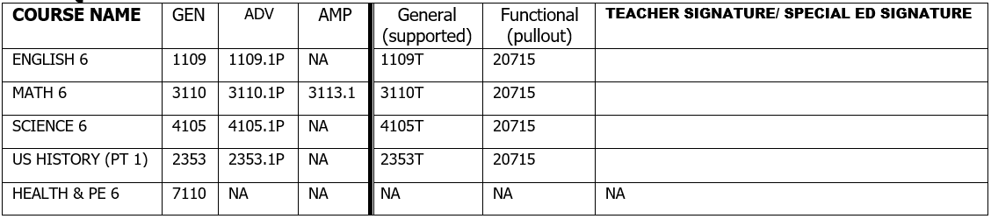
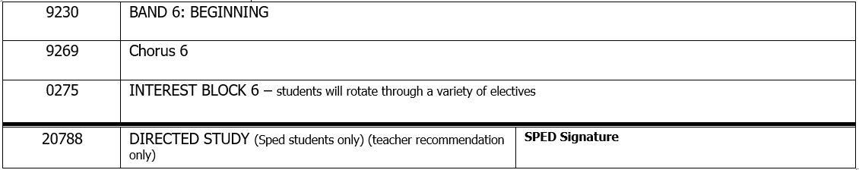
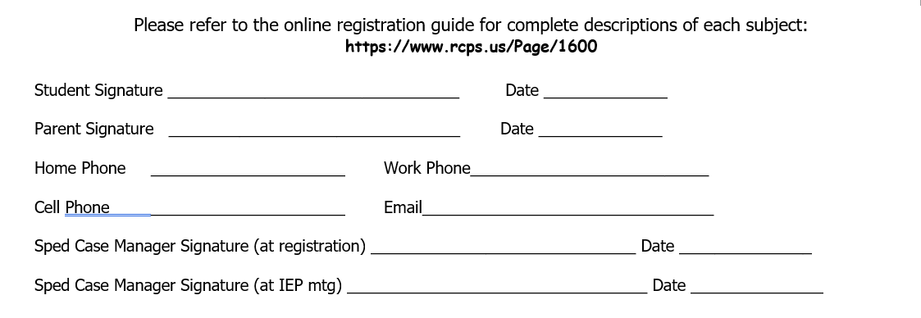
ELEMENTARY SCHOOL:
HIDDEN VALLEY MIDDLE
GRADE 6 – CLASS OF 2029
Registration Form 2022– 2023
ELEMENTARY SCHOOL:
ELEMENTARY SCHOOL:
REQUIRED COURSES
ELECTIVES – Circle ONE choice or recommendation

Slide 18
Elective Choice
Choose one elective: Band, Choir, Interest Block or Directed Study Hall
Choose the elective YOU want, not the one your friend is taking!
6th graders will get the elective they choose.
HVMS will enter courses and give each student a list of courses they are registered for in February Changes can be made at that time.
No schedule changes after June 1

Slide 19
Registration Form
Teacher recommendations will be marked on the registration form.
Teachers will tell you date form is due back to them.
Must have parent signature on the form.
Make sure address and phone number are correct.
Questions about recommendations should be directed to current teacher.

Slide 20
When do you get your schedule?
Schedule Pick Up Night—July/August, pick up schedule, locker number and combination are on the schedule
Locker Mates
Gym Suits
Dates will be in newsletter

Slide 21

Lunch
30 minutes
Buy or pack
Sit with your friends
Lunch Code
Announcements

Slide 22




Sixth Grade Activities
After School Socials/Dances
Team Managers
Builder’s Club
First Priority Club
Book Club
Art Club
Destination Imagination
SCA
Kindness Club
TSA
Coding Club
Game Club
Yearbook Club
Math Counts

Slide 23


Questions?

