Slide 1
Fall ELL Assessment Update
September 26, 2016
TETN Event #43176
Student Assessment Division
Texas Education Agency

Slide 2
Disclaimer
These slides have been prepared by the Student Assessment Division of the Texas Education Agency.
If any slide is changed for local use, please remove the TEA footer at the bottom of the slide.

Slide 3
Topics
STAAR Spanish updates
TELPAS updates
Assessment Decisions for ELLs Updates
Recommended steps to take this fall
Questions

Slide 4
STAAR Spanish Updates

Slide 5
STAAR SPANISH
            Test Results
            Misc. Updates
            STAAR Spanish Website

Slide 6
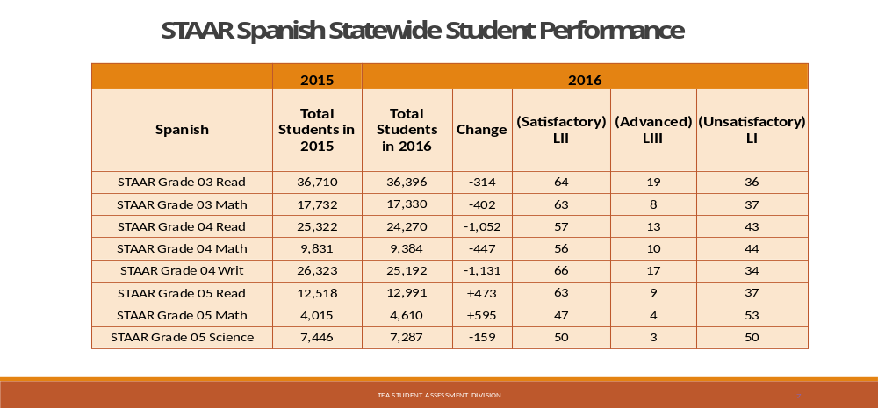
STAAR Spanish Results
Notes:
Number of students who took STAAR Spanish in Spring 2015 and 2016.
Student performance in Spring 2016

Slide 7
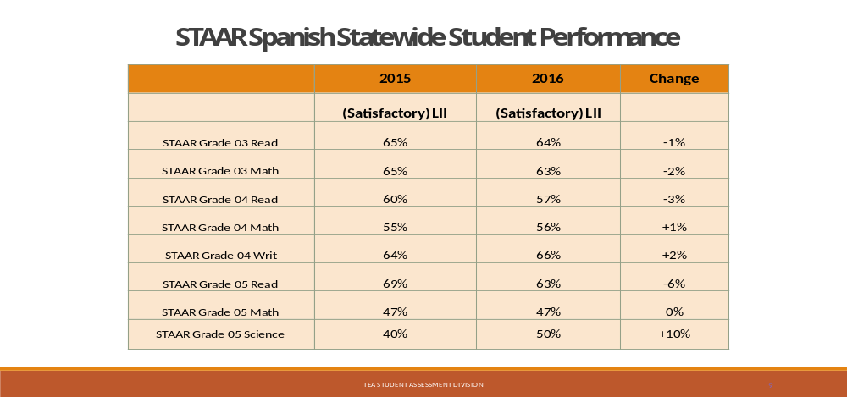
STAAR Spanish Results
Notes:
STAAR Spanish results for Spring 2015 and 2016.

Slide 8
2016 STAAR and STAAR Spanish Results
Math and Science
 | STAAR | STAAR Spanish
 | LII | LII
Grade 3 Math | 73% | 62%
Grade 4 Math | 68% | 55%
Grade 5 Math | 70% | 47%
Grade 5 Science | 61% | 50%
Notes:
Spring 2016 math and science comparison (English and Spanish).

Slide 9
STAAR Spanish Results History
STAAR Spanish Statewide Student Performance
 | 2012 | 2013 | 2014 | 2015 | 2016
 | Level II* | Level II | Level II | Level II | Level II
Grade 3 Read | 65% | 68% | 65% | 65% | 64%
Grade 3 Math | 56% | 58% | 61% | 65% | 63%
Grade 4 Read | 60% | 59% | 64% | 60% | 57%
Grade 4 Math | 53% | 70% | 62% | 55% | 56%
Grade 4 Writ | 64% | 59 | 60% | 64% | 66%
Grade 5 Read | 69% | 51% | 52% | 69% | 63%
Grade 5 Math | 49% | 44% | 45% | 47% | 47%
Grade 5 Sci | 41% | 41% | 47% | 40% | 50%
*Satisfactory
Notes:
STAAR Spanish results since the beginning of STAAR.

Slide 10
Miscellaneous Updates
Released Tests Posted
- All 2016 Spring tests (primary forms), Grades 3-8 and EOC assessments
- Grade 4 writing scoring guides
New Confidential Student Reports (CSRs) for Spring 2017
Student Success Initiative (SSI)
- Student Success Initiative (SSI) grade-advancement requirements in
mathematics and reading will continue for the 2016-2017 school year.
- Retest opportunities will be available for math and reading in
grades 5 and 8 on the dates shown on the testing calendar.

Slide 11
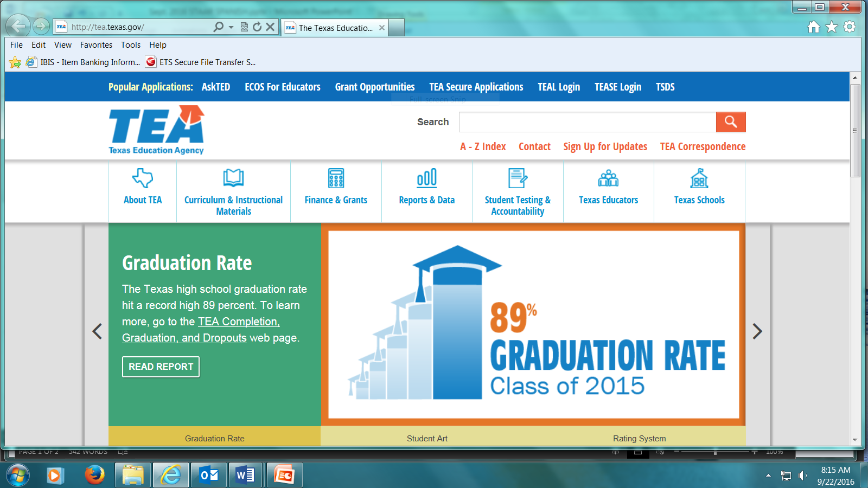
STAAR Spanish Webpage

Slide 12
TELPAS Updates

Slide 13
TELPAS Holistic Rating Training
No significant changes for 2017.
The optional Assembling and Verifying Grades 2–12 Writing Collections course is now separated into two modules (assembling collections and verifying collections).
The Grades K-1 Rater Online Basic Training Course and the Assembling and Verifying Grades 2–12 Writing Collections courses will now have a practice activity outside of the modules.
After completing the practice activities, certificates of completion will be available to print in the scoring summary.

Slide 14
TELPAS Holistic Rating Training
TELPAS Training Center no longer saves training histories.
Raters will be required to create a new account each year.
Raters need to print their certificates after training completion and calibration.
Calibration must be completed in monitored setting.
Local procedures must be established for verifying the completion of online courses and calibration activities.
Raters have two opportunities to calibrate.
Accounts and calibration certificates will be purged from training site at the end of each training window.
Notes:
Raters may use their TELPAS Rater Manual or a copy of the PLDs and scratch paper to make notes during calibration. Any notes taken during calibration should be done on the scratch paper provided and not in the TELPAS manual.
All notes taken by raters during the session must be turned in to the proctor and destroyed.

Slide 15
TELPAS Spring Dates – DRAFT
Date | Activity
Jan 3-6 | TELPAS manuals shipped to districts
Jan 18 | Assembling and Verifying Grades 2–12 Writing Collections course available
Jan 30 | End date for district coordinator training—all TELPAS components
Jan 30 | Online basic training courses for new K–1 and 2–12 raters available
Feb 10 | End date for campus coordinator training—holistically assessed components
Feb 13 | Calibration window opens for new and returning raters
Feb 13 | End date for training raters on administration procedures
Feb 13 | Earliest eligibility date for TELPAS writing samples
Mar 6–Apr 5 | TELPAS assessment window
Apr 6–7 | Data verification window
Notes:
Calendar of TELPAS Spring Dates that are draft. Final version of dates will be included in the 2017 District and Campus Coordinator Manual.

Slide 16
Holistic Rating Training Resources
2016–2017 training resources:
PowerPoint presentations (coming soon)
  Making the ELPS-TELPAS Connection: K–12 Overview
  Introductory Training on the PLDs (separate modules for K–1 and 2–12)
  Grades 2–12 Writing Collection Overview
  Holistic Rating Training Requirements
Educator Guide to TELPAS
  The Educator Guide will be updated for 2017-2018 to reflect the changes in the test design.

Slide 17
Changes to TELPAS Online Testing
Grades 2–12 online TELPAS reading tests and entry of holistic rating information will be delivered through the TestNav.
Entering students holistic ratings will no longer require a student test ticket. Holistic rating sessions still need to be created before entering ratings information.
After selecting the individual student in the Texas Assessment Management System a TestNav window will pop-up for designated personnel to enter ratings information.

Slide 18
TELPAS Listening and Speaking Assessment Development
TEA is developing a new way to increase standardization and validity of listening and speaking ratings while reducing the overall amount of training required of TELPAS raters.
Cognitive lab activities happened last week. Gave us a chance to observe the students interacting directly with the newly developed items.
Results from the cog lab will inform the development of our pilot study coming this Spring.

Slide 19
2017 Listening and Speaking Pilot Study
Pilot study of the new TELPAS listening and speaking assessments will be conducted during the testing window for 2017 TELPAS reading.
Information obtained from the pilot study will inform test development and administration policy decisions going forward.
If your district is interested in participating on the pilot study, DTCs will need to complete a survey.
A link to the survey will be located under the TELPAS Resources section of the Student Assessment Division site.

Slide 20
2017 Listening and Speaking Pilot Study
The survey will collect information about participation counts as well as current equipment (headsets) available at participating schools.
During the spring assessment registration window, districts who volunteered to participate will have to register the students through Pearson Access.
If the volunteer sample is not representative, it may be necessary to select additional campuses for the pilot study.

Slide 21
Assessment Decisions for ELLs - Updates

Slide 22
December 2016 STAAR L EOC Administrations
Will be available in the online interface.
Student tutorials and released tests are available for students to practice.
Special request process for paper administrations still available.
December STAAR L Paper Administration Guides:
  Non-secure section will be posted on STAAR L webpage ahead of time.
  Complete paper administration guides (including secure section with off-limits word list) will be shipped later this fall with testing materials.

Slide 23
English I EOC Special Provision TAC §101.1007
For ELLs who ―
  have been enrolled in U.S. schools 3 school years or less (5 or less if qualifying unschooled asylee/refugee) and
  have not yet attained TELPAS advanced high reading rating
When enrolled in English I/ESOL I course, eligible ELL shall not be required to retake assessment each time it is administered if student passes course but does not meet standard.
Note:
Students are not exempt from testing while in the course.
Provision does not apply to English II.
Provision is not tied to any particular graduation plan.

Slide 24
Special Provision and the Individual Graduation Committee – SB 149
ELLs who qualify for the Special Provision for English I are required to complete IGC requirements for English I in addition to the other course in which the student failed to achieve the EOC assessment performance requirements.

Slide 25
ELLs with Parental Denials TAC §101.1005 (f)
Reminder: These students are not eligible for special ELL assessment, accommodation, or accountability provisions
  No testing in Spanish
  No linguistic accommodations during testing
  No English I EOC special provision
  No unschooled asylee/refugee provision
ELLs with parental denials may, however, use bilingual, ESL, or other allowable dictionaries as part of the dictionary policy for STAAR reading and writing tests in grade 6 and up; under this policy, use of certain dictionaries are not considered linguistic accommodations.

Slide 26
Recommended Steps to Take This Fall

Slide 27
1. Conduct ELPS and TELPAS professional development sessions
Teachers are required to implement the ELPS and content area TEKS in instruction.
District and campus administrators need working knowledge of ELPS and TELPAS.
TELPAS familiarization training is
  good for future raters
  good way to reinforce use of PLDs all year long

Slide 28
2. Help support teacher use of TELPAS results and ELPS PLDs to monitor and maximize learning of English
Beginning of year:
Review ELLs’ past TELPAS results to see if making steady progress in learning English
TELPAS confidential campus student rosters include
  2 years of test scores
  how long student has been in U.S. schools

Slide 29
3. Help support LPAC use of TELPAS results and ELPS PLDs to monitor and maximize learning of English
LPAC meetings during school year:
Use previous spring’s TELPAS results and current year’s teacher input to
  gauge progress in English proficiency
  review and adjust linguistic accommodations and supports used in instruction
  plan for instructional interventions, if necessary
  plan for designated supports during state assessment

Slide 30
Future TETN
LPAC Training: Event #43184
December 2, 2016 from 9:00 AM – 12:00 PM (CST)
Open to ESCs only
This TETN is a training of trainers (TOT) for designated ESC staff to train districts to guide language proficiency assessment committees (LPACs) in making assessment and accommodation decisions for English language learners (ELLs) participating in the state’s assessment program.

Slide 31
Contact Information
Information regarding Assessments for ELLs can be found at: http://tea.texas.gov/student.assessment/ell/
TEA Student Assessment Division phone number: (512) 463-9536
Email us at ELL.tests@tea.texas.gov

