Slide 1

Picture Books
Toy Books, Alphabet, Counting, and other Concept Books, Wordless Books, &Picture Storybooks

Slide 2

Picture Books include…
Books that rely solely on illustrations to convey their message (wordless books)
Books in which illustrations combine with text to create the message
  “Illustrated books” : words carry most of the message
    Many full chapter books are lightly illustrated throughout
    Transition books—shorter than regular chapter books, organized in a few, short chapters, illustrations throughout
  “Picture storybooks” : tell a story with pictures on every page that are AS IMPORTANT as the text in conveying the story
  Picture books (e.g. “concept books”), that have no storyline, but include pictures and some text

Slide 3

Toy Books
Stimulate development
  Cognitive, language, social, personal
Provide happy experiences with books for continued interest in reading

Slide 4

Toy Book Types/Examples
Board Books
  Pat the Bunny (1940), a “classic”, by Dorothy Kunhardt
Flap Books
  Where’s Spot?, by Eric Hill (series)
Pop-Up Books
  Wheels on the Bus, by Paul Zelinsky
  The Peter Rabbit Pop-Up Book
Special Effects Books
  The Very Quiet Cricket
Notes:
Show examples for each type f book!!!
Toy books include: board books, flap books, pop-up books, cloth books, plastic books
Also, “special effects” books (e.g. by Eric Carle)
For babies/toddlers in “sensori-motor stage” of development
Flap books and pop-up books -- best used with adult supervision, because may be torn; are made to be interactive
Pat the Bunny: has tactile part for each picture (fur material for baby to touch on bunny; sandpaper on Daddy’s face for whiskers, etc.)
Another flap book, in CL, Which Way, Ben Benny? (Use knowledge of left and right to lift correct flap to discover which way the “carrot thief” went!)
Special effects books:
Eric Carle’s, The Very Lonely Firefly & The Very Quiet Cricket

Slide 5
Concept Books
Purpose—to teach a concept
Most are for early childhood
Examples of concepts
  Alphabet
  Numbers/Counting
  Colors
  Shapes
May have a storyline
Notes:
While most concept books are for early childhood, there are some that are even for upper primary or intermediate grades (teach parts of speech—books by Ruth Heller, or Fractions)

Slide 6
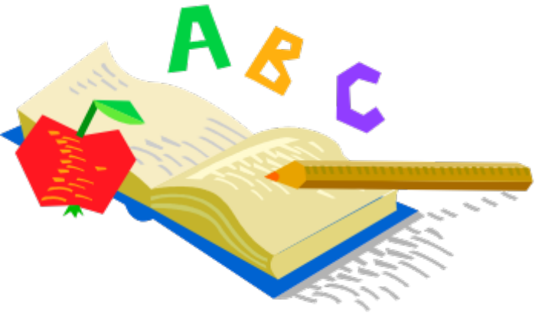
Alphabet Books
May be for any grade level, pre-school - grade 5 because…
  Not all are intended to teach alphabet
  Some use alphabet as organizational pattern for teaching other information

Slide 7

Pictures in Alphabet Books for Young Children should
be easy for child to identify
begin with the most common sound of the letter
  For initial instruction
be of things familiar
to the child
be of objects for which
the child thinks of one name
Notes:
TYPES of Alphabet books include: Animal Alphabet books
Bert Kitchen’s Animal Alphabet -- unusual as well as common animals (jerboas, newts, umbrella birds); identities of animals must be guessed, using letter as a clue; answers given at end of book
Ed Emberley’s ABC; can motivate students to write own alphabet book; series of 4 pictures, show how each letter is formed
Pigs from A to Z, by Arthur Geisert -- One or two sentences per page, describing pigs performing accompanying actions; Hidden letters for preceding, present, and following letter; key at end helps reader verify locations
Other Alphabet books:
Anno’s Alphabet: An Adventure in Imagination, by Mitsumasa Anno
Allison’s Zinnia, by Anita Lobel -- Flowers, associated with verbs and girls’ names: “Allison acquired an Amaryllis for Beryl”
Alphabatics, by Sue Mac Donald -- very creative alphabet book; series of pictures proceed from letter in various positions to an object that represents letters’ sound
Alphabet books organized by certain locations:
The Folks in the Valley: A Pennsylvania Dutch ABC, by Jim Aylesworth
Antler, Bear, Canoe: A Northwood's Alphabet Year, by Betsy Bowen (seasons in Northwoods of Minnesota)
The Z was Zapped, by Chris Van Allsburg -- Each letter is treated to an action that begins with that letter’s sound (26 act play); Invites students to write their own acts
Chicka Chicka Boom Boom, by Bill Martin, Jr., and John Archambault
For Older Children:
Ashanti to Zulu: African Traditions, by Margaret Musgrove; Illus. by Leo & Diane Dillon; Customs of 26 African peoples
Jambo Means Hello: Swahili Alphabet Book, by Muriel Feelings -- Swahili words and customs
Illuminations, by Johnathan Hurt -- People and events of the Middle Ages; (“excalibuer”, “falconry”, “grail”)
The Alphabet from Z to A (With Much Confusion on the Way), by Judith Viorst (English language curiosities and inconsistencies)

Slide 8
More About Alphabet Books…
May be for pre-schooler or kindergarten child to teach
  letter recognition (see letter, say name)
  Associate sound(s) with letters
May be effective to teach phonics for beginning reader
  Teach/reinforce consonant letter sounds (single, blends or clusters, digraphs; hard & soft sounds of “c” & “g”)
  Teach/reinforce vowel sounds (short, long, digraphs, diphthongs)

Slide 9

Counting Books
Objectives:
  To teach concept of the number (i.e. “two-ness”)
  To develop one-to-one correspondence
  To teach counting sequentially, one to ten or
  higher
Criteria for Quality:
  Easily identifiable numbers and objects
  Clarity in representing number
  Likely to stimulate manipulation of real objects

