Slide 1
Flexible Learning Program
Louisville Academy
Flexible Learning Program
The Flexible Learning Program (FLP) is an alternative supplemental academic intervention that is required for Priority and Focus Schools.
Flexible Learning Plan
We chose to focus on math using the Math Inventory to help us target specific student needs. The assessment was given twice last year to grades 2nd – 5th. All students in grades K – 5th will take the assessment three times during the 2016 – 2017 school year.

Slide 2
Gains Analysis
Jefferson County Schools
Math Inventory Assessment:
FLP Evaluation 2015-16:
CES & LA
Results Based On Assessment Data
08/01/2015 – 05/26/2016
Academic Planning & Analysis

Slide 3
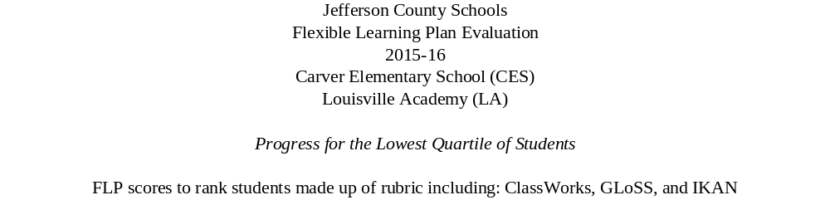
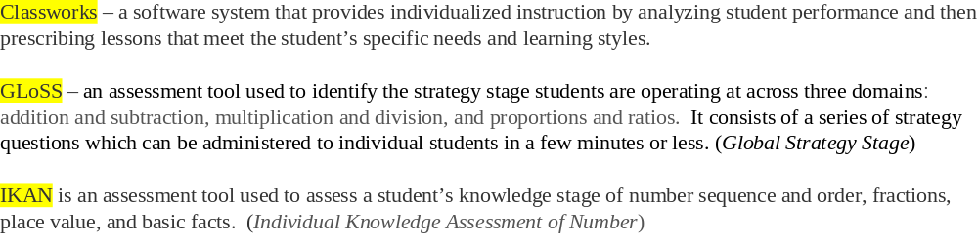
 | # of students | FLP Score – October 2015 | FLP Score – May 2016 | Gain | % of Student Growth
CES | 49 | .35 | 4.53 | 4.18 | 80
LA | 107 | .819 | 4.0 | 3.18 | 83.9

Slide 4
Executive Summary
In partnership with Jefferson County Schools, Houghton Mifflin Harcourt has analyzed Math Inventory data from universal screening test administrations from two sites for students from Kindergarten to grade 5.
Preliminary Analysis Observations
494 students were evaluated using The Math Inventory.
  Highest Quantile® measure indicates potential need for intervention.
  Data indicates that at least 36% of students need math intervention.
427 students (grades 1 - 5) had sufficient data to analyze Quantile growth.
  Data export indicates Quantile growth occurred for 82% of students.
Analytic Notes
Quantile measures are based on Math Inventory test administration.
Results are aligned to College and Career Readiness levels.
Always consider multiple measures when making intervention placement decisions for each student. Best practice is to use Math Inventory results together with in-class performance and other math performance data.

Slide 5
Screening Efforts Overview
How Many Students have Math Inventory Test Administration Data?
94% of students had 2+ Math Inventory test administrations.
Administration of 6+ tests in one year can lead to test fatigue which could yield anomalous results.

Slide 6
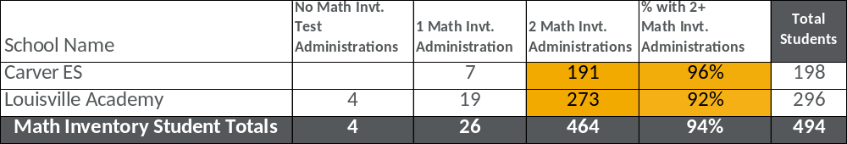
Screening Efforts by School
How Many Students have Math Inventory Test Administration Data?
94% of students (in grades K - 5) had 2+ Math Inventory test administrations.
Administration of 6+ tests in one year can lead to test fatigue which could yield anomalous results.

Slide 7
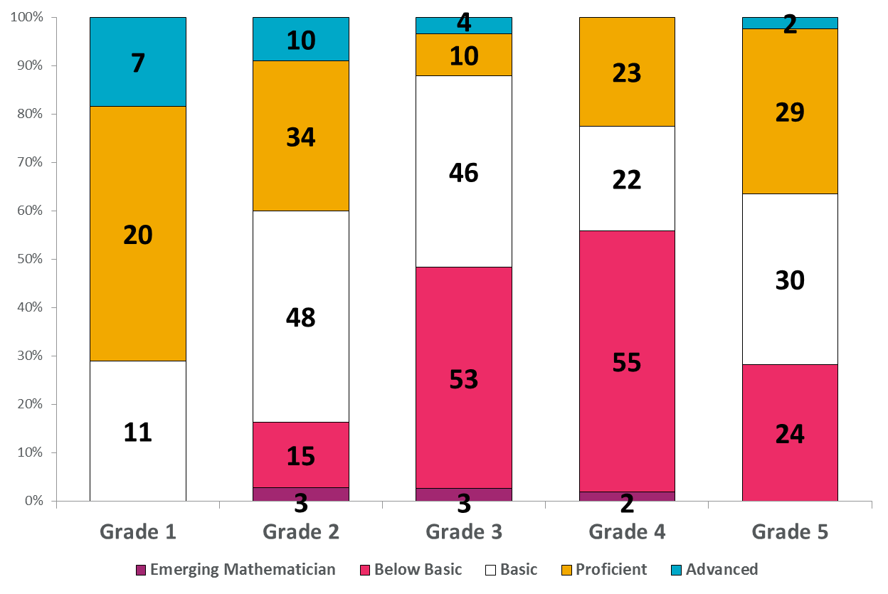
College and Career Readiness by Grade
Readiness Based upon Students’ Highest Quantile Measures
Above reflects students’ highest Quantile measure held to end-of-year spring targets for proficiency.

Slide 8
College and Career Ready Quantile Proficiency
Spring Targets for Performance Bands – Reflects July 15th Cut-Scores
Grade | Below Basic | Basic | Proficient | Advanced
K | EM400Q – EM190Q | EM185Q – 5Q | 10Q – 175Q | 180Q & Above
1 | EM400Q – 60Q | 65Q – 255Q | 260Q – 450Q | 455Q & Above
2 | EM400Q – 205Q | 210Q – 400Q | 405Q – 600Q | 605Q & Above
3 | EM400Q – 425Q | 430Q – 620Q | 625Q – 850Q | 855Q & Above
4 | EM400Q – 540Q | 545Q – 710Q | 715Q – 950Q | 955Q & Above
5 | EM400Q – 640Q | 645Q – 815Q | 820Q – 1020Q | 1025Q & Above
6 | EM400Q – 700Q | 705Q – 865Q | 870Q – 1125Q | 1130Q & Above
7 | EM400Q – 770Q | 775Q – 945Q | 950Q – 1175Q | 1180Q & Above
8 | EM400Q – 850Q | 855Q – 1025Q | 1030Q – 1255Q | 1260Q & Above
9 | EM400Q – 940Q | 945Q – 1135Q | 1140Q – 1325Q | 1330Q & Above
10 | EM400Q – 1020Q | 1025Q – 1215Q | 1220Q – 1375Q | 1380Q & Above
11 | EM400Q – 1150Q | 1155Q – 1345Q | 1350Q – 1425Q | 1430Q & Above
12 | EM400Q – 1190Q | 1195Q – 1385Q | 1390Q – 1505Q | 1510Q & Above
As many states adopt more rigorous standards for content and assessment, HMH has partnered with MetaMetrics to determine what Quantile measure performance would best prepare students to be college-ready in the 21st century. HMH Math Inventory Quantile measure performance bands above have been implemented as part of SAM and gains reports since fall 2014.

Slide 9
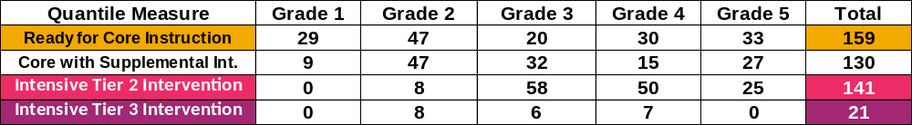
Math Intervention Needs
Estimated Need for Intervention from Quantile Measures
130 students in the Basic range may be able to understand core math instruction if provided additional time and support (Tier 2 Intervention).
141 students are Basic-Below Basic with Quantile measures of at least 200Q and need intensive intervention to rebuild content that they have not understood through systematic and structured support (Tier 2 Intervention).
21 students with Quantile measures below 200Q need to rebuild foundational math skills in intensive math intervention (Tier 3 Intervention).
Use Number Core and Arithmetic skills assessments and in-class performance to determine specific content needs.
FASTT Math or Do The Math Now!
Always use multiple measures to determine appropriate student placement at the student level.

Slide 10
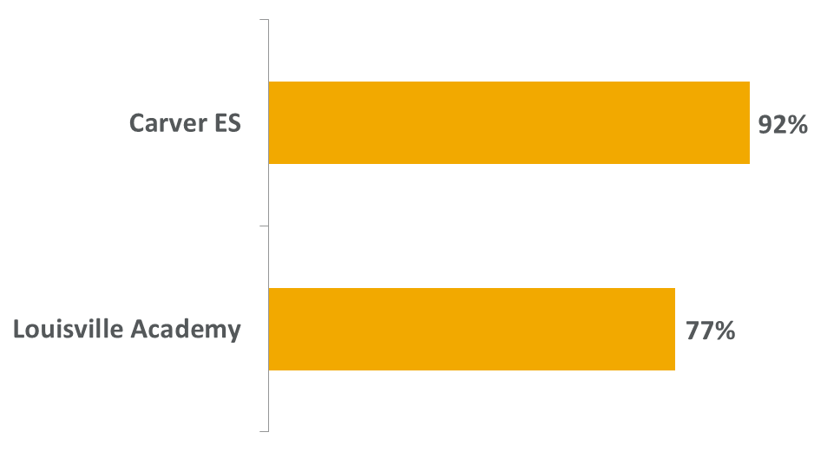
Percent of Students Who Gained Quantiles
Quantile Growth and Increased Readiness for Mathematics Instruction
Increased Quantile measures indicate students are ready for more complex math.
Decreased Quantile measures could indicate that the student lost motivation or encountered higher Quantile material he or she could not complete.
Above includes students in Grade 1 through Grade 5.

Slide 11
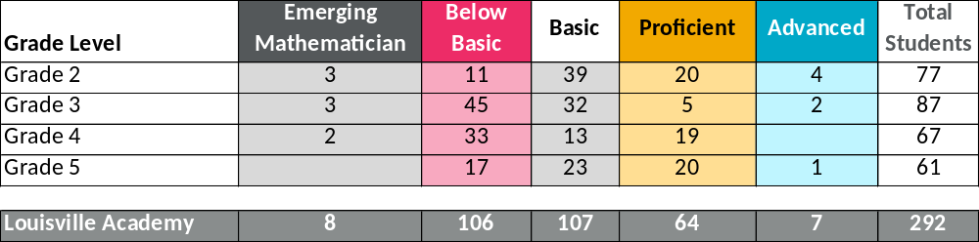
Quantile Measures
Performance Bands Based Upon HIGHEST Math Inventory Score
When estimating need for intervention of a group of students, it is best to use their highest Quantile measures from The Math Inventory.
Emerging Mathematicians may have gaps in foundational math concepts or skills.
It is recommended to screen students with low Quantile measures with assessments like Do The Math modules or FASTT Math placement tests to determine whether reinforcement of skills is needed.

Slide 12
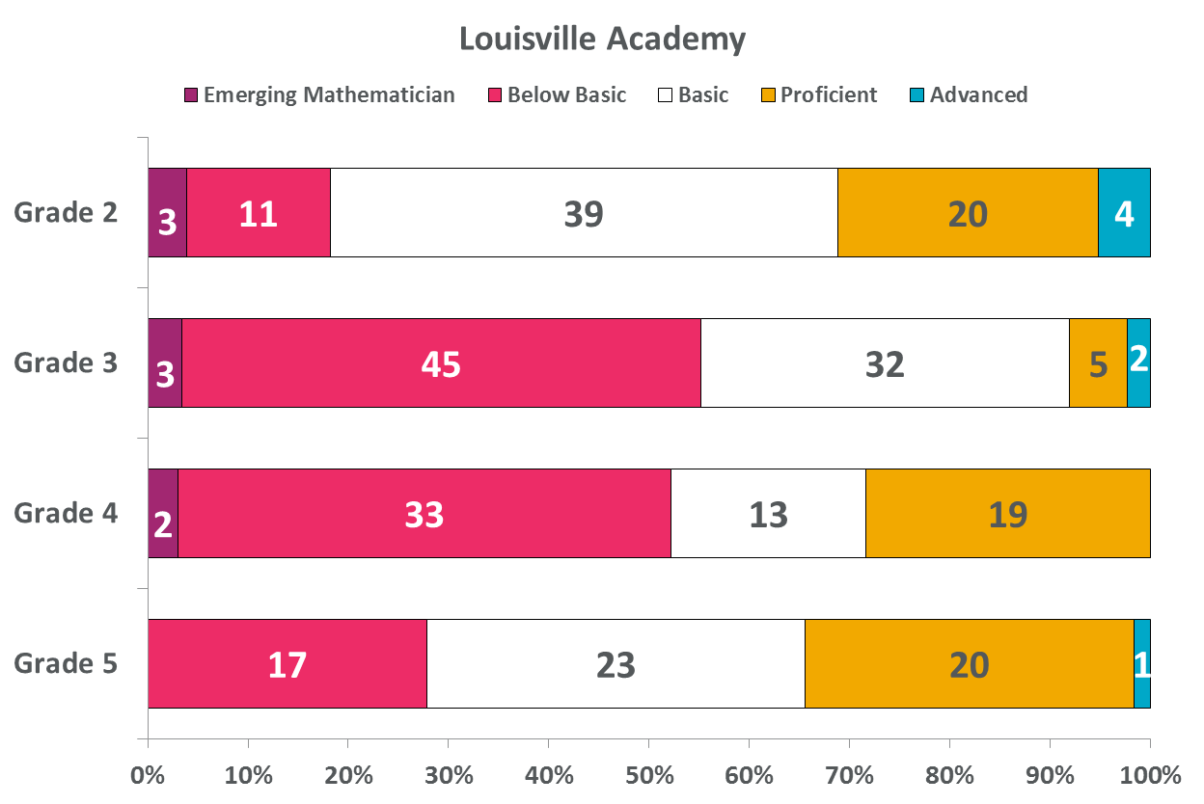
Math Inventory Performance Bands
Percent of Students in Each Band by Grade Level

Slide 13
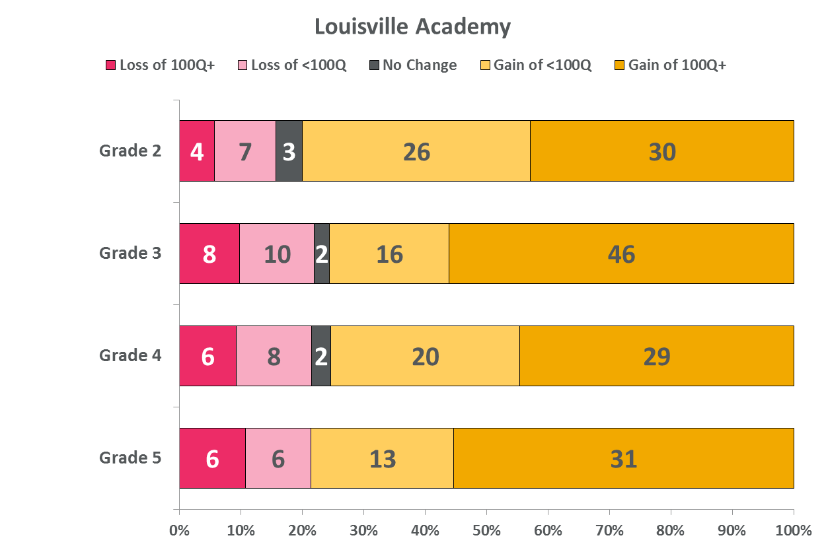
Math Inventory Quantile Trends
Percent of Students Who Gained or Lost Over 100Q by Grade Level

