Slide 1
ESL Parent Meeting
Wednesday, January 31, 2018

Slide 2
Agenda
Information about the upcoming WIDA ACCESS test (for all ESL students)
General, specific, and technical language and what it means for your child's English proficiency level
Valentine’s Day at West Maple
Break-off
Good Fit Books
Middle School Information for Fifth Grade Parents

Slide 3
WIDA ACCESS February-March, 2017
Students’ English language proficiency levels assessed in listening, speaking, reading, and writing
Assessment weighted 70% literacy, 30% oral
Kindergarten: one-on-one test with teacher
Grade 1-3: reading, listening, and speaking tests on the computer, writing on paper
Grades 4-5: reading, writing, listening, and speaking on the computer

Slide 4
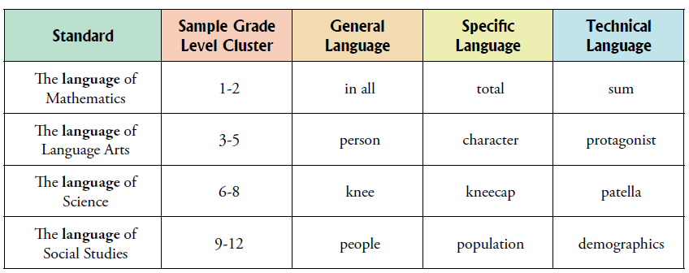
General, Specific, and Technical Language
general language: words or expressions that are not connected to specific academic areas (e.g., describe or book)
specific language: words or expressions that are used in more than one academic area (e.g., chart, total, individual)
technical language: the most exact words or expressions connected with topics within academic areas

Slide 5
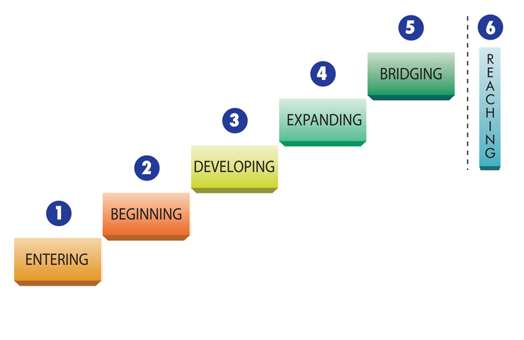

Levels of English
Language Proficiency
technical language
specific and some technical language
general and some specific language
General language
Notes:
5

Slide 6
Testing information for winter and spring
WIDA ACCESS
  For English learners Feb-March
NWEA
  K, 1, 2, 3 – Reading in October, January, May
  K, 1, 2, 3 – Math in October and May
  4, 5 – Math and Reading in October, March
M-STEP (Michigan state test)
  Grade 3: math and reading
  Grade 4: math and reading
  Grade 5: math, reading, science, and social studies
  Staggered in April and May, with oldest students going first

Slide 7

Valentine’s Day at West Maple
ALL GRADE LEVELS- Do not write classmates’ names; just have your child sign his or her name.
Kindergarten, First, Second, and Third Grade will decorate a bag or box in class. Bring Valentines for classmates only.
Fourth Grade students will decorate a Valentine bag in class. They should bring a Valentine for each classmate. They may bring a Valentine for students in other fourth grade classes too.
Fifth Grade- The Valentine’s Day dance is on February 13, 6:30 – 8 PM. There will be no party during school hours.

Slide 8
5th Grade: Berkshire Core Subjects
All 6th-graders take: | ESL students take (based on teacher recommendation): | French students take:
English Language Arts 6th (ELA) | ESL B or ELA (ESL B follows 6th-grade ELA curriculum) | ESL B or ELA (based on teacher recommendation)
Science | Science | Science
Math | Math | French School
Social Studies | Social Studies | French School

Slide 9
5th Grade: Berkshire Electives
All 6th-graders take: | ESL students take (based on teacher recommendation): | French students take (based on teacher recommendation):
Rotation 1 quarter each: art, physical education, skills for living (cooking), engineering | ESL tutorial (help with all subjects—ELA, math, science, social studies) OR rotation | ESL tutorial (help with ELA, science) OR rotation
Two electives on alternating days from list below: Languages: Spanish, French, Japanese (French School: make sure that Japanese does not conflict with French School schedule in 7th and 8th grades) Physical Education Music: Band/Orchestra and other electives (please see Berkshire packet for full list)
Please contact Kalyn Wulatin at kwulatin@birmingham.k12.mi.us if you have questions.

Slide 10
Reading at Home
Reading Tips for Parents (in multiple languages) – Kindergarten through 3rd Grade
http://www.readingrockets.org/article/reading-tips-parents-multiple-languages#english
Reading Tips for Parents- 4th and 5th Grade
http://www.scholastic.com/parents/resources/collection/milestones-expectations/raise-reader-parent-guide-to-reading-ages-8-10
http://www.scholastic.com/parents/resources/article/reading-together/5-ways-to-bond-your-advanced-reader
Suggestions for reading with English Learners
Scroll down to section “For Parents”: http://www.readingrockets.org/reading-topics/english-language-learners
Other Tips
http://www.readingrockets.org/taxonomy/term/1353/article/31253?page=7

Slide 11
Graphic Novels and
High Interest, Low Level Books (Hi-Lo)
Graphic Novels for Young Kids
http://www.readingrockets.org/article/graphic-novels-young-kids
http://www.ala.org/offices/resources/its_elementary_graphic_novels
http://www.ala.org/alsc/graphicnovels2016
Hi/Lo Books
http://www.readingrockets.org/article/highlow-books-children
Step Into Reading
http://www.stepintoreading.com/
Red Rhino Books (grade 4-6)
http://www.sdlback.com/red-rhino-books/red-rhino-books

