Slide 1



Projects to make Social Studies Memorable and Fun!!!
By Roberta Haeffele
Ward Elementary
Grade 4

Slide 2
Problem-Based Learning
A student centered way of teaching that allows students to learn about a subject through experience of a real world problem.
There is usually more than one answer to the problem.
Students learn critical thinking strategies, domain knowledge, and analyzing their work and others.
This helps students develop flexible knowledge, problem solving skills, self-directed learning, collaboration, confidence, and motivation.
The role of the teacher is to facilitate learning by supporting, guiding, and monitoring learning.

Slide 3
Why do it???
Hits different learning styles
Children can learn or figure out which way they retain information best and then use this to create, perform, show, etc. that they have learned the material that was taught
Uses real word problems that they may encounter in the real world instead of testing 24/7
Testing only shows one aspect of a child’s capabilities, they can do more if given other avenues to show it

Slide 4
Pacing Guide
^{4th Gr.} Q 1 | Week 1 8/26-8/30 | Week 2 *9/3/-9/6 | Week 3 9/9-9/13 | Week 4 9/16- 9/20 | Week 5 9/23-9/27 | Week 6 9/30-10/4 | Week 7 10/7-10/11 | Week 8 10/14-10/18 | Week 9 10/21-10/25 | Week 10 *10/28-10/31
Red Band – Reading RF.4.4, RF.4.4c, RL.4.10,RI.4.10 | Getting to know you activities Getting started Imagine it- | Unit 1- Risks and Consequences Story- The Island of the Blue Dolphins Strategies: Making connections, visualizing, predicting, summarizing Skills: Point of view, setting, character, Language use Science Inquiry: The Star Called Sun RL4.1, RL4.2, RI 4.2, RL 4.5 | Story- Two Tickets to Freedom Strategies: Making connections, asking questions, summarizing Skills: Author’s purpose, dialogue Social Studies Inquiry: Helping Hands RL4.1, RL4.2, RI 4.2, RL 4.5 | Story- Mrs. Frisby and the Crow Strategies: Making connections, visualizing, predicting Skills: Description, setting, plot, character Science Inquiry: Amazing Animals RL4.1, RL4.2, RI 4.2, RL 4.5 | Story- Langston Hughes: Poet of the People Strategies: Clarifying, adjusting reading speed, summarizing Skills: Characters and conflict, stage directions, plot, dialogue Social Studies Inquiry: Public Schools RL4.1, RL4.2, RI 4.2, RL 4.5 | Story- Daedalus and Icarus Strategies: Predicting, clarifying Skills: Foreshadowing, genre, character RL4.1, RL4.2, RI 4.2, RL 4.5 | Day 6- Science Inquiry- From Liquid to Solid and Back Again Day 7-Poem- Hippo’s Hope Day 8-Poem- The Dream Keeper and Dreams Day 9- Freedom Day 10- Test Prep and Review Review week | Unit 2 – Nature’s Delicate Balance Story- The Snowflake: A Water Cycle Story Strategies: Making connections, clarifying,, summarizing Skills: Alliteration, onomatopoeia, personification, repetition, author’s purpose Science Inquiry: Erosion and Landslides RL.4.3, RL.4.6, RL.4.9, RI.4.7 | Story- Energy Makes Things Happen Strategies: asking questions, summarizing Skills: Effective Beginnings, cause and Effect, Effective Endings Science Inquiry: Making Life Easier RL.4.3, RL. 4.6, RL. 4.9, RI.4.7 | Bench mark testing/Review/ Extensions) Story- Who Eats What? Strategies: asking questions, summarizing, visualizing, clarifying Skills: Language use, author’s purpose Science Inquiry: All Kinds of Eaters RL.4.3, RL. 4.6, RL. 4.9, RI.4.7
Word Structure Green Band | Review – Getting Started | L.4.5 – a, b, c Root Word plus suffix | L.4.5 – a, b, c Root word plus prefix | L.4.5 – a, b, c Root word plus suffix | L.4.5 – a, b, c Inflectional Endings and Pluralizing noun endings | L.4.5 – a, b, c Compound Words | Review | L.4.3 Compound Words and Greek Root, Inflectional Endings | L.4.3a,b Latin Roots plus Affixes | L.4.3a,b Synonyms and spelling changes with affixes
Blue Band- Writing- W.4.10 | What are the steps of the writing process? W.4.3, W.4.4, W.4.5 | Narrative Writing: Realistic Fictions Grammar – nouns | Narrative Writing: Realistic Fictions Grammar – verbs | Narrative Writing: Biography Grammar – verbs, plural and irregular nouns | Narrative Writing: Play Grammar – nouns | Unit Review Narrative Writing: Play Grammar – subjects and predicates | Writing an Advertisement Review all grammar | Describing how to do something Grammar- Simple sentence, paragraph indentation | Describing how to do something Grammar- types of sentences and end marks | Writing and Informative Report Grammar- compound sentences
Math | Place Value- 10 days (Aug 26- Sept 9) 4.NBT.1 4.NBT.2 |  | Addition & subtraction- 13 days (Sept 10- Sept 26) 4.NBT.3 4.NBT.4 | 4.OA.3 4.MD.3 (perimeter and area) |  | Operations and Problems with measurement- 8 days (Sept 27- Oct 8) 4.MD.1 4.MD.2 |  | Factors, Prime and Composite- 11 days (Oct 9- Oct 22) Part 1 4.OA.4 4.OA.5 | Bench mark testing/Review/Extensions) Oct. 23- Oct 31 | Quarter Testing
Social Studies | Getting to know you | Exploration & colonization (24 days) 4.H.1.1 - P 4.H.1.2 - P 4.H.1.3 - S | 4.G.1.2 - S 4.G.1.3 - P 4.C&G.1.3 - S |  |  |  |  |  | Migration & settlement Patterns (25 days) 4.H.1.1 - S 4.H.1.3 - P 4.H.1.4 - P | 4.G.1.2 - S 4.G.1.3 - S 4.C&G.1.3 – S 4.C.1.1 – P 4.C.1.2 - S
Science | Getting to know you |  |  | Ecosystems (23 days) 4.L.1.1 4.L.1.2 4.L.1.3 4.L.1.4 |  |  | Molecular Biology (25 days) 4.L.2.1 4.L.2.2

Slide 5

Native Americans In NC
4.H.1.1 Summarize the change in cultures, everyday life and status of indigenous American Indian groups in North Carolina before and after European exploration.
4.H.1.3 Explain how people, events, and developments brought about changes to communities in various regions of North Carolina.
4.G.1.2- Explain the impact that human activity has on the availability of natural resources in North Carolina.
At the beginning, we filled in a KWL chart on Native Americans. The children didn’t know much at this time.
Then I gave my children an ABC chart to record what they learned about Native Americans as we read, listened to videos, researched, etc through the unit.
After you have done some formal teaching of Native American groups in NC to the students, then discuss ways of life, their community, regions they lived, etc. Add any new info to the KWL chart.
Introduce PBL problem- discuss facts from the problem, what we need to know to solve the problem, and some possible solutions. Then children will work in groups to solve the problem. After they are done, they can present to the class.

Slide 6


ABC Chart
Early Native Americans in North Carolina | Use the blocks to take notes on what we learn about Native Americans in NC. | A | B
C | D | E | F
G | H | I | J
K | L | M | N
O | P | Q | R
S | T | U | V
W | X | Y | Z

Slide 7
Problem and Outline
Native Americans in NC
Researchers from the Museum of Anthropology at Wake Forest have asked you for your help in teaching children in 4th grade around Winston-Salem about early Native Americans that inhabited North Carolina. As part of your research, they would like you to find your groups way of life (food, how they gathered, types of housing, clothing, etc.), where they lived, way of life before and after the settlers, and any interesting facts about your tribe. This is to be presented to your class in 3 days for approval for the museum.
Group:______________________________
A. Place they lived
1.
2.
B. Way of life
1. Food
a.
b.
2. Housing
a.
b.
3. Transportation
a.
b.
C. Life Before Settlers
1.
2.
D. Life After Settlers
1.
2.
E. Interesting Facts
1.
2.

Slide 8


Project
Each group will have to research an Indian group, their way of life, region they lived in, life before settlers/after settlers, and any interesting facts.
Live Binder http://www.livebinders.com/play/play?id=520366&backurl=/shelf/my
You can assess children’s knowledge by what they do in group work. While they are working and finding new information, ask them questions on the relevance of the info and whether they understand the info.
A rubric will help children figure out what needs to be in the presentation/project. Show them this before they get started so they know what to expect.
When children are presenting, you can assess the information they are presenting.
The listeners take notes on their ABC charts of what they are learning.
Allow children to ask questions to the groups. This is a skill that has to be taught and modeled constantly.

Slide 9
Rubric
 | To get a 5 | To get a 4 | To get a 3 | To get a 2 | To get a 1
Characteristics of Native American Group _______________ | Information is clear and accurate. There are many extra interesting facts and details that make this project appealing. | Information is clear and accurate. There are some extra interesting facts and details that make this project appealing. | Information is somewhat clear, but may seem unorganized at times. There are some interesting facts and details that make this project appealing. Information is mostly accurate. | Information gets confusing in parts. There are some facts and details that make this project appealing. Information may have some inaccuracies. | Information is confusing and unorganized. Information is incorrect.
Changes | Project and presentation shows a strong understanding of life before and after the settlers. | Project and presentation shows an understanding of life before and after the settlers. | Project and presentation shows that some of the information is understood, but there are some inaccuracies. | Project and presentation shows that some of the information is understood, but there are lots of inaccuracies. | The project and presentation did not show an understanding of life before and after the settlers.
Presentation | Presentation is organized. Group members took turns and spoke clearly during their presentation. | Presentation is organized. Group members took turns and spoke clearly during their presentation. | Presentation is somewhat organized. Only a couple of the group members spoke. | The presentation was unorganized. Only one person in the group spoke. | The presentation was unorganized. Only one person in the group spoke and they were unclear.
Conventions and grammar | All conventions and grammar are correct. | Only 2-3 mistakes are in the writing. | Only 4-5 mistakes are in the writing. | Only 6-7 mistakes are in the writing. | There were over 8 mistakes in grammar and conventions.
Teamwork | Our team worked together the whole time. | We worked together most of the time. | We worked together some times. | We worked together a little bit. | We didn’t work together.

Slide 10
Other ways to tie it in or Assess at the same time
Children can write summaries on what they have learned from other projects and how Native American life changed after settlers arrived in NC.
Children can choose another tribe different from theirs and create a Venn Diagram on the similarities and differences
In Writing, children can create journal entries or write a skit of an Indian tribe member and how they felt before/after the settlers came. (Narratives)
Have children create a NC map to show locations of Indian Tribes. Then write 1-2 facts about each group.

Slide 11
Resources for Native Americans
Social Studies Book- Unit 2 Lesson 1, Unit 4 Lesson 1 & 3
Time For Kids Readers- The Lumbee People
Leveled Readers- People Today and Long Ago, Coming to North Carolina,
Use the old S.S. text books if you have them, they have good info and are good for researching
Any of the If you lived with ……books
The public library

Slide 12
Early Explorers and Exploration
4.H.1.2- Explain how and why North Carolina was established.
4.G.1.2- Explain the impact that human activity has on the availability of natural resources in North Carolina.
Review what we learned and now know about Indians before/after settlers/explorers started coming to North Carolina
Start KWL chart on explorers and exploration
Then in our notebooks we would draw a picture of the explorer, write a few notes about that person, and then write or draw where they came from.
After you have done some formal teaching of NC explorers, then tell children they are going do a PBL problem.
Believe me, they never get tired of these and look forward to completing them!!!

Slide 13

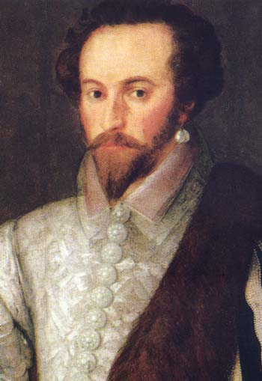
Problem
Trading Cards
The 4th grade students at Ward Elementary have been selected to design a new line of trading cards. Your job is to create the first ever Early North Carolina Historical Figures/Events Trading Cards. These cards will look similar to baseball cards and other trading cards you have seen, but they will have facts about major historical figures or events in NC. Using the information you have been provided, material you have learned, and additional sources, you will select the information that will be printed on the cards. Good Luck!

Slide 14
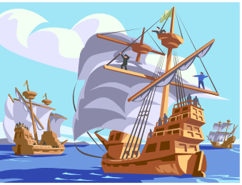
Procedure
Children will get a person or event
Show samples of baseball, basketball cards, etc. in case someone has never seen one.
Research using books, internet, videos, etc.
Explorers and Early North Carolina History- http://www.livebinders.com/play/play?id=477517
Early Exploration and Settlement- www.livebinders.com/play/play?id=537763&backurl=/shelf/my
http://allaboutexplorers.com/explorers
Once they have all their research, children will create a trading card that includes who, what, when, where, why, and anything else that seems interesting or relevant
Remember to show them the Rubric so they know what to expect. This is like their map of what they should be expecting.
Afterwards, children will present to the class their cards. Again you can access what children know by what they present, the work you saw them do in group, and by the questions you asked while facilitating the learning. Also allow children to ask groups questions after presenting. This take A LOT of practice, so they don’t ask ridiculous questions.
To make sure all are listening, you can have a set of questions that they need to listen for and answer while others are presenting.

Slide 15
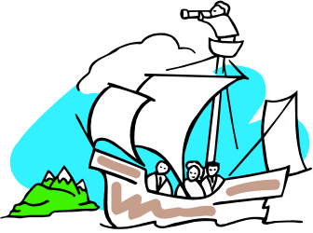
Rubric
 | To get a 4 | To get a3 | To get a 2 | To get a 1
Person or Event Information _______________ | Information is clear and accurate. Who, what, when, where, why, and anything else that is interesting about your topic. Information is also accurate. | Information is mostly clear, but parts may be confusing or unorganized. Information is accurate. | Information gets confusing in parts. There are some parts that are unorganized. Information may have some inaccuracies. | Information is confusing and unorganized. Information is incorrect.
Contributions to NC | Justified that this person or event contributed to the establishment of NC | Established that this place or person contributed to NC | Noted that this person has a place or this person contributed to the history of NC but there are some discrepancies | Did not demonstrate that this person or event contributed to the establishment of NC
Presentation | Presentation is organized. Group members took turns and spoke clearly during their presentation. | Presentation is somewhat organized. Only a couple of the group members spoke. | The presentation was unorganized. Only one person in the group spoke. | The presentation was unorganized. Only one person in the group spoke and they were unclear.
Conventions and grammar | All conventions and grammar are correct. | Only 4-5 mistakes are in the writing. | Only 6-7 mistakes are in the writing. | There were over 8 mistakes in grammar and conventions.
Teamwork | Our team worked together the whole time. | We worked together some times. | We worked together a little bit. | We didn’t work together.

Slide 16
Other ways to tie it in or Assess at the same time
After all projects are completed, children can assemble info for their projects and then create a class timeline of all info that has been presented
Create journal entries from the explorers point of view, settlers point of view, etc. (narrative)
Create a skit of the explorers, settlers, etc. finding the new world (narrative- discuss components of a play)
Write persuasion story on allowing the queen/king to fund their expedition to NC
Write a story of the first interaction/meeting between an Indian group and explorers/ settlers (narrative)
Create newspaper article all about what the explorers found in the new world- http://www.fodey.com/generators/newspaper/snippet.asp
This is a lesson Called the Land of Milk and Honey. Children were to read a letter written by Swiss Citizens that wanted to move to NC. In Switzerland, their government didn’t want them to move unless it was under special circumstances. After children read the letter, they had to write a persuasive story about why they wanted to leave and what would be provided if they got permission. http://docsouth.unc.edu/classroom/lessonplans/csr/milk_honey1.html
Have children create a wax museum

Slide 17
Resources for Explorers and Exploration
Social Studies Books- Unit 2 Lesson 2, Unit 4 Lesson 2 and 4,
Leveled Readers- Treasure Hunt, The Lost Colony at Roanoke Island, Coming to North Carolina, North Carolina Past and Present
Time For Kids Readers- Pirates on the Prowl, The Mystery of Roanoke
Use the old S.S. text books if you have them, they have good info and are good for researching
Public Library and media center
NC History Museum
NCPedia

Slide 18
Migration and Settlement Patterns
4.H.1.3- Explain how people, events, and developments brought about changes to communities in various regions of North Carolina
4.C.1.1- Explain how the settlement of people from various cultures affected the development of regions in North Carolina (languages, foods, and traditions)
Review with children what they have learned about early exploration of NC. Then give children map of NC. Tell them that we will be mapping where people migrated and settled to. While they are keeping an on-going map in their notebooks, you can use the big class maps in your room and yarn and track where groups of people came from in Europe to NC. Also pose the question to the children as to why people would want to leave their land for a new land (opportunity, religious freedom, adventure, conflict, forced migration, etc. If you have children from other countries, see if they will share why their families came to NC.
Then share reasons why some wanted to leave for the New World.
Make bubble maps of this in their notebooks so they can take notes while learning new things.

Slide 19

Problem
Who Are WE?
You are a ___________ from ____________. Many members of your group have moved into areas of North Carolina. Create a poster that describes your culture, language, religious views, foods, traditions, and anything else that you would like others to know about your group. Also be able to explain why your people came to North Carolina and what community changes and contributions they have made to North Carolina.

Slide 20
Procedure
Give children problem.
Quickly review reasons that people wanted to come to the new world.
Then give children different groups that came to North Carolina. (Quakers, Scottish , Irish, Moravians, Slaves, etc.) Let them choose or you can choose a group for each pair.
Children will work in small groups for researching. Then when they have completed researching, let them compile information on a poster to present to the class. Afterwards, you can make a class Venn diagram and compare the similarities and differences between the groups.

Slide 21
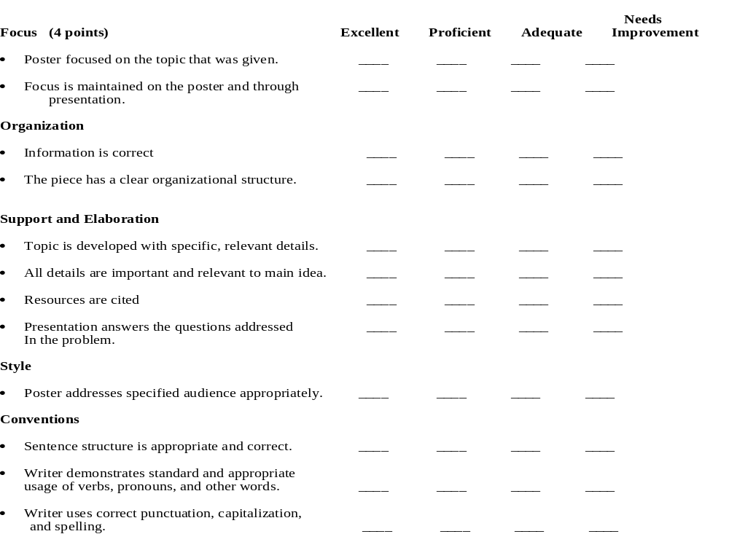
Rubric

Slide 22
Other ways to tie it in or Assess at the same time
Compose narratives about traveling to the regions of NC (narrative)
Create an advertisement urging people to move from the coastal plains to other areas of NC
You can also have them research individuals like Daniel Boone, John Lawson, William Davie, etc. Children can write a report on the individuals. Then you can have children perform it for others by setting up a wax museum.
Have children study slave labor through slave narratives
Born in Slave Labor- http://memory.loc.gov/ammem/snhtml/snhome.html
American Slave Narratives- http://xroads.virginia.edu/~hyper/wpa/wpahome.html
After children have read through several of the narratives, then have them discuss and record on chart paper who the person is, how they feel, and what the person knows. Then discuss what role slave labor played in development of NC, what contributions were made by this group of people, and what community changes occurred after the Civil War.

Slide 23
Resources for Migration and Settlement
Social Studies book series Unit 2- Lesson 3,4, & 5
Time For Kids Readers- Moravians of Old Salem, The People of Appalachia
Leveled Books- North Carolina and the Past, North Carolina Festivals, People Today and Long Ago
Library Books
Digital Heritage

Slide 24
Revolutionary War/ Civil War
4.H.1.4- Analyze North Carolina’s role in major conflicts and wars from the Pre-Colonial period through Reconstruction.
Make KWL chart on what they know about each war. Start with Revolutionary and then proceed with the Civil War( I only spend about 4 days on each). For the Revolutionary War, we discuss what the words independence, conflict, representation, protest, revolution, constitution, and bill of rights are.
For the Civil War we talk about the words Civil, state’s rights, secede, amendments, and conflict. I want to make sure students understand all of these vocabulary words.
I give them a brief overview of both so they know what’s going on and what each side is fighting for.
I introduce and talk about each war because the children love this stuff, but I also make sure they understand that war is usually started over a conflict of some sort no matter where it is, when it takes place, or who is in it. War also brings about change in communities and regions and I want to make sure children understand the big picture of it. When they understand the big pictures of wars, then the other stuff will fall into place.
For both of these wars, I have maps that the children color on to show where all of this takes place and to also show that all of the US is not settled yet like it is now.

Slide 25
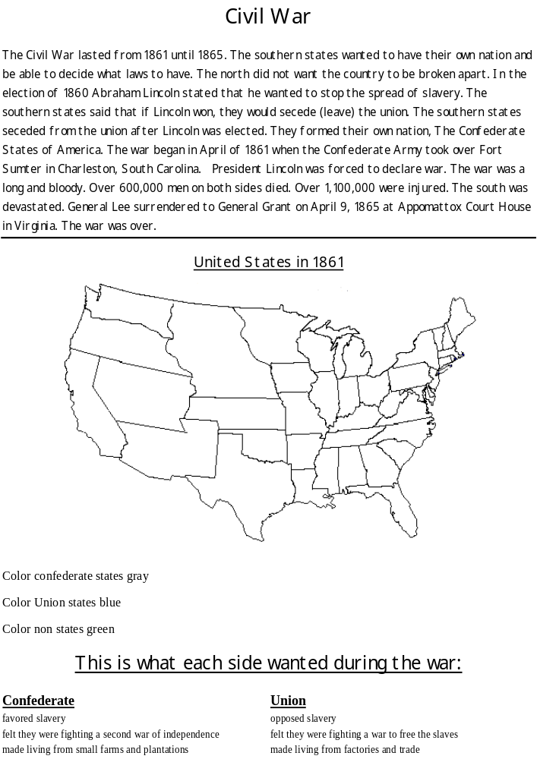
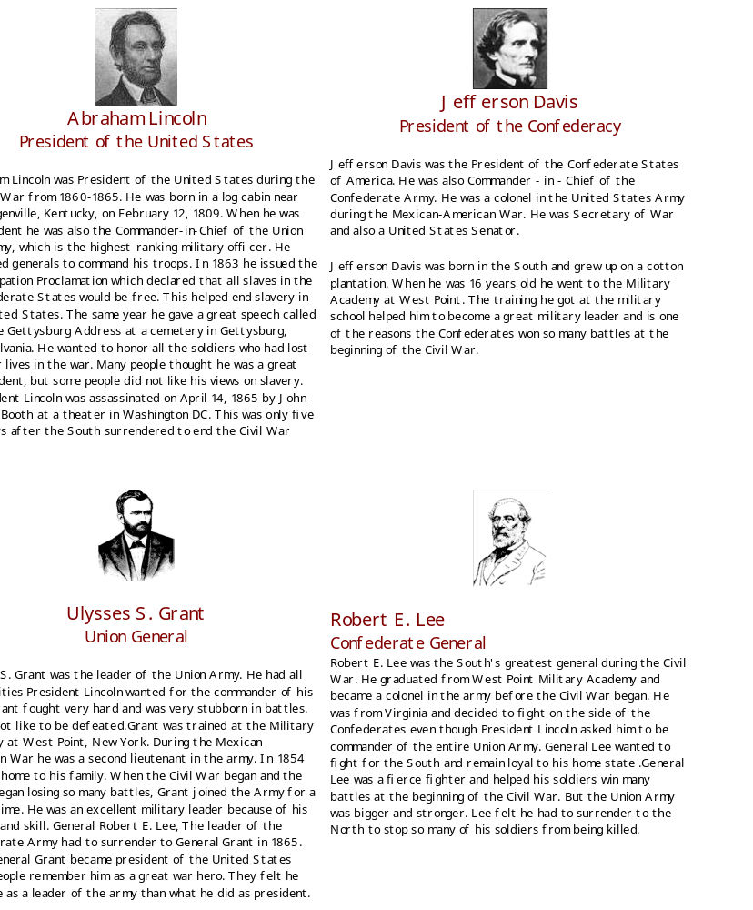
Some resources I created for the Civil War for their notebooks

Slide 26

Problem
Conflict in the Americas
You have been hired by the Natural History Museum in Raleigh to create a display of one of the battles in the American Revolutionary War or the Civil War. The curator has asked that you include a scene of one of the battles, information that details what happened before, during, and after the battle, and any other information that will grab the attention of onlookers as they visit the Museum.

Slide 27
Procedure
Review what we have learned about both Wars
Then children will read the problem, list the facts from the problem, and then discuss possible hypothesis
There will be a list of battles in NC for both Wars. You can either assign each group one or let them choose. I just pulled battles out of a hat.
Allow children to research using books, internet, primary or secondary sources, etc. Here is a livebinder site- http://www.livebinders.com/play/play?id=477517
Make sure you have shown the children the rubric so they know what the expectations are.
Then allow them to create their projects and get them ready for presentation times.
This is a big project so I had a list of questions that they were supposed to answer while they are listening to others. They could work together to answer with the people in their groups only and could only discuss answers when their was transition between groups.
Also after all the presentations, have the children take a gallery walk so they can get a better view of what each group did.

Slide 28
Rubric
Task | Strong 5 | Medium 3 | Weak 1
Illustration or 3-D diorama of battle | All three of the following are included: -Illustration or diorama shows both combatants of the war - The Landscape of the battle is clearly shown - The main event of the battle is evident in the picture or model | Two of the following are included: -Illustration or diorama shows both combatants of the war - The Landscape of the battle is clearly shown - The main event of the battle is evident in the picture or model | Zero or one of the following are included: -Illustration or diorama shows both combatants of the wars - The Landscape of the battle is clearly shown - The main event of the battle is evident in the picture or model
Map of the Battle | All three of the following are included: -map shows the correct area of the battle -important geographical features are included -a short paragraph explains how the geography helped the Continental Army | Two of the following are included: -map shows the correct area of the battle -important geographical features are included -a short paragraph explains how the geography helped the Continental Army | Zero or one of the following are included: -map shows the correct area of the battle -important geographical features are included -a short paragraph explains how the geography helped the Continental Army
Description of Battle’s Importance | Paragraphs clearly explain why this battle was important to the American Revolution or Civil War. | Paragraphs explain the importance of this battle, but some information is missing or unclear. | Paragraphs do not explain why this battle was important to the American Revolution or Civil War.
Changes after the Battle or War | Paragraph clearly states what changes the battle had on the area. | Paragraph explains how the battle changed the area, but some information is missing or unclear. | Paragraph does not explain the changes after the battle.

Slide 29
Resources For Revolutionary and Civil War
Revolutionary War
Book of Plays that comes with S.S. adoption
Magic Tree House- Revolutionary War on Wednesday by Mary Pope Osborne and the Accompanied Nonfiction Guide
If You Lived at the Time of the Revolutionary War
The North Carolina Colony by Kevin Cunningham
Mission USA
The Declaration of Independence by Syl Solel
Civil War
Sweet Clara and The Freedom Quilt by Judy Ramsey
Reward Posters that you can find online
Follow the Drinking Gourd By Jeanette Winter
Magic Tree House- Civil Way on Sunday by Mary Pope Osborne
If You Lived At the Time of the Civil War by
If You Traveled on The Underground Railroad by Ellen Levine
Civil War by John Perritano

Slide 30
Other ways to tie it in and to Assess at the same time
Have children look at slave reward posters and then do a comparison between how the slaves felt about being slaves and then how the slave owners felt about runaway slaves. Use this comparison to write a poem with two voices. The purpose is to get the students to see both sides of slavery and to see how it affected individuals and communities.
Children can create a wax museum of famous war heroes, soldiers, generals, etc from NC in either war, famous abolitionists, or other heroes from this time. After researching and practicing what they will say about each person, children can get into small groups and perform for each other. The group members listening will be in charge of listening for the person’s name, where they are from, and their contributions.
Children can create timelines of the events from all of the projects.
Create newspaper articles from the point of view of some one watching the battle on the side lines.
Show children time period pictures/paintings and have them respond as to how it makes them feel, any details they notice, and what questions they might have. (Library of Congress)
Instead of making dioramas or pictures, have them create power points on battles
Write journal entries from any perspective during either of these time periods- slave, slave owner, soldier, woman, general, etc.

Slide 31
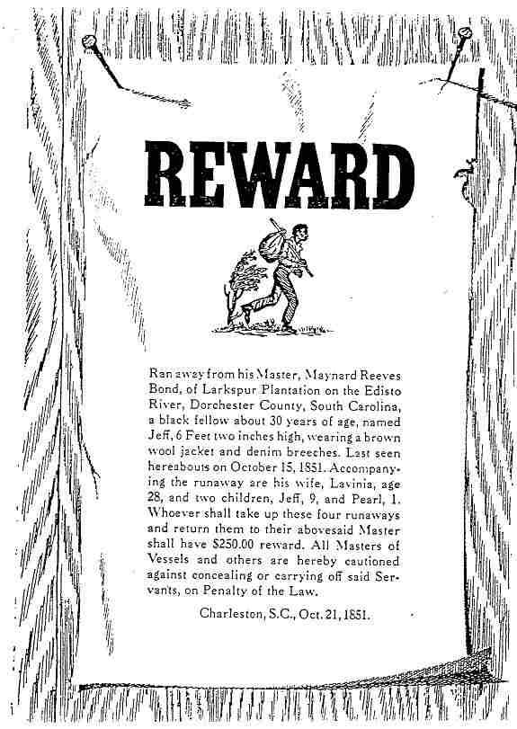
Reward Poster
This is an example of a reward poster that I found. Show this to the children and ask them why were posters like this used, what does the poster tell us about Jeff, and why was Jeff’s master willing to pay $250 for his return.
Using these types of real world examples makes this more real for the students. They become very invested.

Slide 32
Other Resources
North Carolina Museum of History- http://www.nchistoryresources.org/
Mrs. Walker’s Class Website- http://steveandcat.net/mrswalker/4th_grade_stuff.htm
NC Pedia- http://ncpedia.org/
Live Binders for 4th grade- http://wsfcs.k12.nc.us/Page/61631
Digital Heritage- http://digitalheritage.org/page/3/
Webquests- http://its.guilford.k12.nc.us/webquests/socialst.html
Old State Magazines
North Carolina Brochures- that you can get free!
Journeys for Freedom by Susan Buckley and Elspeth Leacock
Read Write Think- http://www.readwritethink.org/classroom-resources/lesson-plans/
Library of Congress
North Carolina Museum of History
North Carolina Facts
North Carolina History
North Carolina Studies Weekly

Slide 33
Other Technology Tools
Big Huge Labs
Blabberize
Voki
Fakebook
Museum Box
Story Bird
Popplet
Powerpoint
Prezi

Slide 34
Any questions or comments….
I hope you learned something or got ideas. If you have anything to share, then please do.
If you have any questions or comments please feel free to email Andrew Kraft or Roberta Haeffele- rlhaeffele@wsfcs.k12.nc.us

