Slide 1
ROSA PARKS COMMUNITY SCHOOL
BACK TO SCHOOL NIGHT PRESENTATION
SEPTEMBER 24, 2020
6:00-8:00 pm

Slide 2
WELCOME and INTRODUCTIONS
SUPERINTENDENT OF SCHOOLS DR. GERALD FITZHUGH II
MEMBERS OF THE BOARD OF EDUCATION
SCHOOL INSTRUCTIONAL LEADERSHIP
PRINCIPAL DR. DEBRA JOSEPH-CHARLES
ASSISTANT PRINCIPAL MR. TERENCE WESLEY
DEAN OF STUDENTS MR. JOSHUA CHUY

Slide 3
AGENDA
State of the School Address: English/Spanish (6:00-6:30)
Remarks by the support staff:
School Counselors: Mrs. Esther Lawal
Mrs. Natasha Murphy
School Nurse: Ms. Ijeoma Anyanwu
Grade Level Meetings: 6:30-8:00
State of the School Address: English/Creole (7:45-8:00)

Slide 4

MEETING ATTENDANCE/PROTOCOL
Attendance will be taken during your meeting with the grade level teachers. Please ensure that you check in to record your attendance when you sign in with your child’s grade level team.
If you have a question, please place it in the chat, along with your child’s name. We will address as many questions as possible in the chat. If we do not get to your question, we will follow up with an email or phone call. Ensure you leave a phone number where you can be reached.
At 6:30pm, you will join your child’s grade level to meet the teachers and receive information on curriculum, expectations, attendance, how progress will be assessed, and how to communicate with staff.

Slide 5
ROSA PARKS/CENTRAL ELEMENTARY SCHOOL
CAMPUS MODEL
ROSA PARKS COMMUNITY SCHOOL
Grades 3-7
Principal: Dr. Joseph-Charles
Assistant Principal: Terence Wesley
Dean of Students: Joshua Chuy
Shared staff: Encore Teachers
SWD/ESL Teachers
Shared facilities
CENTRAL ELEMENTARY SCHOOL
Grades K-2
Principal: Ms. Denise White
Shared staff: Encore Teachers
SWD/ESL Teachers
Shared facilities

Slide 6
GREAT NEWS
Kiosks
  504 of Chromebooks distributed in September
  Prepared and distributed supplies
  Student schedules
Student Attendance
  75% to 83% (1st vs 2nd week)
21st Century Award
  $347,000 (RPCS and Oakwood Avenue Community School)
  To continue our afterschool work with grades 4-7 (academics, social clubs, and SEL)
First year participating in the Debate Club
Math Problem of the Week Winners

Slide 7
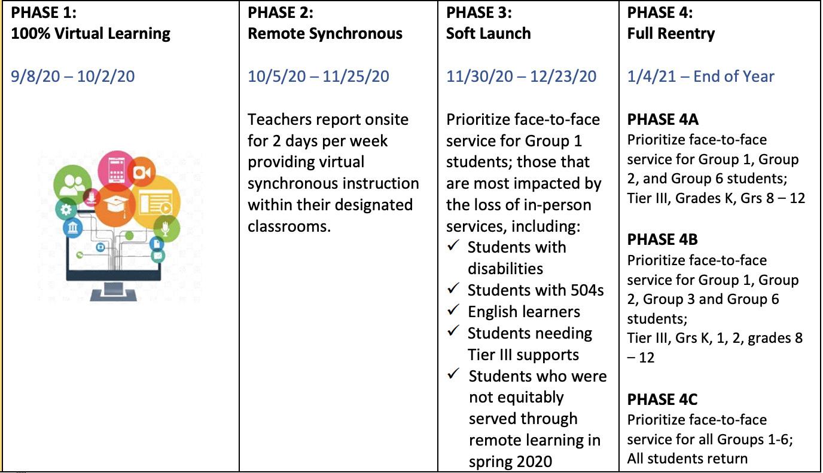
Parental Option 2: Plan B
“Plan B”

Slide 8

PLAN B
Phase 2 Remote Synchronous Oct. 5-Nov. 25 (7 weeks)
Teachers report onsite for 2 days per week. While onsite, webcams are used during instruction for at home learners. Teachers provide virtual synchronous instruction within their designated classroom spaces.*Webcams will be trained only on teachers during use.
Synchronous instruction will be conducted Monday, Tuesday, Thursday, and Friday. Wednesday is an asynchronous instructional day, while staff is involved in common planning opportunities and professional development.
Support Staff (guidance, CST, related service providers, social workers, attendance officers, and paraprofessionals), nurses, TC’s, secretaries are onsite 4 days per week. Teachers are onsite for the length of the school day.

Slide 9
Sample Phase 1 Schedules
Homeroom: Taylor Rm 103
Grades 3-5
Grades 6-7
Time | MONDAY | TUESDAY | WEDNESDAY | THURSDAY | FRIDAY
8:30-8:45 | Homeroom, Attendance, Class Community Time (SEL) | Homeroom, Attendance, Class Community Time (SEL) | Homeroom, Attendance, Class Community Time (SEL) | Homeroom, Attendance, Class Community Time (SEL) | Homeroom, Attendance, Class Community Time (SEL)
8:45-9:30 | A-Day Social Studies St. Fort B-Day Science Devose | A-Day Social Studies St. Fort B-Day Science Devose | A-Day Social Studies St. Fort B-Day Science Devose | A-Day Social Studies St. Fort B-Day Science Devose | A-Day Social Studies St. Fort B-Day Science Devose
9:30-10:15 | ELA Assia | ELA Assia | ELA Assia | ELA Assia | ELA Assia
10:15-11:00 | MATH Taylor | MATH Taylor | MATH Taylor | MATH Taylor | MATH Taylor
11:00-11:45 | Small Group Instruction | Small Group Instruction | Small Group Instruction | Small Group Instruction | Small Group Instruction
11:45-12:30 | PE Anzano | COMPUTER LITERACY Raimondi | HEALTH Anzano | PE Anzano | FRENCH Vertus
12:30-1:00 | LUNCH | LUNCH | LUNCH | LUNCH | LUNCH
1:00-3:20 | Teachers’ Office Hours Students complete Homework, Digital content , assignments | Teachers’ Office Hours Students complete Homework, Digital content , assignments | Teachers’ Office Hours Students complete Homework, Digital content , assignments | Teachers’ Meeting Students complete Homework, Digital content , assignments | Teachers’ Office Hours Students complete Homework, Digital content , assignments
Time | MONDAY | TUESDAY | WEDNESDAY | THURSDAY | FRIDAY
8:30-8:45 | Homeroom, Attendance, Class Community Time (SEL) | Homeroom, Attendance, Class Community Time (SEL) | Homeroom, Attendance, Class Community Time (SEL) | Homeroom, Attendance, Class Community Time (SEL) | Homeroom, Attendance, Class Community Time (SEL)
8:45-9:30 | A-Day Physical Education (Dilworth) B-Day Physical Education (Dilworth) | A-Day Media (Jackson) B-Day Art (Wszolkowski) | A-Day Band/Strings B-Day Health (Dilworth) | A-Day World Language B-Day Physical Education (Dilworth) | A-Day Vocal Music B-Day Art (Wszolkowski)
9:30-10:15 | MATH Khan Room 412 | MATH Khan Room 412 | MATH Khan Room 412 | MATH Khan Room 412 | MATH Khan Room 412
10:15-11:00 | ELA Brown Room 413 | ELA Brown Room 413 | ELA Brown Room 413 | ELA Brown Room 413 | ELA Brown Room 413
11:00-11:45 | A-Day Science Ellerbe Room 417 B-Day Social Studies Pais Room 402 | A-Day Science Ellerbe Room 417 B-Day Social Studies Pais Room 402 | A-Day Science Ellerbe Room 417 B-Day Social Studies Pais Room 402 | A-Day Science Ellerbe Room 417 B-Day Social Studies Pais Room 402 | A-Day Science Ellerbe Room 417 B-Day Social Studies Pais Room 402
11:45-12:30 | Small Group Instruction | Small Group Instruction | Small Group Instruction | Small Group Instruction | Small Group Instruction
12:30-1:00 | LUNCH | LUNCH | LUNCH | LUNCH | LUNCH
1:00-3:20 | Teachers’ Office Hours Students complete Homework, Digital content , assignments | Teachers’ Office Hours Students complete Homework, Digital content , assignments | Teachers’ Planning Students complete Homework, Digital content , assignments | Teachers’ Office Hours Students complete Homework, Digital content , assignments | Teachers’ Office Hours Students complete Homework, Digital content , assignments

Slide 10
Sample Phase 2 Schedules
Homeroom: Taylor Rm 103
Grades 3-5
Grades 6-7
Time | MONDAY | TUESDAY | WEDNESDAY | THURSDAY | FRIDAY
8:30-8:45 | Homeroom, Attendance, Class Community Time (SEL) | Homeroom, Attendance, Class Community Time (SEL) | Asynchronous Instructional Day | Homeroom, Attendance, Class Community Time (SEL) | Homeroom, Attendance, Class Community Time (SEL)
8:45-9:30 | A-Day Social Studies St. Fort B-Day Science Devose | A-Day Social Studies St. Fort B-Day Science Devose | Asynchronous Instructional Day A-Day Social Studies St. Fort B-Day Science Devose | A-Day Social Studies St. Fort B-Day Science Devose | A-Day Social Studies St. Fort B-Day Science Devose
9:30-10:15 | ELA Assia | ELA Assia | Asynchronous Instructional Day | ELA Assia | ELA Assia
10:15-11:00 | MATH Taylor | MATH Taylor | Asynchronous Instructional Day | MATH Taylor | MATH Taylor
11:00-11:45 | Small Group Instruction | Small Group Instruction | Small Group Instruction | Small Group Instruction | Small Group Instruction
11:45-12:30 | PE Anzano | COMPUTER LITERACY Raimondi | Asynchronous Instructional Day HEALTH Anzano | PE Anzano | FRENCH Vertus
12:30-1:00 | LUNCH | LUNCH | LUNCH | LUNCH | LUNCH
1:00-3:20 | Teachers’ Office Hours Students complete Homework, Digital content , assignments | Teachers’ Office Hours Students complete Homework, Digital content , assignments | Teachers’ PLANNING Students complete Homework, Digital content , assignments | Teachers’ Meeting Students complete Homework, Digital content , assignments | Teachers’ Office Hours Students complete Homework, Digital content , assignments
Time | MONDAY | TUESDAY | WEDNESDAY | THURSDAY | FRIDAY
8:30-8:45 | Homeroom, Attendance, Class Community Time (SEL) | Homeroom, Attendance, Class Community Time (SEL) | Asynchronous Instructional Day | Homeroom, Attendance, Class Community Time (SEL) | Homeroom, Attendance, Class Community Time (SEL)
8:45-9:30 | A-Day Physical Education (Dilworth) B-Day Physical Education (Dilworth) | A-Day Media (Jackson) B-Day Art (Wszolkowski) | Asynchronous Instructional Day A-Day Band/Strings B-Day Health (Dilworth) | A-Day World Language B-Day Physical Education (Dilworth) | A-Day Vocal Music B-Day Art (Wszolkowski)
9:30-10:15 | MATH Khan Room 412 | MATH Khan Room 412 | Asynchronous Instructional Day | MATH Khan Room 412 | MATH Khan Room 412
10:15-11:00 | ELA Brown Room 413 | ELA Brown Room 413 | Asynchronous Instructional Day | ELA Brown Room 413 | ELA Brown Room 413
11:00-11:45 | A-Day Science Ellerbe Room 417 B-Day Social Studies Pais Room 402 | A-Day Science Ellerbe Room 417 B-Day Social Studies Pais Room 402 | Asynchronous Instructional Day A-Day Science Ellerbe Room 417 B-Day Social Studies Pais Room 402 | A-Day Science Ellerbe Room 417 B-Day Social Studies Pais Room 402 | A-Day Science Ellerbe Room 417 B-Day Social Studies Pais Room 402
11:45-12:30 | Small Group Instruction | Small Group Instruction | Asynchronous Instructional Day | Small Group Instruction | Small Group Instruction
12:30-1:00 | LUNCH | LUNCH | LUNCH | LUNCH | LUNCH
1:00-3:20 | Teachers’ Office Hours Students complete Homework, Digital content , assignments | Teachers’ Office Hours Students complete Homework, Digital content , assignments | Teachers’ PLANNING Students complete Homework, Digital content , assignments | Teachers’ Office Hours Students complete Homework, Digital content , assignments | Teachers’ Office Hours Students complete Homework, Digital content , assignments

Slide 11
Virtual Teaching & Learning Expectations
Students attend classes each day according to their schedules.
Students submit assigned work based on outlined deadlines and timelines.
Students are expected to complete work independently .
Attend ALL classes, participate and remain in class until dismissed.
Complete assigned homework, including digital content.
Contact teachers, administrators, and/or school counselors/social workers for support.

Slide 12
Virtual Attendance Policies and Procedures
Attend ALL daily Synchronous lessons.
Complete and submit independent work during Asynchronous learning.

Slide 13
SCHOOL GOALS
ELA-By June 2021, using research-based effective instructional strategies, at least 70% of the students in grades 3-7 at RPCS will meet their academic goals set in September 2020.
MATH-By June 2021, 70% of our Tier 3 students at RPCS will progress at least a 1.5-year achievement gap in Math, and 70% of our Tier 2 students will improve at least 1 year in Math by the staff utilizing a research-based data protocol.
CLIMATE/CULTURE-By June 2021, using a structured Climate and Culture Plan, RPCS will have systematic protocols in place to address the following -SEL, student voice and school operation.

Slide 14
VIRTUAL INTERVENTION/ENRICHMENT PROGRAMS
Digital Platforms
  READING PLUS
  IREADY
  SYSTEM 44 (ELA)
  ROSETTA STONE
  STMATH
  READORIUM
Programs
  RTI/Afterschool Program
  STEM, ART CLUB, DANCE EMSEMBLE, ROBOTICS, CHORUS, BAND, GAME 24, DEBATE CLUB

Slide 15
SUPPORT STAFF
School Counselors: Mrs. Esther Lawal Mrs. Natasha Murphy
School counselors work with students, teachers, and parents to improve student achievement and success for all students.
We listen to student’s concerns-academic, social, or emotional, and provide the necessary SEL support and services that help students. We cater to the whole child.
Grade 3, Grade 6 and 7- (Last Name A-L) : Mrs. Esther Lawal (LawalEst@orange.k12.nj.us)
Grades 4, 5 and 7 (Last Name M-Z) : Mrs. Natasha Murphy (MurphyNa@orange.k12.nj.us)

Slide 16
SUPPORT STAFF
School Counselors: Mrs. Esther Lawal Mrs. Natasha Murphy
Social Emotional Learning (SEL), Resources
Our SEL theme for the school year is Empathy.
SEL provides everyone the skills necessary to communicate and understand emotions, establish positive relationships, and show empathy to others.
Benefits of Social Emotional Learning: Students become more successful in the classroom, in the school, and later in life.
Outside Counseling Resources: NJ PerformCare- Call 1-877-652-7624 or visit the website: https://www.performcarenj.org/
Additional SEL Resources can be located on the district’s website Additional Resources

Slide 17
SUPPORT STAFF
School Counselors: Mrs. Esther Lawal Mrs. Natasha Murphy
Intervention and Referral Services (I&RS) and 504
I&RS is the planning and delivery of intervention and referral services to assist students. It is a process- from the identification of problem to the solution.
Who needs I&RS? Students who are experiencing learning, behavior, or health difficulties and staff who have difficulties addressing students’ needs.
Functions of I&RS: Identify student’s difficulties, develop and implement action plans for the identified difficulties. I&RS Coordinator: Mrs. Esther Lawal (LawalEst@orange.k12.nj.us)
504 Coordinator: Mrs. Natasha Murphy (MurphyNa@orange.k12.nj.us)
Please refer the Parent & Student Handbook for additional Intervention and Referral Services information Parent/Student Handbook

Slide 18

From The Nurse’s Office
Ijeoma Anyanwu (Nurse Ij)
anyanwij@orange.k12.nj.us

Slide 19
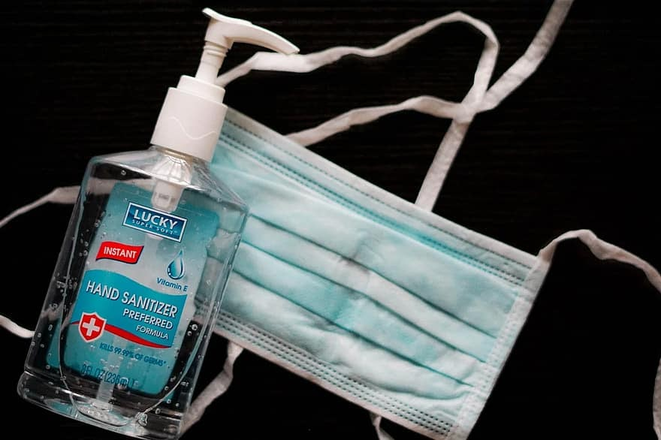
TOPICS: COVID 19 Discussion/Information
Transmission - Droplets when people talk, cough or sneeze.
Testing and treatment - Free testing sites in NJ. No known treatment.
Face coverings:
  As a means of protection.
  Avoid touching the outside of your mask with your hands.
  If using cloth masks, wash regularly and dry completely.
Respiratory and Hand Hygiene
  Wash hands with soap and water.

Slide 20

TOPICS : COVID 19 Discussion/Information
Respiratory and Hand Hygiene continued:
  Use hand sanitizer containing at least 60% of alcohol if soap and water not available.
  Cover cough and sneeze always and wash hands immediately.
Isolation and Quarantine: Stay at home if sick or came into contact with the sick.
Flu shot: Recommended yearly by CDC for protection against influenza.
Vaccinations: Have you student/child seen by his/her PCP.

Slide 21
Important Information
Lunch Forms
Emergency Contact Forms
Media Release Forms
Parent Portal Parent Portal Links
Home School Compacts
Continue to check the school website for current updates
Please ensure that you listen to the phone blasts, read emails, and visit Class Dojo regularly to remain informed

Slide 22
JOINING GRADE LEVEL BREAK OUT ROOMS
Prior to exiting our meeting, please find the link to your grade level meeting in the chat.
Click the link to join your child’s grade level meeting
Make sure you click your child’s name for attendance.
We will be on this link to assist anyone who is experiencing problems logging into their meeting.
The links have also been placed on our website –labeled by grade level.

Slide 23



Orange Public Schools Social Media
Social Media Hashtags:
#GoodtoGreat
#FROrange
#OrangeStrong
Follow us:
- Orange Public School District
- @ops_district
@RPCS369
- opsdistrict
rosaparks369
- -Orange Public School District

