Slide 1
Claim 3: Communicating Reasoning
The Smarter Balanced summative mathematics assessment and its relationship to instruction
Notes:
Hello and welcome to the OSPI video series on the Smarter Balanced assessment claims and their relationship to instruction.
This video focuses on Claim 3: Communicating Reasoning.
We hope this video increases your understanding of Claim 3 and its relationship to the Washington State K—12 Learning Standards for mathematics.

Slide 2
What is Claim 3?
Assesses students’ ability to clearly and precisely construct viable arguments to support their own reasoning and critique the reasoning of others.
Somewhat similar to Washington’s short-answer items.
Uses multiple item types in new assessment
Notes:
Claim 3 addresses students’ ability to clearly and precisely construct viable arguments to support their own reasoning and critique the reasoning of others. Communicating mathematical reasoning is not just a requirement of the Standards for Mathematical Practice, it is also a theme in the content standards. Many content standards ask students to explain, justify, or illustrate.
There are many ways to assess a student’s ability to communicate their reasoning. Washington State has a tradition of using short-answer items to assess students’ ability to explain their reasoning. Students will still be asked to explain their thinking in their own words, including mathematical symbols when appropriate. However, multiple-choice, equation/numeric, and other item types can be used to assess a student’s ability to reason and communicate mathematically as well. These items ask students to determine if conjecture is plausible or not, whether there is a flaw in a given argument, or construct a logical sequence of steps to support or refute a proposition.

Slide 3
More Information
More information about communicating reasoning for Claim 3 is available in the Mathematics Content Specifications, online at http://www.smarterbalanced.org/smarter-balanced-assessments/
Notes:
More information about communicating reasoning for Claim 3 is available in the Mathematics Content Specifications, online at this website.

Slide 4
Claim 3 requires use of content in the Standards
Communicating reasoning is critical for solid mathematical understanding.
It provides a firmer foundation for future learning than just knowing a procedure.
Claim 3 focuses on a particular standard or part of the standard.
Notes:
Communicating reasoning is critical for solid mathematical understanding. For example, when a student is able to explain why a mathematical procedure works - not just follow the procedure - they have a deeper understanding of the mathematics. This deeper understanding provides a foundation for future learning. It is likewise essential that the communication of reasoning be about a topic, in this case mathematical ideas. Where Claim 2 is assessed at the cluster level, Claim 3 primarily focuses on a particular standard or part of the standard.

Slide 5
Examining a standard
4.NF.A.2
Compare two fractions with different numerators and different denominators, e.g., by creating common denominators or numerators, or by comparing to a benchmark fraction such as ½. Recognize that comparisons are valid only when the two fractions refer to the same whole. Record the results of comparisons with symbols >, =, or <, and justify the conclusions, e.g., by using a visual fraction model.
Notes:
Examining a Grade 4 standard may be helpful.
The yellow-highlighted words of this standard describes procedures to compare fractions and how to record these comparisons. These parts of the standard are assessed in Claim 1. The green-highlighted words lend themselves to Claim 3 assessment. They ask students to communicate about valid fraction comparisons based on the size of the whole and justify a conclusion based on a visual model.

Slide 6
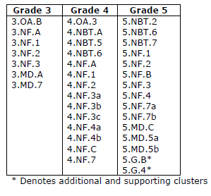
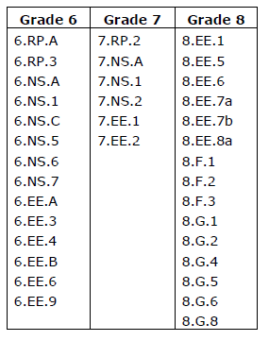
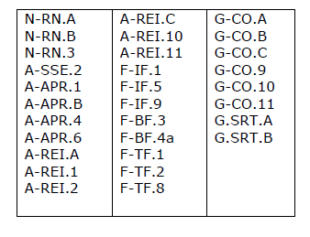
Domains
Notes:
These tables represent the standards that lend themselves to Claim 3 and should be highlighted for communicating reasoning. As with the Grade 4 example, these standards contain key language describing the mathematical reasoning with which students should engage. This is not to say that other content could not be a source of student discussion and communication; students should be able to communicate reasoning about any mathematical content area.

Slide 7
More information on Standards in Claim 3
The three Claim 3 documents, Grades 3 through 5, Grades 6 through 8, and High School are available online at http://www.smarterbalanced.org/smarter-balanced-assessments/#item
Look under “Mathematics” in the Item/Task Specifications section.
Notes:
The three Claim 3 documents, Grades 3 through 5, Grades 6 through 8, and High School, are available online at this website. Look under “Mathematics” in the Item/Task Specifications section.

Slide 8
Claim 3 is based on the Mathematical Practices
Mathematical Practices 3 and 6 are foundational support for Claim 3.
  3. Construct viable arguments and critique the reasoning of others.
  6. Attend to precision.
Notes:
Mathematical Practices 3 and 6 are the foundational support for Claim 3. These practices ask students to construct viable arguments and critique the reasoning of others, and attend to precision.
Probably no claim mirrors the related Standards for Mathematical Practices more than Claim 3. Precision in computational procedure has been a focus in mathematics for years. While that is still a focus, student precision with mathematical language and symbols has not been emphasized. Students should be attending to precision both when talking and writing about mathematical concepts. This clarity and precision applies not only to arguments a student develops, but also to the arguments of others.

Slide 9
Additional information on Claim 3 and the Mathematical Practices
The Smarter Balanced Content Specifications, with additional information on how these practices inform Claim 3, is available online at http://www.smarterbalanced.org/smarter-balanced-assessments/
Notes:
The Smarter Balanced Content Specifications, with additional information on how these practices inform Claim 3, is available online at this website.

Slide 10
Communicating Reasoning: A variety of skills
Claim 3 has seven targets, with the last target reserved for later grades.
The six targets are the same at each grade level.
Each target describes a particular skill that should be developed in students as part of the ability to communicate and reason about mathematical ideas.
Most items assess more than one target.
Notes:
Mathematics provides opportunities for students to clearly and precisely construct arguments based on given assumptions. It also requires that students evaluate and critique the arguments of others. But creating and critiquing arguments are not the only skills assessed in Claim 3 items. There are seven targets in Claim 3, and all but the last target are the same at all grade levels. Each target describes a particular skill that students should develop as part of their ability to communicate and reason about mathematical ideas. Most items assess more than one of these targets, requiring students to use multiple communication and reasoning skills.

Slide 11
Target A: Test propositions
Test propositions or conjectures with specific examples.
Tasks used to assess this target ask for specific examples to support or refute a proposition or conjecture.
Notes:
The first target is:
Test propositions or conjectures with specific examples.
Tasks used to assess this target should ask for specific examples to support or refute a proposition or conjecture.

Slide 12
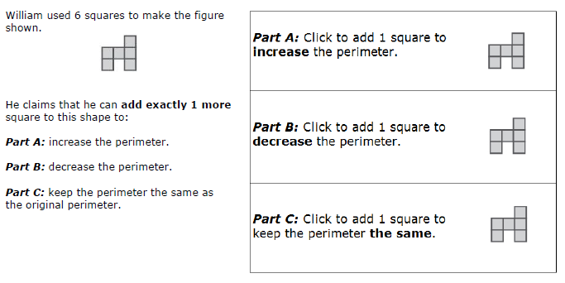
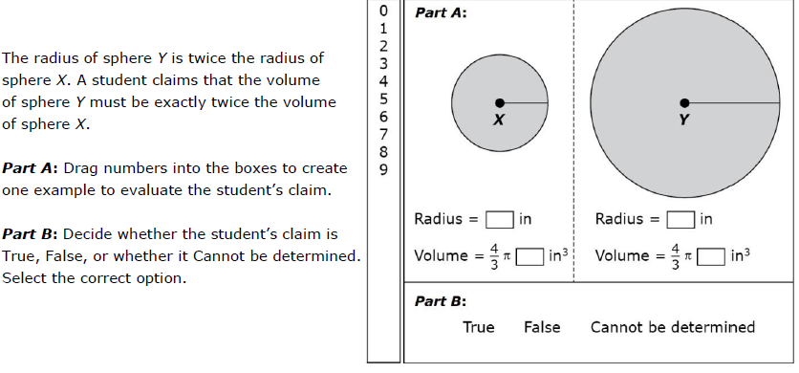
Grade 5
High School
Notes:
The Grade 5 and high school items shown primarily ask students to test a proposition with specific examples. Take a moment to consider how specific examples support a student’s reasoning about these mathematical concepts.

Slide 13
Target B: Justify or refute propositions or conjectures
Construct, autonomously, chains of reasoning that will justify or refute propositions or conjectures.
“Autonomous” in this target means students respond to a single question without further guidance.
Target B has less scaffolding that Target A.
Notes:
The second target is:
Construct, autonomously, chains of reasoning that will justify or refute propositions or conjectures.
Students are asked to identify or construct reasoning that justifies or refutes a conjecture. “Autonomous” means the student responds to a single question, without further guidance. Target B has less scaffolding that Target A, even though there may be similar types of items as Target A.

Slide 14
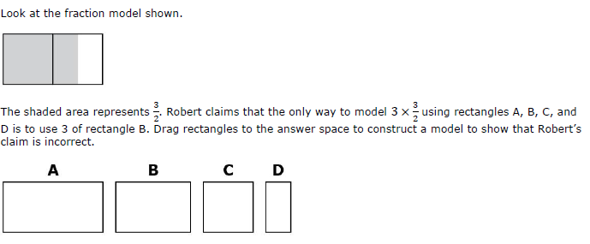
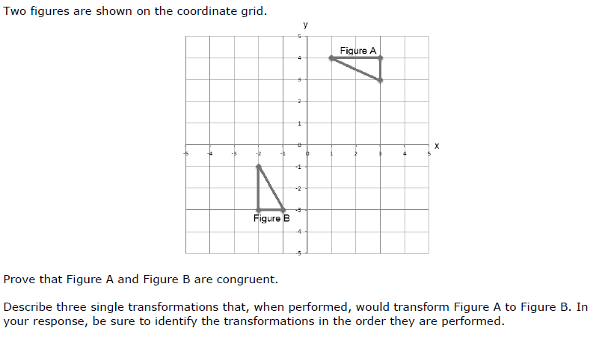
Grade 5
Grade 8
Notes:
These Grade 5 and Grade 8 examples primarily ask students to construct chains of reasoning to justify a proposition. Take a moment to consider the “chain of reasoning” a student might follow to develop an answer to the question asked.

Slide 15
Target C: State logical assumptions
State logical assumptions being used.
Students may be asked to identify the assumption, or they may be asked to use an assumption to answer a question.
Notes:
The third target is:
State logical assumptions being used.
Students are presented with a mathematical or real-world scenario. Students are asked to identify the assumption used in the scenario, or they may be asked to use an assumption to answer a question.

Slide 16
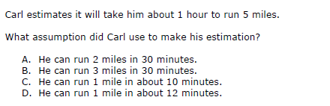
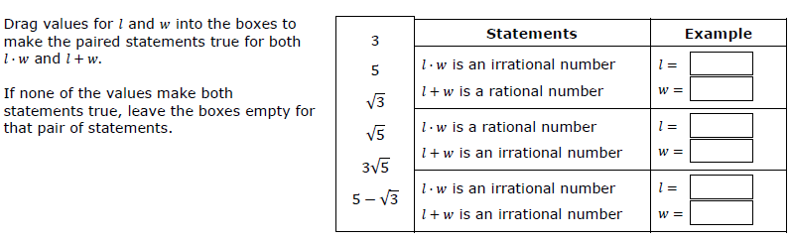
Grade 4
High School
Notes:
These Grade 4 and high school items ask students to identify an assumption or determine when an assumption is true. Take a moment to identify the assumption or assumptions necessary to answer the questions.

Slide 17
Target D: Breaking an argument into cases.
Use the technique of breaking an argument into cases.
Students look for conditions that make an argument true and those that show an argument is not true.
Notes:
The fourth target is:
Use the technique of breaking an argument into cases.
Students analyze a situation by breaking it into cases, specifically looking for conditions that make an argument true and those that show an argument is not true. Students recognize and make use of counterexamples as part of this work.

Slide 18
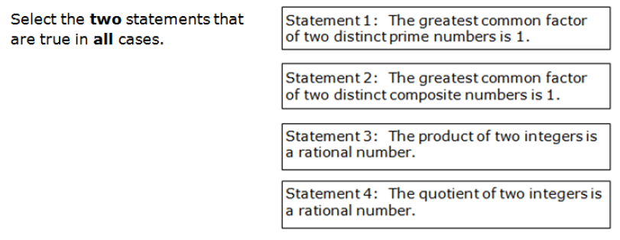
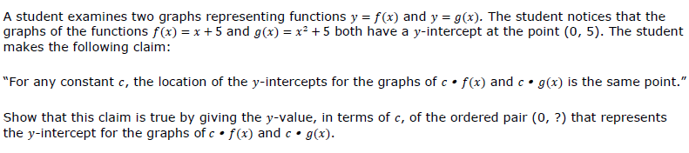
Grade 7
High School
Notes:
These Grade 7 and high school items ask students to consider particular cases. The student must determine if the cases are true or provide a value that will make the argument true. Take a moment to consider what conditions are necessary for the argument to be true, and what, if any, counterexamples would show the argument is not true.

Slide 19
Target E: Correct or flawed reasoning
Distinguish correct logic or reasoning from that which is flawed, and if there is a flaw in the argument, explain what it is.
Finding flaws in arguments helps students develop their own correct reasoning.
Notes:
The fifth target is:
Distinguish correct logic or reasoning from that which is flawed, and if there is a flaw in the argument, explain what it is.
Being able to find the flaw in an argument is important as students develop their own correct reasoning about a topic. Students should carefully review other students’ reasoning, as well, to develop their skills. Students should also be able to compare two arguments and determine which, if either, has correct reasoning and which has flawed reasoning.

Slide 20
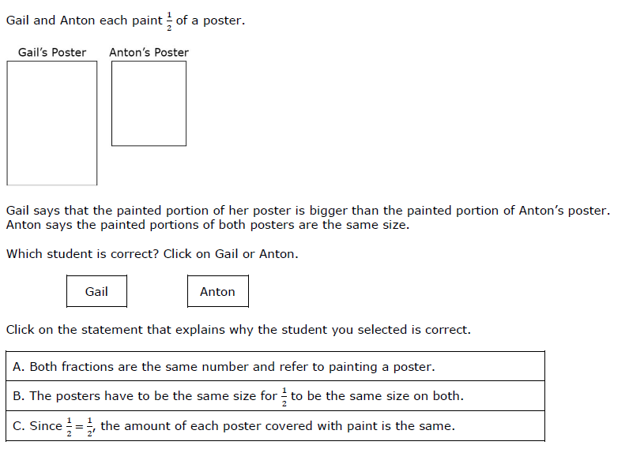
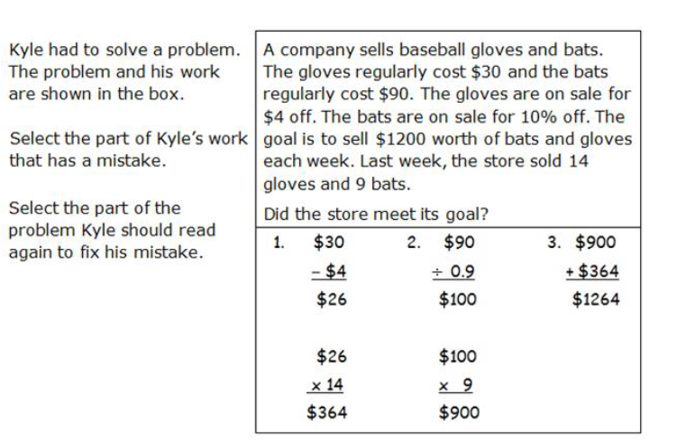
Grade 3
Grade 8
Notes:
These Grade 3 and Grade 8 items ask students to determine whether an argument is correct or not and where the error is in an argument, if there is one. Take a moment to identify what students might show or say to explain the error in each argument.

Slide 21
Target F: Arguments based on concrete referents
Base arguments on concrete referents such as objects, drawings, diagrams, and actions.
Students may be asked to use a drawing or diagram to support or refute a conjecture.
In later grades, concrete referents will often support generalizations as part of the justification of an argument.
Notes:
The sixth target is:
Base arguments on concrete referents such as objects, drawings, diagrams, and actions.
In early grades, students support or refute a conjecture or evaluate a chain of reasoning based on a specific drawing or diagram. In later grades, students use concrete referents to support generalizations as part of the justification of an argument.

Slide 22
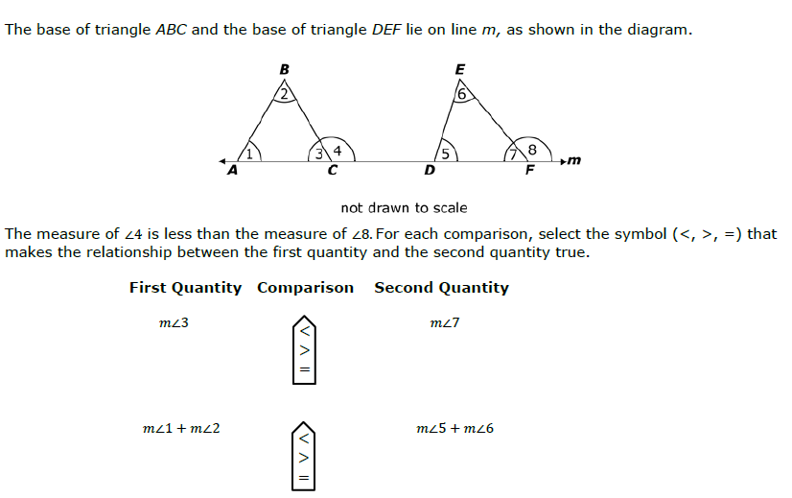
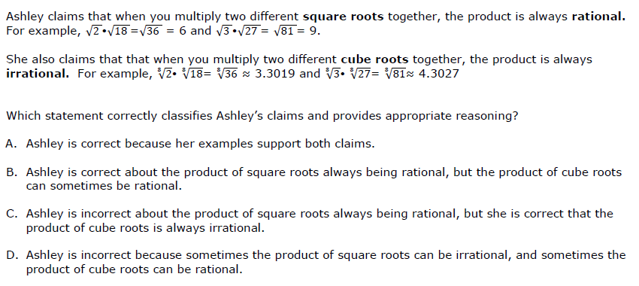
Grade 8
High School
Notes:
These Grade 8 and high school examples show how students are basing an argument on a referent. In the first case, the referent is a diagram. In the second, there are several equations to consider.

Slide 23
Target G: Determine conditions of an argument
At later grades, determine conditions under which an argument does and does not apply. (For example, area increases with perimeter for squares, but not for all plane figures.)
Often these tasks ask students to determine whether a proposition or conjecture always applies, sometimes applies, or never applies.
Notes:
The last target is:
At later grades, determine conditions under which an argument does and does not apply. (For example, area increases with perimeter for squares, but not for all plane figures.)
Often these tasks will ask students to determine whether a proposition or conjecture always applies, sometimes applies, or never applies. Students provide justification to support the conclusion they make. Items for Target G are very similar to items for Target D, but while Target D presents a conjecture or statement that is either always true or always false, Target G presents a conjecture or statement that can be true in some cases and not true in other cases.

Slide 24
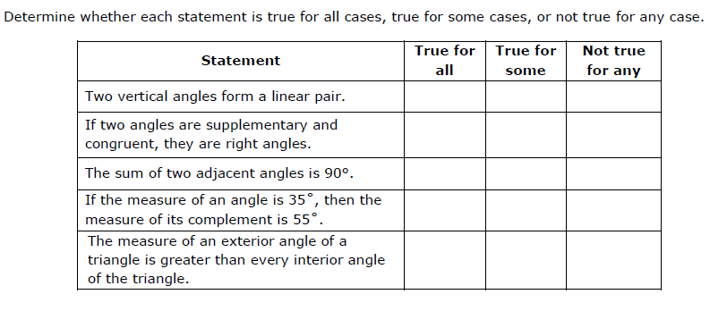
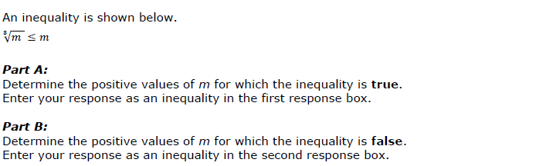
Grade 7
High School
Grade 7
Notes:
These Grade 7 and high school examples show items where conditions may change depending on the value of the variables involved. Take a moment to consider how a student might determine the values that support each condition.

Slide 25
More information on Claim 3 assessment
More example items for each target are available in the Claim 3 item specifications, online at http://www.smarterbalanced.org/smarter-balanced-assessments/#item
Look under “Mathematics” in the Item/Task Specifications section.
Notes:
More example items for each target are available in the Claim 3 item specifications, online at this website. Look under “Mathematics” in the Item/Task Specifications section.

Slide 26
How Claim 3 informs assessment
Students will reason about the central mathematical ideas in the standards.
Students must go beyond recall and application of concepts and procedures.
They will use evidence to support their thinking.
Approximately one-fifth of the Smarter Balanced CAT and performance task assessments will consist of Claim 3 items.
Notes:
Items and tasks aligned to this claim reflect the quality and precision that is at the heart of reasoning about mathematics. Students are not asked to “reason” in the abstract; rather, they will be asked to reason about the central mathematical ideas in the standards.
Communicating reasoning requires a high level of cognitive demand. In order to truly reason, students must go beyond both recall and application of concepts and procedures. They must compare and analyze data, generalize from specific examples, and use evidence to support their thinking. Item development in Claim 3 is flexible to elicit a wide range of strategic thinking and reasoning. Item writers must combine the skills described in the Claim 3 targets with content described in the standards. This is why there are no set task models in the Claim 3 documents, only descriptions and example items.
Approximately one-fifth of the Smarter Balanced computer-adaptive and performance task assessments consist of Claim 3 items. Typically there are six Claim 3 questions on the computer-adaptive portion of the assessment and two Claim 3 questions in the performance task.

Slide 27
More information on Claim 3 assessment
More information on Claim 3 on the summative assessment, both the computer-adaptive and the performance task portions, is available in the Test Blueprints, online at http://www.smarterbalanced.org/smarter-balanced-assessments/
Notes:
More information on Claim 3 on the summative assessment, both the computer-adaptive and the performance task portions, is available in the Test Blueprints, online at this website.

Slide 28
How Claim 3 informs instruction
Students must be given opportunities to communicate reasoning.
Claim 3 lends itself to a collaborative, open classroom.
The classroom environment is richer than a summative assessment can be.
Questions need to promote deep thinking.
Notes:
To communicate reasoning about mathematics, students must be presented with a variety of opportunities to do so. Mathematical reasoning and the targets in Claim 3 lend themselves to a collaborative, open classroom where students are safe to express their reasoning and to have it critiqued by others. Both written and verbal communication should be part of the classroom environment.
Reasoning tasks in the classroom should not be limited to the problem types that Smarter Balanced uses on the test. Teachers have a much richer environment in which to engage students, specifically in dialogue around mathematical ideas. To encourage the skills in Claim 3, teachers can press students to clarify and articulate their thinking when defending or refuting a proposition. Teachers can model this for their students, then encourage and support students to do the same when discussing mathematical ideas among themselves.
Engagement in mathematics must be more than a “spectator sport;” the classroom must be a community of active learners. Students need opportunities to listen to the reasoning of others and consider whether an argument is correct. Likewise, students need to present their own thinking so that it can be evaluated and critiqued by others. This give-and-take to develop coherent, logical arguments adds to students’ understanding of the content at their grade level.
Teachers must carefully and purposefully engage students in these reasoning activities. Questions that promote deep thinking are necessary, and the targets in Claim 3 document can guide the development of these questions. Use of concrete referents to support or refute arguments is valuable in earlier grades. These concrete examples continue to be important at the later grades where students will use them to generalize their thinking around mathematical ideas. Students should also be asked to construct examples that fit a particular proposition and to defend their examples. In all these cases, students should be able to articulate the assumptions on which they are basing their thinking.

Slide 29
Further help
Specific Claim 1, 2, and 4 videos are available on the website to get a more complete picture of each claim and the skills students should develop through focused instruction.
Notes:
We hope this brief introduction to Claim 3 gives you greater insight into assessing students’ abilities to communicate reasoning, as described in the Washington State K—12 Learning Standards and mathematical practices.
We encourage you to view the videos for Claims 1, 2, and 4 to get a more complete picture of the skills and practices students should develop. Thank you.

