Slide 1


CogAT & the WS/FCS Academically/Intellectually Gifted Program

Slide 2
Grade 2 Group Screening Process
October 2, 3, and 4: Administer CogAT in 2nd grade classes
Students scoring 80th percentile or higher are invited for ITBS screening during the school day in November
Some students may be identified as AIG from CogAT administration
ITBS results combined with CogAT will determine student eligibility for AIG, HAG, or re-screening opportunity

Slide 3
Basic Information about the CogAT
The purpose of the Cognitive Abilities Test (CogAT) is to serve as a screener to determine a student’s need for AG services
CogAT
  CogAT is an ability measure.
  CogAT is used for AG identification in many NC districts.

Slide 4
IQ versus Ability Tests
Intelligence Tests cover a much broader spectrum of abilities. CogAT focuses on the cognitive processes most related to academic success in school.
Intelligence Test
CogAT

Slide 5
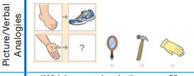


Types of Verbal Questions

Slide 6



Quantitative Questions

Slide 7

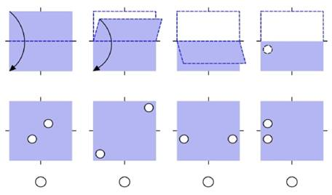

Nonverbal Questions

Slide 8

Three Primary Uses of
CogAT Scores
Help teachers adapt instructional goals, methods and materials to the individual needs of students
Measure each student’s level of cognitive development
Identify students whose level of academic achievement differ from what would be expected on their CogAT scores

Slide 9
WSFCS Definition of Academically/Intellectually Gifted
“Academically or intellectually gifted students perform or show the potential to perform at substantially higher levels of accomplishment when compared with others of their age, experience, or environment. Academically or intellectually gifted students exhibit high performance capability in …specific fields.
~WSFCS, AIG parent handbook 2013

Slide 10
WSFCS Program Description
We offer different levels of advanced instruction to meet the academic needs of students.
  Academically Intellectually Gifted – AIG
  Highly Academically Gifted – HAG
Start in elementary school and continue through high school
We emphasize academic achievement through student development in reflection and autonomy

Slide 11
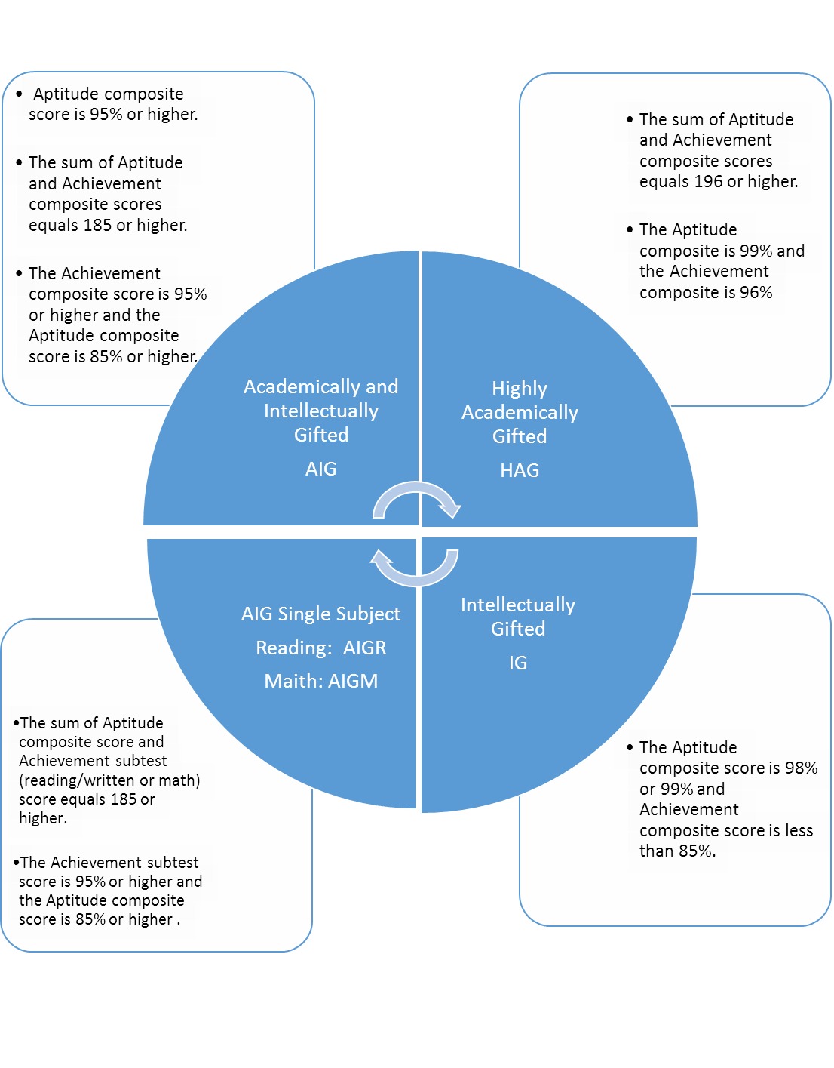

Slide 12
Academically/Intellectually Gifted Criteria
  Aptitude composite score is 95% or higher.
  The sum of Aptitude and Achievement composite scores equals 185 or higher.
  The Achievement composite score is 95% or higher and the Aptitude composite score is 85% or higher.

Slide 13
Highly Academically Gifted Criteria
  The sum of Aptitude and Achievement composite scores equals 196 or higher.
  The Aptitude composite is 99% and the Achievement composite is 96%

Slide 14
Single Subject Academically/Intellectually Gifted Criteria
  The sum of Aptitude composite score and Achievement subtest (reading/written or math) score equals 185 or higher.
  The Achievement subtest score is 95% or higher and the Aptitude composite score is 85% or higher .

Slide 15
Intellectually Gifted Criteria
  The Aptitude composite score is 98% or 99% and Achievement composite score is less than 85%.

Slide 16
Rescreening Opportunities
AG: Aptitude composite or any subtest score must be at least 80% AND Achievement composite or subtest must be at least 90%.
HAG: Sum of Aptitude and Achievement composite scores = 193-195.

Slide 17
Independent Evaluations
  Student must score at or above the 80th percentile on a standardized aptitude test AND at or above the 90th percentile on a standardized achievement test.
  Parent requests AG-2 form from AIG coordinator
  Parent locates private psychologist and has them complete AG-2 form PRIOR to evaluation
  AG-2 form should be submitted PRIOR to submission of results
  Parent may choose whether or not to release scores (AG-2 is record that they sought evaluation)
  AIG coordinator keeps in cumulative folder and cross-references
No student can take same screening instrument (form/level) within 12-month period… if this is violated, results are invalid and must wait 12-months to be eligible to re-screen

Slide 18
Elementary Program – AG
Third through Fifth Grade
Minimally, AG students receive…
  45 minutes of AG instruction daily (math or reading=90 minutes for both subjects)
  in a separate classroom
  Reading and mathematics
  AIG licensed teacher
  Content is one or more years above grade level

Slide 19
Questions?
Chrissy Sergiacomi
School Counselor
AIG Referral Coordinator
774-4646
cmsergiacomi@wsfcs.k12.nc.us

