Slide 1
Get Ready for
HIGH SCHOOL
Welcome Class of 2022

Slide 2
Counselor Assignment
By Your Last Name
E-mail addresses can be found on the AHS website…
A - J Ms. Schell
K - U Mr. McMahon
V - Z Ms. Nelson (and all AVID and EL students)

Slide 3

REGULAR DAY
CLASS SCHEDULE
Period 1: 7:40-8:47
Period 2: 8:54-10:01
Period 3: 10:08-11:15
Period 4: 11:22-1:06
(lunch is 30 minutes)
Period 5: 1:13-2:20

Slide 4
Required Credits for Graduation
4.0 - English
4.0 - Social Studies
3.0 - Science
3.0 - Math
1.0 - Physical Education
0.5 - Health
1.0 - Arts, visual or performing
10.5 - Electives
27.0 credits

Slide 5
Trimester schedule:
5 periods each trimester
x 3 trimesters in a year
15 – course numbers
You will register for 15 classes, which becomes 15 separate five digit course numbers on your registration sheet.

Slide 6
Grade Nine Courses
English A & B 2 trimesters 1 credit
English 9 or
Honors English 9 (talk to your teacher)
Social Studies 2 trimesters 1 credit
Civics 9 and Geography or
Honors Civics 9 and/or AP Geography (both = 3 trimesters)
(talk to your teacher)
Science A & B 2 trimesters 1 credit
Physical Science 9 or
Honors Physical Science 9 (talk to your teacher)

Slide 7
Grade Nine Courses
Mathematics 3 trimesters 1 credit
(most students)
Physical Education 1 trimester 0.5 credit
Electives 5 courses 2.5 credits
A total of 15 7.5 credits

Slide 8
Math Course Recommendations
Most students will take the Intermediate Algebra with College Foundations (CF) – Bridge to College program (3 trimesters)
* If you’re in an advanced math class, your current math teacher will recommend which course you should take next year in high school.
3 trimester course numbers are on your registration sheet. If you’re taking an advanced level math course, you will need to cross off the preselected numbers and replace with the correct advanced numbers.

Slide 9
Bridge to College program
The Bridge to College 3 trimester curriculum is interwoven through-out the Intermediate Algebra course in grade 9 and English in grade 10.
Cornell notetaking
Study skills
Time management
Critical thinking
The curriculum specifically teaches college-readiness skills that enables success in courses offered in high school that can grant college credit.

Slide 10

General Honors Course Criteria
Teacher recommendation
A (or B+)
Excellent reading/writing skills
High interest in the subject area
Willing to take on intellectual challenges, and extended research projects
Willing to engage in classroom discussion
Strong study habits and personal motivation

Slide 11
How many Honors?
The key is selecting the load that is “appropriate” for you.
Keep in mind your abilities, interests and outside commitments.
Talk with your parents and your teachers.
Request to balance your schedule.

Slide 12
Freshman
REGISTRATION MATERIALS

Slide 13
You will receive these key registration materials :
Registration Guide – write your name on the cover
Registration Worksheet – this is what you will use to register online
Course Reference sheet (course numbers)
**Deadline for 2018-2019 registration is
Friday, January 12th at midnight.

Slide 14
ANOKA HIGH SCHOOL GRADE 9 REGISTRATION INSTRUCTIONS
Read through the Registration Guide.
Graduation Checklist is included in the front of the book.
Be sure to plan your course selections carefully. Use the course planner provided in the book.
2. Look carefully at the information noted for honors level courses in the registration guide. In addition, talk to your 8th grade teacher to determine if an Honors course is appropriate.
3. If you’ve earned strong grades in Level I World Language and your teacher recommends it, you should register for level II of that language at AHS.

Slide 15
REGISTRATION INSTRUCTIONS - continued
4. Transfer the course numbers CORRECTLY to the appropriate lines on the Grade 9 Registration Worksheet.
5. Your core courses (English, Science etc…) have been preLOADED for you in the online registration program.

Slide 16
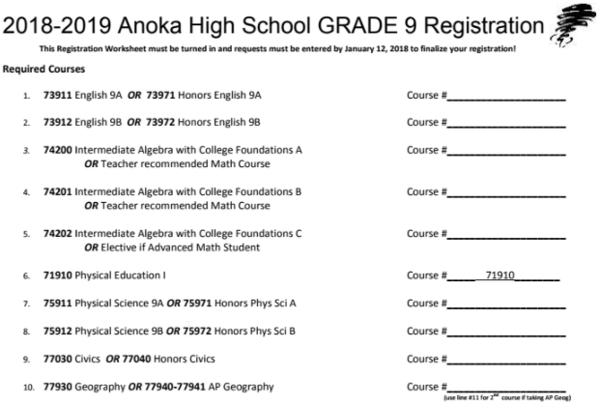
Sample Registration Worksheet

Slide 17
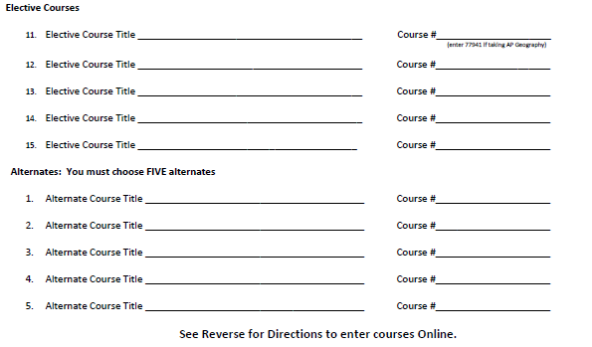

Slide 18
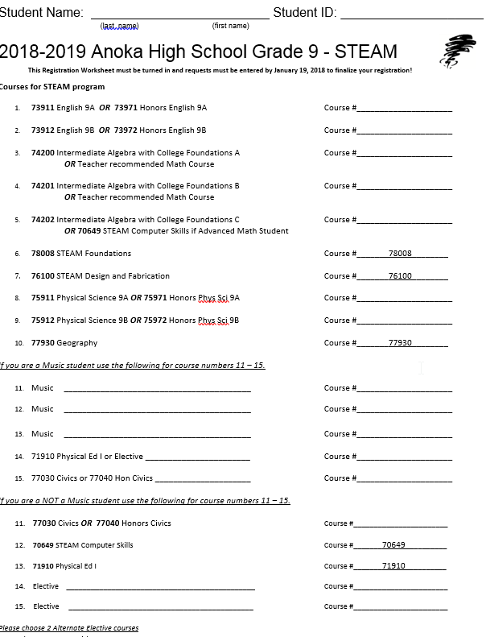
STEAM Info and Registration Sheet
STEAM stands for Science, Technology, Engineering, Art, and Math
Benefits of enrolling in the STEAM program:
  Develop and apply technology and computer science skills in the arts, sciences, math and engineering.
  Develop and refine design skills to create product prototypes.
  Senior internship or mentorship experiences.
  Explore careers related to technology, arts, math and engineering.
  Develop high level skills for post-secondary computer science and arts programs.
  Earn AP and articulated college credit in a variety of elective coursework.
  Earn levels of distinction for participation in STEAM and receive recognition at graduation.
Example of Registration Sheet

Slide 19
Elective Choices
Select classes that may be of interest to you.
Students may register only for the courses on their registration form. The Registration Guide includes classes for all grades.
Choose a variety of elective courses.

Slide 20
REGISTRATION INSTRUCTIONS - Alternates
  Choose your 5 alternate classes carefully. Due to class availability there is a good chance you will be scheduled for one or more. You need to list them on your sheet, because you will turn in your Registration Worksheet.
  **You will receive instructions on where and when to turn your worksheets in.

Slide 21
Honors course #’s
If you’re choosing an Honors level course, select the Honors course number and write the number on the corresponding line. Example:
73911 English 9A or 73971 Honors English 9A Course # 73971
73912 English 9A or 73972 Honors English 9B Course # 73972

Slide 22
Specialty Programs at Anoka HS
AVID
  A specialized program structured around preparing students for college success. Students that meet specific criteria will need to complete an application and interviewed to be selected. More information coming.
STEAM
  Students who have already committed to this program will complete the STEAM registration sheet (opposite side of regular 9th grade registration sheet).

Slide 23
Driver’s Education
Register by birth date – need to be 15 at the end of the class in order to take the permit test.
Regardless of birth date, trimester 1 is generally for sophomores, juniors, and seniors.
Class still has to fit with other courses; there is no guarantee that you’ll get the course right around your birthday or in your schedule at all.
Other options – after school classes, summer classes, or private businesses.

Slide 24
Reviewing the
ONLINE
Registration Process

Slide 25
Registration Process
Every student will register online from home. Use your completed registration form to input your course numbers. The program automatically saves your selections. You don’t need to LOCK selections, just log out when finished.
Go to the Anoka homepage (www.ahschools.us/ahs)
Click on the lock and key icon and use your student ID and password to log in to your Student Vue in your AH-Connect account.

Slide 26
Demo registration

Slide 27
If you do not know you’re student ID and/or password please see your tech support coordinator at Anoka Middle School to get this information.
Students that are unable to register online from home, stop in to your counselor, Ms. Klein.
Deadline for registration is Friday, January 12th at midnight.

Slide 28
Private/Homeschool Families
If you have not yet picked up your district enrollment forms and registration materials, you can pick them up this evening.
All forms should be returned to Anoka High School by Friday, January 12th.
Staff at Anoka will input course numbers for private and homeschool families.

Slide 29
Questions?
Please email your specific question to your student’s school counselor for the quickest response.
Talk to Ms. Klein in the Counseling Office.
Talk to your student’s teacher for specific academic placement questions.
This powerpoint can be accessed on Anoka High School’s website under Counseling.

Slide 30

Next step…
High School!
Go Tornadoes!!

