Slide 1
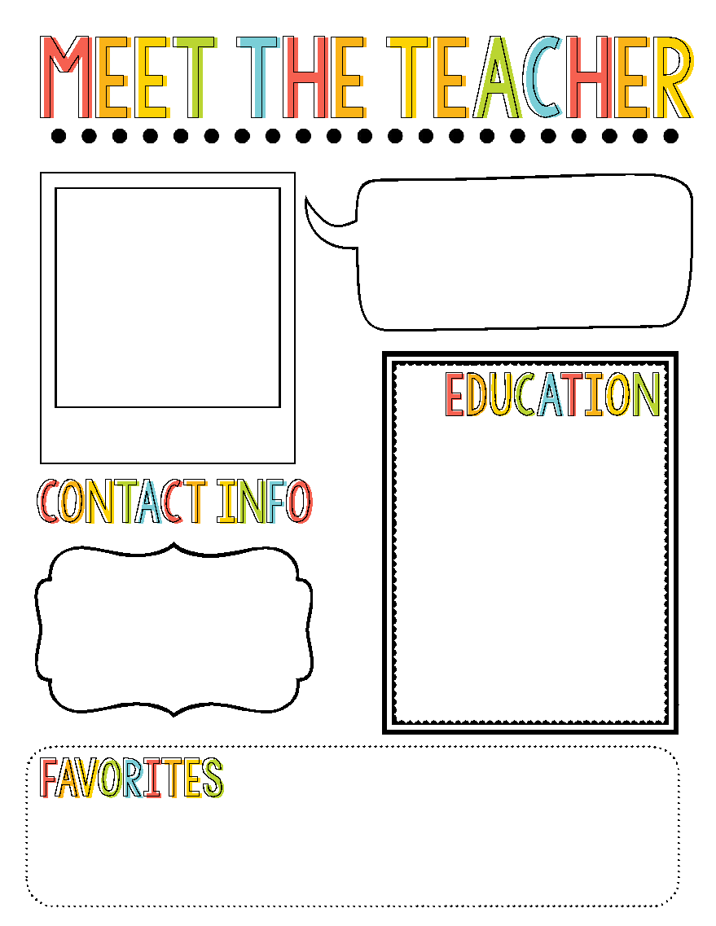
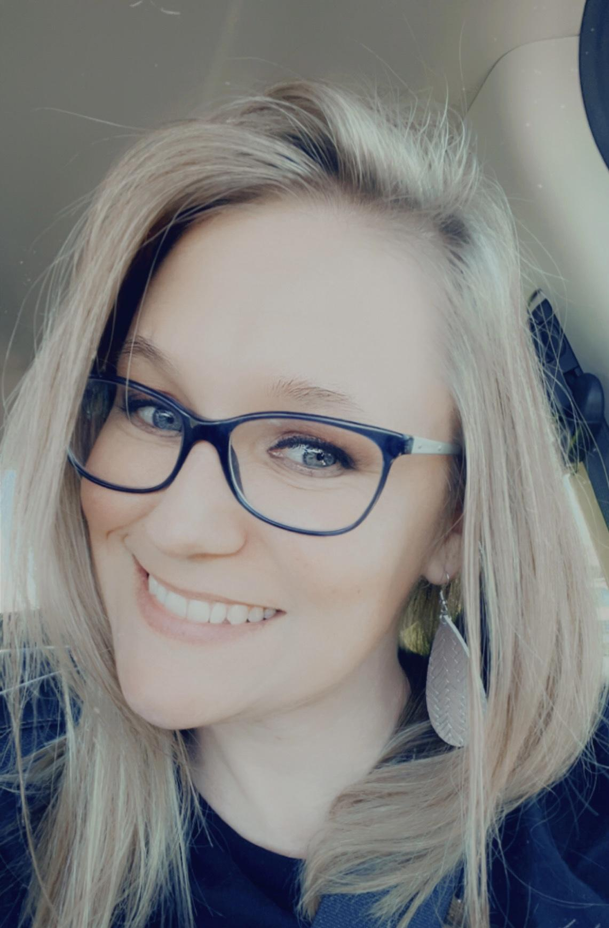
Mrs. Gage
Hello! My name is Mrs. Gage, and I am SO excited and lucky to be your classroom teacher! I have such a fun & exciting year planned for us. I can’t wait to get to know each of you.☺
I will be graduating from Western Governors University with my Bachelors in Elementary & Special Education in December. This is my first year teaching, but I have been educating students as a Paraprofessional for the last 6 years. This is my second year in the district and my first year at Partridge!
Remind App
Email:
sgage@waynesville.k12.mo.us
Drink: Amino Energy Animal: Polar Bear Color: Blue
Food: Tacos Store: Target Places: Beach
Book: Chicka Chicka Grade: 1st Movie: Monsters Inc
Boom Boom

