Slide 1
Teacher Evaluation Student Achievement Data Subcommittee
Interim Report
September 25, 2012

Slide 2
Recommendation #1 Grades 4-8 Reading and Math MCA Value-added
35% of total teacher evaluation
Use a value-added model similar to the Bush Foundation model currently used in Minnesota at the Classroom, Grade Level Team and School level
The percentage allocated to grade level and/or school level has not been determined
One possibility is 25% teacher level; 10% either grade level team or school wide

Slide 3
Value-Added: A Visual Representation
Actual student achievement
scale score
Value-Added
Starting student achievement scale score
Predicted student achievement
(Based on observationally
similar students)
Year 1
(Prior-test)
Year 2
(Post-test)

Slide 4
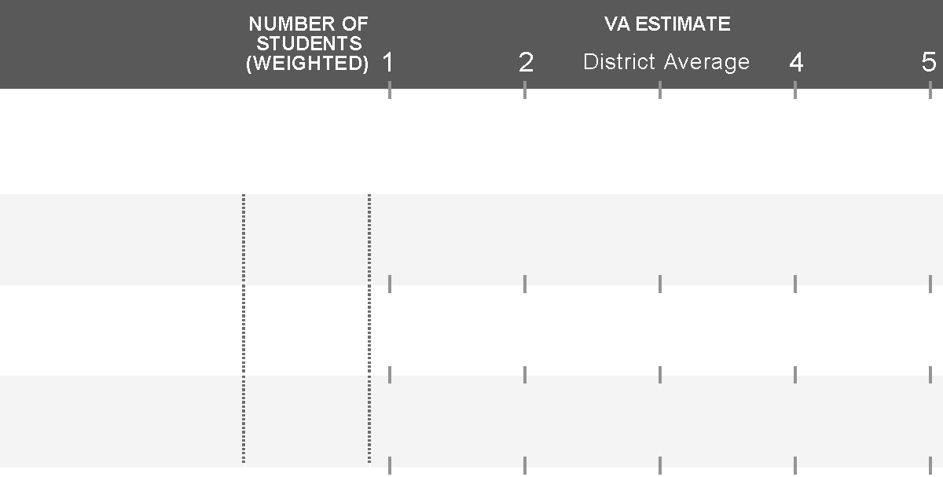

Use value-added for formative purposes (e.g., support, mentoring, PD)
3
READING
2nd Priority
Grade 3
25
3.0
3rd Priority
Grade 4
26
3.9
1st Priority
Grade 5
28
1.8
This is a relatively low-stakes decision.
A literacy coach may be beneficial to any of these teams. There is little risk in providing this resource to all the teachers.
The limiting factor is likely to be availability of this resource. If possible, provide it to all teachers, but limited allocation may be based on area of most need.

Slide 5
Value-added Details
Control for pretests where scales may change from year to year (e.g. MCAII to MCAIII)
Use a dosage model for partial year students
Control for measurement error
Use confidence intervals at 95% reliability
Three Year average value-added should be reported in addition to the most recent year

Slide 6
Recommendation #2
K-3 Reading and Math
35% of total teacher evaluation
Use growth model with measures that have strong predictive validity, reliability, classification accuracy, and growth norms.
Use the response to intervention screening criteria to recommend instruments for districts that do not already have validated K-3 reading and math assessments

Slide 7
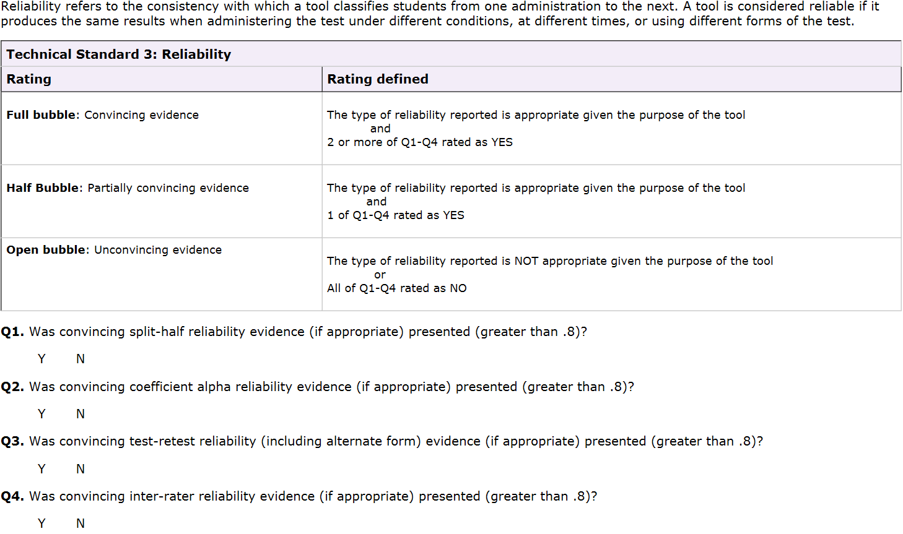
Reliability

Slide 8
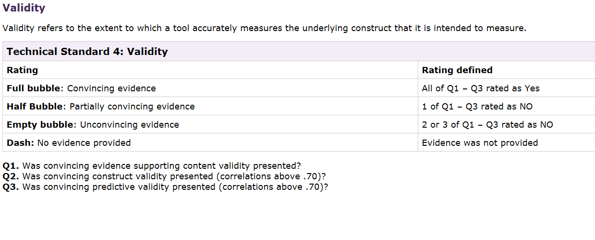
Validity

Slide 9
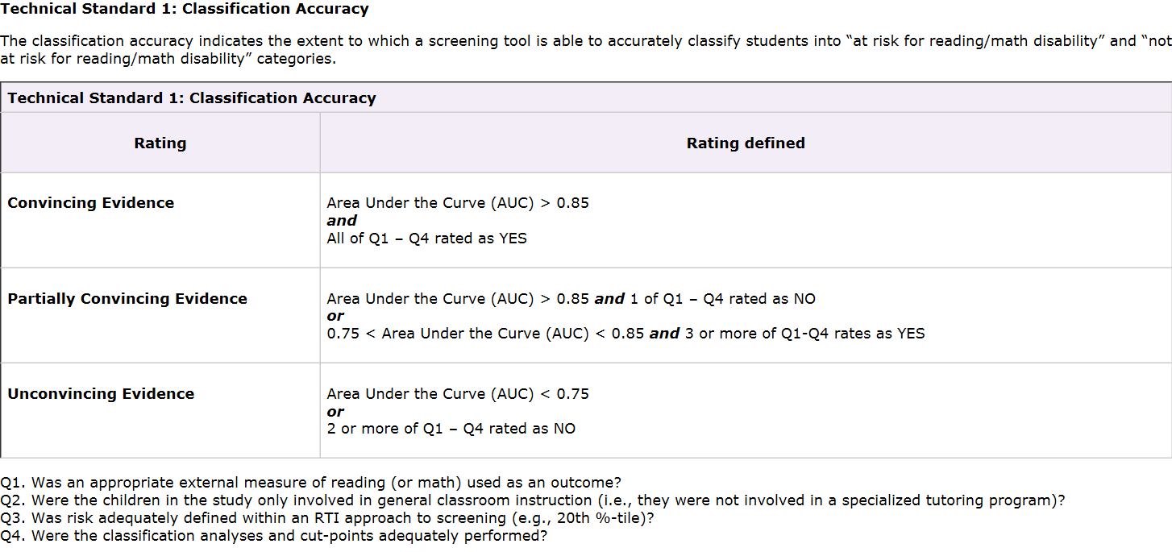
Criteria for Prediction Accuracy of Reading and Math Assessments K-3
We will accept a hit rate of 80% on Minnesota State Tests as well

Slide 10
Literacy/Reading assessments that meet the standards (http://www.rti4success.org/screening Tools)
Assessment | Grades | Classification Accuracy | Generalizability | Reliability | Validity | Diverse Groups Evidence
AIMSweb | K-3 | Partial | Moderately High | High | Partial | Partial
DIBELS | K-3 | Partial | Moderately High | High | Partial | Partial
Easy CBM | K-3 | Convincing | Moderately High | - | Partial | Partial
Edcheckup | 2-3 | Convincing | Moderately High | High | - | Convincing
GRADE | K-3 | Partial | Moderately Low | High | Partial | -
ITBS | 1-3 | Convincing | Moderately High | Partial | Convincing | -
ISIP | K-3 | Partial | Moderately Low | High | High | Partial
mCLASS | K-3 | Partial | Moderately High | Partial | Partial | Convincing
MAP | 2-3 | Convincing | Moderately High | Partial | Partial | Partial
MAP primary | K-1 | Convincing | Moderately High | Partial | Partial | Partial
OSELA | Grade 1 | Convincing | Broad | High | High | High

Slide 11
Literacy/Reading assessments that meet the standards (http://www.rti4success.org/screening Tools)
Assessment | Grades | Classification Accuracy | Generalizability | Reliability | Validity | Diverse Groups Evidence
PALS | K-3 | Convincing | Moderately High | High | Partial | Convincing
PAR | K-3 | Convincing | Moderately High | High | High | Convincing
STAR Early Lit | K-3 | Partial | Broad | High | Partial | Convincing
STAR Reading | 2,3 and 9-11 | Convincing | Broad | High | High | Convincing
STEEP | 1-3 | Convincing | Moderately High | High | Partial | -
Potential
MPS BKA and EKA | K | Convincing | Low (MPS only) | High | High | Convincing

Slide 12
Numeracy/Math assessments that meet the standards (http://www.rti4success.org/screening Tools)
Assessment | Grades | Classification Accuracy | Generalizability | Reliability | Validity | Diverse Groups Evidence
Discovery Education | Grade 3 | Convincing | Moderately High | High | Partial | Partial
Easy CBM | K-3 | Convincing | Moderately High | Partial | Convincing | Convincing
GMADE | 1-3 | Partial | Moderately Low | High | Convincing | Partial
ITBS | Grade 3 | Convincing | Moderately High | Partial | Convincing | -
MAP | 2-3 | Convincing | Moderately High | Partial | Partial | Partial
MAP primary | K-1 | Convincing | Moderately High | Partial | Partial | Partial
STAR Math | 2,3 and 9-11 | Convincing | Broad | High | High | Convincing
Potential
MPS BKA and EKA Math | K | Convincing | Low (MPS only) | Partial | Partial | Partial

Slide 13
Recommendation #3 for Reading and Math Value-added in Grades 9-12
Use the state of Minnesota Assessments for 9-12 in reading and math in a value-added or growth model.
  If ACT assessments are adopted by MN (i.e., EXPLORE, PLAN, ACT and/or end of course assessments), use the ACT scales to calculate value-added in the manner suggested by Rob Meyer (VARC)
  If other assessments are adopted that have scale scores, calculate value-added in the manner suggested by Rob Meyer.

Slide 14
Recommendation #4 for Untested Subjects
Consider adapting the Wisconsin SLO process for untested subjects
Three piece of the pie (15%, 10%, 10%)
  In art, music and areas unrelated to math and reading, each teacher does 3 SLOs
  In social studies and other subjects that empower students to have better reading comprehension (15% school or grade level Value-added in reading + 2 SLOs)
  In science and other subjects that empower students to have better math skills (15% school or grade level Value-added in math + 2 SLOs)

