Slide 1

Goal-setting
Classroom Guidance, November 2014

Slide 2

What is a Goal Anyway?
According to Merriam-Webster a goal is: the end toward which effort is directed.
Dictionary.com defines a goal as: the result or achievement toward which effort is directed; aim; end.
The purpose of goals is to give you something that you want to enhance your life in some way.
A goal is something within your power to reach and clearly defined. A person needs to clearly define their goal and have an active plan to reach that goal.

Slide 3
Types of Goals
Long Term Goals:
One school year, 5-year, 10-year, etc.
Short Term Goals:
Goals for the next few days, next couple of months, or 3-6 months in the future

Slide 4


Slide 5
What Goals are Not…
Goals are NOT the same as dreams.
  Setting a goal is like shooting an arrow.
  You may want to hit the target, but if you don’t take action – shooting the arrow – you only have a dream.
  The difference between a dream and a goal is ACTION.
  Dream + Action = Goal

Slide 6
Goals vs. Dreams
Dreams are free. Goals have a cost (times, money, effort, and sweat).
Goals produce results. Dreams don’t.
Goals have a finish line. Dreams never have to end.
Goals must have focus. Dreams don’t.
Goals require hard work. Dreams just require your imagination.
http://timemanagementninja.com/2013/04/10-big-differences-between-goals-and-dreams-that-you-must-know/

Slide 7

Why Set Goals?
Decreases the difficulty of passing classes
Increases skills of goal setting for after high school
Positively affects other areas of life, not just academics
Decreases stress and anxiety
Increases concentration, self-confidence, performance, and overall enjoyment of life
“If you don't know where you are going, you're likely to wind up somewhere else!”

Slide 8
Obstacle Course

Slide 9

-Not written -Not specific -Not believable -Not realistic
-Not acting on your thoughts -Lack of commitment -Lack of support
-Lack of rewards -Lack of motivation
Notes:
-Not written -Not specific -Not believable -Not realistic -Not acting on your thoughts
Lack of commitment -Lack of support -Lack of rewards -Lack of motivation

Slide 10
S.M.A.R.T Goal Setting
Before you begin your goal setting process, it is important to know what qualities your goals should embody.
You must be aware of the differences between dreams and goals.
You have to recognize challenges, steps to accomplish it, and vision to succeed.

Slide 11


Slide 12
Specific
The goal should be SPECIFIC enough so that we know exactly for what we are striving.
It is clearly defined so you know what to do.

Slide 13
Measurable
A goal must be MEASURABLE. It should have concrete facts. You should be able to answer very specifically, when and how you will know you attained your goal.
It’s measured in time and quantity so you know when you have achieved it.

Slide 14
Action-oriented
ACTION-ORIENTED, declaring positive activity that will produce results.
These are specific items you can do to get you closer to where you want to be.

Slide 15
Realistic
A goal must be REALISTIC. Challenging yourself is an important part of goal setting. You want to aim high; however, you also need to be realistic.
You can accomplish this with your strengths, talents, and abilities.

Slide 16
Target Date
TARGET DATE gives you a deadline and can help you motivate and re-evaluate.
With this date in mind, it pushes you toward the completion of your goal.

Slide 17
I do not know where to start!
Start by considering these examples to more effectively study.
Study regularly
Find a study place
Plan assignments in advance
Improve time management
Get a good night’s sleep
Take advantage of tutoring
Ask for help
Participate actively in class

Slide 18
What if I Fail?
Do you think it is better to set lower goals than risk failure by setting higher ones?
Can anyone describe a time when they turned a failure into a success?
What is the difference between failing and being a failure?
What are some mistakes in goal setting?

Slide 19
How to Stay Motivated
Lack of motivation = fear of failure or fear of change
Keep yourself motivated by…
  Treating yourself well
  Giving yourself rewards
  Keeping track of your accomplishments
  Setting goals and sticking to them
  Planning ahead
No one can teach you how to think, you must motivate yourself to learn how to learn!
You are your own motivator.
Your motivation must come from within yourself. Others may try to encourage you, but you are the only one who can attain what you desire. You must convince yourself - you can!

Slide 20
Goals-Achievement-Blocks

Slide 21
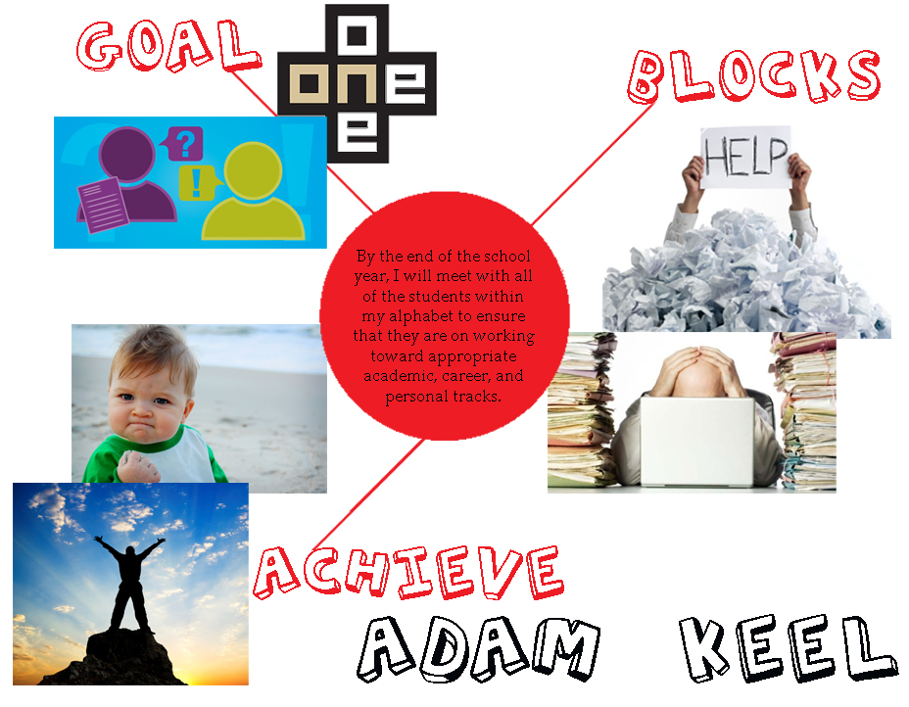
Vision Board Example

