Slide 1
Using the math4life Resources

Slide 2
Opening Activity
Standard Cards

Slide 3
The Mathematical Habits of Mind
The Mathematical Habits of Mind (MHM) are the skills and dispositions students need to have to be successful in mathematics.
The Habits of Mind are a crucial part of the standards for all mathematics courses regardless of grade level.

Slide 4
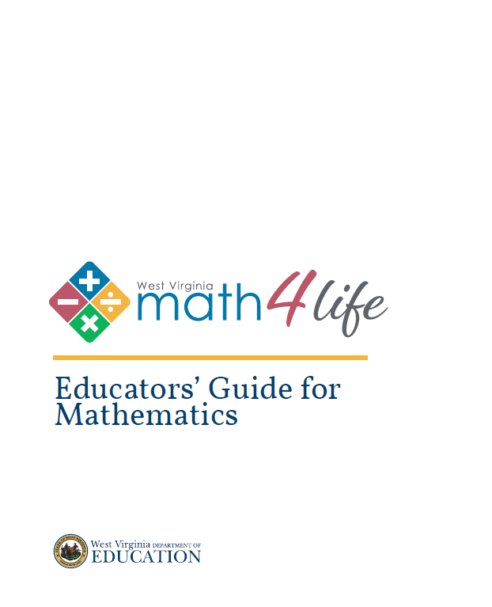
Educators’ Guides for Mathematics

Slide 5
Purpose
The ultimate purpose of the Educators’ Guides is to assist teachers in the implementation of WV CCRS.
The Educators’ Guides help teachers:
Plan their standards-driven curriculum.
Develop a high-quality mathematics program which helps prepare students for college and careers.
Understand the intent and depth of the WV CCRS.
Make connections with the content standards and the Mathematical Habits of Mind.

Slide 6
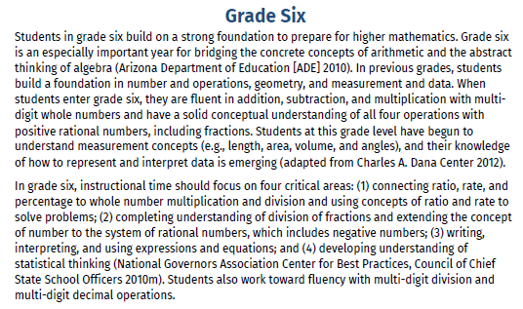
Introduction
Each Guide starts with the intended grade level and a brief introduction.

Slide 7
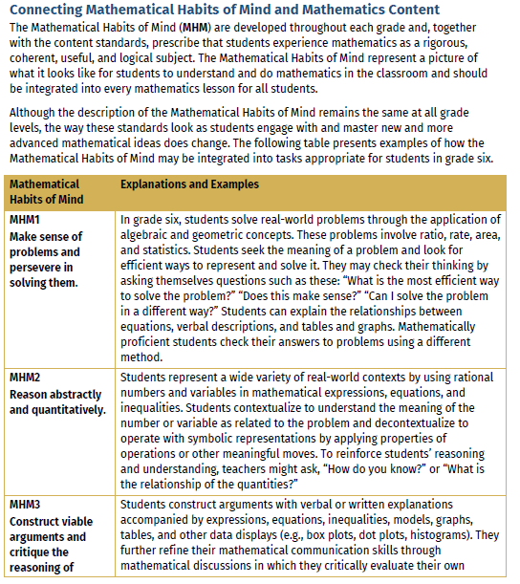
Connecting the Content to the Mathematical Habits of Mind (MHM)
Each Guide will intentionally make the grade-level connection to the Mathematical Habits of mind. Readers will see grade specific examples near the start of each booklet and throughout the content.

Slide 8
The Content
Grades K-8 Documents are organized sequentially by Domains.
Grades 9-12 Documents are organized by Domains.
Features:
Visual examples
Explanation of the Standards
Resources
Student Misconceptions
Connections to the Mathematical Habits of Mind

Slide 9

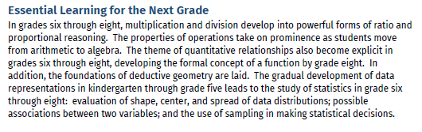
Vertical Connections
The Guides not only look at grade level material, but help the reader make connections among other grade levels.
The reader will see the “Instructional Focus” boxes which help make those connections.
The guides always end with a summary of essential learning for the next grade.

Slide 10

Exploration of the Quantile Resources

Slide 11

Support for CCRS

Slide 12
Available Support for CCRS Documents
K-2 ELA and Math
3-5 ELA and Math
6-8 ELA
6-8 Math
9-12 ELA (includes Transition English Language Arts for Seniors)
9-12 Traditional Pathway (Algebra I, Geometry, Algebra II)
9-12 Integrated Pathway (Math I, Math II, Math III)
http:// wvde.us/college-and-career-readiness/support-for-ccrs/

Slide 13
Purpose
The documents prepare students for study of the grade-level standards through the teaching of prerequisite and enabling skills necessary for mastering each standard.

Slide 14
Support for CCRS Document is…
A companion document to the WV CCRS
A tool for teaching the prerequisite and enabling skills necessary for mastering each standard
Intended to assist teachers to plan instruction to address the achievement gap by recognizing what students are able to do in relation to the grade-level standards
Intended to assist educators in:
  Writing IEP goals
  Designing targeted interventions
  Developing lesson plans
  Planning for instructional grouping
  Planning for parent communication and conferences

Slide 15
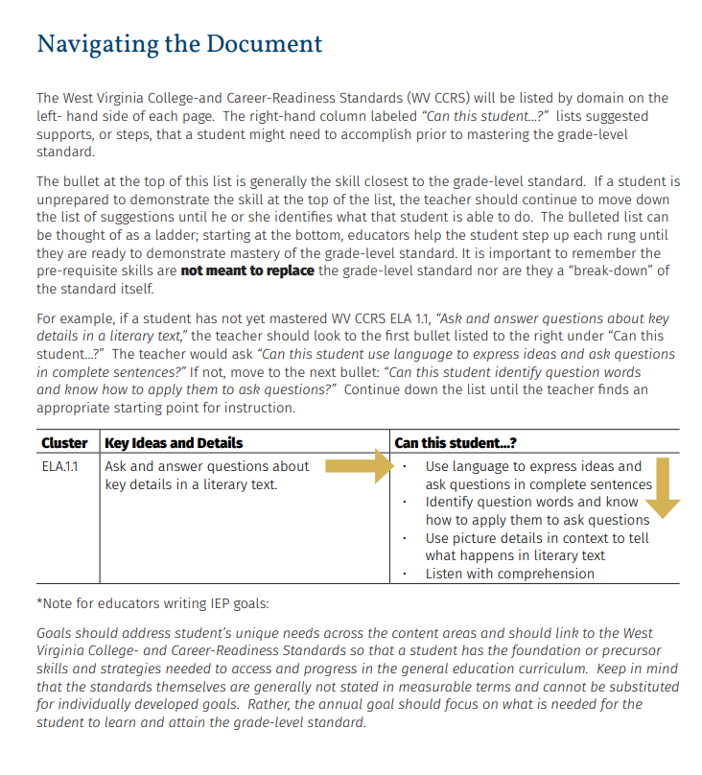

Slide 16
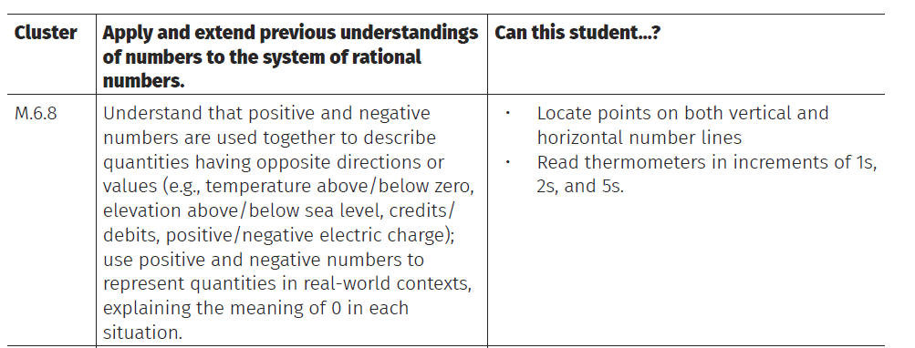
Example of a Math Support

Slide 17
Discussion
How do you plan on using the math4life resources shown in this session?

Slide 18

Joseph Mastracci
Numeracy Coordinator
WVDE Office of Special Education
jmastracci@k12.wv.us
Jessica Houck
Mathematics Coach
Mingo County Schools
jhouck@k12.wv.us

