Slide 1

Three Shifts of the Alaska Mathematics Standards
Notes:
Welcome to an overview of the three shifts of the Alaska Mathematics Standards

Slide 2
Shifts in Mathematics
Focus: 2-3 topics focused on deeply in each grade.
Coherence: Concepts logically connected from one grade to the next and linked to other major topics within the grade.
Rigor: Fluency with arithmetic, application of knowledge to real-world situations, and deep understanding of mathematical concepts.
Notes:
In the mathematics standards, there are additionally three shifts which will encourage changes to instructional practices and curriculum.
Focus: 2-3 topics focused on deeply in each grade. For each grade level there are fewer big ideas to be covered.
Coherence: : Concepts logically connected from one grade to the next and linked to other major topics within the grade. There is a progression of topics allowing for deeper learning each year. This also avoids the re-teaching of topics each year.
Rigor: Fluency with arithmetic, application of knowledge to real-world situations, and deep understanding of mathematical concepts. The standards explicitly start with the goal of career and college readiness and backtrack to develop a body of knowledge to support this goal.

Slide 3
The Why: Shift One
Focus strongly where the standards focus
Significantly narrow the scope of content and deepen how time and energy is spent in the math classroom
Focus deeply only on what is emphasized in the standards, so that students gain strong foundations
Notes:
The standards focus deeply on the major work of each grade so that students can gain strong foundations: solid conceptual understanding, a high degree of procedural skill and fluency, and the ability to apply the math they know to solve problems inside and outside the math classroom.

Slide 4
Focus
Move away from "mile wide, inch deep" curricula identified in TIMSS.
Learn from international comparisons.
Teach less, learn more.
“Less topic coverage can be associated with higher scores on those topics covered because students have more time to master the content that is taught.”
– Ginsburg et al., 2005
Notes:
The Third International Math and Science Study (TIMSS) not only ranks assessment performance of many industrialized nations, but also analyzes the education systems of those countries. The TIMSS study showed that the U.S. covers far more topics than those countries that significantly outperform us. In fact, the TIMSS study revealed that in grade 4, high scoring Hong Kong omitted 48 percent of the TIMSS items. The U.S., on average, omitted only 17%. In the U.S. we have been covering more topics with the net result of learning less about them.
Interestingly, the slogan on the Singapore Ministry of Education’s website is “Teach less, learn more.” By focusing curriculum and instruction, teachers have the opportunity to support students in the development of strong foundations that pay off as the progress through more complex math concepts.
{read quote from bottom of slide}

Slide 5
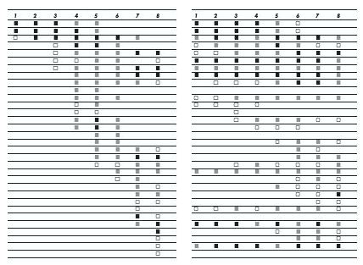
The shape of math in A+ countries
Mathematics topics intended at each grade by at least two-thirds of A+ countries
Mathematics topics intended at each grade by at least two-thirds of 21 U.S. states
¹ Schmidt, Houang, & Cogan, “A Coherent Curriculum: The Case of Mathematics.” (2002).
Notes:
There are no detailed labels here so you can see visually that the overall shape of math topics in A+ countries and those typical in the US is different.
Each row is a math topic, like fractions, or congruence.
In 2/3rds of the high-performing countries, the foundations are laid and then further knowledge is built on them. The design principle is focus and coherent progressions.
In the U.S., the design principle is to teach everything every year that can possibly be taught… as well as many things that cannot.

Slide 6
Traditional U.S. Approach
 | K 12
Number and Operations
Measurement and Geometry
Algebra and Functions
Statistics and Probability
Notes:
This slide represents another visualization of how U.S standards used to be arranged, giving equal importance to all four areas - like “shopping aisles.” Each grade goes up and down the aisles, tossing topics into the cart, losing focus.
There is no disagreement, for example, that the most critical area of mathematics in K-2 is numbers and operations. However, whether looking at typical state standards or typical curriculum that followed, numbers and operations was just one concept among many that was included.
The Alaska Standards are a set of standards that allow teachers to do what they know they need to in order to support the further development of their students: concentrate on fewer, powerful concepts and then build on those.

Slide 7
Focusing Attention Within
Number and Operations
 | Operations and Algebraic Thinking |  |  |  |  |  |  | Expressions and Equations |  |  |  | Algebra
 |  |  |  |  |  |  | → |  |  |  | →
 | Number and Operations—Base Ten |  |  |  |  |  | → | The Number System
 |  |  |  |  |  |  |  |  |  |  | →
 |  |  |  | Number and Operations—Fractions |  |  | →
 | K | 1 | 2 | 3 | 4 | 5 |  | 6 | 7 | 8 |  | High School
Notes:
The Alaska Standards takes the first strand from the last slide (Number and Operations) and expands it to show the relevance and progression of number and operations from K-12. You can see that the one "shopping aisle" or strand of Number and Operations from previous states standards is now split into 5 domains across the K-8 grade span, communicating exactly what is being learned at each grade and clarifying how that learning prepares the students for future studies.

Slide 8
The Why: Shift Two
Coherence Think across grades, and link to major topics within grades
Carefully connect the learning within and across grades so that students can build new understanding onto foundations built in previous years.
Begin to count on solid conceptual understanding of core content and build on it. Each standard is not a new event, but an extension of previous learning.
Notes:
In the second shift of coherence, we take advantage of focus to actually pay attention to sense-making in math. Coherence speaks to the idea that math does not consist of a list of isolated topics.
The Standards themselves, and therefore any resulting curriculum and instruction, should build on major concepts within a given school year as well as major concepts from previous school years.
Typically, current math curriculum spends as much as 25% of the instructional school year on review and re-teaching of previous grade level expectations – not as an extension – but rather as a re-teaching because many students have very little command of critical concepts.
Just as there are two ways to look at focus, there are two elements of coherence: The coherence across grades and the coherence that links topics to the major work of the grade.

Slide 9
Coherence: Think across grades
Fraction example:
“The coherence and sequential nature of mathematics dictate the foundational skills that are necessary for the learning of algebra. The most important foundational skill not presently developed appears to be proficiency with fractions (including decimals, percents, and negative fractions).
The teaching of fractions must be acknowledged as critically important and improved before an increase in student achievement in algebra can be expected.”
Final Report of the National Mathematics Advisory Panel (2008, p. 18)
Notes:
{read slide regarding fraction example}
As an example of coherence, the Alaska Standards takes a different approach to preparing students for success in algebra. Previous approaches moved topics of pre-algebra and algebra earlier and earlier in the grade sequence rather than attend to careful progressions of conceptual development that in fact prepare students for algebra.

Slide 10
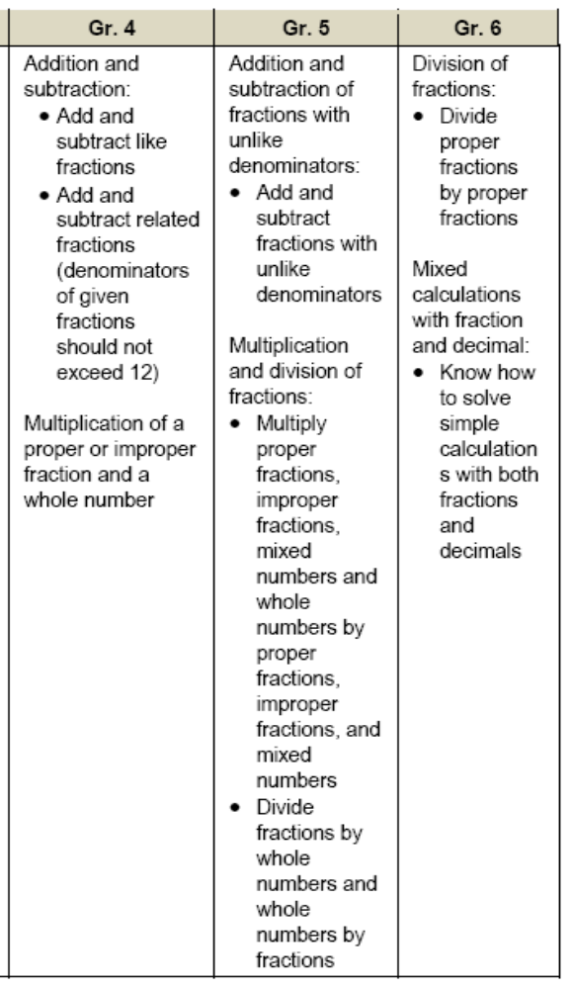
Alaska Standards
4.NF.4. Apply and extend previous understandings of multiplication to multiply a fraction by a whole number.
Grade 4
5.NF.4. Apply and extend previous understandings of multiplication to multiply a fraction or whole number by a fraction.
5.NF.7. Apply and extend previous understandings of division to divide unit fractions by whole numbers and whole numbers by unit fractions.
Grade 5
6.NS. Apply and extend previous understandings of multiplication and division to divide fractions by fractions.
6.NS.1. Interpret and compute quotients of fractions, and solve word problems involving division of fractions by fractions, e.g., by using visual fraction models and equations to represent the problem.
Grade 6
Informing Grades 1-6 Mathematics Standards Development: What Can Be Learned from High-Performing Hong Kong, Singapore, and Korea? American Institutes for Research (2009, p. 13)
Notes:
Here you see some of the international data that informed the development of the CCSSM and the Alaska Standards. On the left you see a coherent progression of multiplication and division of fractions over three grade levels.
On the right you see excerpts from the Alaska Standards that address fractions with purpose and direction. The term “apply and extend previous understandings…” is a sure sign of the expectation within a progression of concept development.
Looking at the progression of multiplying and dividing fractions, you will see that over these 3 years the students are building on previous knowledge and not just repeating the same thing each year. You’ll see that in 4th grade students apply and extend previous understandings of multiplication to multiply a fraction by a whole number. In 5th grade that knowledge and skill is extended to multiply a fraction or whole number by a fraction. Also in 5th grade, students extend previous understandings of division to divide unit fractions by whole numbers and the reverse. In 6th grade, students will continue to build on the foundations laid and will divide fractions by fractions. These are clear and carefully laid progressions.

Slide 11
Alignment in Context:
Neighboring Grades and Progressions
One of several staircases to algebra designed
in the OA domain.
6.EE.1 Apply the properties of operations to generate equivalent expressions.
5.OA.2 Write simple expressions that record calculations with numbers, and interpret numerical expressions without evaluating them.
3.OA.5 Make, test, support, draw conclusions and justify conjectures about properties of operations as strategies to multiply and divide.
1.OA.3 Apply properties of operations as strategies to add and subtract.
11
Notes:
Algebra begins in 6.EE.3 in its cleanest sense. Here is a beautiful illustration of the design of the standards.
{read slide}

Slide 12
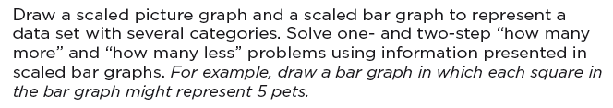
Coherence:
Link to Major Topics Within Grades
Example: Data Representation
Alaska Standard 3.MD.4
Notes:
Instead of bar charts being “yet another thing to cover,” detracting from focus, the standard is telling you how to “aim” bar charts back around to the major work of the grade. These connections are explicit in the standards. While in the past picture or bar graphs might have been distinct things to be assessed, now they need to be connected to the major work of the grade.

Slide 13
The Why: Shift Three
Rigor In major topics, pursue conceptual understanding, procedural skill and fluency, and application
The Alaska Math Standards require a balance of:
  Solid conceptual understanding
  Procedural skill and fluency
  Application of skills in problem solving situations
This requires equal intensity in time, activities, and resources in pursuit of all three
Notes:
This shift is about the depth of what is expected in the standards, and also about what one should expect to see happening in the classroom, in curricular materials, and so on.

Slide 14
Solid Conceptual Understanding
Teach more than “how to get the answer” and instead support students’ ability to access concepts from a number of perspectives
Students are able to see math as more than a set of mnemonics or discrete procedures
Conceptual understanding supports the other aspects of rigor (fluency and application)
Notes:
One aspect of rigor is building solid conceptual understanding. Once we have a set of standards that are in fact focused, teachers and students have the time and space to develop solid conceptual understanding. {read the slide} There is no longer the pressure to quickly teach students how to superficially get to the answer, often relying on tricks or mnemonics. The standards instead require a real commitment to understanding mathematics, not just how to get the answer.
As an example, it is not sufficient to simply know the procedure for finding equivalent fractions, but students also need to know what it means for numbers to be written in equivalent forms.
Attention to conceptual understanding is one way that we can start counting on students building on prior knowledge. It is very difficult to build further math proficiency on a set mnemonics or discrete procedures.

Slide 15
Priorities in Mathematics
Grade | Priorities in Support of Rich Instruction and Expectations of Fluency and Conceptual Understanding
K–2 | Addition and subtraction, measurement using whole number quantities
3–5 | Multiplication and division of whole numbers and fractions
6 | Ratios and proportional reasoning; early expressions and equations
7 | Ratios and proportional reasoning; arithmetic of rational numbers
8 | Linear algebra

Slide 16
Fluency
The standards require speed and accuracy in calculation.
Teachers structure class time and/or homework time for students to practice core functions such as single-digit multiplication so that they are more able to understand and manipulate more complex concepts
Notes:
Another aspect of rigor is procedural skill and fluency. {read slide}
Note that this is not memorization absent understanding. This is the outcome of a carefully laid out learning progression.
At the same time, we can’t expect fluency to be a natural outcome without addressing it specifically in the classroom and in our materials. Some students might require more practice than others, and that should be attended to.
Additionally, there is not one approach to get to speed and accuracy that will work for all students. All students, however, will need to develop a way to get there.
It is important to note here that while teachers in grades K-5 may find creative ways to use calculators in the classroom, students are not meeting the standards when they use them--not just in the area of fluency, but in all other areas of the standards as well.

Slide 17
Required Fluencies in K-6
Grade | Standard | Required Fluency
K | K.OA.5 | Add/subtract up to 5
1 | 1.OA.6 | Add/subtract up to 10
2 | 2.OA.2 2.NBT.5 | Add/subtract up to 20 (know single-digit sums from memory) Add/subtract up to 100
3 | 3.OA.7 3.NBT.2 | Multiply/divide up to 100 (know single-digit products from memory) Add/subtract up to 1000
4 | 4.NBT.4 | Add/subtract up to 1,000,000
5 | 5.NBT.5 | Multi-digit multiplication
6 | 6.NS.2,3 | Multi-digit division Multi-digit decimal operations
Notes:
Fluent in the particular Standards cited here means “fast and accurate.” It might also help to think of fluency as meaning the same thing as when we say that somebody is fluent in a foreign language: when you’re fluent, you flow. Fluent isn’t halting, stumbling, or reversing oneself.
The word fluency was used judiciously in the Standards to mark the endpoints of progressions of learning that begin with solid underpinnings and then pass upward through stages of growing maturity.
Some of these fluency expectations are meant to be mental and others with pencil and paper. But for each of them, there should be no hesitation in getting the answer with accuracy.

Slide 18
Application
Students can use appropriate concepts and procedures for application even when not prompted to do so.
Teachers provide opportunities at all grade levels for students to apply math concepts in “real world” situations, recognizing this means different things in K-5, 6-8, and HS.
Teachers in content areas outside of math, particularly science, ensure that students are using grade-level-appropriate math to make meaning of and access science content.
Notes:
Using mathematics in problem solving contexts is the third leg of the stool supporting the learning that is going on in the math classroom.
This is the “why we learn math” piece, right? We learn it so we can apply it in situations that require mathematical knowledge. There are requirements for application all the way throughout the grades in the Alaska Standards. {read slide} But again, we can’t just focus solely on application—we need also to give students opportunities to gain deep insight into the mathematical concepts they are using and also develop fluency with the procedures that will be applied in these situations. The problem-solving aspect of application is what’s at stake here—if we attempt this with a lack of conceptual knowledge and procedural fluency, the problem just becomes three times harder.
At the same time, we don’t want to save all the application for the end of the learning progression. Application can be motivational and interesting, and there is a need for students at all levels to connect the mathematics they are learning to the world around them.

Slide 19
Contact Us!
Deborah Riddle
Math Content Specialist
Deborah.riddle@alaska.gov
907-465-3758
Notes:
Here are key contacts for the new Alaska Standards.

