Slide 1
Geometry
Pythagorean Theorem
8th Math
Presented by Mr. Laws
A² + B² = C²
c
a
b

Slide 2
Standard
8.G.7 – Real world application of Pythagorean theorem: Apply the Pythagorean Theorem to determine unknown side lengths in right triangles in real-world and mathematical problems in two and three dimensions.

Slide 3
Essential Question
How does the Pythagorean Theorem Formula help you find the unknown side lengths of a right triangles in real-world or mathematical problems?

Slide 4
Target Statment
I CAN use the Pythagorean Theorem Formula help you find the unknown side lengths of a right triangles.
I CAN use the Pythagorean Theorem to help find solution for real-world or mathematical problems.

Slide 5
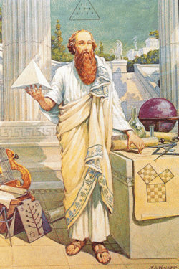
Pythagoras
Lived in southern Italy during the sixth century B.C.
Considered the first true mathematician
Used mathematics as a means to understand the natural world
First to teach that the earth was a sphere that revolves around the sun

Slide 6
Identifying Right Triagnles
Pythagoras developed a formula for finding the length of the sides of any right triangle.
This formula is called the Pythagorean Theorem.
Hypotenuse (c) is on the opposite side of the right angle and is the longest side of the right triangle.
Legs are the side a and b of a right triangle.
Leg (a)
90⁰
Symbol for right triangle
Leg (b)

Slide 7
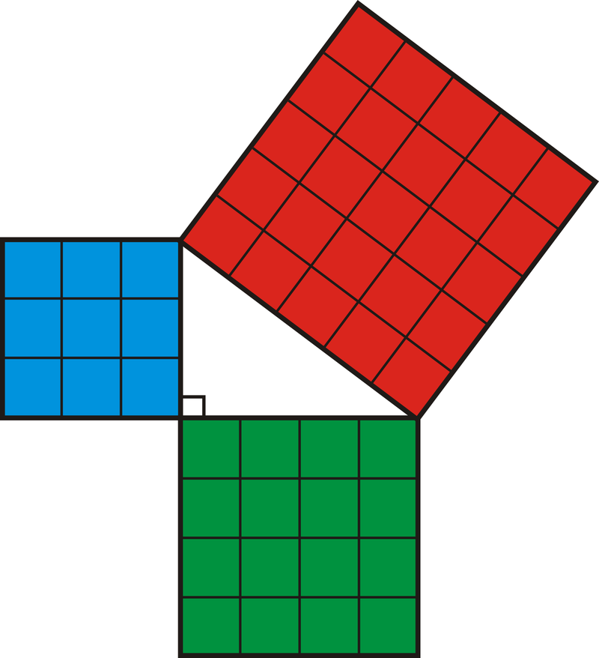
Pythagorean Theorem Formula
Formula: a² + b² = c²
C²
A²
a
c
b
Example: 3² + 4² = 5²
B²
9 + 16 = 25

Slide 8
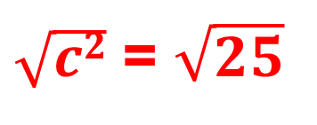
Finding the Hypotenuse (c)
Example # 1
c² = a² + b²
c² = 3² + 4²
?
3
a
c² = 9 + 16
c
c² = 25
$\sqrt{c2}$ = $\sqrt{25}$
b
c = 5
4

Slide 9
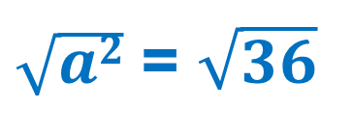
Finding the Leg (a)
Example # 2
a² = c² - b²
a² = 10² - 8²
10
?
a² = 100 - 64
a
c
a² = 36
$\sqrt{a2}$ = $\sqrt{36}$
b
a = 6
8

Slide 10
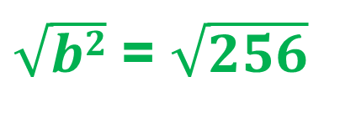
Finding the Leg (b)
Example # 3
b² = c² - a²
b² = 20² - 12²
20
b² = 400 - 144
12
a
c
b² = 256
$\sqrt{b2}$ = $\sqrt{256}$
b
b = 16
?

Slide 11

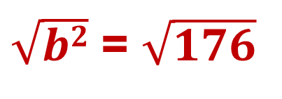
Finding missing sides
3. What steps will you take to find the missing side?
b² = c² - a²
Example # 4
b² = 15² - 7²
b² = 225 - 49
7
b² = 176
15
$\sqrt{b2}$ = $\sqrt{176}$
$$b ≈13.3$$
Round to the nearest tenth

Slide 12
Using Pythagorean Theorem to Prove Right Triangles
4. You know that Pythagorean Theorem formula works with all right triangles, We can use the converse of this theorem, which is: if a² + b² = c², then the triangle is a right triangle.
Is this a right triangle?
13 cm
a² + b² = c²
12 cm
5² + 12² = 13²
25 + 144 = 169
169 = 169
5 cm
Yes, this is a right triangle!

Slide 13

Using Pythagorean Theorem to Prove Right Triangles
You know that Pythagorean Theorem formula works with all right triangles, We can use the converse of this theorem, which is: if a² + b² = c², then the triangle is a right triangle.
Is this a right triangle?
9 cm
a² + b² = c²
8 cm
6² + 8² = 9²
36 + 64 = 81
$$100≠81$$
6 cm
No, this is not a right triangle!

Slide 14
Pythagorean Triple
5. Three numbers can be called a Pythagorean triple if a² + b² = c² and all the numbers are integers (positive whole numbers).
Examples:
a² | b² | c²
3 | 4 | 5
6 | 8 | 10
5 | 12 | 13
7 | 24 | 25
9 | 12 | 15
10 | 24 | 26

Slide 15
SUMMARY
Can you answer the essential question with confidence and a clear understanding of the lesson.
What are some key concepts you should remember about the Pythagorean Theorem
Is there more you need to learn about this lesson?

