Slide 1
Unit 3: Coordinate Geometry
Lesson: Pythagorean Theorem & Its Converse

Slide 2
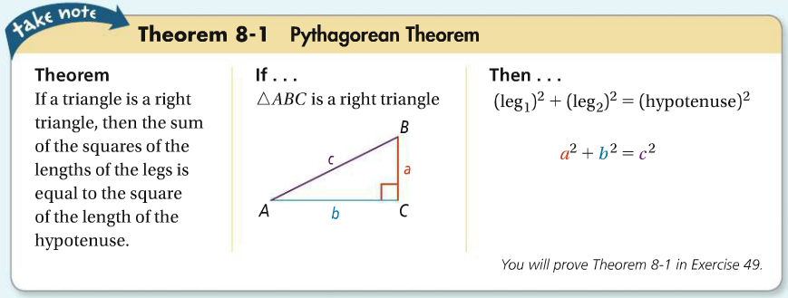

Pythagorean Theorem & Its Converse

Slide 3
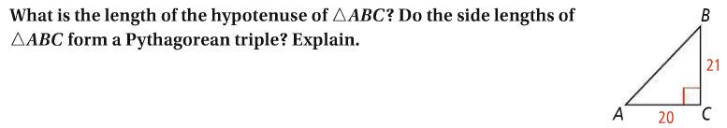
Pythagorean Theorem & Its Converse

Slide 4
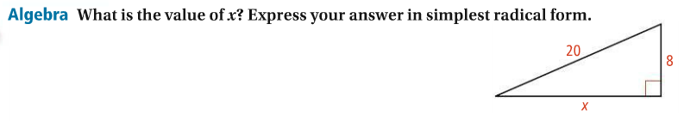
Pythagorean Theorem & Its Converse

Slide 5
Pythagorean Theorem & Its Converse
Classwork:
Worksheet 4.4 problems
1-4, 5-7 (pick one),
& 8-10 (pick 0ne)

Slide 6
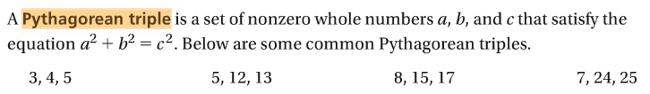
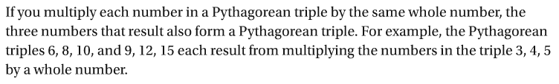
Pythagorean Theorem & Its Converse

Slide 7
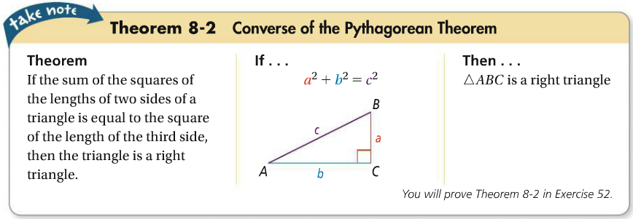
Pythagorean Theorem & Its Converse

Slide 8
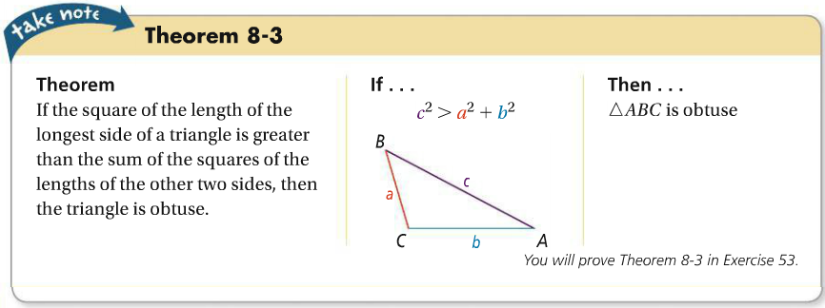
Pythagorean Theorem & Its Converse

Slide 9
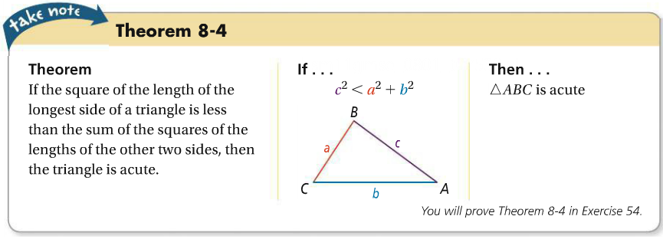
Pythagorean Theorem & Its Converse

Slide 10
Pythagorean Theorem & Its Converse

Slide 11
Pythagorean Theorem & Its Converse

Slide 12
Pythagorean Theorem & Its Converse
Classwork:
Worksheet 4.5 problems
1-3, 4-6 (pick one), 7-9 (pick 0ne),
10-12 (pick 0ne), & 13-15 (pick one)

Slide 13
Unit 3: Coordinate Geometry
Lesson: Midpoint & distance formulas

Slide 14
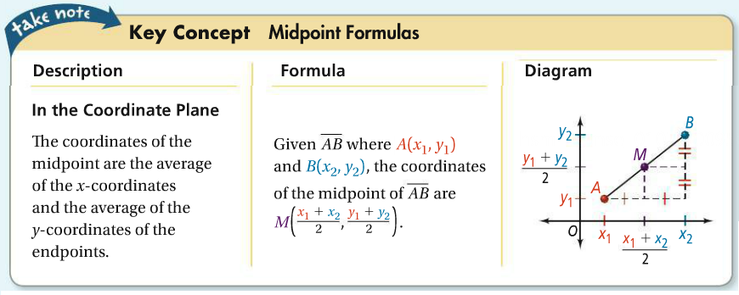
Pythagorean Theorem & Its Converse

Slide 15
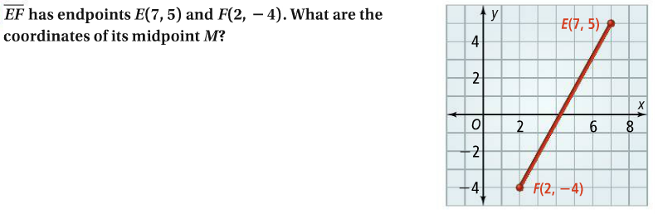
Pythagorean Theorem & Its Converse

Slide 16
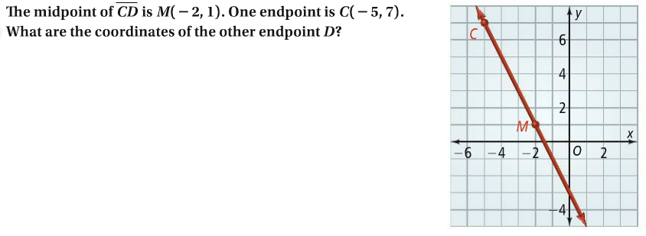
Pythagorean Theorem & Its Converse

Slide 17
Pythagorean Theorem & Its Converse
Classwork:
Worksheet 1.7 problems
6-9 (Pick one),
10-12 (Pick 0ne),
13-14 (pick one)

Slide 18
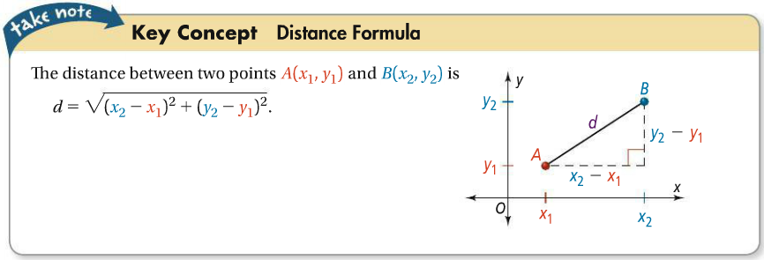
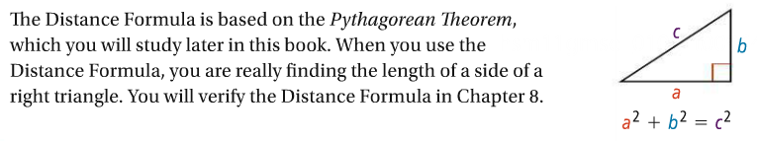
Pythagorean Theorem & Its Converse

Slide 19
Pythagorean Theorem & Its Converse

Slide 20
Pythagorean Theorem & Its Converse
Classwork:
Worksheet 1.7 problems
16-19 (Pick one), 20-23 (Pick 0ne)
25-28 (pick one), & 29

