Slide 1
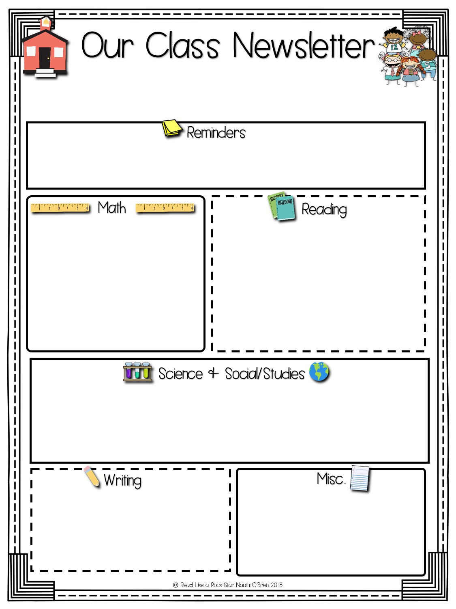

Mrs. McMorrow
Week of: October 2019
October has certainly flown by! This month we had Plainville firefighters visit our classroom, had a visit from a member of the Cultural Society, and celebrated some awesome spirit days!
October focused on time and geometry. Students learned how to tell time to the nearest minute and solved problems involving elapsed time. We also began categorizing shapes. We learned about shape attributes – focusing on quadrilaterals.
We started a new unit called “Whose Story Is It?” This unit focuses on different perspective and points of view both in stories and in real life with non-fiction topics. We read the book, Voices in the Park, which is a story from 4 different points of view! We also began studying words with suffixes (s, es, ed, etc). Suffixes change the meaning of a word.
We have continued learning about Plainville in Social Studies. We made a flip book with lots of new information about Plainville and watched a Nearpod lesson on the town! This was lots of fun! We have continued studying motion in Science! We experimented with pumpkin helicopters and wind up toys to observe how they move!
We have been studying adjectives and how we can use them to add details to our writing. Students have been writing elaborative segments about fall topics! We also focused on identifying main ideas and details with Expository Writing.
Have you signed up for Seesaw yet? It is a quick way to see what is going on in the classroom and to interact with your child’s work!

