Slide 1





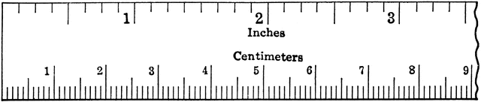





Supply List
➸binder with loose leaf (dividers:2-3)
➸pencils/lead pencils & sharpener
➸index cards & a highlighter
➸Calculator (e.g. TI-30XII) for use at home (optional).https://www.desmos.com/scientific
➸Compass and ruler for use at home.
This Syllabus belongs to:_____________________
Course Description
Geometry is an area of mathematics in which students explore the relationships that exist among points, lines, and shapes in two- and three-dimensional space. The following topics are covered in this course: constructions, proofs, congruence, similarity, right triangle trigonometry, lines, circles, and 3-dimensional figures.
Quizzes & Classwork
TUTORING – make sure you go to HELP tutoring whenever you need extra help or get a grade less than a C.
Expect a quiz and/or classwork EVERY class period to be for a grade.
GRADING POLICY
Online
Resources:
https://www.khanacademy.org/math/engageny-geo https://greatminds.org/math/parents
https://www.mathsisfun.com/geometry/index.html
Summative Grades (60%)
-Tests and/or special projects
Formative Grades (40%)
-Quizzes/Classwork
-DMRs and Exit Tickets
LEAP 2025
-20% of the final grade
-topic diagnostics, interim assessments, DMRs, and exit tickets will all be used to prepare for the LEAP 2025.
%
PowerSchool grades are updated weekly
Make-Up Policy
When sick/absent, it is the student’s responsibility to obtain all missed assignments from google classroom and seek help from peers, teachers, or tutors.
➸ Make-up tests must be taken asap by booking into make-up testing.
➸Work that is not turned in, or not made-up in a timely manner, will result in a zero.
Fall 2021
Period 1 – xz4wggh
Spring 2022
Period 1 – 7hlqtmr
Period 2 – pptnbiv
Work that is not completed in class should be completed at home
Give yourself time at home to practice and study so you understand the work.

Slide 2


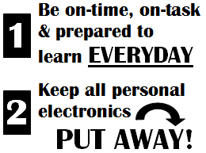
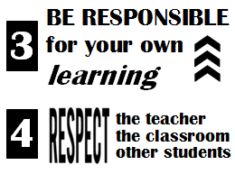




If a student chooses to break a rule/ ignore procedures/not meet expectations:
Expectations:
In this course you will be expected to use your class time as directed. You must abide by the CODE OF STUDENT CONDUCT outlined in your agenda. It is your responsibility to ask questions at the appropriate time in class and get additional help. Some tasks cannot be graded but are necessary to the learning process of this course. Therefore, your cooperation and active participation is essential. Everyone needs to maintain respect and a positive attitude. (Putting your head down or sleeping in class does not reflect a positive attitude!)
Consequences:
Reminder
Non-verbal/verbal redirection
Verbal Warning*
Parental Contact
Referral
Severe Disruptions:
Student sent automatically to in-school with administration notified & referral
*Verbal warnings can be 2 choices with/without relocation to aid reflection
OFF &
IN phone station!
BRING YOUR CHROMEBOOK
FULLY CHARGED!
Classroom Procedures
Put phone in pocket # same as desk #
Follow instructions posted on the board & be in your assigned seat and on-task (pencil ready!) by the bell.
Raise your agenda for permission to leave. All students must use their agenda, and sign both out and in when leaving the classroom. Restroom requests are made AFTER attendance is logged.
Use hand-sanitizer after using a tissue
Pack away when directed, collect phones when your group is directed and stay at your desk until dismissed by the teacher. Even if bell rings wait for greeting ☺!
Use trash can as you leave the room.
Room E-103
Mrs. Monica Ayton
mayton@stcharles.k12.la.us

