Slide 1
Geometry Study Help
Alcorn

Slide 2
Area of a Rectangle
Area is the inside measurement of a figure. You would need to know area for seeding a lawn, painting a deck, and painting the walls of your house.
You can find the area of a rectangle by multiplying length times width. Basically, this means multiplying the measurement of one side by the other side.
Be sure to write the measurement squared on the right of your answer. That means put a small two up in the air next to the measurement.
For example, a rectangle with the sides 2 inches and 3 inches has an area of 6 in².
Sometimes the question asks you to find the area of a square. That’s easy! A square is also classified as a rectangle because it has four right angles and opposite sides are equal. So, use the same formula (Area = Length X Width).
You may only be given one measurement for a square. Don’t freak out! A square has four equal sides, so just use the same number twice.
For example, if a square has a side of 5 in. you know the area is 5 x5 = 25 in² because all the sides are 5 in.
Area = Length X Width
5 x 2 = 10 m² or 2 x 5 = 10 m²
3 x 3 = 9 cm²
5 m
2 m
3 cm

Slide 3
Area of Tricky Rectangles
10 in.
A
15 in.
6 in.
B
9 in.
Sometimes finding the area of a shape requires a little bit more thinking.
You may have to divide a shape up, find the area of two or more rectangles, then add them together.
That’s probably as clear as mud. See the problem to the right for some extra help.
Watch how I draw a line.
Now I need to find the missing measurement. It’s a good thing I know that the opposite sides of rectangles are equal.
6 + ? = 15. So, I know 9 in. is the missing measurement because 6 + 9 = 15.
Now I need to compute (That’s a fancy word for solve.) the area of figure A.
10 x 6 = 60 in²
Next, I’ll compute the area of figure B.
5 x 9 = 45 in²
Finally, I’ll add the two areas up to find the area of the entire figure.
60 + 45 = 105 in²
5 in.

Slide 4
Perpendicular Lines
Perpendicular lines intersect, or cross, at right angles.
Right angles are exactly 90⁰. You can often tell angles are 90⁰ by the square in the corner. You can find right angles all around you. The corners of books, tiles, white boards, and picture frames have right angles.
Figure A shows perpendicular lines. Figure B does not.
Figure A
Figure B

Slide 5
Polygons
You and I have more than one name. We have a first and a last name. Some of us have a middle name as well. Shapes are like that too. They have multiple names.
Polygons are closed figures with three or more straight sides. If a figure is open or curved…it’s not a polygon. Polygons are named by the number of sides they have.
I know one polygon that most kids learned about when they were very little. It’s a triangle. A triangle has three sides and vertices (angles).
All of these figures are quadrilaterals. They may look different, but they are polygons and they have four sides and vertices.

Slide 6
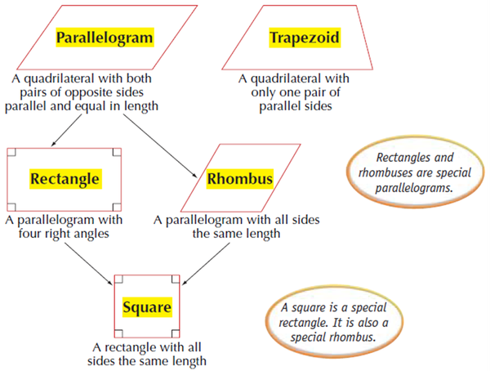
Classifying Quadrilaterals
Earlier I told you shapes have many names. Well, quadrilaterals have several names too.
Some quadrilaterals fit more than one category. For example, a square is a figure with four equal sides and four right angles. That same figure has opposite sides that are equal and four right angles, so it’s a rectangle too. It’s also a parallelogram because opposite sides are parallel. Finally, it’s a rhombus because opposite sides are parallel and all sides are equal. Be careful. A square is a rectangle, but a rectangle is not necessarily a square.
See how this can get confusing? Just memorize the definitions of a trapezoid, square, rectangle, parallelogram, rhombus, and a quadrilateral. Then, take your time and see if the shape in front of you fits the attributes (characteristics) of each of the types of quadrilaterals.

Slide 7
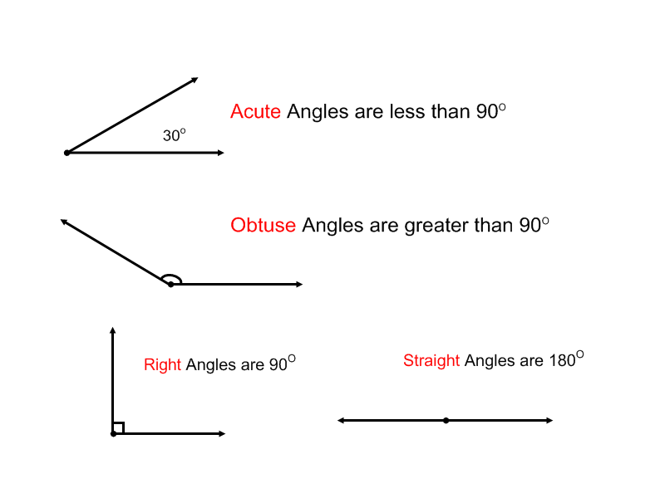
Classifying Angles
We discussed right angles already, but to refresh your memory, they’re exactly 90⁰.
Acute angles are less than 90⁰. I call them cute lil’ angles.
Obtuse angles are bigger than 90⁰. I like to say they’re OOOOBTUUUUSE in a really deep voice to help me remember what obtuse means.
Straight angles are 180⁰. They’re a straight line.
Oh, and that little zero up in the air is the degree sign. Just say degrees when you see it. For example, 35⁰ is thirty-five degrees.

Slide 8
Parallel Lines
Figure A
Parallel Lines are lines that never touch no matter how long they eventually get. A more technical definition is two lines are parallel if they remain the same distance apart FOREVER.
The secret here is a line, by definition, goes on in both directions forever. So, you have to use your imagination. If they ever touch they are not parallel.
Figure A shows parallel lines. Figure B and C are not parallel.
Figure B
Figure C

Slide 9
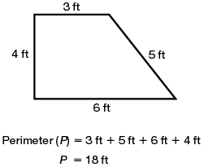
Perimeter
The perimeter is the outside distance around an object.
Some examples of perimeter are a fence, railing around a porch, and moulding around a window.
Perimeter is easy to find. You just find the sum of the sides. (Add them up!)

Slide 10


Perimeter of Tricky Rectangles
1 ft.
Sometimes measurements are missing, but that’s not a problem for you. You know how to find missing measurements. We covered that on slide number three.
I’ll go over it again just in case you need more help.
You may want to try the problem alone before you click. Then you can see if you know how to do it.
First I’ll draw a line.
Now I need to find the missing measurement. It’s a good thing I know that the opposite sides of rectangles are equal.
1 + ? = 10. So, I know the missing side is 9 ft. because I know that 1 + 9 = 10.
Finally, I’ll add all the sides up to find the perimeter of the figure. I suggest going in order. It will keep you from making any silly mistakes.
5 + 9 + 5 +1 +10 +10 = 40 feet
9 ft.
5 ft.
10 ft.

Slide 11
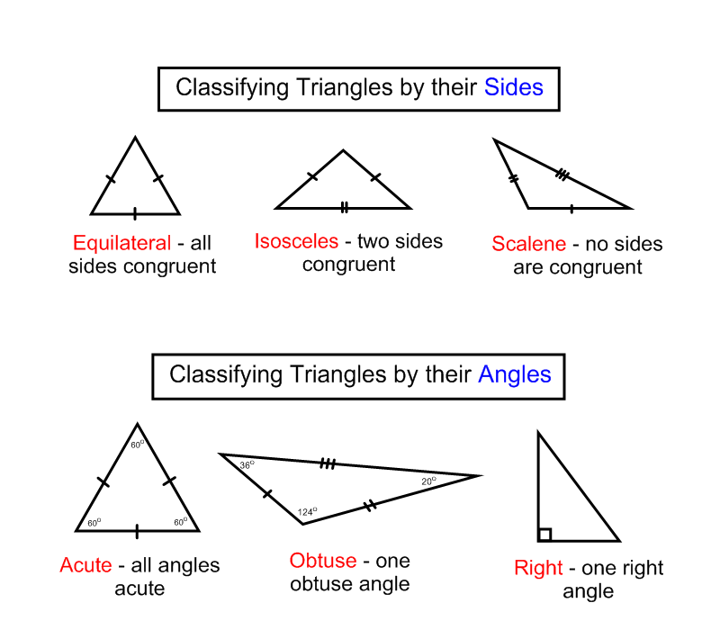
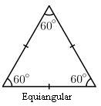
Classifying Triangles
Once again we have a shape with more than one name. A triangle is a polygon and it can be classified two different ways.
One way to name a triangle is to use the length of its sides.
Another way to name a triangle is to use the size of its angles.
That’s crazy, but you can do this. Memorize the chart to the right and you’ll do fine!
Equiangular – all angles are equal

Slide 12
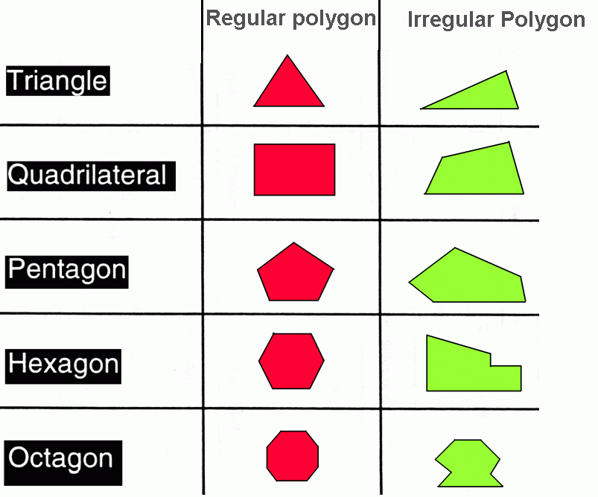
Regular or Irregular Polygons
Regular polygons have equal sides and angles.
Irregular polygons have unequal sides and unequal angles.

