Slide 1
Right Triangle Trigonometry
Pre-Calculus
Day 1

Slide 2
Today’s Objective
Review right triangle trigonometry from Geometry and expand it to all the trigonometric functions
Begin learning some of the Trigonometric identities

Slide 3
What You Should Learn
Evaluate trigonometric functions of acute angles.
Use fundamental trigonometric identities.
Use a calculator to evaluate trigonometric
functions.
Use trigonometric functions to model and solve
real-life problems.

Slide 4
Plan
4.1 Right Triangle Trigonometry
  Definitions of the 6 trig functions
  Reciprocal functions
  Co functions
  Quotient Identities
Homework

Slide 5
Right Triangle Trigonometry
Trigonometry is based upon ratios of the sides of right triangles.
The ratio of sides in triangles with the same angles is consistent. The size of the triangle does not matter because the triangles are similar (same shape different size).

Slide 6
The six trigonometric functions of a right triangle, with an acute angle , are defined by ratios of two sides of the triangle.
hyp
opp
θ
The sides of the right triangle are:
adj
• the side opposite the acute angle ,
• the side adjacent to the acute angle ,
• and the hypotenuse of the right triangle.

Slide 7
Trigonometric Functions
hyp
The trigonometric functions are
opp
θ
adj
sine, cosine, tangent, cotangent, secant, and cosecant.
adj
opp
sin  = cos  = tan  =
csc  = sec  = cot  =
hyp
adj
hyp
hyp
adj
opp
adj
opp
Note: sine and cosecant are reciprocals, cosine and secant are reciprocals, and tangent and cotangent are reciprocals.

Slide 8
Reciprocal Functions
Another way to look at it…
sin θ = 1/csc θ csc θ = 1/sin θ
cos θ = 1/sec θ sec θ = 1/cos θ
tan θ = 1/cot θ cot θ = 1/tan θ

Slide 9
Given 2 sides of a right triangle you should be able to find the value of all 6 trigonometric functions.
Example:
5
θ
12

Slide 10
Example: Six Trig Ratios
Calculate the trigonometric functions for ∠θ .
Calculate the trigonometric functions for ∠α.
The six trig ratios are
5
4
sin  =
sin α =
θ
3
cos  =
cos α =
What is the relationship of
α and θ?
tan  =
tan α =
cot  =
cot α =
They are complementary (α = 90 – θ)
sec  =
sec α =
csc  =
csc α =

Slide 11
Example: Using Trigonometric Identities
Trigonometric Identities are trigonometric equations that hold for all values of the variables.
We will learn many Trigonometric Identities and use them to simplify and solve problems.

Slide 12
Quotient Identities
hyp
opp
θ
adj
adj
opp
sin  = cos  = tan  =
hyp
adj
The same argument can be made for cot… since it is the reciprocal function of tan.

Slide 13
Quotient Identities

Slide 14
Problem-Solving Strategies
Scenario 1) You are given 2 sides of the triangle. Find the other side and the two non-right angles.
c
13
15
OR
k
20
12
1A. Use the Pythagorean theorem to find the 3rd side.
1B. Use an inverse trig function to get an angle. Then use that angle to calculate the 3rd angle. Sum of the angles = 180º

Slide 15
Example: Given 1 Trig Function, Find Other Functions
Example: Given sec θ = 4, find the values of the other five trigonometric functions of θ .
Draw a right triangle with an angle θ such
that 4 = sec θ = = .
hyp
4
adj
θ
Use the Pythagorean Theorem to solve for the third side of the triangle.
1
sin θ = csc θ = =
cos θ = sec θ = = 4
tan θ = = cot θ =

Slide 16
Problem-Solving Strategies
Scenario 2) You are given an angle and a side.
Find the other angle and the two other sides.
26
a
b
1A. Use 2 different trig ratios from the given angle to get each of the other two sides.
1B. Use the sum of the angles to get the 3rd angle.

Slide 17
Problem-Solving Strategies
Scenario 3) You are given all 3 sides of the triangle.
Find the two non-right angles.
25
7
24
1. Use 2 different trig ratios to get each of the angles.

Slide 18
Homework for tonight
Page 227: complete the even numbered problems. Show your work.
Cover your textbook

Slide 19
Using the calculator
Function Keys
Reciprocal Key
Inverse Keys

Slide 20
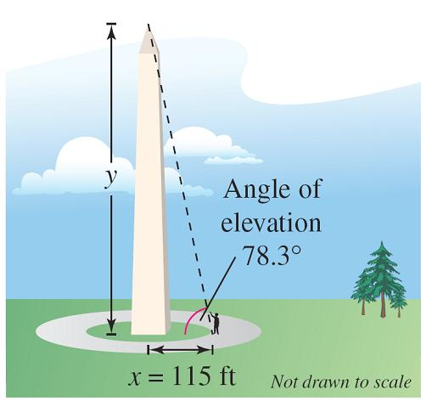
Using Trigonometry to Solve a Right Triangle
A surveyor is standing 115 feet from the base of the Washington Monument. The surveyor measures the angle of elevation to the top of the monument as 78.3°.
How tall is the Washington Monument?
Figure 4.33

Slide 21
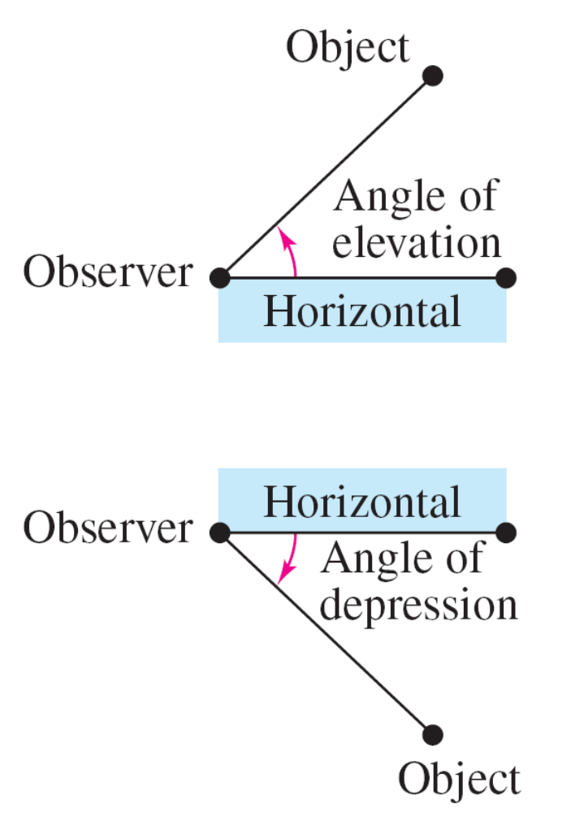
Applications Involving Right Triangles
The angle you are given is the angle of elevation, which represents the angle from the horizontal upward to an object.
For objects that lie below the horizontal, it is common to use the term angle of depression.

Slide 22
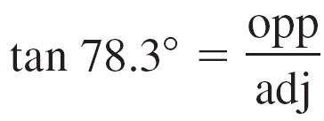
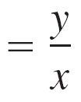
Solution
where x = 115 and y is the height of the monument. So, the height of the Washington Monument is
y = x tan 78.3°
≈ 115(4.82882) ≈ 555 feet.

Slide 23
Homework
Section 4.1, pp. 238 # 40 – 54 evens

