Slide 1
Chapter P
Preparation for Calculus
HW page 37 1- 49 odd
P 39 1 -13 odd
Notes:
Mark,
I originally set up notes for myself. So I would have a reference to the ElMO and problems. If you want just give them the homework and click through the sides. I am touching on important review material while introducing some history and terminology that may not have been introduced when originally taught. I do not expect you to finish in one class period. So just Mark where you get to. I will go back and review again if need be and Let them know HW is due end of this week Friday. Sept 16. Have them look at the end of section problems to help solve these problems. Julia

Slide 2

Graphs and Models
In 1637, This French mathematician joined two major fields :
Algebra
Geometry
Geometry concepts could be formulated analytically
Algebraic concepts could be viewed graphically

Slide 3
Linear equations
Plot points
Slope intercept form y = mx + b
x/y intercept or general form ax+by= c
Rules for parallel and perpendicular lines
Horizontal and vertical lines
Notes:
Elmo: Sketch and graph by point plotting
Numerical approach
P. 8 1-4 together
Graph the line by analytic approach of the slope intercept
Y = 6 -3x and
By analytical approach of the intercepts
3x + y = 6
Questions: What is the Parallel and Perpendicular slopes of the lines?
What does the horizontal line look like? Vertical line?

Slide 4

The slope of a line
IN Calculus we will use the triangle to represent change
y = y2-y1 slope = y / x
where x1 is not x2
x = x2 –x1
* See note on page 10
Notes:
Note on page 11 box to upper left find slope
Example of Slope with (3,-2) ( 3, 4) M is undefined
(9,4) (-3, 4) m is 0
(7/8, ¾) ( 5/4, - ¼) 1 divided by 3/8 or m is 8/3
What is parallel slope? same
What is perpendicular slope? -3/8
Page 16 9 – 14 pick one
15- 18 pick one
20
23-26
27-29
44, 45
52, 53,
59 – 64

Slide 5
Direction of Graphs
Positive negative
Zero (horizontal) undefined
                (vertical)

Slide 6
Linear Regression Analysis
Plot the data (scatter plot)
Find the regression equation (y = mx+b)
Super impose the graph of the regression equation on the scatter plot to see the fit
Use the newly formed regression equation to predict y-values for particular values of x
Notes:
Page 3
Need Graph Paper Divide into groups of 2
Y = $\frac{1}{30}x\left(39−10x^{2}+x^{4}\right) Using Domain \left(−3,−1,0,1,3\right) find Range and plot points What does the graph look like?$ Equation on next slide
Pick a point value between each domain value and find it’s range equivalent and plot more points.
Repeat this process.
Finally check with the graphing calculator Do you know how to adjust the screen?
p. 9 73 -74

Slide 7
Y = 1/30 x (39-10x^2 + x^4)
Hand graphing?
Calculator graphing?

Slide 8
example
Year | Annual Compensation (in dollars)
1980 | 22,033
1985 | 27,581
1988 | 30,466
1989 | 31,465
1990 | 32,836
2011 | ???
Find the linear regression equation for the data
Find the slope of the regression line. What does the slope represent?
Superimpose the graph of the linear regression equation on a scatter plot of the data
Use the regression equation to predict the construction worker’ s average annual compensation in the year 2011
Notes:
Use Calculator to answer the questions on regression

Slide 9

x and Y intercepts
Find y (0,b)
  Set all x’s to zero and solve
Find x (a,0)
  Let y be zero and solve for x
  May need to know factoring rules which is an analytical approach
Notes:
Examples
5x + 2y = 20
1/5x – 2 y = 8
X^3 – 4x = 0

Slide 10
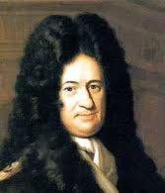
Function Fact
Gottfried Liebniz in 1694 first used the term function but use of the function notation was used by Leonhard Euler in 1734

Slide 11
Functions
Relation vs Function
Independent → dependent
Domain → range
Notation f(x) = vs y =
  Implicit form x + 2y = 1
  Explicit form y = ½ - ½ x
  Function notation f(x) = ½ (1-x)
Notes:
Example problems on page 27 1, 5, 17, 18, 25, 33 to be used with next slide ( end of slide 12) work a few

Slide 12
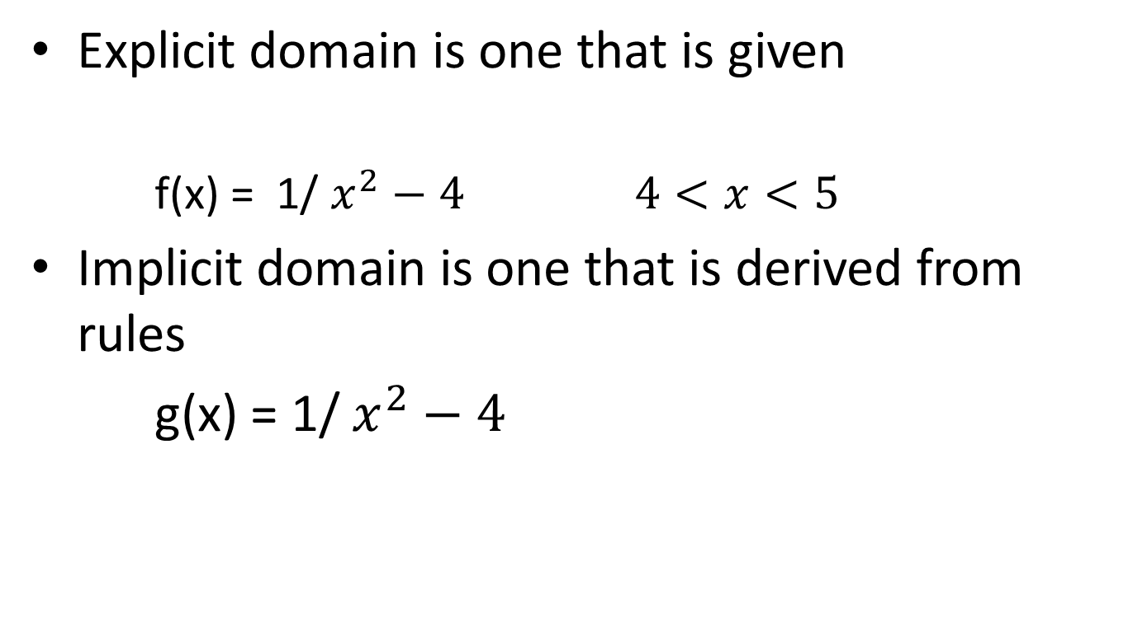
Finding Domain and Range
Explicit domain is one that is given
  f(x) = 1/ $x^{2}−4 4<x<5$
Implicit domain is one that is derived from rules
g(x) = 1/ $x^{2}−4$

Slide 13
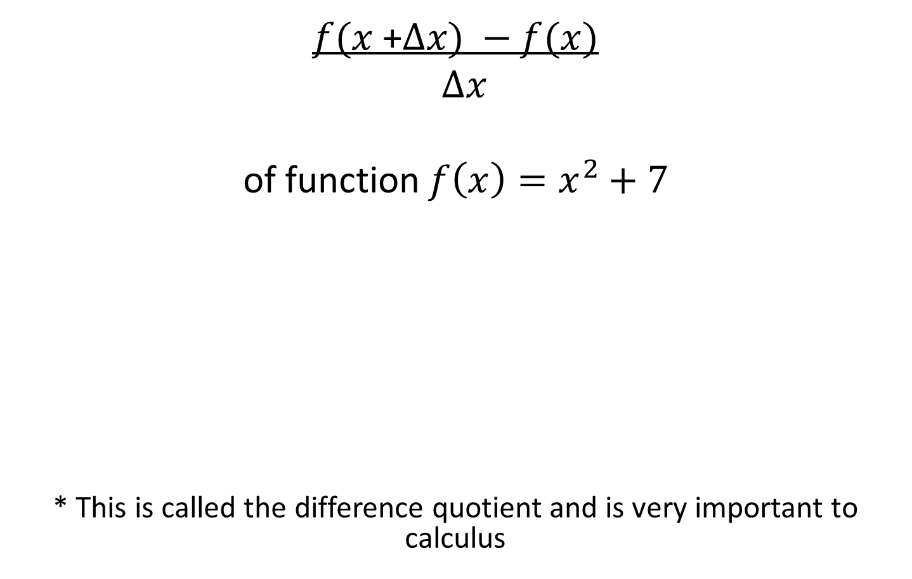
Important use of evaluating a function
$f(x$ +$∆x) −f(x)$
$∆x$
of function $f\left(x\right)=x^{2}+7$
* This is called the difference quotient and is very important to calculus
Notes:
(x+ h)^2 + 7 - x^2 + 7 / h

Slide 14
Library of Functions
Function | Domain | Range
IDENTITY (linear)
Quadratic (square)
Cube
Absolute Value
Rational
Radical (square root)
Cube root
Exponential
Logs
Polynomial
Trigonometric
Piecewise
Step
More ???
Notes:
Fill in chart with students Have them draw on a piece of paper

Slide 15
Graphing information
Plot many points to get true idea of the graph
Know intercepts y and x
Know rules of symmetry
Know rules of asymptotes
Know rules of domain
Know transformation rules

Slide 16
Symmetry of a graph
Symmetric with respect to the y-axis (even)
(x,y) and (-x,y) are both points
replace x by –x and yields same equation
also all exponents are even
Symmetric with respect to the x- axis
(x,y) and (x,-y) are both points
replace y by –y and yields same equation
Symmetric with respect to the origin (odd)
(x,y) and (-x,-y) are both points
  replace x by –x and yields the opposite signed equation
  also all exponents are odd

Slide 17

Transformation rules of function
$$af\left(b\left(x−c\right)\right)+d$$
a compression/expansion about the x axis if negative reflection about x axis
b compression/expansion about the y axis if negative reflection about y axis
* If both a and b are negative reflection about the origin
c shift horizontal to the left or right
d shift vertically up or down

Slide 18
Polynomial Function
1st find degree
2nd the leading coefficient test and end behavior
3rd symmetry
4th Find number of roots (Descartes rule of signs)
5th find the zero’s (intermediate value)
  Multiplicity (touch or cross)
6th sketch

Slide 19
Is it one or more functions?
Use the sum, difference, product and quotient rules of functions
  Polynomial and rational functions are algebraic
Composite of functions
Note Trig functions are transcendental

Slide 20
Points of intersection of two graphs
Graphically
Substitution
Elimination ( ADDITION)
Matrices

Slide 21
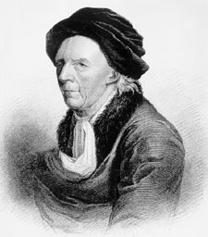
Who is responsible for those word problems?
Swiss Mathematician Leonhard Euler was one of the first to apply calculus to real life problems in physics. Including topics as shipbuilding, acoustics, optics, astronomy, mechanics, and magnetism.

Slide 22
Real world modeling
Simplicity
  Simple enough to be workable
Accuracy
  Accurate enough to produce meaningful results

Slide 23
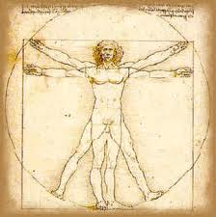
Scientific revolution in 1500’s
Two early publications
  On the Revolutions of the Heavenly Spheres
  On the Structure of the Human Body
  Each of these books broke with prior tradition by suggesting the use of a scientific method rather than unquestioned reliance on authority
Leonardo da Vinci’s famous drawing Vitruvian Man that indicates that a person’s height and arm span are equal

