Slide 1
Warm Up
Find the area of each figure.
1. a rectangle in which b = 14 cm and
h = 5 cm
2. a triangle in which b = 6 in. and h = 18 in.
3. a trapezoid in which b₁ = 7 ft, b₂ = 11 ft, and
h = 3 ft
A = 70 cm²
A = 54 in²
A = 27 ft²

Slide 2
Objectives
Use the Area Addition Postulate to find the areas of composite figures.
Use composite figures to estimate the areas of irregular shapes.

Slide 3
A composite figure is made up of simple
shapes, such as triangles, rectangles,
trapezoids, and circles. To find the area of a composite figure, find the areas of the simple shapes and then use the Area Addition Postulate.

Slide 4
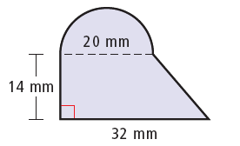

Example 1A: Finding the Areas of Composite Figures by Adding
Find the shaded area. Round to the nearest tenth, if necessary.
Divide the figure into parts.
area of half circle:

Slide 5

Example 1A Continued
area of triangle:
area of the rectangle:
A = bh = 20(14) = 280 mm²
shaded area:
50π + 280 + 84 ≈ 521.1 mm²

Slide 6
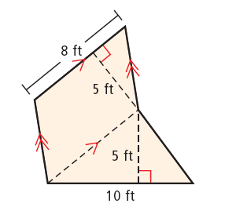

Example 1B: Finding the Areas of Composite Figures by Adding
Find the shaded area. Round to the nearest tenth, if necessary.
Divide the figure into parts.
area of parallelogram:
A = bh = 8(5)= 40ft²
area of triangle:
shaded area:
40 + 25 = 65 ft²

Slide 7
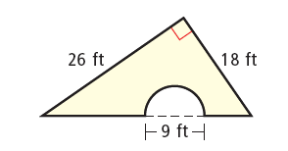


Check It Out! Example 1 Finding the Areas of Composite Figures by Subtracting
Find the shaded area. Round to the nearest tenth, if necessary.
area of a triangle:
area of the half circle:
Subtract the area of the half circle from the area of the triangle.
area of figure:
234 – 10.125π ≈ 202.2 ft²

Slide 8
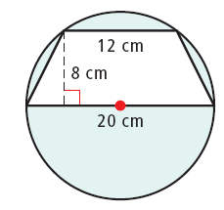
Example 2: Finding the Areas of Composite Figures by Subtracting
Find the shaded area. Round to the nearest tenth, if necessary.
area of circle:
A = πr² = π(10)² = 100π cm²
area of trapezoid:
area of figure:
100π –128 ≈ 186.2 cm²

Slide 9
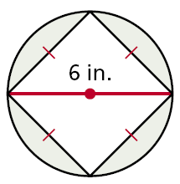
Check It Out! Example 2
Find the shaded area. Round to the nearest tenth, if necessary.
area of circle:
A = πr² = π(3)² ≈ 28.3 in²
area of square:
A = bh ≈ (4.24)(4.24) ≈ 18 in²
area of figure: 28.3 – 18 = 10.3 in²

Slide 10
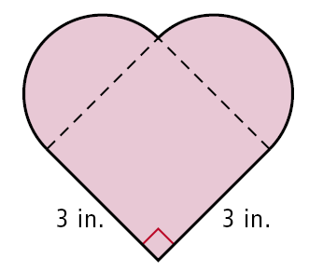
Example 3: Fabric Application
A company receives an order for 65 pieces of fabric in the given shape. Each piece is to be dyed red. To dye 6 in² of fabric, 2 oz of dye is needed. How much dye is needed for the entire order?
To find the area of the shape in square inches, divide the shape into parts.
The two half circles have the same area as one circle.

Slide 11

Example 3 Continued
The area of the circle is
π(1.5)² = 2.25π in².
The area of the square is
(3)² = 9 in².
The total area of the shape is 2.25π + 9 ≈ 16.1 in².
The total area of the 65 pieces is 65(16.1) ≈ 1044.5 in².
The company will need 1044.5 ≈ 348 oz of dye for the entire order.

Slide 12
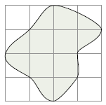
To estimate the area of an irregular shape, you can sometimes use a composite figure.
First, draw a composite figure that resembles the irregular shape.
Then divide the composite figure into simple shapes.

Slide 13
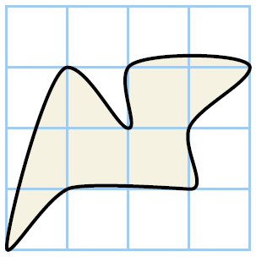
Example 4: Estimating Areas of Irregular Shapes
Use a composite figure to estimate the shaded area. The grid has squares with a side length of 1 ft.
Draw a composite figure that approximates the irregular shape. Find the area of each part of the composite figure.
b
d
a
c

Slide 14


Example 4 Continued
area of triangle a:
d
b
c
area of triangle b:
a
area of rectangle c:
A = bh = (2)(1) = 2 ft²
area of trapezoid d:
Area of composite figure:
1 + 0.5 + 2 + 1.5 = 5 ft²
The shaded area is about 5 ft².

Slide 15
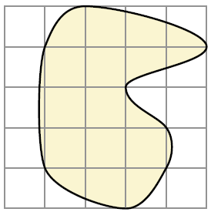
Check It Out! Example 4
Use a composite figure to estimate the shaded area. The grid has squares with side lengths of 1 ft.
Draw a composite figure that approximates the irregular shape. Find the area of each part of the composite figure.

Slide 16


Check It Out! Example 4 Continued
area of triangle:
area of half circle:
area of rectangle:
A = lw = (3)(2) = 6 ft²
The shaded area is about 12 ft².

Slide 17
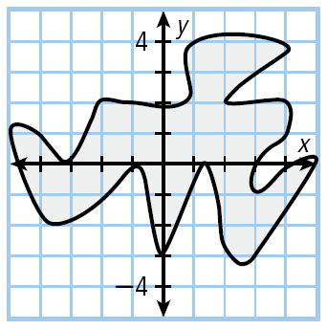
Example 1A: Estimating Areas of Irregular Shapes in the Coordinate Plane
Estimate the area of the irregular shape.

Slide 18
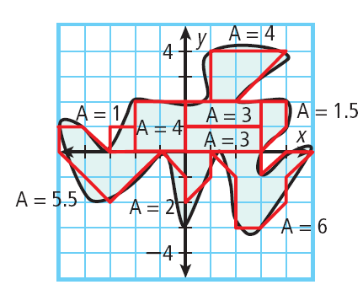
Example 1A Continued
Method 1: Draw a composite figure that approximates the irregular shape and find the area of the composite figure.
The area is approximately
4 + 5.5 + 2 + 3 + 3 + 4 + 1.5 + 1 + 6 = 30 units².

Slide 19
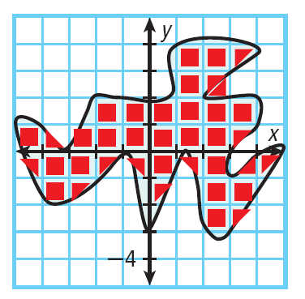

Example 1A Continued
Method 2: Count the number of squares inside the figure, estimating half squares. Use a  for a whole square and a for a half square.
There are approximately 24 whole squares and 14 half squares, so the area is about

Slide 20
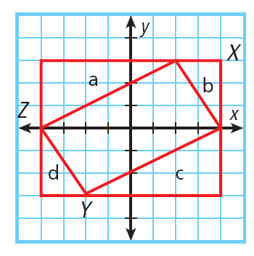
Example 3: Finding Areas in the Coordinate Plane by Subtracting
Find the area of the polygon with vertices A(–4, 1), B(2, 4), C(4, 1), and D(–2, –2).
Draw the polygon and close it in a rectangle.
Area of rectangle:
A = bh = 8(6)= 48 units².

Slide 21




Example 3 Continued
Area of triangles:
The area of the polygon is 48 – 9 – 3 – 9 – 3 = 24 units².

Slide 22
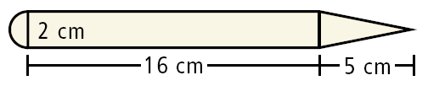
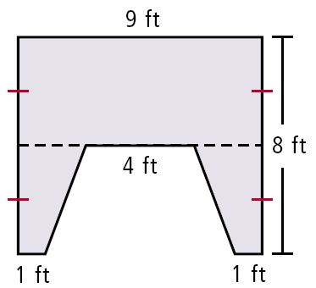
Lesson Quiz: Part I
Find the shaded area. Round to the nearest tenth, if necessary.
1.
38.6 cm²
2.
50 ft²

Slide 23
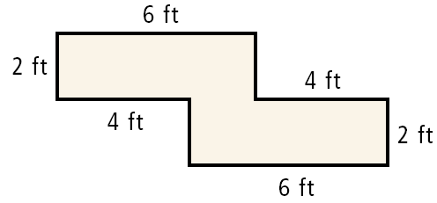
Lesson Quiz: Part II
3.
Mike is remodeling his kitchen. The countertop he wants costs $2.70 per square foot. How much will Mike have to spend on his remodeling project?
$64.80

Slide 24
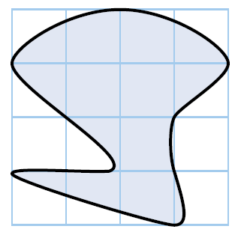
Lesson Quiz: Part III
4.
Use a composite figure to estimate the shaded area. The grid has squares with side
lengths of 1 cm.
about 8.5 cm²

