Slide 1
Objectives
Write and simplify ratios.
Use proportions to solve problems.

Slide 2
A ratio compares two numbers by division.
The ratio of two numbers a and b can be written as
a to b
a:b
where b ≠ 0.
Remember!
In a ratio, the denominator of the fraction cannot be zero because division by zero is undefined.

Slide 3



Given that two points on m are C(–2, 3) and D(6, 5), write a ratio expressing the slope of m.
Substitute the given values.
Simplify.

Slide 4
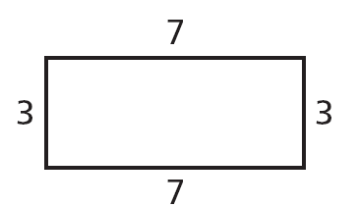
A ratio can involve more than two numbers. For the rectangle, the ratio of the side lengths may be written as 3:7:3:7.

Slide 5
Example 2: Using Ratios
The ratio of the side lengths of a triangle is 4:7:5, and its perimeter is 96 cm. What is the length of the shortest side?
Let the side lengths be 4x, 7x, and 5x.
Then 4x + 7x + 5x = 96 . After like terms are combined, 16x = 96. So x = 6. The length of the shortest side is 4x = 4(6) = 24 cm.

Slide 6
Check It Out! Example 2
The ratio of the angle measures in a triangle is 1:6:13. What is the measure of each angle?
x + y + z = 180°
x + 6x + 13x = 180°
20x = 180°
x = 9°
y = 6x
z = 13x
y = 6(9°)
z = 13(9°)
y = 54°
z = 117°

Slide 7

A proportion is an equation stating that two ratios
are equal. In the proportion , the values
a and d are the extremes. The values b and c
are the means. When the proportion is written as
a:b = c:d, the extremes are in the first and last
positions. The means are in the two middle positions.

Slide 8
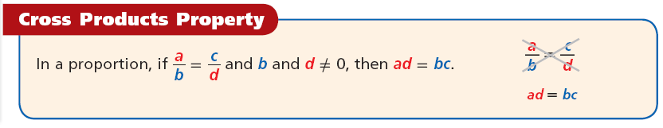
In Algebra 1 you learned the Cross Products Property. The product of the extremes ad and the product of the means bc are called the cross products.
Reading Math
The Cross Products Property can also be stated as, “In a proportion, the product of the extremes is equal to the product of the means.”

Slide 9

Example 3A: Solving Proportions
Solve the proportion.
7(72) = x(56)
Cross Products Property
504 = 56x
Simplify.
x = 9
Divide both sides by 56.

Slide 10

Example 3B: Solving Proportions
Solve the proportion.
(z – 4)² = 5(20)
Cross Products Property
(z – 4)² = 100
Simplify.
(z – 4) = ±10
Find the square root of both sides.
(z – 4) = 10 or (z – 4) = –10
Rewrite as two eqns.
z = 14 or z = –6
Add 4 to both sides.

Slide 11

Check It Out! Example 3b
Solve the proportion.
2y(4y) = 9(8)
Cross Products Property
8y² = 72
Simplify.
y² = 9
Divide both sides by 8.
y = ±3
Find the square root of both sides.
y = 3 or y = –3
Rewrite as two equations.

Slide 12

Check It Out! Example 3d
Solve the proportion.
(x + 3)² = 4(9)
Cross Products Property
(x + 3)² = 36
Simplify.
(x + 3) = ±6
Find the square root of both sides.
(x + 3) = 6 or (x + 3) = –6
Rewrite as two eqns.
x = 3 or x = –9
Subtract 3 from both sides.

Slide 13
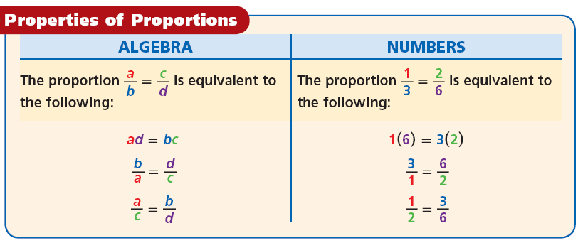
The following table shows equivalent forms of the Cross Products Property.

Slide 14


Example 4: Using Properties of Proportions
Given that 18c = 24d, find the ratio of d to c in simplest form.
18c = 24d
Divide both sides by 24c.
Simplify.

Slide 15


Check It Out! Example 4
Given that 16s = 20t, find the ratio t:s in simplest form.
16s = 20t
Divide both sides by 20s.
Simplify.

Slide 16

Example 5: Problem-Solving Application
Marta is making a scale drawing of her bedroom. Her rectangular room is 12 feet wide and 15 feet long. On the scale drawing, the width of her room is 5 inches. What is the length?
1
Understand the Problem
The answer will be the length of the room on the scale drawing.

Slide 17

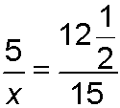
Example 5 Continued
2
Make a Plan
Let x be the length of the room on the scale drawing. Write a proportion that compares the ratios of the width to the length.

Slide 18


Example 5 Continued
3
Solve
5(15) = x(12.5)
Cross Products Property
75 = 12.5x
Simplify.
x = 6
Divide both sides by 12.5.
The length of the room on the scale drawing is 6 inches.

Slide 19

Example 5 Continued
4
Look Back
Check the answer in the original problem. The ratio of the width to the length of the actual room is 12 :15, or 5:6. The ratio of the width to the length in the scale drawing is also 5:6. So the ratios are equal, and the answer is correct.

Slide 20
Check It Out! Example 5
What if...? Suppose the special-effects team made a different model with a height of 9.2 m and a width of 6 m. What is the height of the actual tower?
1
Understand the Problem
The answer will be the height of the tower.

Slide 21


Check It Out! Example 5 Continued
2
Make a Plan
Let x be the height of the tower. Write a proportion that compares the ratios of the height to the width.

Slide 22
Check It Out! Example 5 Continued
3
Solve
9.2(996) = 6(x)
Cross Products Property
9163.2 = 6x
Simplify.
1527.2 = x
Divide both sides by 6.
The height of the actual tower is 1527.2 feet.

Slide 23
Check It Out! Example 5 Continued
4
Look Back
Check the answer in the original problem. The ratio of the height to the width of the model is 9.2:6. The ratio of the height to the width of the tower is 1527.2:996, or 9.2:6. So the ratios are equal, and the answer is correct.

