Slide 1
1-1
Nets and Drawings for Visualizing Geometry
Chapter 1
Notes:
This lesson assumes some general knowledge of naming geometric solids.

Slide 2
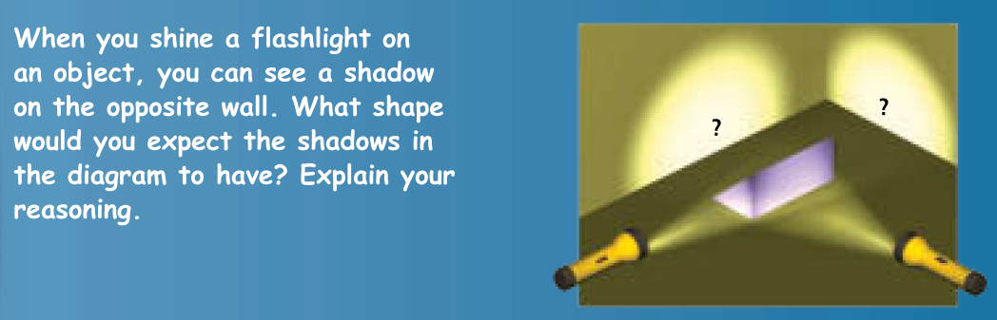
1.1: Nets and Drawings for Visualizing Geometry
rectangle
triangle
Pearson Geometry Common Core 2015 ©

Slide 3
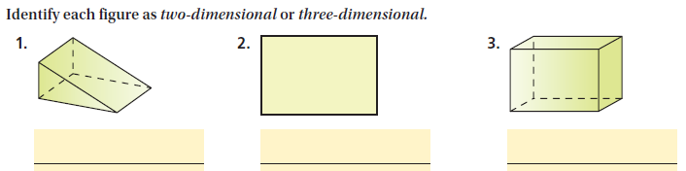
What makes a polygon 2-dimensional or
3-dimensional?
Polygon:
A closed figure (all sides meet and no sides cross each other) with straight sides.
2D objects have only a length and width (or you could call it “base and height.”)
3D objects have a length, width, and height.
3D
2D
3D

Slide 4


NET
A 2-dimensional diagram that you can fold to form a 3-dimensional figure
Name the 3D figure that would be formed.
cylinder
Rectangular prism

Slide 5
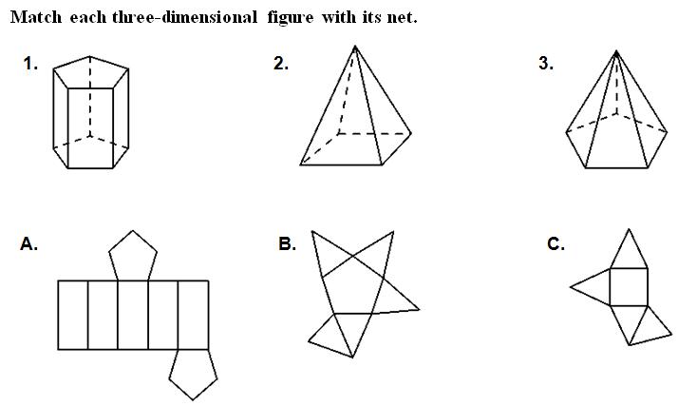
You Try!
Match each 3D figure with its net.
Then name the 3D figure.
Pentagonal prism
Square-based pyramid
Pentagon-based pyramid

Slide 6
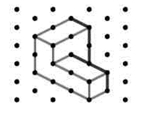
ISOMETRIC DRAWING:
shows a corner view of a 3-dimensional figure
It shows the:
Top
(Right) Side
Front

Slide 7
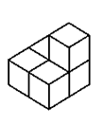

Draw the figure to the right onto the isometric dot paper.
After drawing:
place a T on each square that appears on the TOP
an F for FRONT
and an S for (right) SIDE.

Slide 8
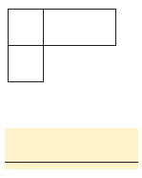
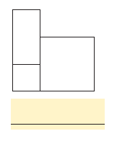
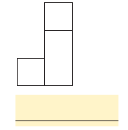
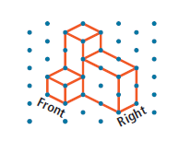
ORTHOGRAPHIC DRAWING:
shows three separate views as 2-D objects
MATCH THE DESCRIPTION TO EACH ORTHOGRAPHIC VIEW.
(CLICK BELOW TO SEE ANIMATIONS)
Top view
Front view
(Right) Side view
Top
Front
Side

Slide 9
Think…….
When would you use a solid line in a drawing?
.. A dashed line????
Dashed lines show hidden edges.
Solid lines show visible edges.

Slide 10
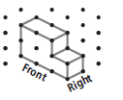
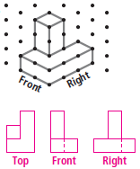
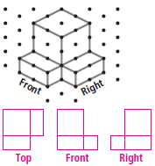

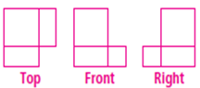
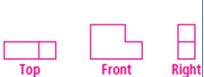
You Try!
Sketch the three orthographic drawings (top, front, and side) for each isometric drawing.
1.
2.
3.

