Slide 1
The Grasslands
By: Zach Gledhill

Slide 2
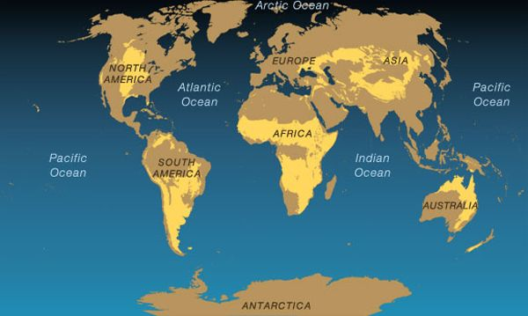
World Map of Grassland Biomes
The Grasslands Are The Areas In Yellow

Slide 3
Climate
The climate contains cold winters and hot summers.
Fires and some seasonal droughts help maintain the grasslands.

Slide 4


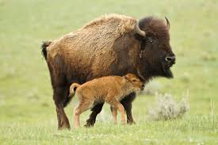
The Animals
Some animals in the Grasslands consist of bisons, prairie dogs, wolves, gophers, coyotes, badgers, swift foxes, and pronghorns.

Slide 5

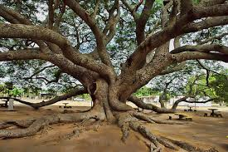
The Plants
Some of the plants in the Grasslands consist of; buffalo grass, switch grass, blue gamma, common everlasting, pink bindweed, little bluestem, chocolate lily, and big blue stem.

Slide 6
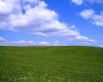
The Unique Geography
The grasslands are flat, with very few trees, and pretty dry.
The soil is usually dry.
Most of the plants and animals have adapted to the dryness in the grasslands

Slide 7

Other Unique Factors
The plants usually have long roots to get the water that they need.
- Take the Buffalo Grass for an example.
- The buffalo grass is also very resilient, so it is able to survive insect infestation.

Slide 8
Living Conditions for Humans
There is a short supply on water.
Summers are hot, and the winters are cold.
You would see a variety of many beautiful flowers, so the sight is great, and the smell wouldn’t be bad either.
There is plenty of open areas for farming, but to get some food we would have to kill some of the animals like the bison.

Slide 9

Living Condition for Animals and Plants
Animals and plants have adapted well to the low water supply and the bad soil.
Fires sometimes destroy the living organisms, but many national parks have helped the living organisms survive.

Slide 10
References
http://www.snowcrest.net/geography/slides/biomes/index.html
http://www.snowcrest.net/geography/slides/biomes/index.html
http://www.cotf.edu/ete/modules/msese/earthsysflr/biomes.html
Our textbook

