Slide 1
Louisiana Tax Commission
Submission of Rebuttal for Chapter 13 LTC Rules and Regulations
Tax Year 2017
Property Tax Partners

Slide 2
Discussion of new data points for 2017
CAMERON ACCESS PROJECT
  27.3 Miles of 36-in-diameter - Jefferson Davis, Cameron, and Calcasieu parishes
  Project estimated cost of $90,234,146 or $12,890,592 per mile
GULF TRACE EXPANSION
  34.1 Miles of 36-in-diameter – Cameron parish
  Project estimated cost of $218,600,000 or $6,410,557 per mile
Property Tax Partners

Slide 3
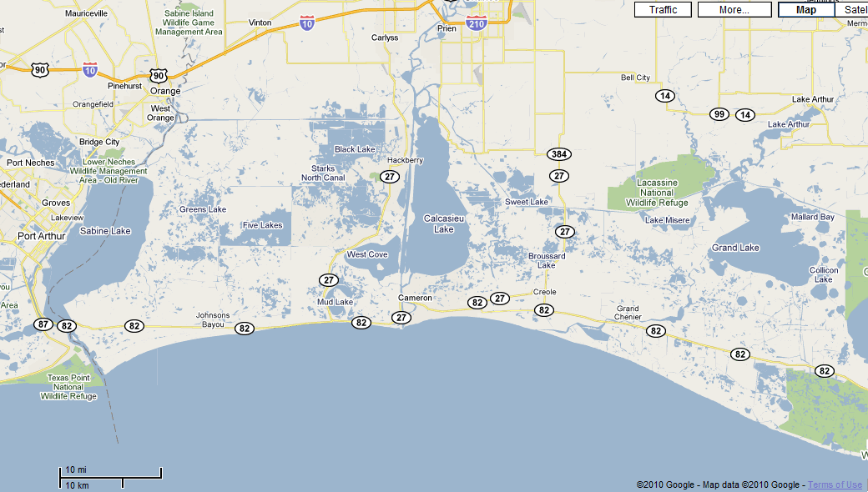
Overview of Cameron Parish – Map provided by Google
Property Tax Partners

Slide 4
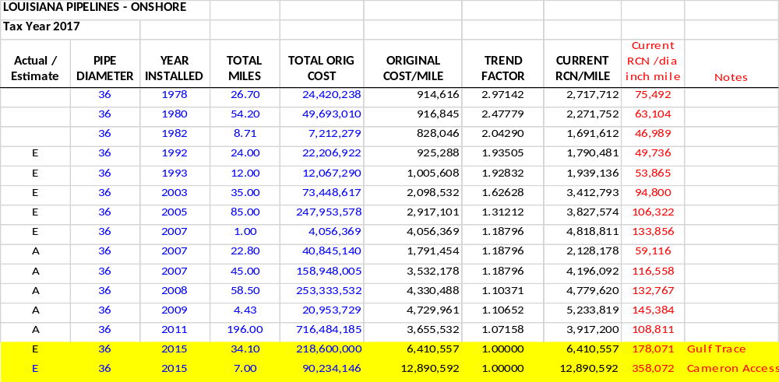
Effects of the Cameron Access/Gulf Trace Projects for 36” Pipeline costs
*Source: Oil and Gas Journal (Annual Pipeline Economics Issue)
Property Tax Partners

Slide 5
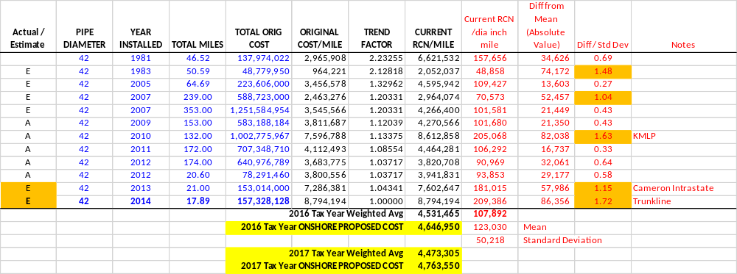
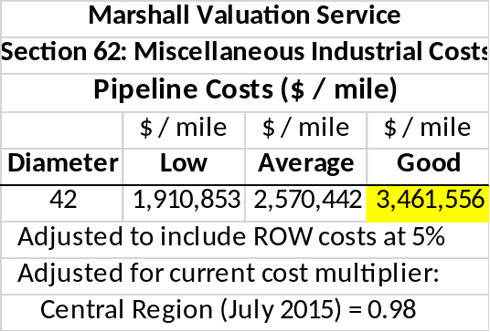
42 Diameter Pipe - KMLP/Cameron/Trunkline
*Source: Oil and Gas Journal (Annual Pipeline Economics Issue)
Property Tax Partners

Slide 6
Discussion of 42-in diameter data points
Kinder Morgan Louisiana Pipeline
Original FERC filing to be built for $518,012,338 ($3.9M per mil)
Final estimated cost $1,000,000,000
Defective pipe
Problematic contractor cost
Hurricane delays
Cost overruns
Cameron Interstate / Trunkline Project
Both projects involve construction in marshy geography with numerous river
and canal crossings add considerable cost to pipeline construction projects
The project costs are estimated and not based on actuals
Property Tax Partners

Slide 7
1307. Pipeline Transportation Tables
Table 1307.A
Current Cost for Other Pipelines (Onshore)
Footnote:
NOTE: Excludes river and canal crossings. For river and canal crossings, apply a factor of 2.0 to Cost Per Mile figures in table above.
Property Tax Partners
LAA suggested revision highlighted above
Acknowledgement of high cost associated with river and canal crossings
Our cost data points identified as outliers involve construction in marshy geography with numerous river and canal crossings (Except KMLP)
Ample rational to exclude these data points from our sample
Property Tax Partners

Slide 8
Economic Obsolescence
F. Assessment will be based on fair market value. Functional and/or economic obsolescence shall be considered in the analysis of fair market value as substantiated by the taxpayer in writing. Consistent with Louisiana R.S. 47:1957, the assessor may request additional documentation.
G. Pipeline sales, properly documented, should be considered by the assessor as the fair market value, provided the sale meets all tests relative to it being a valid sale.
Property Tax Partners
Few sales, often times between related parties
Usually include other value considerations
  Upstream and/or downstream asset
  Compression, treating, processing, storage assets
  Contractual considerations
Purchase price allocation studies used by industry to separate these values
Allocation studies do not prove fair market value per Section 301
Property Tax Partners

Slide 9
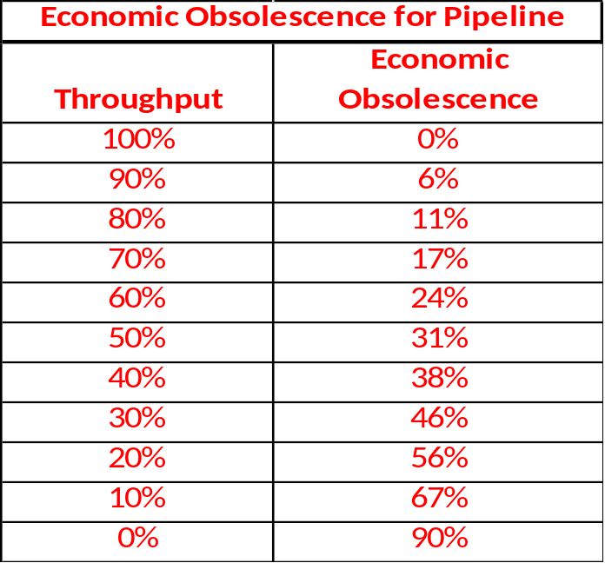
Economic Obsolescence (cont.)
Accordingly, we suggest the following addition (paragraph H) to §1305 Reporting Procedures within Chapter 13 Guidelines for Ascertaining the Fair Value of Pipelines.
  H. A throughput adjustment may be used to determine economic obsolescence. Throughput and capacity must be reported on Company letterhead or email and signed by company official prepared to discuss basis for calculation. The following table details the level of economic obsolescence for a range of throughputs.
Property Tax Partners

