Slide 1
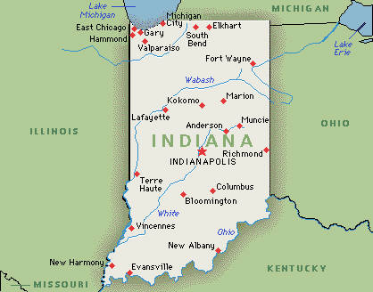
Indiana Geography Test Review

Slide 2
The study of Earth and the way that people live on it.

Slide 3
Geography

Slide 4
The pattern of weather in a certain place over many years.

Slide 5
Climate

Slide 6
A natural substance that can be replaced for later use.

Slide 7
Renewable Resource

Slide 8
The way a place uses and produces natural resources, goods, and services.

Slide 9
Economy

Slide 10
A natural feature of Earth’s surface.

Slide 11
Landform

Slide 12
The business of growing crops and raising animals.

Slide 13
Agriculture

Slide 14
A change in the water when large bodies of water are near land.

Slide 15
Lake Effect

Slide 16
An area with common features.

Slide 17
Region

Slide 18
A line of low hills formed by rocks pushed up by glaciers.

Slide 19
Moraine

Slide 20
A dangerous wind that forms a funnel shape and moves over the ground very quickly.

Slide 21
Tornado

Slide 22
A natural substance with the limited supply.

Slide 23
Nonrenewable resource

Slide 24
A soft rock that is crushed and used to make roads and buildings.

Slide 25
Limestone

Slide 26
A natural substance found on Earth that doesn’t come from plants or animals.

Slide 27
Mineral

Slide 28
Using machines to make goods.

Slide 29
Manufacturing

Slide 30
Choose between the three regions:
Northern Lakes and Moraines
Central Till Plains
Southern Lowlands

Slide 31
What region is Indianapolis, Lafayette, and Muncie found in?

Slide 32
Central Till Plains

Slide 33
What region is Gary, South Bend and Ft. Wayne found in?

Slide 34
Northern Lakes and Moraines

Slide 35
What region is Bloomington, Terra Haute, and Evansville found in?

Slide 36
Southern Lowlands

Slide 37
What regions are the following landforms found in: Sand Dunes, lakes and ponds, mostly flat land

Slide 38
Northern Lakes and Moraines

Slide 39
What region are the following landforms found in: Rich- fertile soil, farms, flat lands

Slide 40
Central Till Plains

Slide 41
What region are the following landforms found it: Caves, hills, valleys, forests

Slide 42
Southern Lowlands

Slide 43
What region are the following resources found in: Minerals, limestone, forests

Slide 44
Southern lowlands

Slide 45
Which region are the following resources found in: Corn, soybeans, wheat

Slide 46
Central Till Plains

Slide 47
Which region are the following resources found in: Steel, cattle, chickens

Slide 48
Northern Lakes and Moraines

Slide 49
Which region are the following industries found in: Oil refineries, recycling plants, steel mills

Slide 50
Northern Lakes and Moraines

Slide 51
Which region are the following industries found in: farming, prescription drugs, automotive factories

Slide 52
Central Till Plains

Slide 53
Which region are the following industries found in: Manufacturing, plastic factories, medicine

Slide 54
Southern Lowlands

Slide 55
Answer the question.

Slide 56
What large body of water is located north of Indiana?

Slide 57
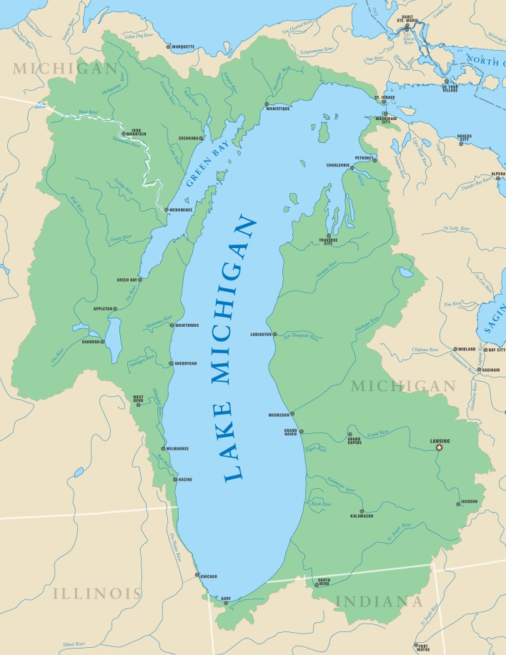
Lake Michigan

Slide 58
The distance between an area and the _______ has a big effect on the areas climate and temperature.

Slide 59
Equator

Slide 60
Some examples of renewable resources are _________?

Slide 61
Water, forests, and soil

Slide 62
Teachers, salespeople, and police officers are people who work in _________.

Slide 63
Service Industry

